Slide 1

AVATARLAB -AI Powered Talking Avatars
Project Overview
Objective: Develop an AI-powered animation pipeline that converts text into realistic talking head videos.
Core Technologies: DiffTalk for facial animation, SMALL-E for speech synthesis.
Key Features:
Realistic facial expressions and lip-sync
AI-driven voice modulation
AI-driven video modulation
- G.Sreeshma
23BD1A059T

Slide 2
Business Problem Addressed
High costs and time-intensive efforts in video production.
Misalignment between speech and facial expressions reduces immersion
Creating talking avatars from text requires complex animation skills and tools.
Target Users
Content creators, educators, game developers, and businesses needing automated digital avatars.
Pain Points Solved:
Reduces cost and time in creating animated content.
Enables scalable and personalized AI-driven media.
User Roles & Interaction
Content Creator/User: Inputs text script into the application.
AI System: Processes input to generate synchronized speech and facial animation.
End User/Audience: Recieves the generated video and can modify It by providing new text.

Slide 3
Tech StacK
TARGET AUDIENCE
EASY TO USE
COST SAVINGS
Simple design that gives customers the targeted information they need
CLOSE THE GAP
Datasets & Sources
Facial Animation Data: HDTF dataset (for training facial landmarks and animations).
Speech Synthesis Data: LibriTTS datasets for training SMALL-E.
Data Preprocessing
Text Tokenization : Using Byte Pair Encoding (BPE)
Speech Feature Extraction : Convert to Mel Spectrograms.
Lip Sync Alignment :Extract facial key points for motion mapping .
Frontend: React.js(User Interface)
Backend: FastAPI
AI Models: DiffTalk (Facial Animation), SMALL-E (Speech Synthesis)
Frameworks: PyTorch, TensorFlow
Development Environment: Google Colab, RTX 4090 GPU
Database : Firebase/AWS S3(store videos)
Deployment: Cloud-based API for avatar generation (AWS/GCP)

Slide 4
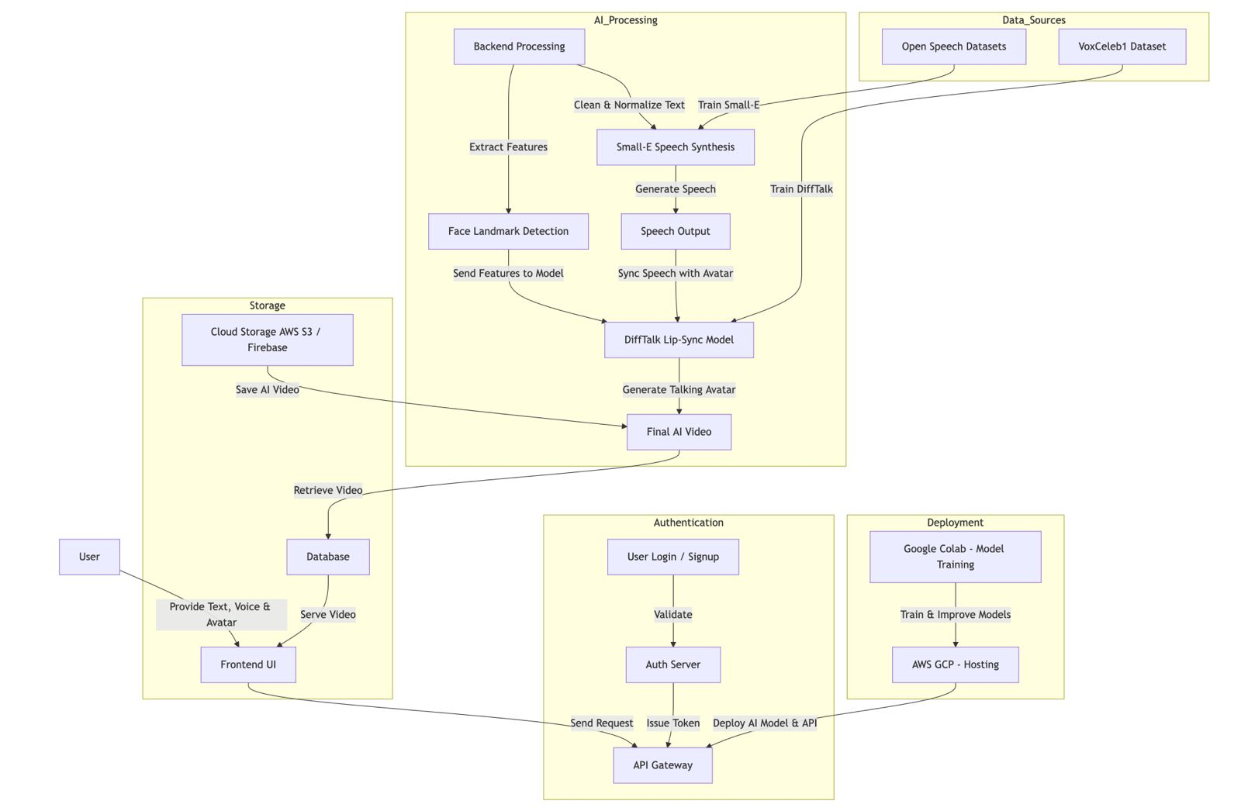
Our competition
User Input : Text ,Voice Selection , Image/Video Upload
Text Processing : Tokenization & Embedding
Speech Synthesis (Small-E) : Generates realistic voice
Facial Animation (DiffTalk) : Creates synchronized avatar motion
Output Generation : AI avatar speaks & moves realistically
Convenient
Contoso
Competitor A
Affordable
Expensive
Competitor D
Competitor C
Competitor B
Competitor E
Inconvenient

