Slide 1
AVATAR AI
~Praneetha Palakurla [G-359]

Slide 2
TECH STACK USED - MERN
FRONTEND
BACKEND
REACT.js + Tailwind
Purpose :
User Interface, User Inputs, Video Playback.
Express.js (Node.js)
Pupose:
Manages API Requests, uploads, And the User Validation.
AI INFERENCE SERVER
DATABASE
Fast API (Python)
Purpose:
Runs XTTS and SadTalker for the audio and video generation.
MongoDB
Purpose:
Stores the User information and the history of their video generations

Slide 3
CHANGES FROM INITIAL ARCHITECTURE
VIDEO MODEL
BACKEND FRAMEWORK
Fast API for async handing and speed
TTS MODEL
Coqui XTTS – for better audio genertaion and Zero-shot Clonning
Switched to SadTalker for Better Realism

Slide 4
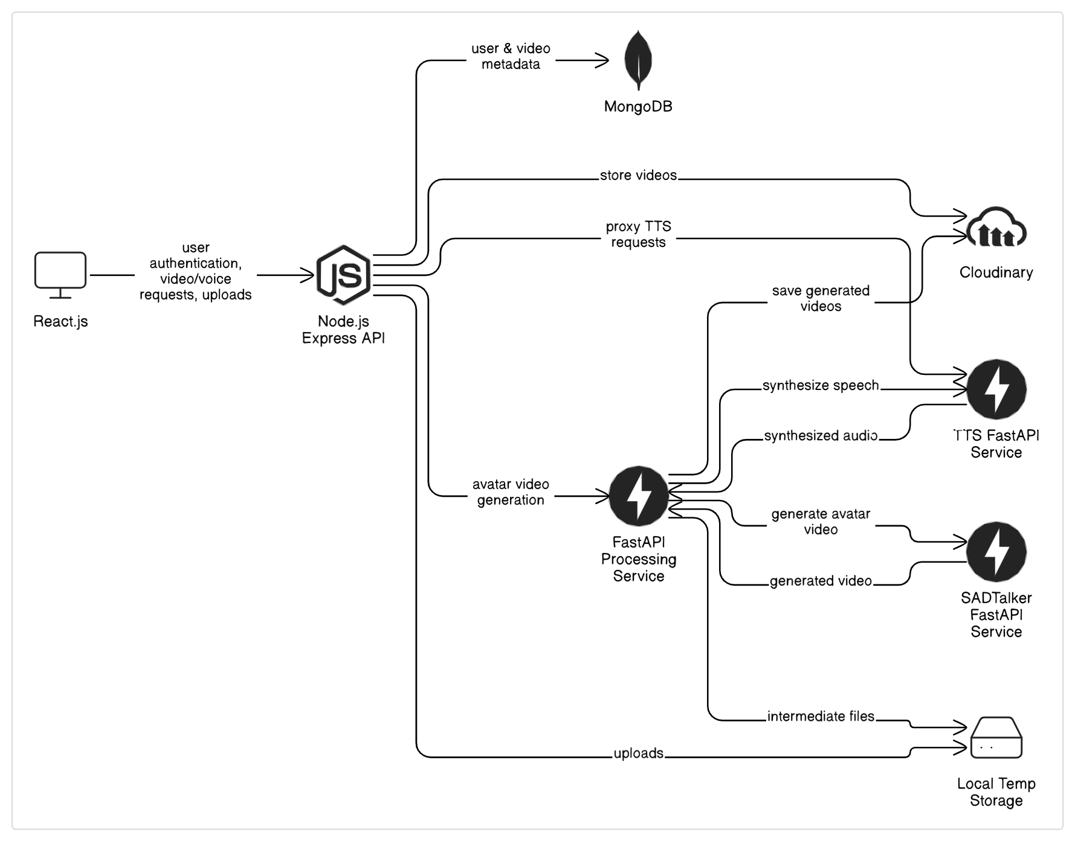
AARCHITECUTRE

Slide 5

MODEL DECISIONS
✅ Why Coqui XTTS?
Delivers natural-sounding cloned voices from just a few seconds of input audio
Open-source, customizable, and supports multi-language speech synthesis
✅ Why Sad Talker?
Provides expressive animations (lip, head, eye movements) → makes avatars feel alive
Supports image-to-video synthesis with voice input — seamless for our pipeline
OTHER CONSIDERED MODELS:
Wave2Lip-Rejected for limited expressions
LinaSpeech-Complex setup and training pipeline

Slide 6
CHALLENGES AND LEARNINGS
FINAL REFLECTIONS
Challenges:
Integrated XTTS and SadTalker smoothly into one pipeline.
File transfer latency between Express and FastAPI
Learnings:
Full-stack AI pipeline integration
Async handling in FastAPI
Managing large media files efficiently
Communication between JS and Python layers
Successfully built an end-to-end avatar video system.
Planning to deploy the AI server this semester.
Exploring multilingual support using Coqui XTTS.
Aiming to improve video realism, add voice styles, and scale storage.

Slide 7
THANK YOU

