Slide 1
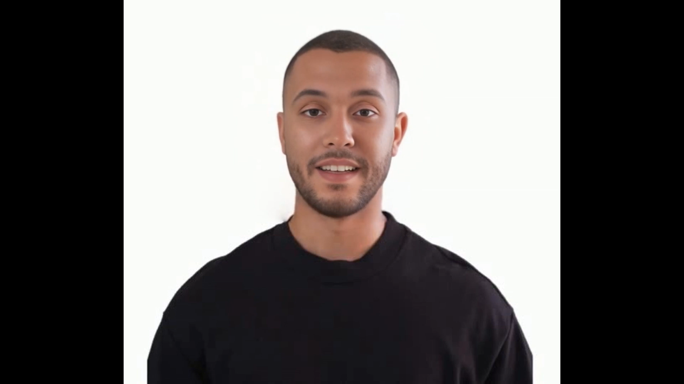
AVATARLAB-AI Powered Talking Avatars
Sample Video
Project Overview
Objective:
Develop an AI-powered animation pipeline that converts text into realistic talking head videos.
Core Technologies:
Sadtalker for facial animation, XTTS for speech synthesis.
- G.Sreeshma
23BD1A059T
G359

Slide 2
MODELS
Coqui XTTS
SADTALKER
XTTS is a multilingual, zero-shot text-to-speech model that can clone voices using just a short audio sample.
SadTalker is an AI driven talking head generation model that creates realistic facial animations from a still image & an audio clip.
Input : Text , Reference Audio
Input : Image , Audio
Why XXTS Over Small-E
Small-E only needs text as input, no reference audio where as XTTS can have both text and audio as input.
Small-E requires training for each new speaker but that’s now the case with XTTS.
XTTS can also handle multilingual text input or cross-lingual text inputs.
Why Sadtalker over Difftalk
Unlike DiffTalk which often requires specific identity modeling (e.g., with 3DMMs), SadTalker only needs a single reference image to generate high-quality animation .
Sadtalker Produces natural, dynamic head pose & facial expressions, not just lip-sync.
Difftalker is more complex, computationally heavy

Slide 3





TECH STACK
React (Frontend): Powers the interactive user interface, managing component rendering, user interactions, state management, and routing to ensure a seamless user experience
Node.js (Backend):Acts as the central gateway for frontend requests. It handles file uploads, manages user authentication, communicates with FastAPI-based AI services, and interacts with the MongoDB database
FastAPI (AI Backend): Hosts and manages the AI models such as Coqui TTS and SadTalker. Responsible for audio-video processing and directly uploading generated videos to Cloudinary.
MongoDB (Database):Stores user-related data and metadata, including Cloudinary video URLs and generation timestamps, supporting features like video history & download tracking.
Cloudinary (Cloud Media Storage & CDN): Handles storage and delivery of generated videos using a global CDN, enabling fast and reliable access to large media files while solving performance and bandwidth challenges

Slide 4
Challenges & Learnings
Challenges Faced
=>Model Selection Dilemma Choosing between SadTalker, DiffTalk, MakeItTalk & Wav2Lip – each had trade-offs. =>High Time & Space Complexity Heavy models slowed down processing, especially with limited memory. =>Integration Complexity Handling files through React → Node.js → FastAPI was tricky. =>Audio Input Sensitivity Low-quality audio gave poor animation results. =>Resource Constraints Limited GPU power on platforms like Colab made it hard, affecting testing.
Major Learnings
=> Model Evaluation & Benchmarking Compared models based on more than just accuracy.
=>File Handling & Format Conversion: Learned how to efficiently handle audio (WAV/MP3), image (JPG/PNG), and video (MP4) formats across different layers of the stack.
=>AI Pipeline Management Built and debugged multi-step pipelines from input to video output. =>Component Communication Understood the importance of clean APIs and format consistency between frontend and backend components.

Slide 5
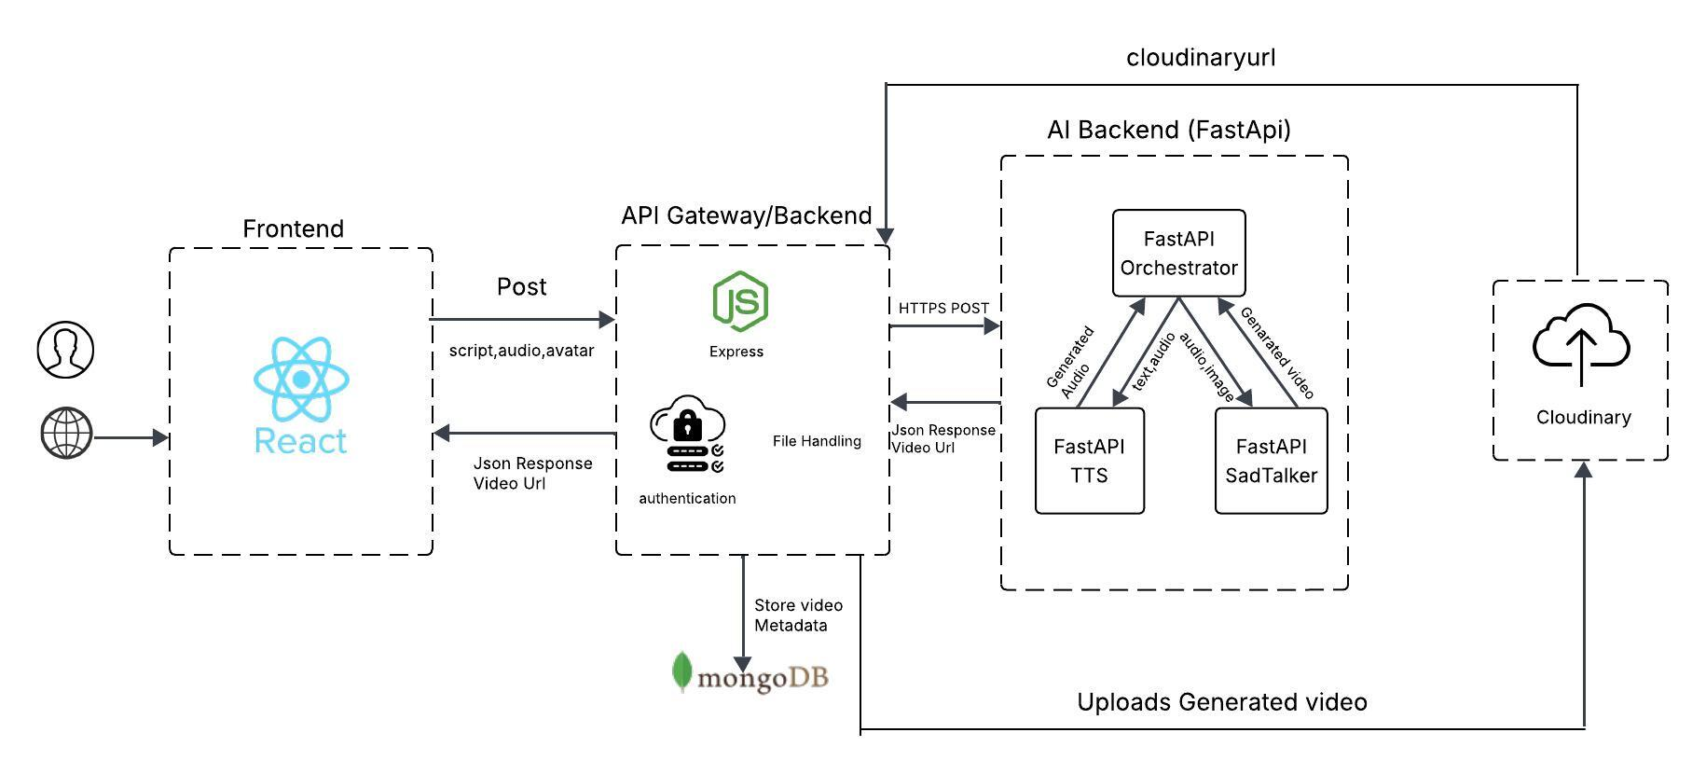
ARCHITECTURE DIAGRAM

