Slide 1
AVATARLAB
BUILDING SMART AND REALISTIC AI AVATARS
G359
SRITHI

Slide 2
OVERVIEW
Developed AvatarLab: text-to-talking-head video system
Integrated XTTS for multilingual voice cloning and SadTalker for lip-synced animation.
Enabled user uploads of voice samples for personalized voices.
Developed a full-stack app using ReactJS (frontend) and Express.js (backend).
Achieved a smooth, end-to-end pipeline from text input to final MP4 video output.

Slide 3
TECH STACK
Frontend: React
Backend: Node.js+Express.js
Database: MongoDB
AI Models:
- XTTS (text-to-speech)
- SadTalker (talking head animation)
Infrastructure:
- Cloud Deployment(AWS)

Slide 4
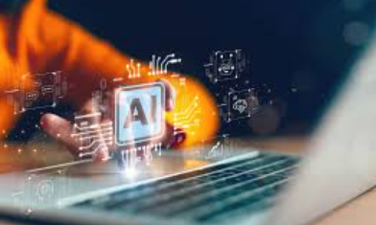
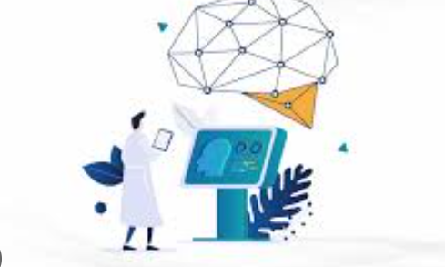
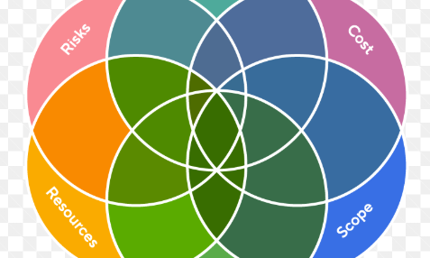

MAJOR LEARNINGS
AI Integration in Web Stacks
Pretrained Model Tuning
Handling Real-World Constraints
Problem Solving & Debugging
Learned how to integrate AI models like SadTalker and XTTS into a MERN-based web application.
Experimented with SadTalker’s pose and expression threshold parameters to enhance realism without retraining
Adapted the pipeline to work on limited compute (Colab Free Tier), optimizing for memory usage, inference speed, and fallback logic.
Faced and fixed real-world issues like mouth desync, processing delays and file handling bugs,.

Slide 5
CHALLENGES FACED
Model Selection: Diffusion models were slow; finding the right alternatives took time.
Accuracy & Sync: Audio-video alignment needed careful tuning.
Dependency Issues: Frequent version conflicts in Python and Node packages.
File Handling: Large uploads led to crashes and storage issues.
Multimodal Integration: Combining audio, image, and text into one smooth pipeline required careful orchestration.

Slide 6

MODEL SELECTION
XTTS (Text-to-Speech):
Chosen for its high-quality, multilingual voice cloning, fast inference, and open-source availability.
→ Ideal for generating expressive speech from text using small voice samples.
SadTalker (Talking Head Generation):
Selected for its ability to generate realistic, identity-preserving videos from a single image and audio input.
→ Offers natural head motion, strong lip-sync, and low computational requirements.
Ingoude Company

Slide 7
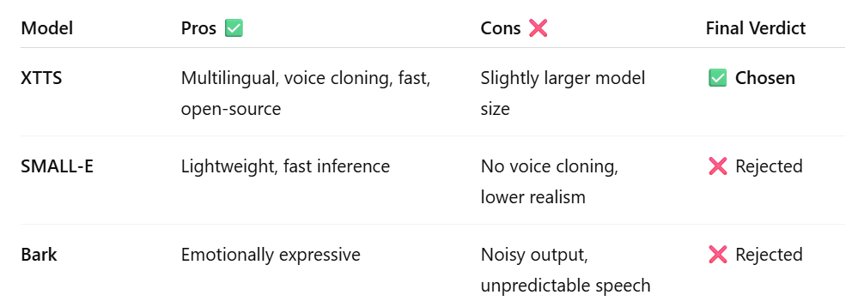
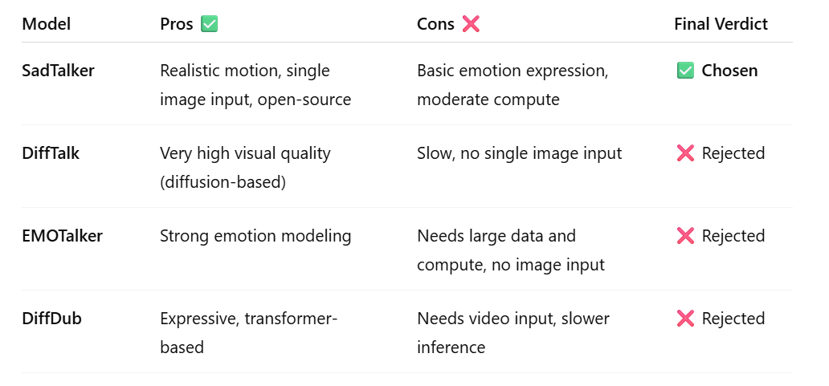
TTS model comparison:
Milestone Achievements:
Achieved functional TTS-to-video pipeline, model integration, working frontend/backend
Not achieved:
cloud deployment
Talking Head Model comparison:

Slide 8
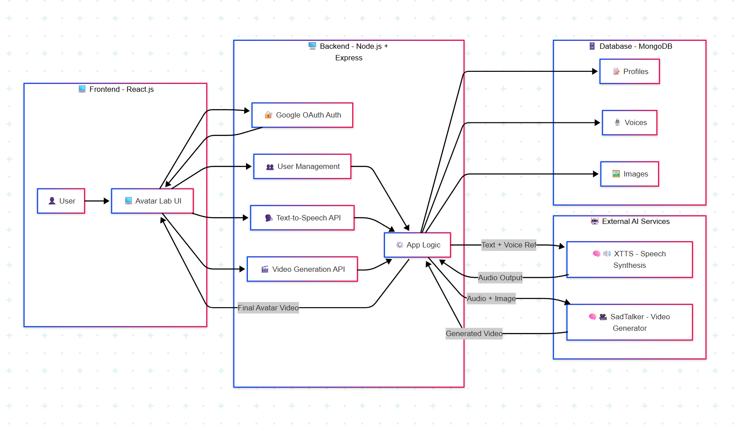

Slide 9
Thank you!

