Slide 1
AVATAR LAB
BUILDING SMART AND REALISTIC AI AVATARS
GROUP-359
ANUSHKAA PARSI
23BD1A059H

Slide 2
PROJECT OVERVIEW
• What does our application do?
• Generates realistic AI avatars that speak based on text input.
• Uses speech synthesis and lip-sync animation to create lifelike videos.
• End Goal:
• By the end of this semester, we will have a functional AI tool that turns text input into a talking avatar video.
• Why is this important?
• Useful for content creators, educators, virtual assistants, and marketing.
• Reduces cost & effort in video production and enhances communication, education, entertainment, and customer engagement across various industries.

Slide 3
Business Problem and Data Users
Problem:
• Creating talking avatars from text requires complex animation skills and tools.
• Manual lip-syncing is time-consuming and expensive.
• Need for scalable, automated solutions for personalised avatars.
END USERS:
•Content Creators (YouTube, TikTok, etc.)
• E-learning Platforms (Teachers, Online Courses)
• Customer Service Bots (AI-powered chat & voice bots)
• Marketing & Advertisement (Virtual sales agents)
•VR/AR, Gaming characters(Personalised avatars)
How does it help?
• Saves time in avatar creation, reduces the video editing time.
• Automates lip-syncing for a natural experience.
• Scales easily for different industries.

Slide 4
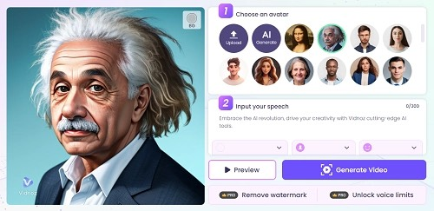
TECH STACK AND DATA SOURCES
Tech Stack:
• Frontend: React.js (User Interface)
• Backend: FastAPI (Handles requests)
• AI Models:
• DiffTalk – Lip-sync & facial animation
• Small-E- (Lina-Speech) – Speech synthesis
• Database: Firebase / AWS S3 (Stores videos)
• Deployment: Google Colab (Training), AWS/GCP (Hosting)
Datasets Used:
• VoxCeleb1, HDTF Dataset (For training DiffTalk lip-sync model)
• Open Speech Datasets (For speech synthesis model training)
INPUT :
Text Input – The script or message the avatar should speak
Image/Video Upload - A custom face or avatar reference for animation
Voice selection - Options to choose a specific AI-generated voice.

Slide 5
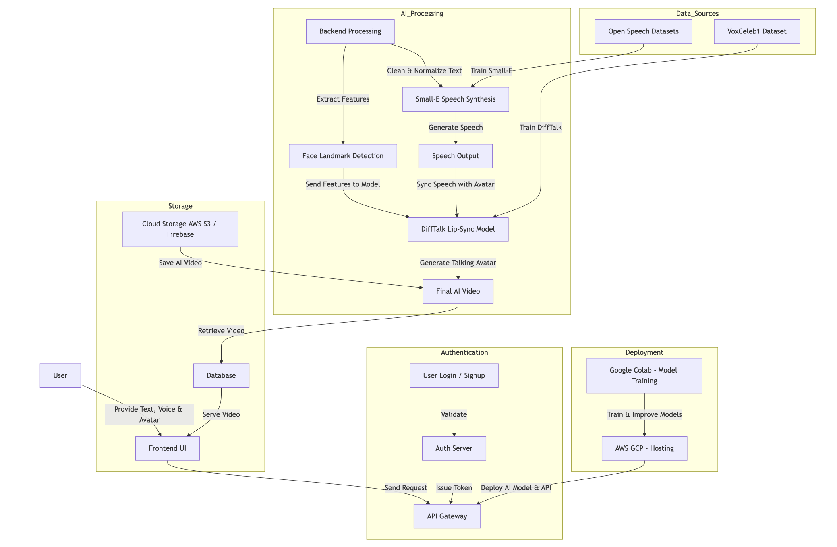
ARCHITECTURE

Slide 6
THANK YOU!

