Slide 1
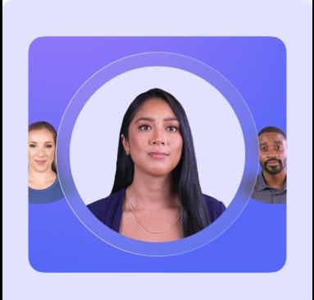
Avatar Lab
Generating Realistic AI Avatars
Gayathri-23BD1A056W
Group-No:356

Slide 2
Project Overview
Problem Statement:
Traditional animation is time-consuming & expensive. We need AI-powered avatars
to automate realistic facial animation with accurate lip sync.
Solution:
AI-driven talking head avatar that converts text into lifelike animations. Seamlessly integrates speech synthesis & facial animation.
Target Users:
Content Creators – Automate animated videos Educators – AI-powered lecture avatars Businesses – AI avatars for customer support Game Developers & Virtual Assistants
Productivity Impact:
Reduces manual work for animation
Enhances accessibility with multilingual AI avatars

Slide 3
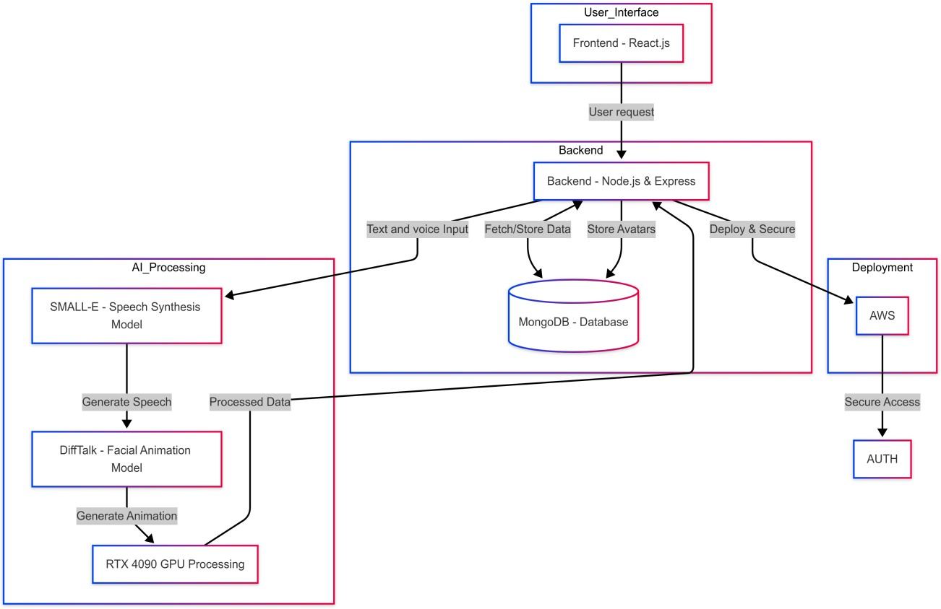
Work flow
Input: User provides text input and voice
Small-E: Converts text to speech (TTS).
Audio Preprocessing: Formats audio to match DiffTalk requirements.
DiffTalk: Generates a talking head animation using the speech input.
Output: Final video with realistic speech & lip-sync.

Slide 4
Data Preprocessing
Preprocessing for Small-E(TTS):
Text Cleaning: Normalize text, convert numbers & abbreviations
Phoneme Conversion (Optional): Convert text to phonemes for better pronunciation
Preprocessing for DiffTalk:
Video Frame Rate: Ensure all videos are set to 25 frames per second (fps).
Audio Extraction: Extract audio signals from the videos.
Facial Landmarks: Extract facial landmarks from the video frames.
Datasets Used
Small-E:
Trained on datasets like LibriTTS, LibriTTS-R
DiffTalk:
Utilizes the High-Definition Talking Face (HDTF) dataset for training and testing.
•

Slide 5
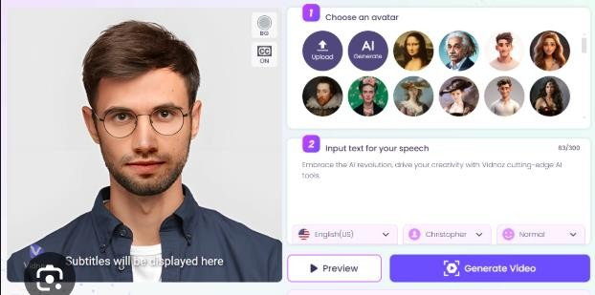
Tech-Stack
Frontend (User Interface)
React.js (for building the web interface)
Backend (API & Processing)
Node.js + Express (for API handling)
Python (FastAPI) (for model inference)
Deep Learning Models
DiffTalk (for facial animation)
SMALL-E (for text-to-speech)
PyTorch/TensorFlow (for inference)
Database
MongoDB (to store user-generated content)
Infrastructure & Deployment
NVIDIA RTX 4090 (for model acceleration)
Cloud Hosting (AWS/GCP) (for scalable deployment)

