Slide 1
AVATARLAB
BUILDING SMART & REALISTIC AI AVATARS
G359

Slide 2

Avatar Lab – AI-Powered Talking Avatars
Avatar Lab uses AI to turn text into realistic talking avatars with DiffTalk for facial animation and SMALL-E for speech, optimized for fast performance with RTX 4090 and cloud deployment.
Scope:
Develop an AI-powered talking head animation pipeline.
Realistic lip-sync & facial animations.
Generate speech from text input.
Deploy on cloud infrastructure for scalability.

Slide 3


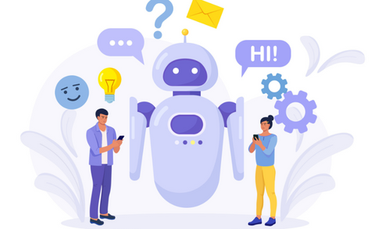
END USERS
Content Creators & YouTubers
E-Learning Platforms & Educators
Virtual Assistants & Customer Support
Generate videos without filming.
AI avatars for teaching.
Virtual Assistants & Customer Support
User Roles:
Admin/Developers – Train & fine-tune AI models.
End Users – Use the web app to generate AI avatars.

Slide 4
TECH STACK
Frontend: React.js
Backend: Node.js + Express.js
Database: MongoDB
AI Models:
- DiffTalk – Creates facial animations & lip-sync.
- SMALL-E – Converts text into human-like speech.
Infrastructure:
- Cloud Deployment (AWS)

Slide 5
DATA PREPROCESSING
Datasets Used:
HDTF (High-Definition Talking Faces),
LibriSpeech (Speech Dataset for AI Training).
Preprocessing steps:
Data Verification – Removing noise.
Normalization – Standardizing formats.
Validation – Ensuring AI accuracy.

Slide 6
