Slide 1
Avatar Lab
Generating Realistic Avatars
Gayathri-23BD1A059W
Group-No:359

Slide 2
Models Used
TTS Model Used: Coqui TTS (XTTS v2):
Open-source (non-commercial use); excellent few-shot voice cloning; multilingual; high quality.
Alternatives Considered:
Bark
YourTTS
Linaspeech
Avatar Animation Model Used: SadTalker
open-source model for realistic talking heads from single image; flexibility in expression,active community; supports image enhancement
Alternatives Considered:
Diffatlk
wav2lip

Slide 3
Tech Stack
React (Frontend): Builds our interactive User Interface (UI), managing components, user state, and routing for a smooth user experience.
Node.js (Backend/API Gateway): Handles frontend requests, handles file uploads, integrates with our AI services (FastAPI), manages user authentication, and interacts with MongoDB.
FastAPI (AI Backend/Microservices): Hosts and orchestrates our AI models (Coqui TTS, SadTalker) on Google Colab (leveraging GPU). Crucially, it handles direct video uploads to Cloudinary.
MongoDB (Database): Stores user data and metadata for generated videos (Cloudinary URLs, timestamps)
Cloudinary (Cloud Media Storage & CDN): Stores all generated videos and delivers them quickly via a global Content Delivery Network (CDN), solving large file transfer issues.

Slide 4
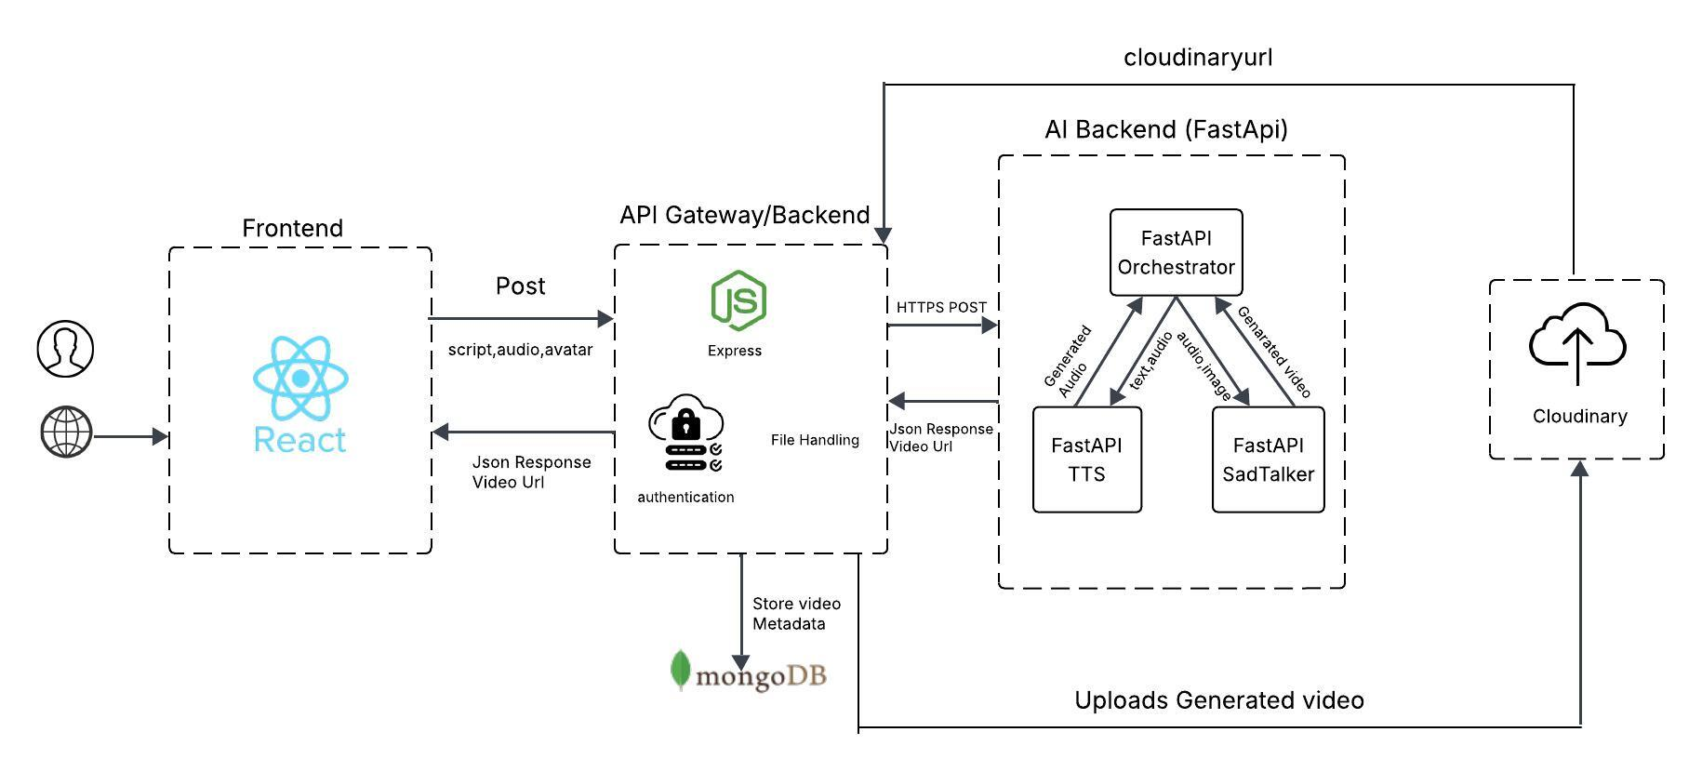
Architecture Diagram

