Slide 1


Avatar AI Labs
AI-powered Talking-Head Video Generation
Initial Plan
(DiffTalk + Small-E)
Final Build:
SadTalker + XTTS
Future: Cloud Deployment
Presented by Risheel Kumar
23BD1A05BV

Slide 2

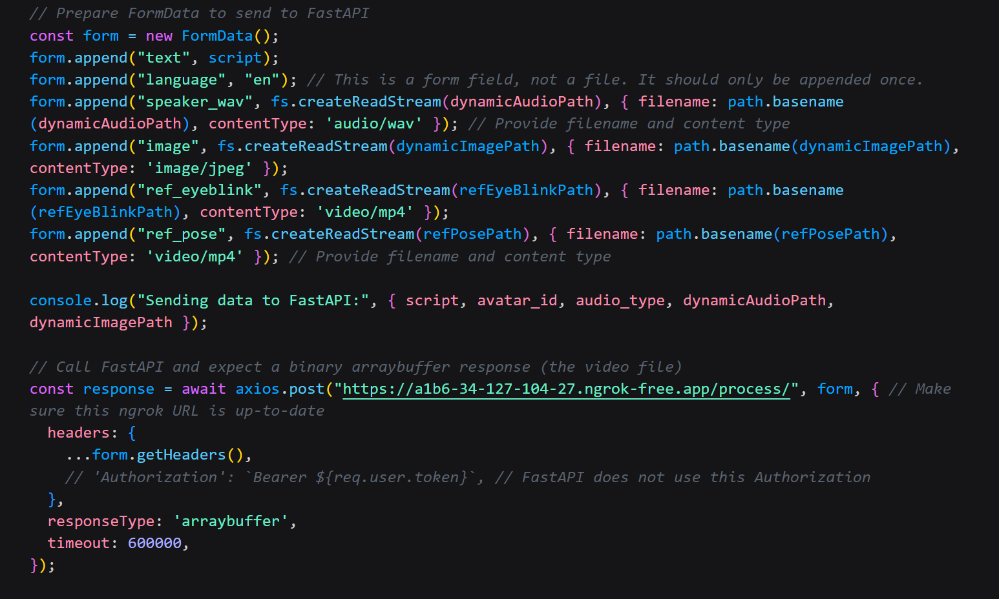
Demo of Developed Application
User selects image/audio/text -> receives avatar video
Text/Audio Input & Avatar Generation.
User Login & History Tracking.
Video Generation with Lip-Sync.
Downloadable .mp4 Output (~70% Realism)

Slide 3

Key Learnings
Key Learnings
AI Model Integration (XTTS/ SadTalker)
CPU Optimization (16-core, 16 GB RAM)
Error Handling & Debugging
Pipeline Management (Audio- Video Sync)
React Animations (Framer Motion)

Slide 4
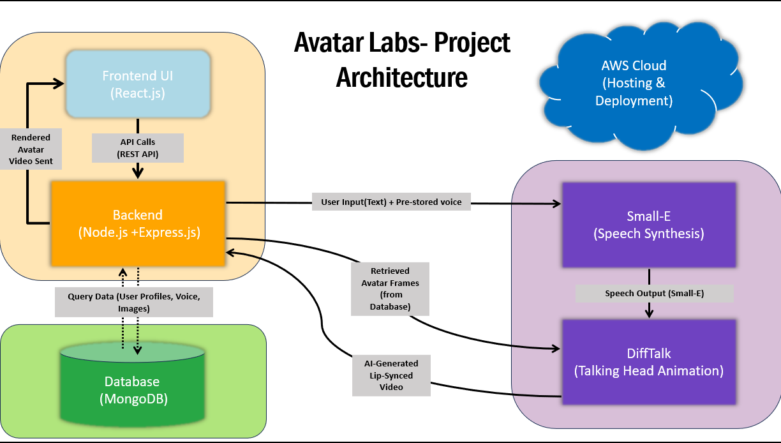
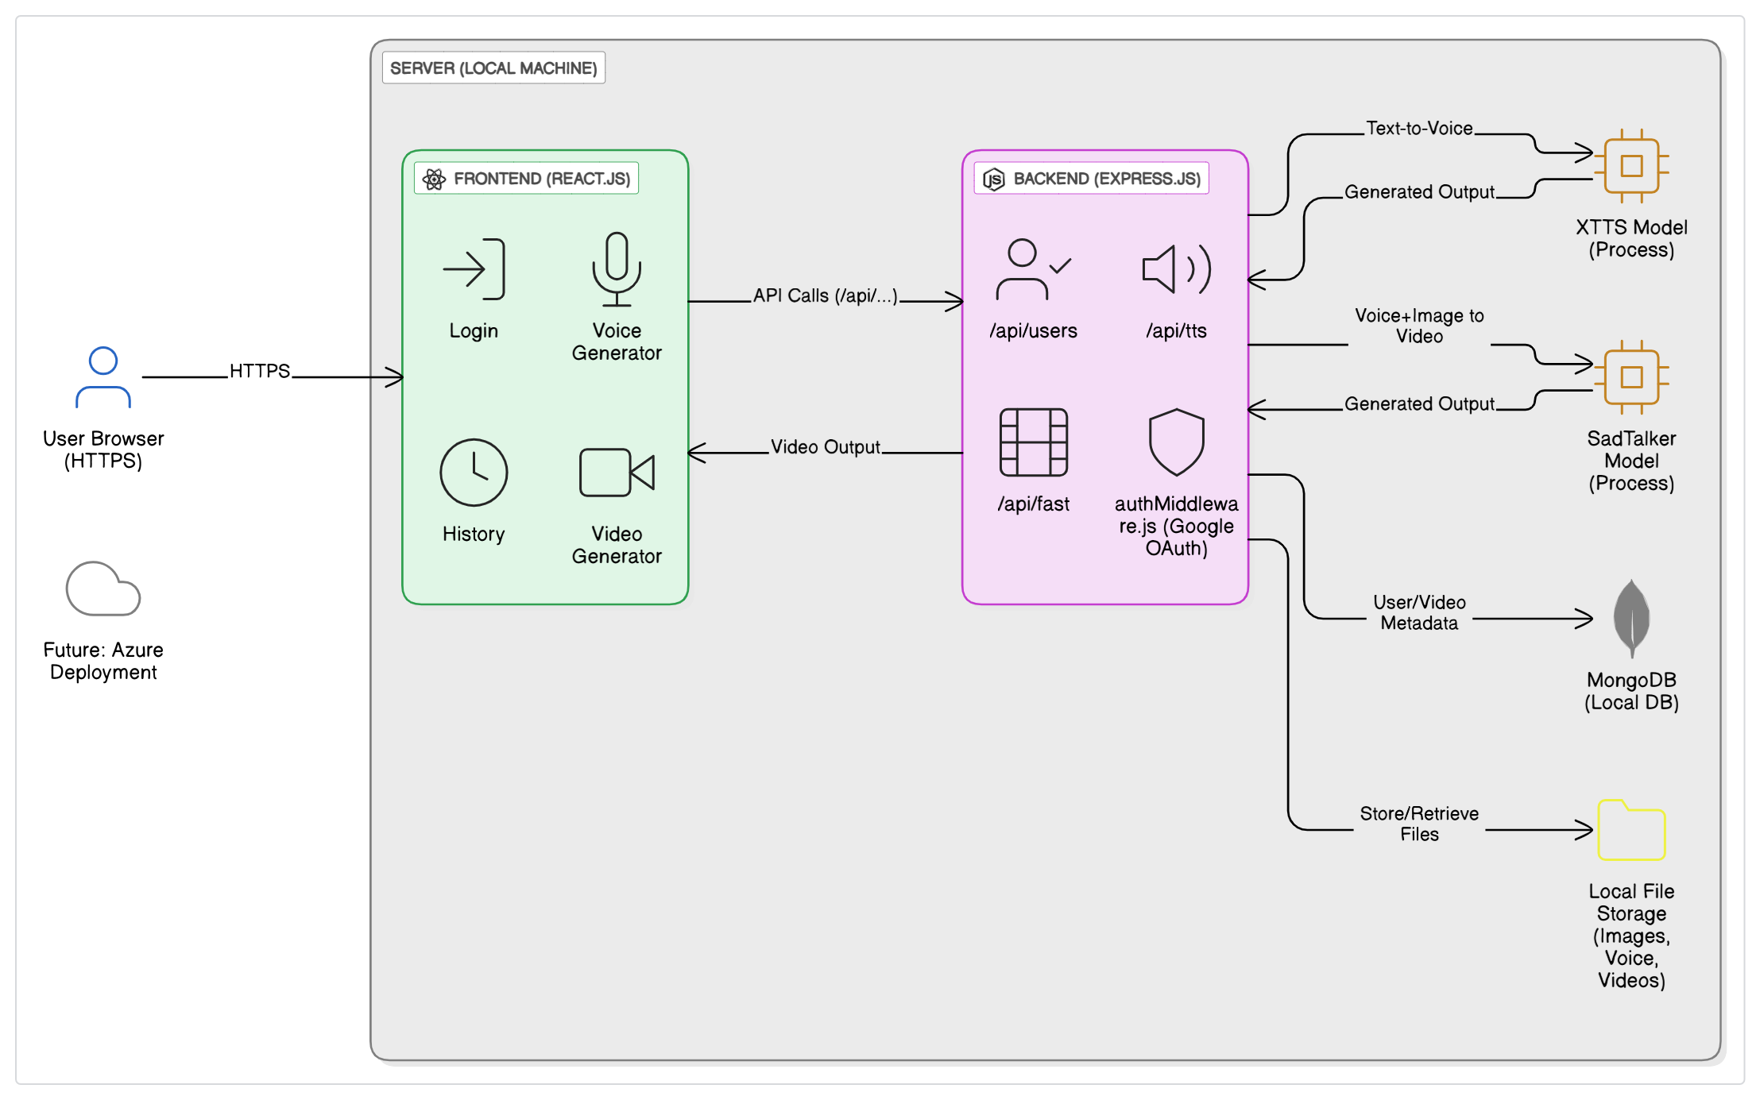
Architecture Evolution & Milestones
Initial Architecture: DiffTalk + Small-E
Final Architecture: Sad Talker + XTTS (lower compute), Google Oauth, Optimized APIs
Achieved:
model Integration
~70% Realism
Not Achieved:
Original TTS-to-Video Pipeline,
Cloud deployment

Slide 5


Challenges
Model Issues: Colab Struggles, moved to local, excessive movement (fixed), sync issues
Performance: Slow load times (CPU), frontend delays (large files)
Time Constraints: Limited optimization.
Debugging: Cross-model bugs resolved

Slide 6



Model Selection & Deployment
SadTalker: Single Image input, realistic movements, open-source
XTTS: High-quality, TTS, multilingual, low latency
Considered: latentSync, DiffDub
Considered:
Small-E,
Bark
Current:
Local machine deployment
Future:
AWS hosting

Slide 7

Thank You!
Presented by:
Voore Risheel Kumar
23BD1A05BV

