Slide 1
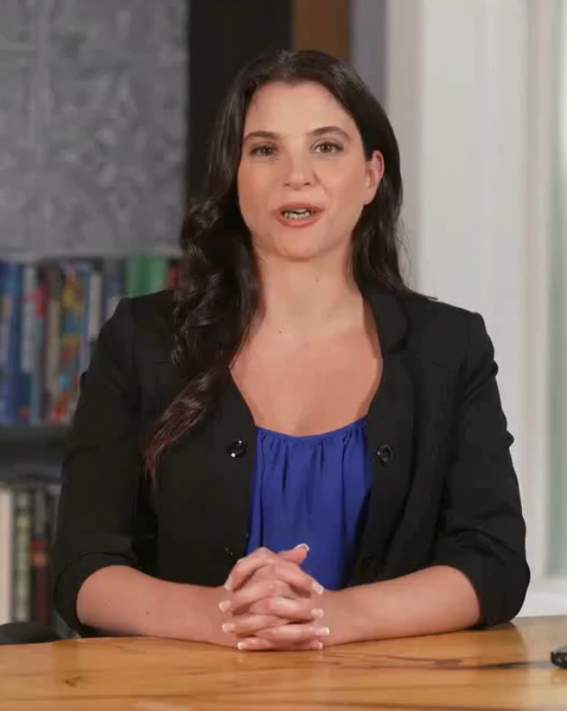
Avatar Lab: AI-Powered Talking Avatars
Text-to-Lifelike Digital Storytellers with DiffTalk & Small-E
Presented by:
Voore Risheel Kumar, 23BD1A05BV
20 March, 2023

Slide 2



Project Vision & Value
Vision:
Avatar Lab delivers an end-to- end AI pipeline transforming text into realistic talking head videos…
Business Problem:
Manual animation and traditional TTS lack scalability and realism…
Target Users:
Content creators
Developers
Enterprises
Pain Points Solved:
Cuts production time/ costs,
Enhances realism.
Flowchart:
DiffTalk
+
Small-E
Text,
Video,
Audio
Video

Slide 3
User Roles & Interaction
Roles:
Content Creators: Input text, customize avatars
Developers: Use REST APIs to integrate
End Users: Experience real-time avatars
Interaction:
Input: Text via UI
Output: MP4
Productivity: Automates creation. Rapid deployment
Mind Map:
Developers
Content Creators
End Users
Avatar Lab

Slide 4
Technical Architecture
Tech Stack:
MERN (React.js, Node.js/Express), REST APIs
DiffTalk
Small-E
RTX 4090
AWS/Azure
Architecture Diagram:
Output Layer
Image Decoder,
Video Output
(MP4)
Frontend/ UI
Input Layer
React.js,
Web Interface
Text
Preprocessing
AI Core
Audio Encoder, Image Encoder
Audio
(Speech)
DiffTalk
Denoising M)
Small-E
(LCLM + Paca)
Reference Image (Xr)
Node.js/Express,
API Endpoints
RTX 4090, Acceleration
REST API Layer
GPU
Layer

Slide 5
Data & Preprocessing
Datasets:
Dataset | Source type (Public/ Private) | Availability | Model Used in
HDTF | Public | Github-link | DiffTalk
LibriTTS | Public | Download-Link | Small-E
Preprocessing:
Verify: Syntax, audio quality
Validate: Lip-sync error, PACA checks
Normalize: 1080p, audio bitrate
Data Source
Verify
Validate
Normalize
Model Input

Slide 6
Thank You
Pioneering AI-Driven Digital Storytelling

