Slide 1
21-01-25 세미나
국민대학교 컴퓨터공학과 김명진
HCI Lab.

Slide 2
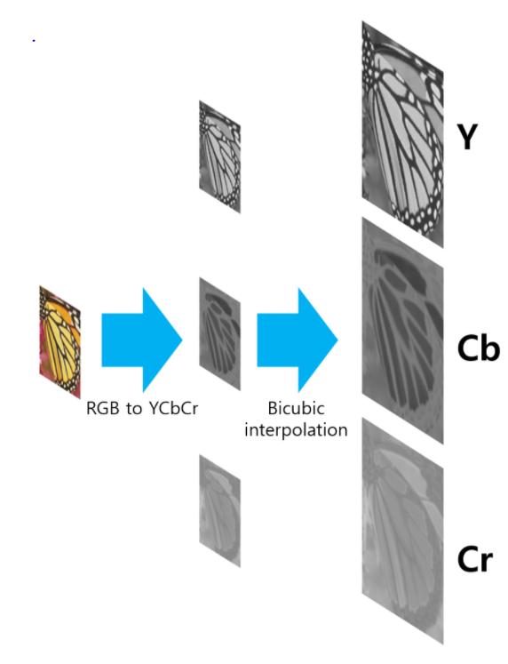
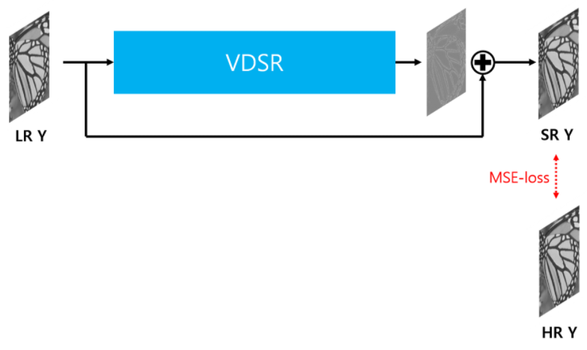
Experiment Detail
Model = Resnet / Training Dataset = Mnist Data converted RGB(28 * 28 * 3)
PSNR 측정 = Tensorflow 2.0
Gray → RGB ↔ YCbCr 채널 변환 = OpenCV
Attack Method(FGSM, I-FGSM, Shadow / Noise epsilon = 0.3)

Slide 3
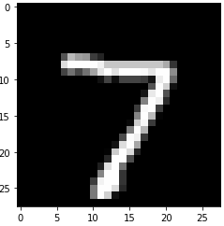


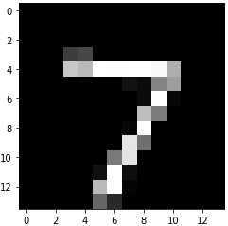




Experiment Detail(Gray Channel)
VDSR
14 * 14 * 1
(GRAY)
28 * 28 * 1
(GRAY)
28 * 28 * 1
(GRAY)
28 * 28 * 1
(GRAY)

Slide 4
Experiment Result
 | ACC | PSNR
LR | 99%
Bicubic | 97.3% | LR
 |  | 20.61
HR | 98.5% | LR | Bicubic
 |  | 24.86 | 22.11

Slide 5
VDSR(LR + noise)
 | ACC |  | PSNR
LR(+a) | FGSM | I-FGSM
 | 45.8% | 5.1%
Bicubic | FGSM | I-FGSM | LR(+a) | LR
 | 46.3% | 12.3% | 16.92 | 19.59
HR | FGSM | I-FGSM | LR(+a)
 | 45.9% | 11.9% | 15.69 | 18.92
 |  |  | Bicubic
 |  |  | 19.83 | 20.98

Slide 6
VDSR(Bicubic + noise)
 | ACC |  | PSNR
LR | 99% | I-FGSM
Bicubic(+a) | FGSM | I-FGSM | LR | LR
 | 26.3% | 1.2% | 12.36 | 16.67
HR | FGSM | I-FGSM | LR
 | 25.6% | 1.2% | 11.42 | 15.95
 |  |  | Bicubic(+a)
 |  |  | 21.70 | 22.76

Slide 7
VDSR(MID + noise)
 | ACC |  | PSNR
LR | 99% | I-FGSM
Bicubic | 97.3% |  | LR | LR
 |  |  | 20.61
HR(Mid+a) | FGSM | I-FGSM | LR
 | 63.3% | 88.5% | 13.13 | 18.59
 |  |  | Bicubic
 |  |  | 13.73 | 21.56

Slide 8
VDSR(HR + noise)
 | ACC |  | PSNR
LR | 99% | I-FGSM
Bicubic | 97.3% |  | LR | LR
 |  |  | 20.61
HR(+a) | FGSM | I-FGSM | LR
 | 30.8% | 2.7% | 12.70 | 17.07
 |  |  | Bicubic
 |  |  | 13.15 | 17.64

Slide 9

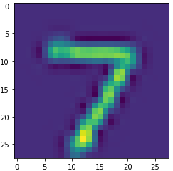
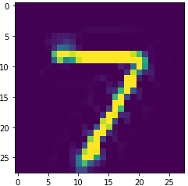
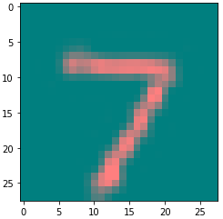
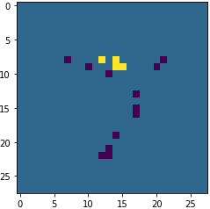
Experiment Detail(RGB Channel)
VDSR
28 * 28 * 1
(GRAY)
28 * 28 * 1
(Y Channel)
28 * 28 * 1
(Y Channel)
14 * 14 * 3
(RGB)
28 * 28 * 3
(RGB)
94.6%
28 * 28 * 3
(RGB)
87.4%
28 * 28 * 3
(YCbCr)
28 * 28 * 1
(Cb Channel)
28 * 28 * 1
(Cb Channel)
28 * 28 * 3
(RGB)
92.3%
28 * 28 * 1
(Cr Channel)
28 * 28 * 1
(Cr Channel)

Slide 10
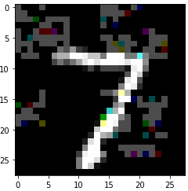
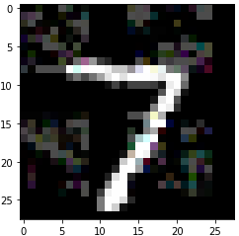
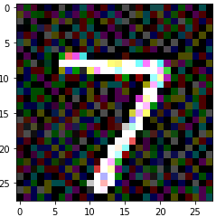
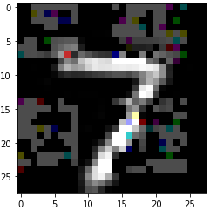
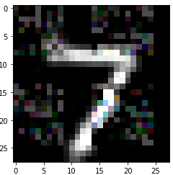
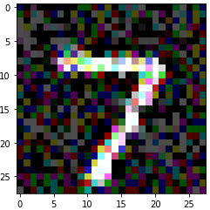
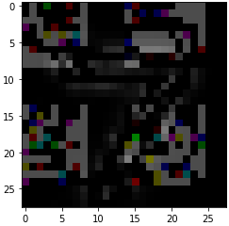
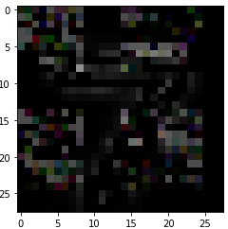
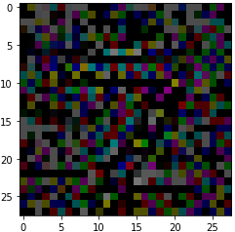
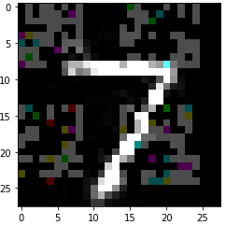
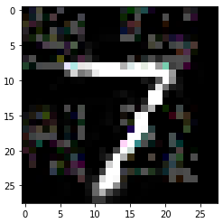
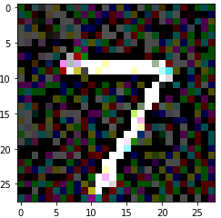
Experiment Result
 | FGSM | I-FGSM | Shadow
LR(+a)
Bicubic(+a)
Mid(+a)
HR(+a)

Slide 11
Experiment Result
 | ACC | PSNR
LR | 94.6% | X
Bicubic | 87.4% | LR
 |  | 20.79
HR | 92.3% | LR | Bicubic
 |  | 21.29 | 21.41

Slide 12
VDSR(LR + noise)
 | ACC |  |  | PSNR
LR(+a) | FGSM | I-FGSM | Shadow
 | 1.4% | 0% | 19%
Bicubic | FGSM | I-FGSM | Shadow | LR(+a) | LR | LR
 | 18.3% | 4.8% | 27.1% | 18.10 | 18.79 | 14.76
HR | FGSM | I-FGSM | Shadow | LR(+a)
 | 14% | 3.3% | 24.2% | 17.49 | 18.41 | 14.46
 |  |  |  | Bicubic
 |  |  |  | 20.57 | 20.78 | 20.06

Slide 13
VDSR(Bicubic + noise)
 | ACC |  |  | PSNR
LR | 94.6% | I-FGSM | Shadow
Bicubic(+a) | FGSM | I-FGSM | Shadow | LR | LR | LR
 | 1.1% | 0% | 18.6% | 14.96 | 16.91 | 13.53
HR | FGSM | I-FGSM | Shadow | LR
 | 1.6% | 0% | 18.4% | 14.13 | 16.10 | 13.37
 |  |  |  | Bicubic(+a)
 |  |  |  | 21.80 | 22.01 | 21.14

Slide 14
VDSR(MID + noise)
 | ACC |  |  | PSNR
LR | 94.6% | I-FGSM | Shadow | X
Bicubic | 87.4% |  |  | LR | LR | LR
 |  |  |  | 20.79
HR(Mid+a) | FGSM | I-FGSM | Shadow | LR
 | 39.9% | 15.9% | 12.2% | 15.3 | 17.7 | 13.8
 |  |  |  | Bicubic
 |  |  |  | 16.1 | 19.1 | 14.2

Slide 15
VDSR(HR + noise)
 | ACC |  |  | PSNR
LR | 94.6% | I-FGSM | Shadow | X
Bicubic | 87.4% |  |  | LR | LR | LR
 |  |  |  | 20.79
HR(+a) | FGSM | I-FGSM | Shadow | LR
 | 0.4% | 0% | 16% | 14.85 | 16.93 | 13.39
 |  |  |  | Bicubic
 |  |  |  | 14.98 | 17.07 | 13.19

Slide 16
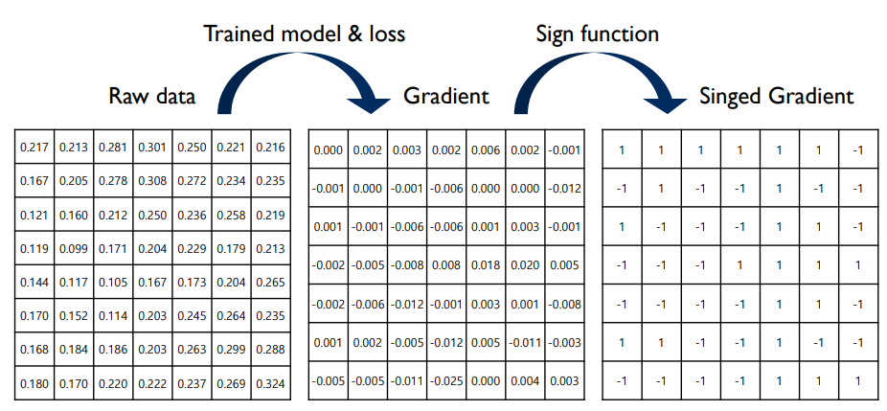
Adversarial Attack
Adversarial Attack(White Box)

Slide 17
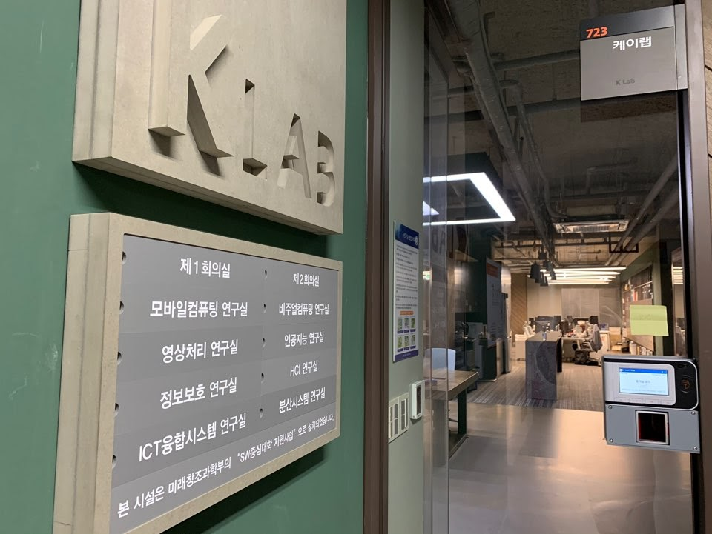
Thank you.

