Slide 1
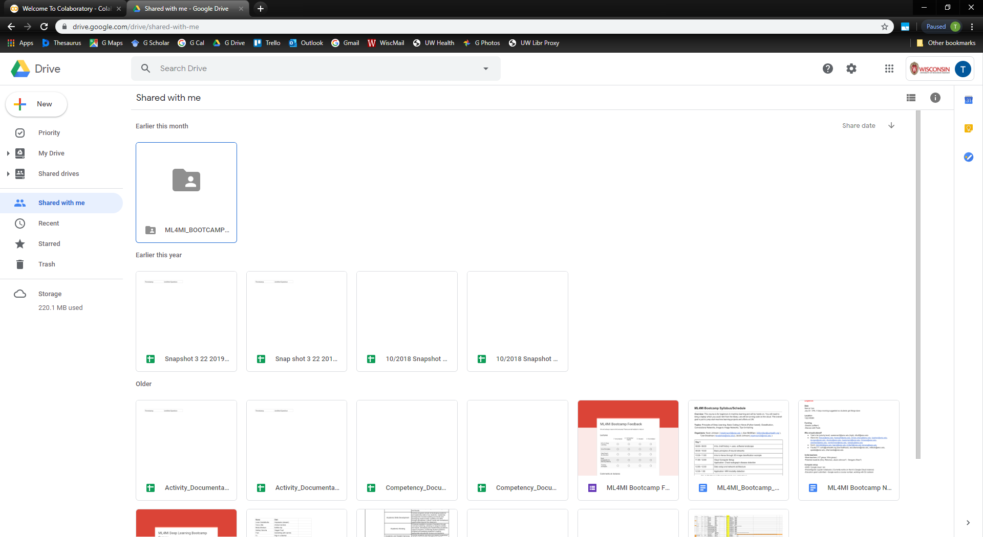
Log in to your Google Drive account (wiscmail only!)
Click on the link:
https://drive.google.com/drive/folders/14dkDddwgSPZA-YMuqqaFmx5QtFKdooGg?usp=sharing
Find folders shared with you

Slide 2
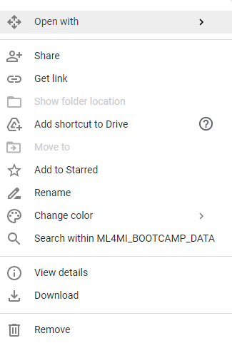
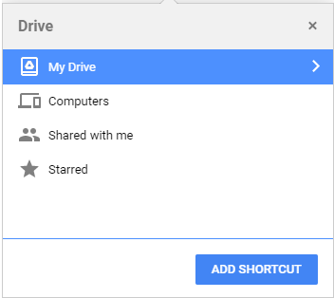
Right click
Add Shortcut to Drive
It should now be in your My Drive
Add Shortcut under My Drive

Slide 3
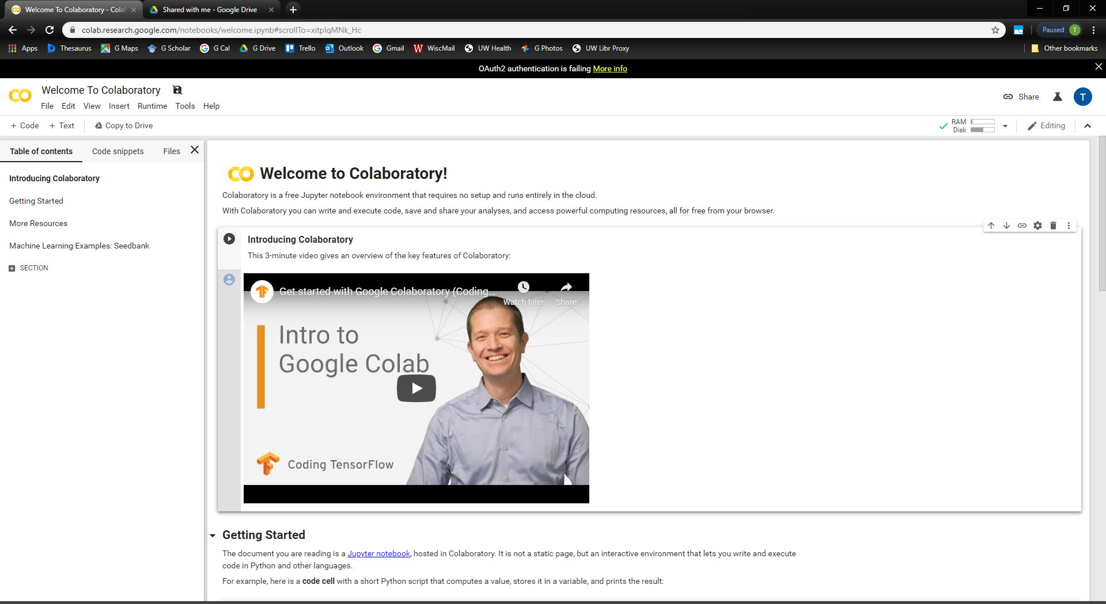
Go to colab, sign in using wiscmail

Slide 4
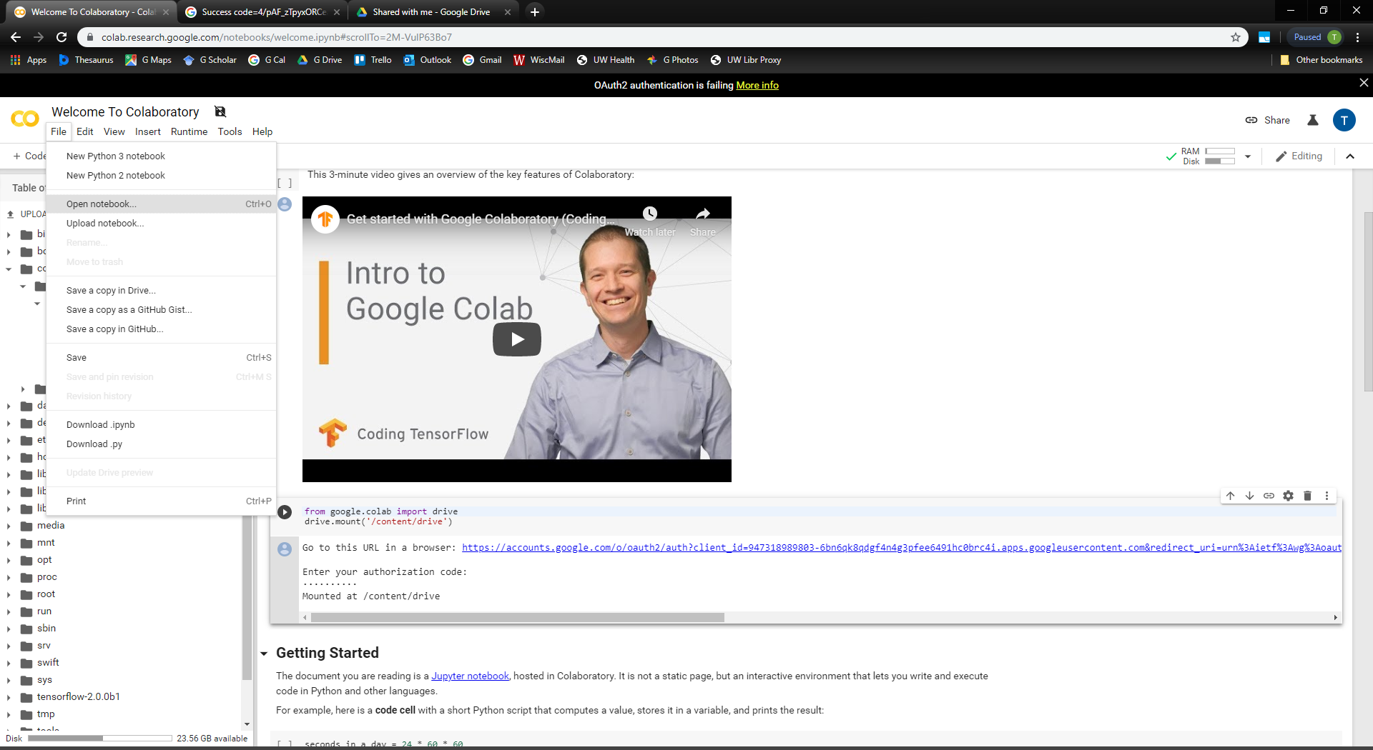
Go to File > Open notebook

Slide 5
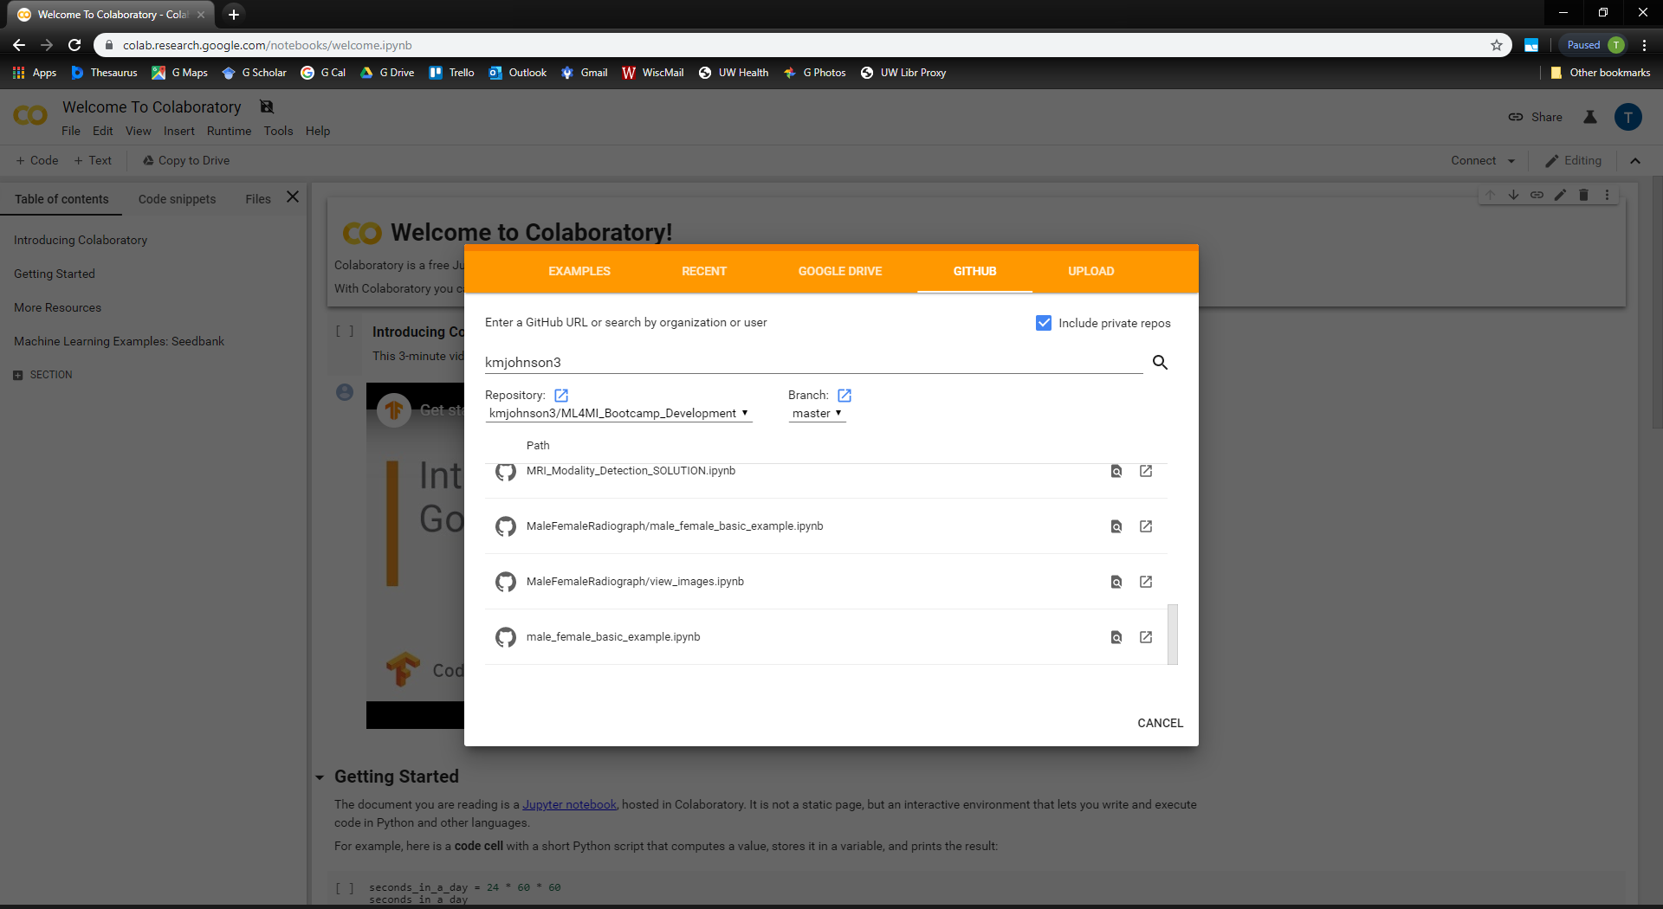
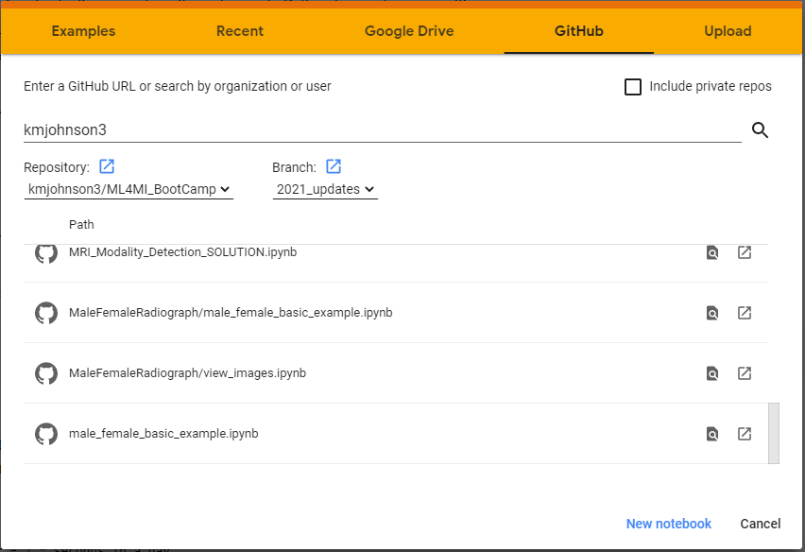

Click GITHUB
Type in kmjohnson3
Select ML4MI_BootCamp
Select MaleFemaleRadiograph/male_female_basic_example.ipynb

Slide 6
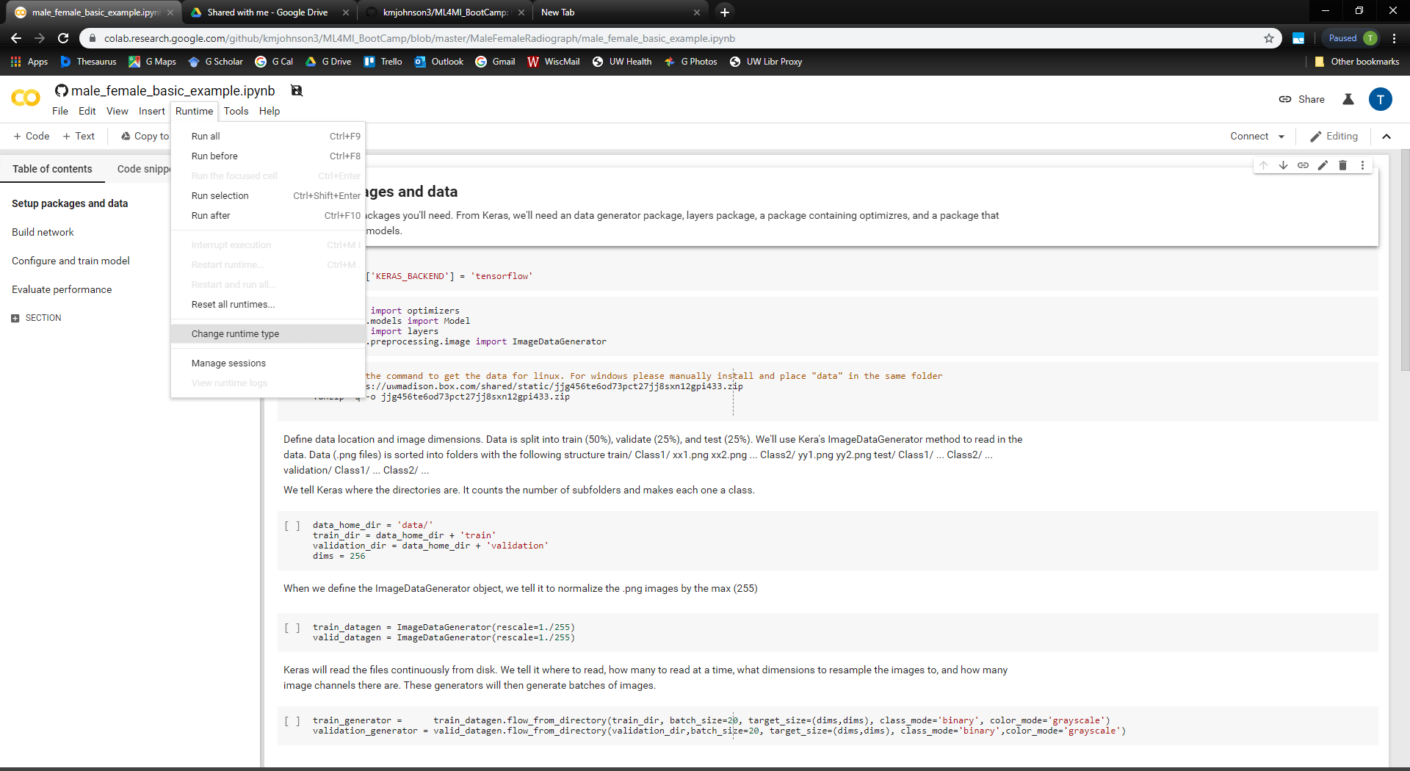
Change runtime

Slide 7
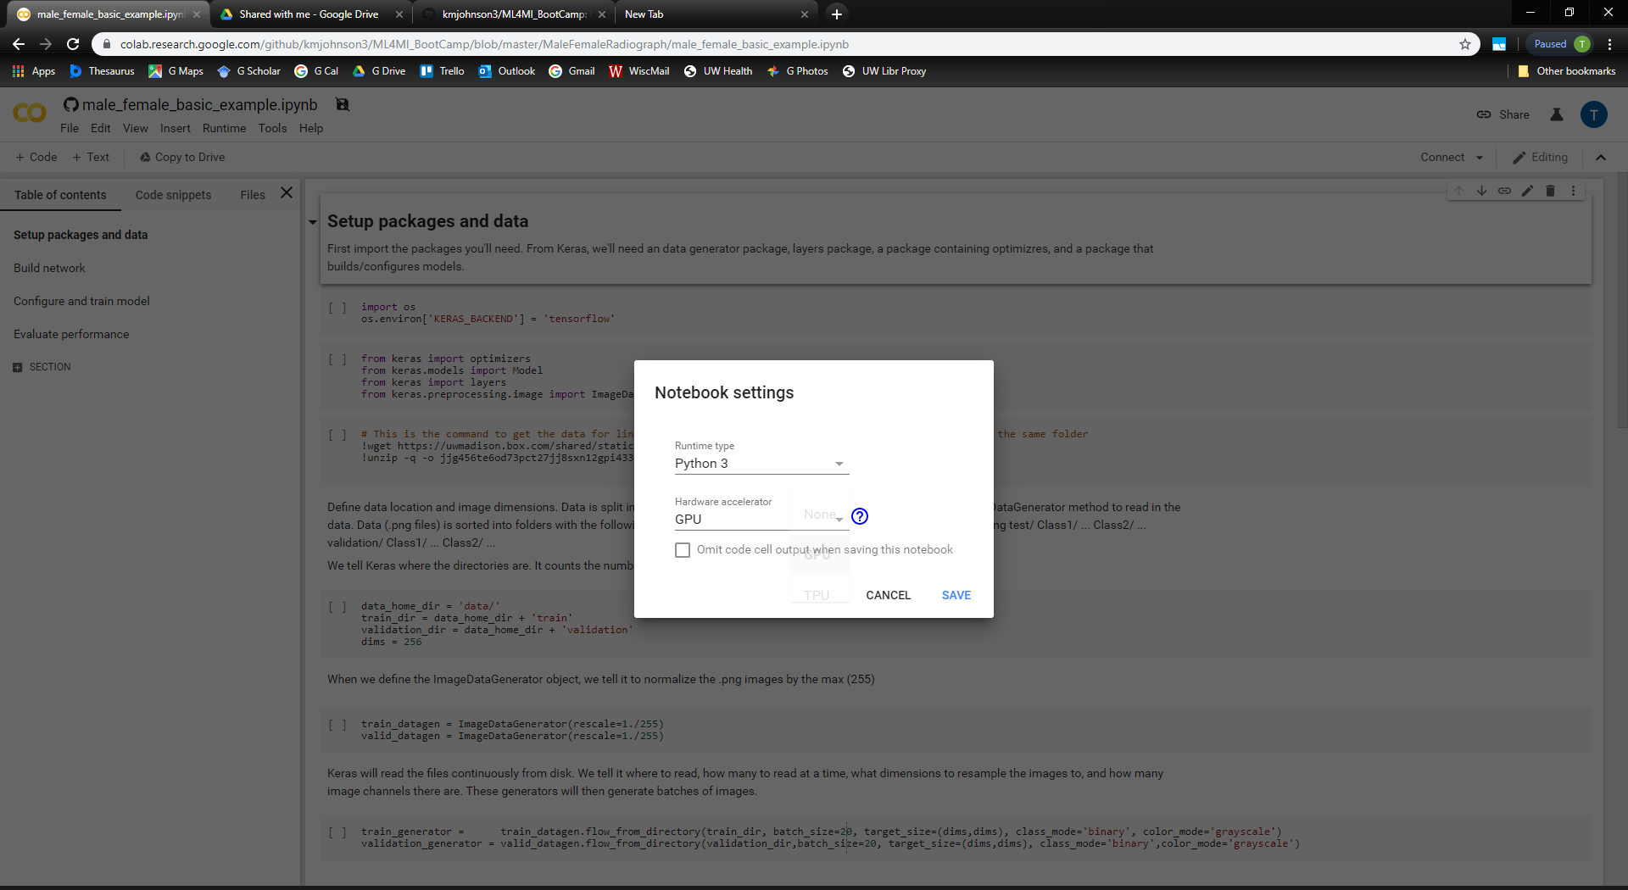
Select GPU

Slide 8
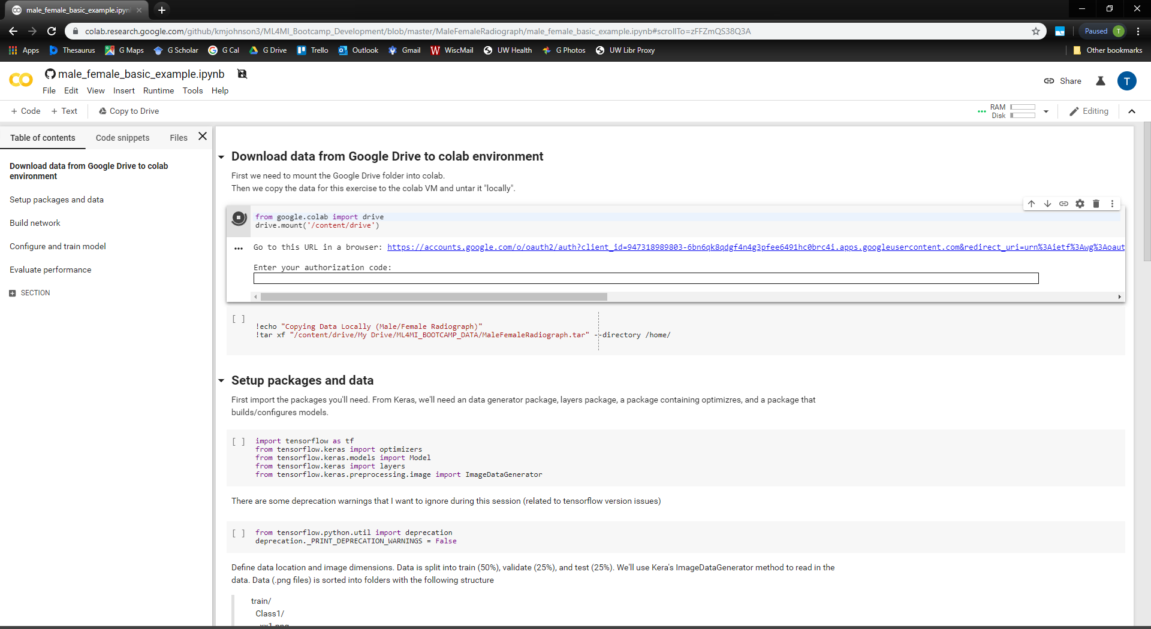
Click Play button (or Shift + Enter) to mount Google Drive. Follow authentication instructions

Slide 9
Run cell to copy data from Google Drive to colab session (not necessary, but faster)

Slide 10
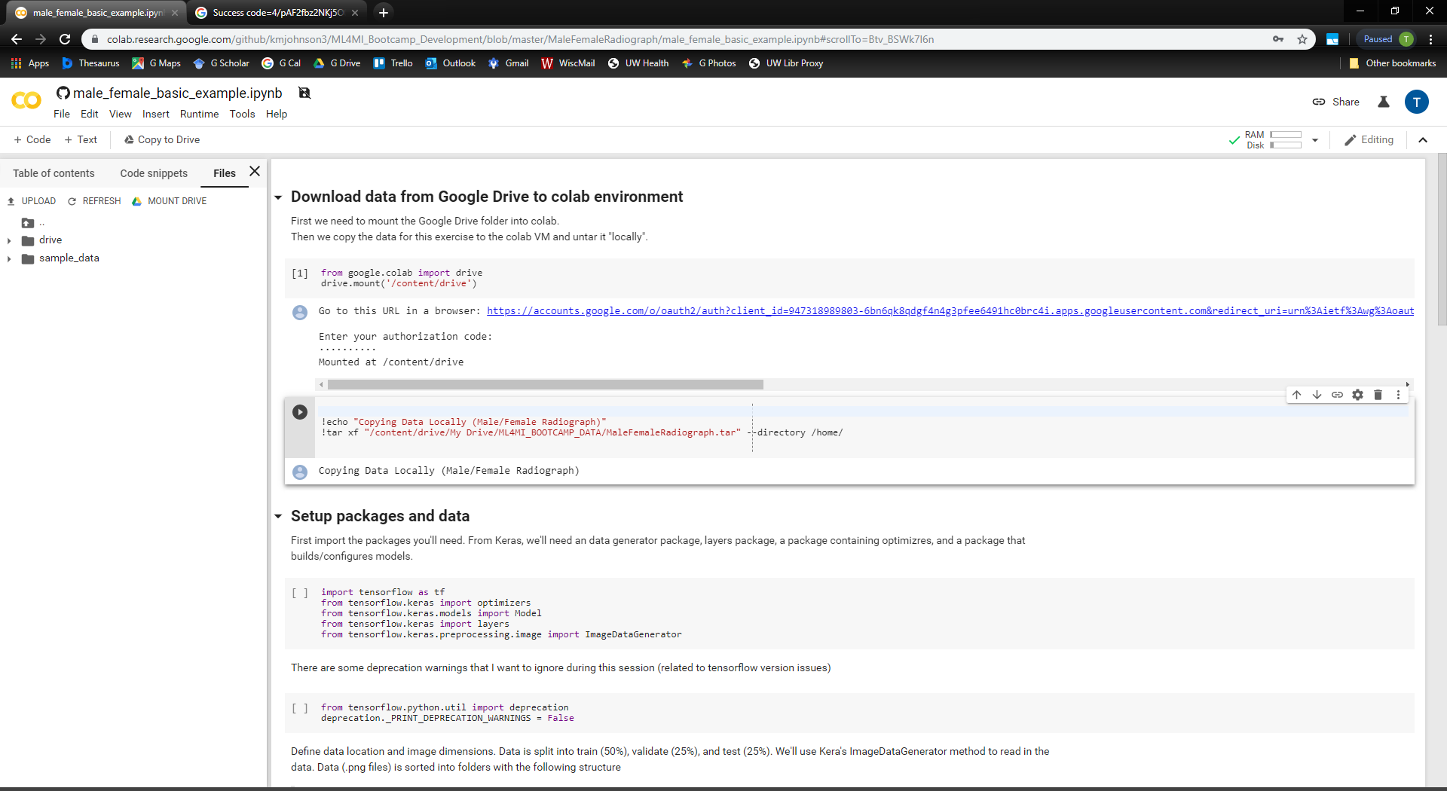
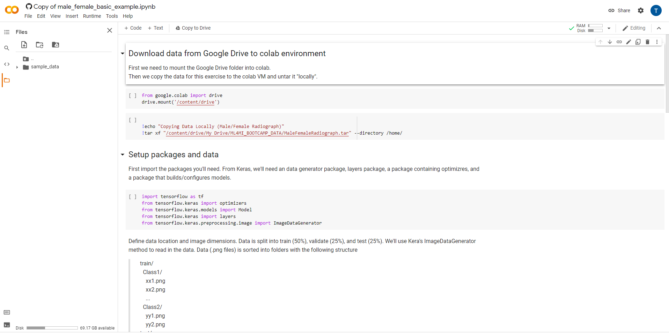
Click Files tab
Go up a folder, and see if data is in /home/ (MaleFemaleRadiograph)

Slide 11
Run through the rest of the code!

