Slide 1
Submesoscale processes at Depth in Gulf of Mexico
Keshav Joshi, Annalisa Bracco,
Hao Luo, Jim McWilliams
ECOGIG contribution # 309
GRIIDC #: R1.x132.141:0005

Slide 2
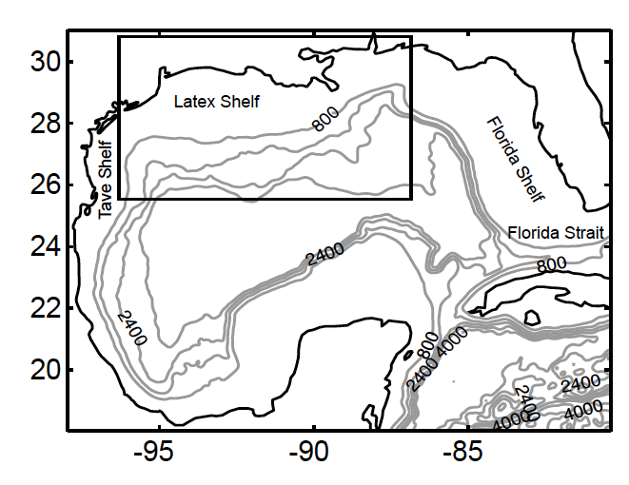
Model Setup: ROMS-AGRIF 2.1
Domain:
    LR -> 5km (98.0W~80.4W) & (18.0N~31.0N)
    HR -> 1.6km (96.3W~86.9W) & (25.4N~30.7N)
70 vertical terrain-following layers
HYCOM GoM 31.0: Boundary and Initial Condition
ECMWF ERA-interim reanalysis (6-hour wind stress and daily heat fluxes)
Run dates
  Jan 2010 – Dec 2012

Slide 3
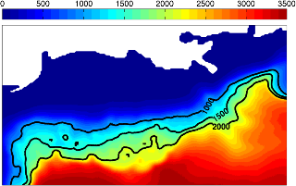
Model Setup: ROMS-AGRIF 2.1
Domain:
    LR -> 5km (98.0W~80.4W) & (18.0N~31.0N)
    HR -> 1.6km (96.3W~86.9W) & (25.4N~30.7N)
70 vertical terrain-following layers
HYCOM GoM 31.0: Boundary and Initial Condition
ECMWF ERA-interim reanalysis (6-hour wind stress and daily heat fluxes)
Run dates
  Jan 2010 – Dec 2012

Slide 4
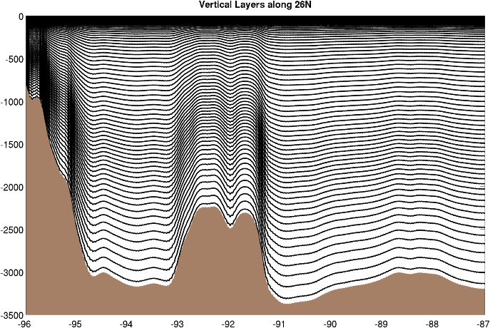
Model Setup: ROMS-AGRIF 2.1
Domain:
    LR -> 5km (98.0W~80.4W) & (18.0N~31.0N)
    HR -> 1.6km (96.3W~86.9W) & (25.4N~30.7N)
70 vertical terrain-following layers
HYCOM GoM 31.0: Boundary and Initial Condition
ECMWF ERA-interim reanalysis (6-hour wind stress and daily heat fluxes)
Run dates
  Jan 2010 – Dec 2012

Slide 5
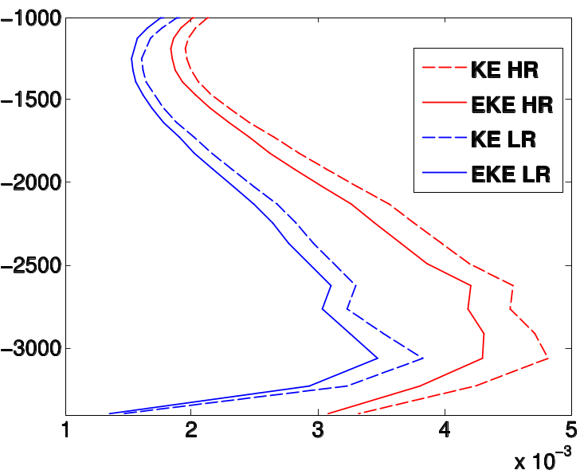
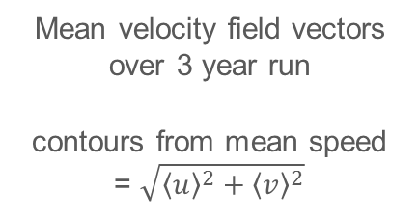
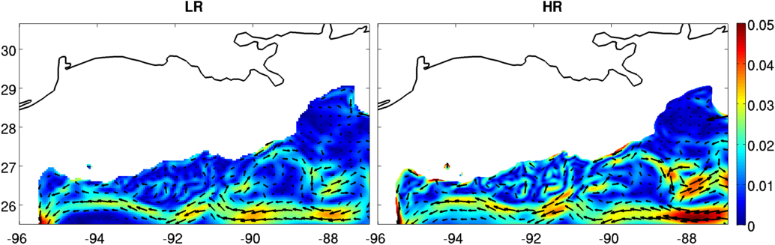
Mean Flow
Depth(m)
Energy Profile below 1000m (right)
m/s

Slide 6
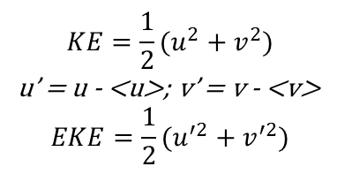
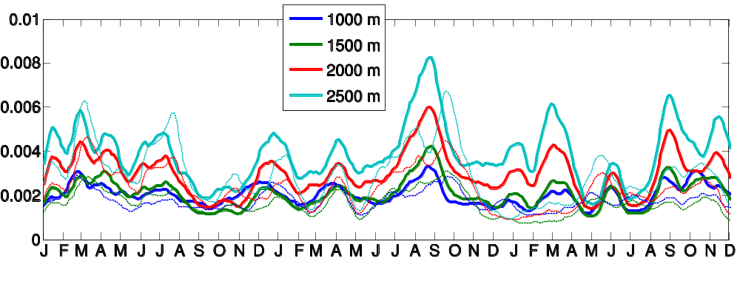
EKE variability
Depth(m)
greater EKE variability in HR
black dots: consistent separation cyclone off Mississippi Fan

Slide 7
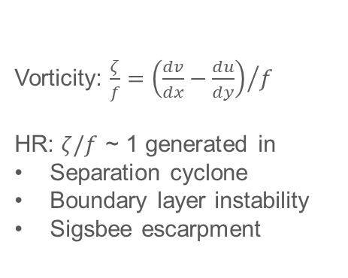
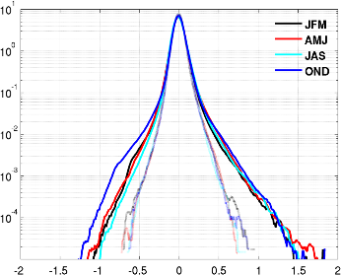
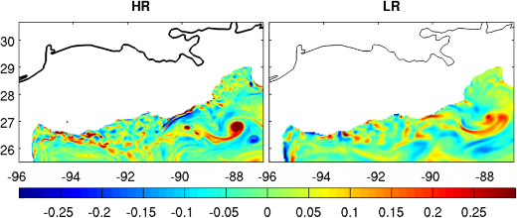
Vorticity generation
Seasonal Vorticity PDF @1000m
LR – lighter dashed line
HR – darker line
Skewness
@1000m
HR – 0.95; LR – 0.55
@2000m
HR – 1.58; LR – 1.10
15 Jul 2010

Slide 8
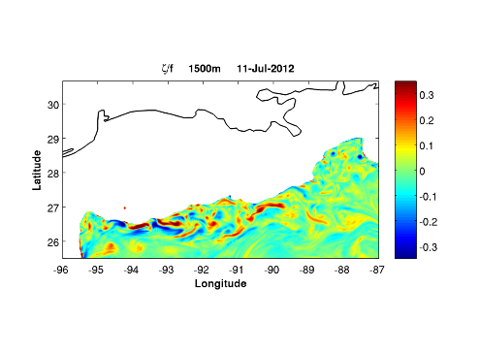
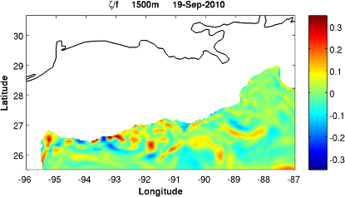
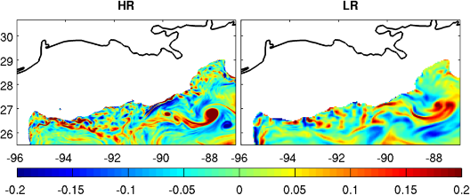
Vorticity generation
HR
LR
15 Jul 2010

Slide 9
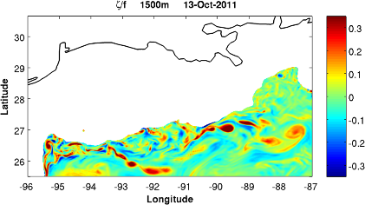
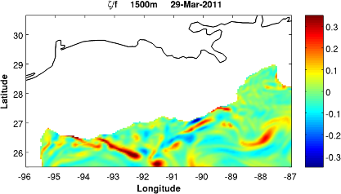
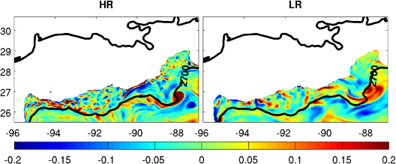
Vorticity generation
HR
LR
15 Jul 2010

Slide 10
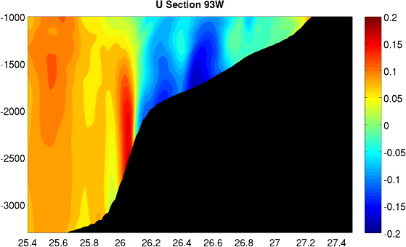
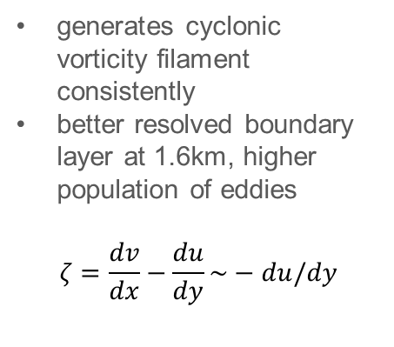
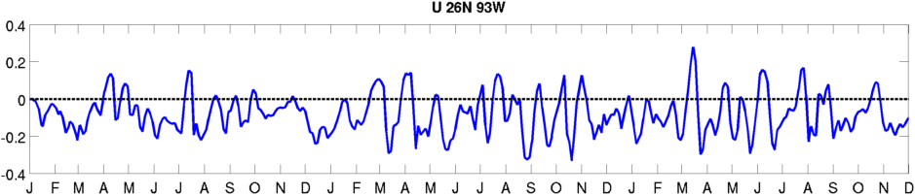
Boundary
Layer
15 Jul 2010

Slide 11
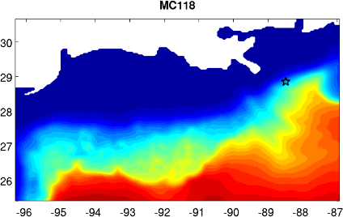
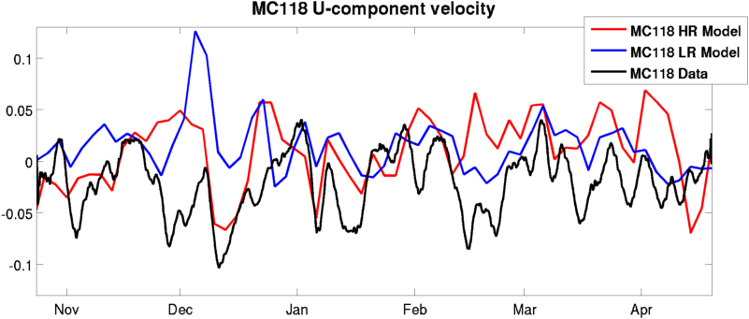
U-variability: data
Data gathered every 2 minutes by lander at MC118 location, natural seep site
3-day lowpass applied to all data
More data needed for validation of bottom currents
2011
2012

Slide 12
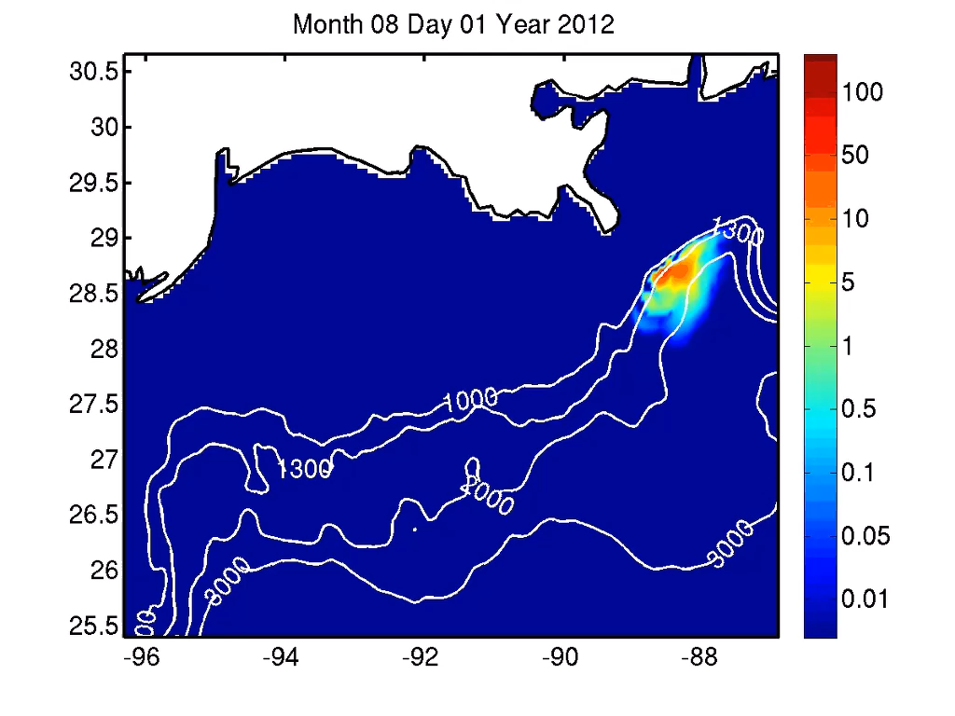
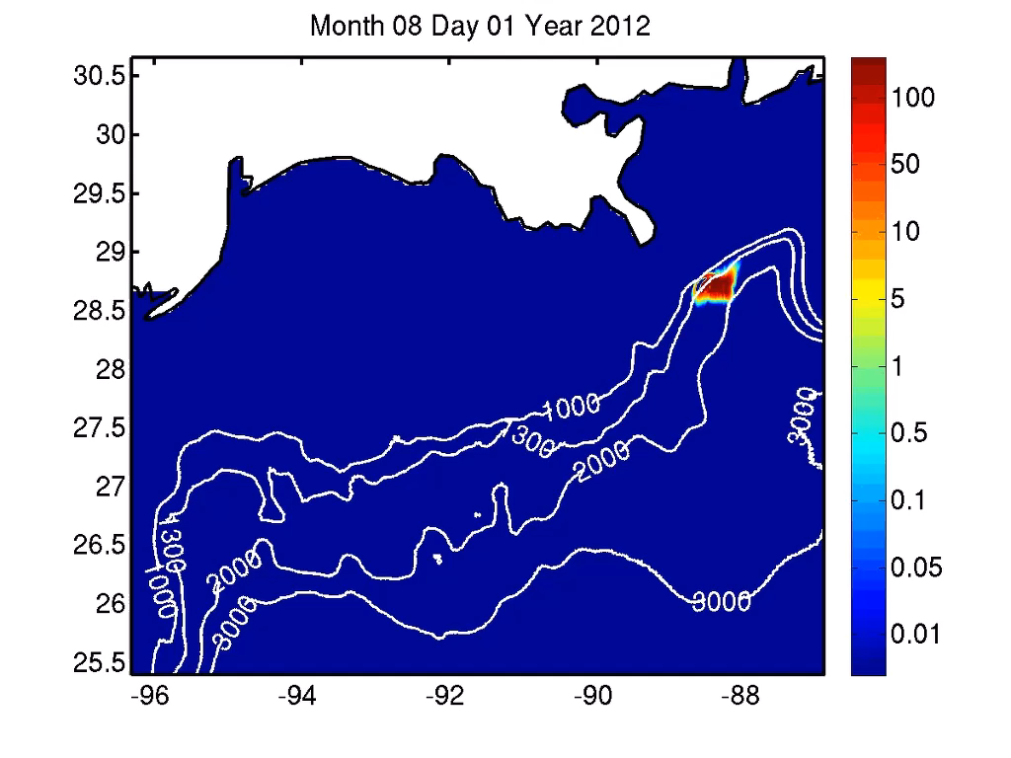
Tracer Evolution
Tracers released on Jul. 28 2012, close to Macondo Blowout site, advected for 4 months
LR
HR

Slide 13
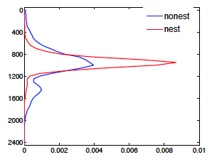
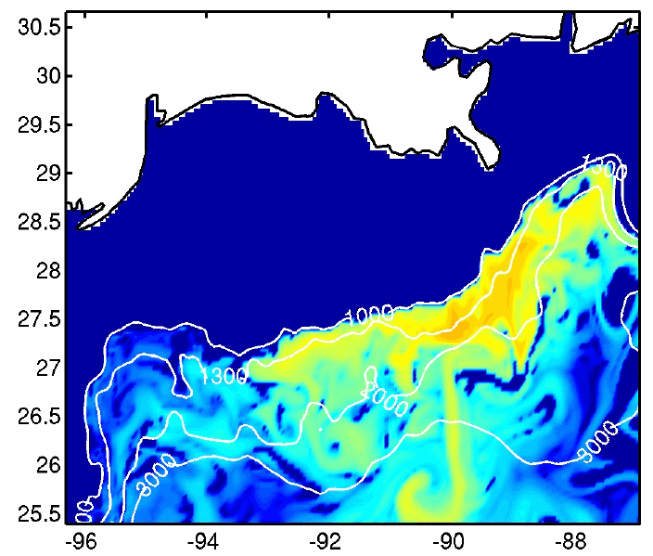
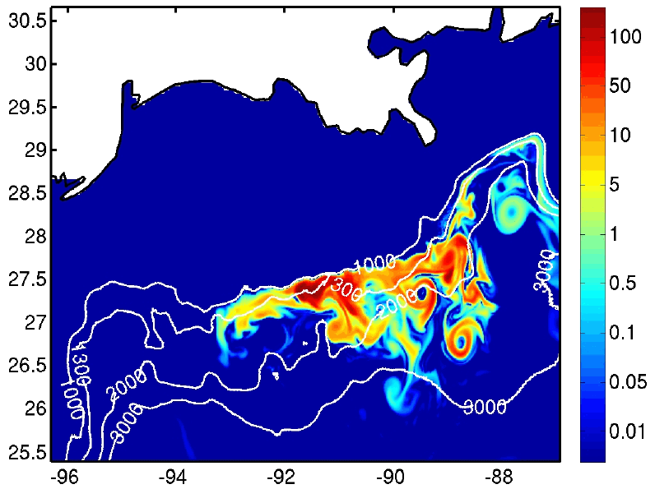
Tracer vertical distribution
5km
1.6km
LR tracer diffuses more both horizontally and vertically
HR traps tracer in submesoscale structures along the continental slope
LR
HR

Slide 14
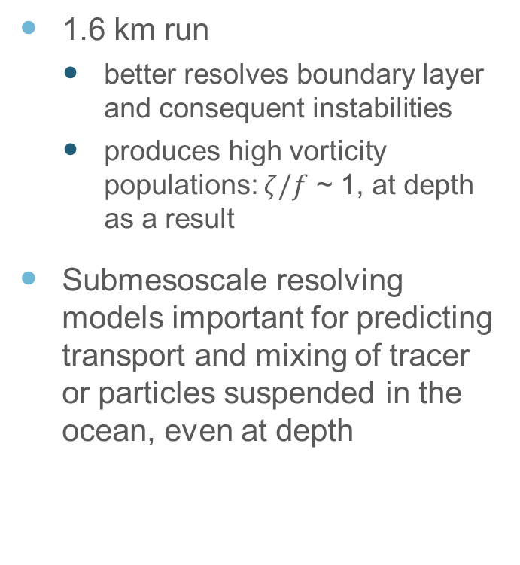
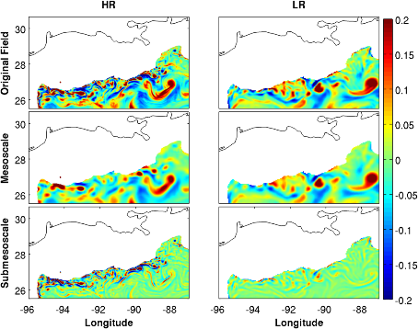
Summary
15-Sep-2011

