Slide 1

Researching business organizations Using survey Methods
AMIS Workshop, bucharest 2023
PROF. Karol Marek Klimczak (Lodz University of Technology)
Karol.Klimczak@p.lodz.pl

Slide 2

Agenda
Learning about organizations
Survey research designs
Problems and solutions
Examples

Slide 3
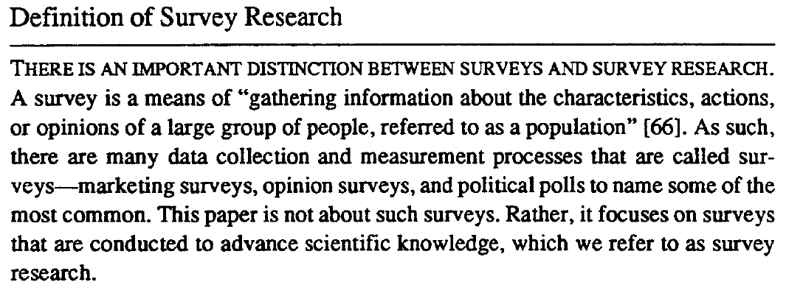
https://doi.org/10.1080/07421222.1993.11518001

Slide 4
Standardized information about subjects.
Structured, predefined questions – items.
A quantitative method, requiring advanced statistics.
Requires random sampling and 200+ responses.
Results can be generalized to the population

Slide 5
Example with solutions
Accessibility Survey Administered at Lodz University of Technology

Slide 6

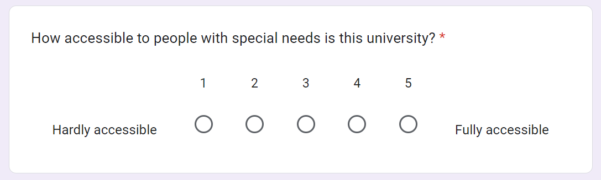
Would this count as a survey?

Slide 7
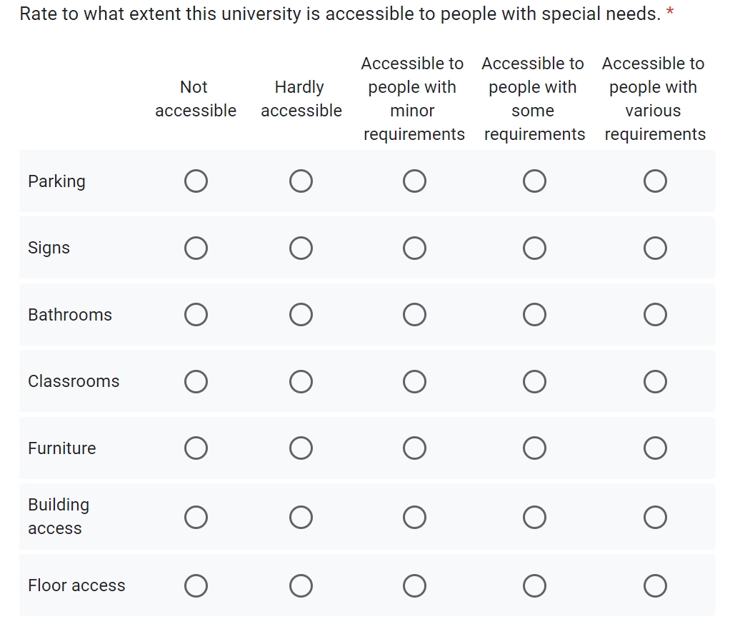
Items in Survey design

Slide 8
These 7 items generate 2 factors that explain 75% of total variance.
Only Factor 0 correlates with the overall rating at 0.72.
This means respondents may fail to consider:
Bathrooms
Signs
Parking

Slide 9
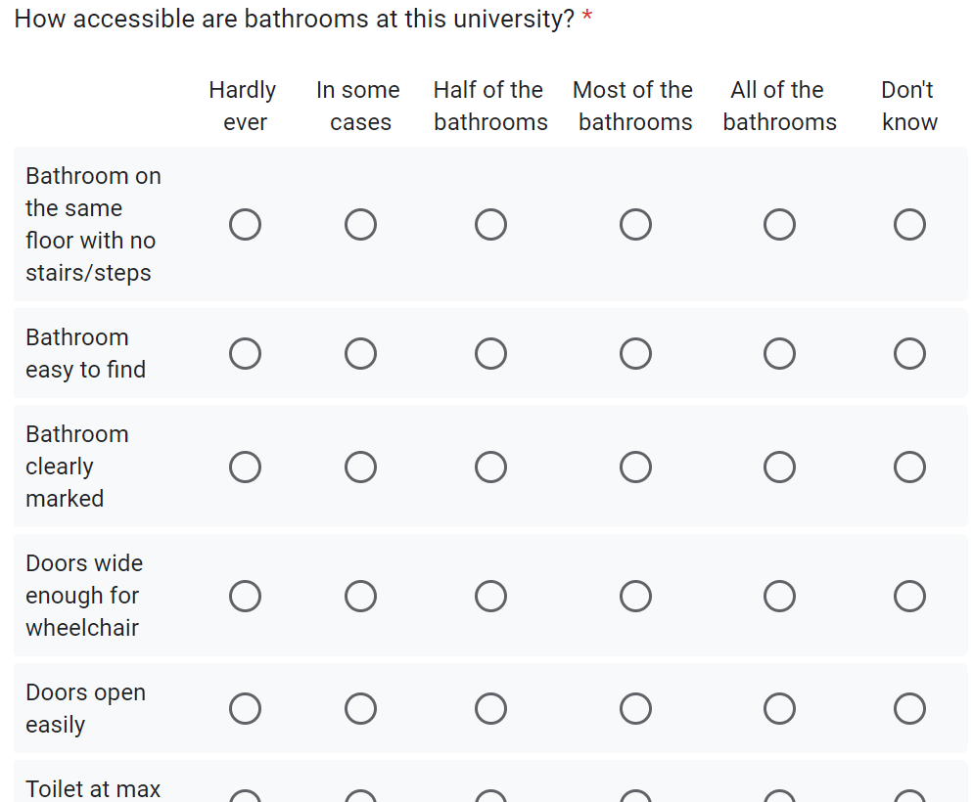
Let’s get more information about Bathrooms

Slide 10
These 12 items generate 3 factors that explain 86% of total variance.
We can validate these answers: Where the respondents knowledgeable?
Factor 1 seems like people marked the same answer everywhere.
Factor 2 seems a bit random.
Factor 3 is the closest to actual conditions.
Factor 1 and 3 correlate with the overall bathroom rating,
but correlation is low at 0.4.

Slide 11
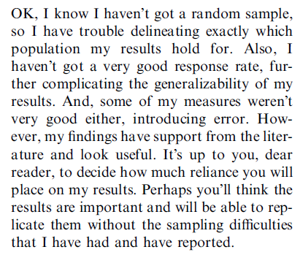
Typical Problems
A single respondent taken as representative of an entire organization.
Few studies look at variance between departments, groups, teams within.
Single data collection method used instead of a mix.
No consideration of time (i.e. responses can change over time).
Convenience sampling – whoever responded.
No control of ultimate respondent – cleaner? intern? the cat?
No control of bias: non-responses, common method etc.

Slide 12
Typical Problems
A single respondent taken as representative of an entire organization.
Few studies look at variance between departments, groups, teams within.
Single data collection method used instead of a mix.
No consideration of time (i.e. responses can change over time).
Convenience sampling – whoever responded.
No control of ultimate respondent – cleaner? intern? the cat?
No control of bias: non-responses, common method etc.
https://doi.org/10.1016/j.aos.2005.01.003

Slide 13
Example of my Own work
Company-level research on risk perceptions
Note how the various issues are addressed

Slide 14
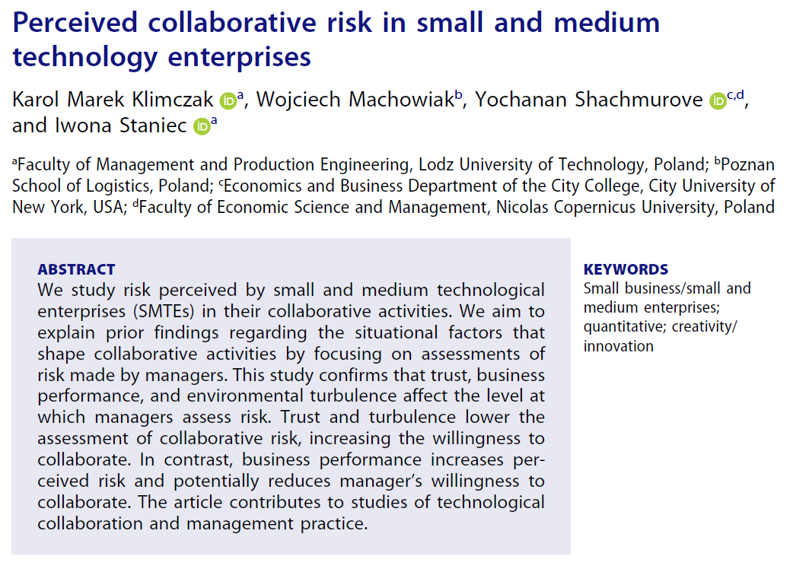
https://doi.org/10.1080/00472778.2020.1799305

Slide 15
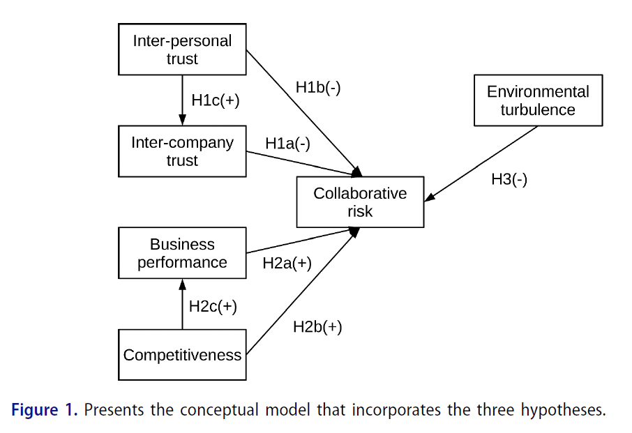

Slide 16
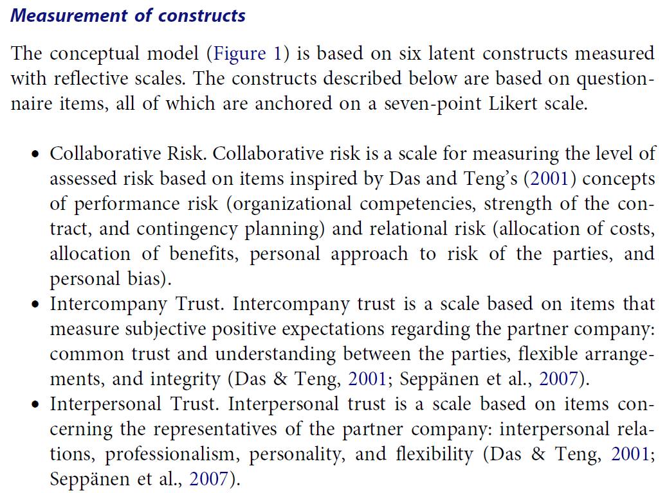

Slide 17
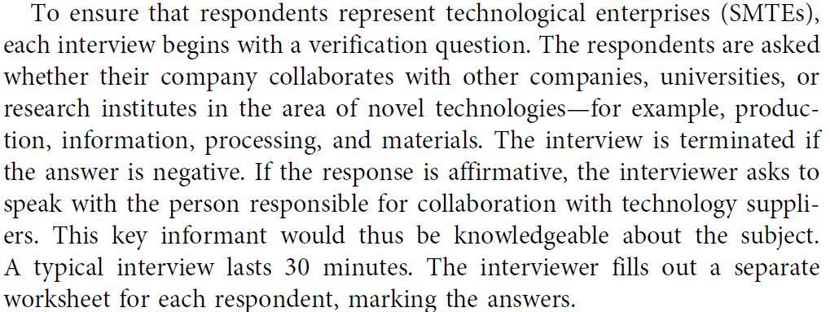
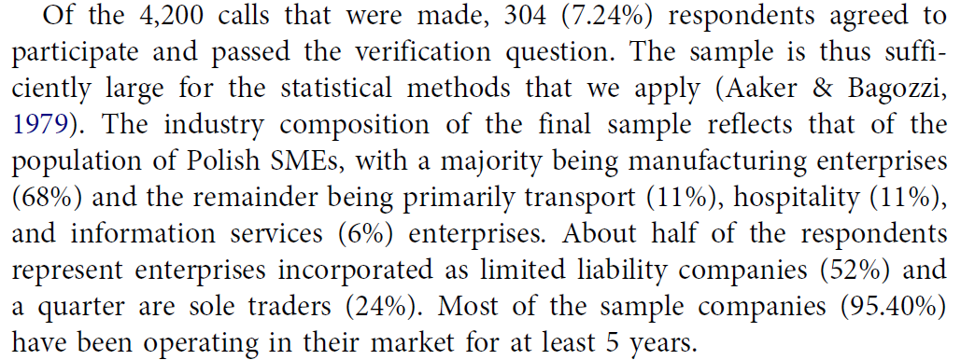
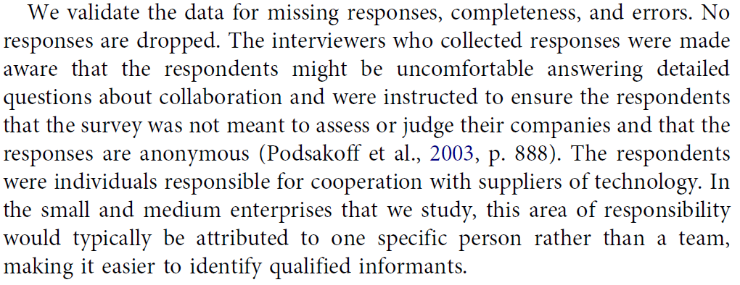

Slide 18
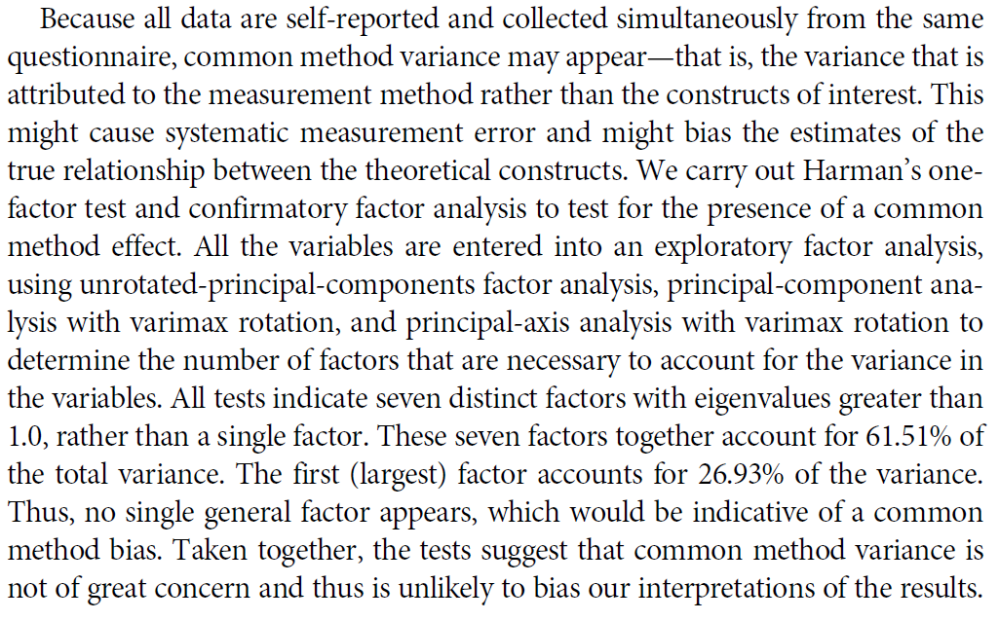




Slide 19
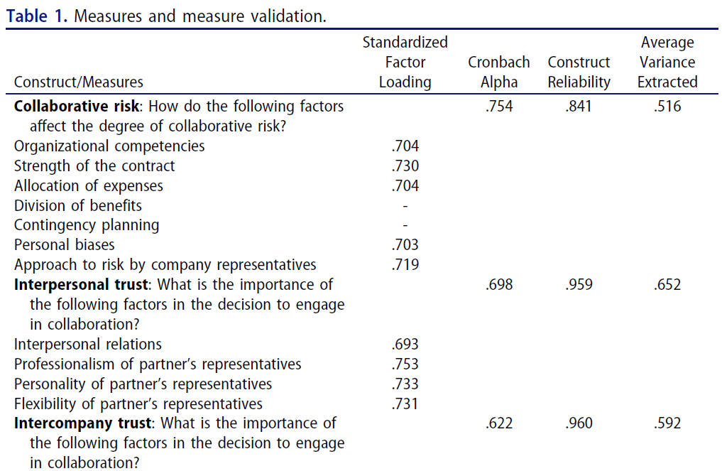

Slide 20
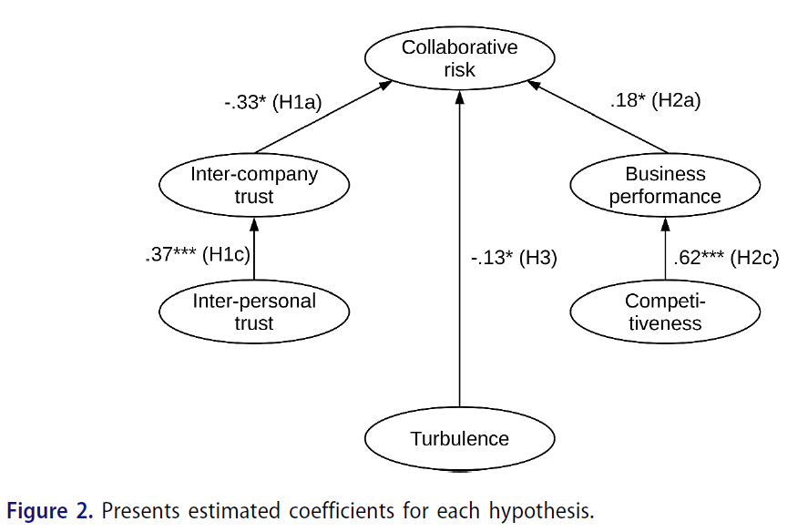

Slide 21
Example of a recent paper on Big data Use
Note how the author plays with who the ultimate respondets were
See how survey data can be recycled in several stories / Papers

Slide 22
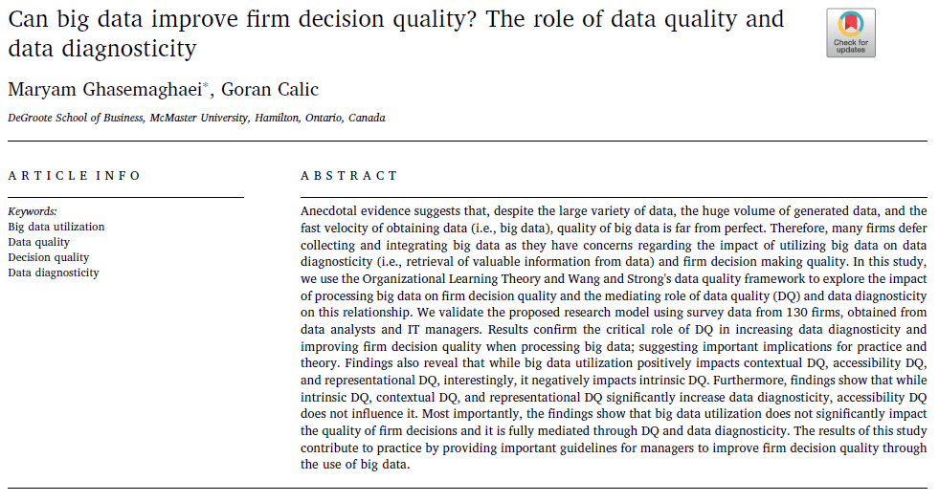




https://doi.org/10.1016/j.dss.2019.03.008

Slide 23
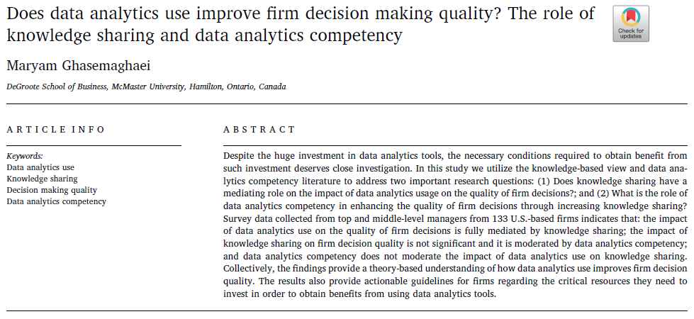

https://doi.org/10.1016/j.dss.2019.03.004

Slide 24
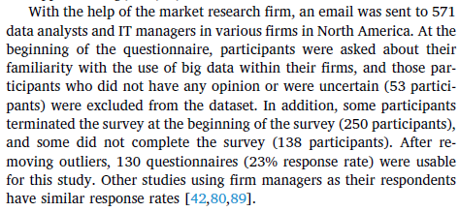
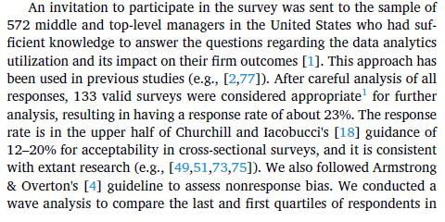
Respondents?

Slide 26
Readings
Van der Stede, W. A., Young, S. M., & Chen, C. X. (2005). Assessing the quality of evidence in empirical management accounting research: The case of survey studies. Accounting, Organizations and Society, 30(7–8), 655–684. https://doi.org/10.1016/j.aos.2005.01.003
Klimczak, K. M., Machowiak, W., Shachmurove, Y., & Staniec, I. (2020). Perceived collaborative risk in small and medium technology enterprises. Journal of Small Business Management, 61(2), 540–559. https://doi.org/10.1080/00472778.2020.1799305
Pinsonneault, A., & Kraemer, K. (1993). Survey Research Methodology in Management Information Systems: An Assessment. Journal of Management Information Systems, 10(2), 75–105. https://doi.org/10.1080/07421222.1993.11518001

