Slide 1

COMPE 101
Introduction to Computers
and
Programming
Murat KARAKAYA
Department of Computer Engineering

Slide 2
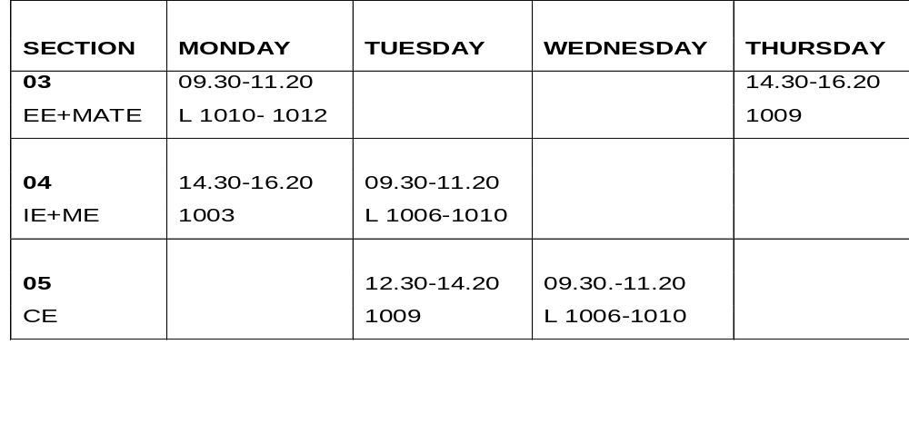
COMPE 101
  Instructor : Murat KARAKAYA
  Email : kmkarakaya@atilim.edu.tr
  TA : TBD
  Email : ......@atilim.edu.tr
  Office : Z09
  Lecture Hours:
  Course Web page: http://e.atilim.edu.tr/

Slide 3
Text Books and References
  Timothy J. O’Leary, Linda I. O’Leary, “Computing Essentials 2008”, McGraw-Hill, 2008.
  Jeri R. Hanly, Elliot B. Koffman, “Problem Solving and Program Design in C”, Addison Wesley, 5th Edition, 2007.
  Ali Yazıcı, Çiğdem Turhan, Fügen Selbes, “C Programming: Problem Book”, Atılım University, Department of Computer Engineering, 2004.

Slide 4
Grading
  Midterm 1 20 % November, 1st Thursday
  Midterm 2 20 %
  Lab (Midterm + Final) 20 %
  Final Exam 35 %
  Attendancy * 5%
* If you miss 4 or more classes you will get NA grade!
Notes:
Öğrencilerin derslere en az %70, uygulamalara ise %80 oranında devamı
zorunludur. Disiplin cezası ile uzaklaştırma dahil hangi gerekçe ile olursa olsun devam
zorunluluğunu yerine getirmeyen öğrenciler dönem sonu sınavına girme hakkını kaybeder. Bu
durumdaki öğrencilere (NA) notu verilir.

Slide 5
Grading Policies
  Policy on missed midterm:
    no make-up exam
  Lateness policy:
    Late assignments are penalized up to 10% per day.
  All assignments are to be your own work.
  On the final grade instructor has 10% judgement right.

Slide 6
Goals
Provide students with the basis of information systems
Gain experience in
  basic applications software,
  Internet
  basic programming.

Slide 7
Objectives
1. To learn computer types and information systems
2. To learn computer software and hardware.
3. To learn how to use word processor, spreadsheet and presentation software
4. To learn basics of internet, browsers , TCP/IP, telnet, ftp
5. To learn basic programming concepts

Slide 8
Course Outline
1. Introduction to Computer Systems (2 weeks)
2. Computer Software (2 weeks)
3. Computer Hardware (1 week)
4. Secondary Storage (1 week)
5. Input/Output (1week)
6. Networks (1 week)
7. Internet (1 week)
8. Introduction to Programming (5 weeks)

Slide 9
Labs
Weekly laboratory sessions (2 hours/week) will be held under the supervision of the instructor and the lab assistant.
Students will use Office applications and Internet and get hands-on experience through laboratory assignments.
Labs will begin after the 3rd week.
  If you can pass qualification exam for MS Office suit (grade>= 70) you would be exempted from labs (but still you have to attend the classes) until C Programming Language topic gets started.

Slide 10
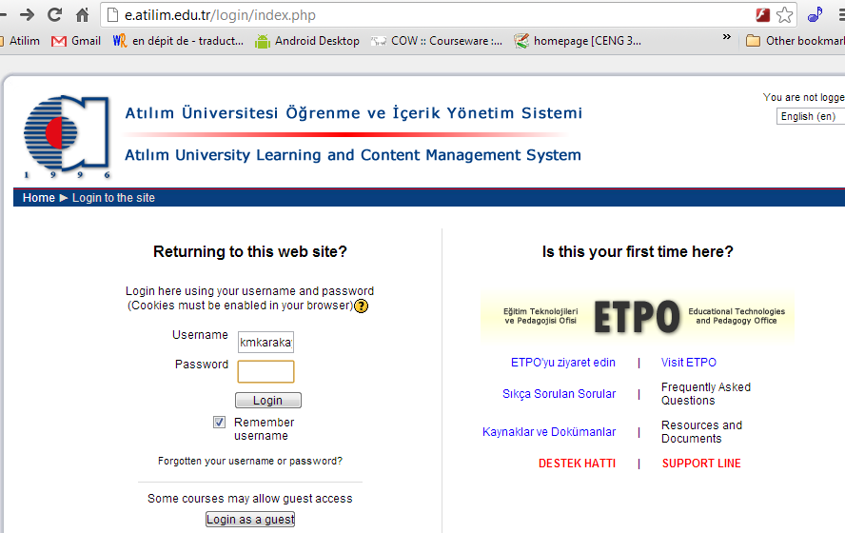
Course Web Site

Slide 11
  Any Questions or Comments
  are
  Welcomed.

