Slide 1
PROJECT
SOCIAL MEDIA ANALYSIS

Slide 2
INTROUCTION
Hii I am Kavita I have done The "Social Media Analysis Using SQL" project provides a solid foundation for understanding and analyzing social media data. By utilizing SQL, we can efficiently manage and query large datasets to uncover valuable insights. This project not only demonstrates the power of SQL in data analysis but also highlights the potential of data-driven decision-making in enhancing social media platforms.
Linked Profile- https://www.linkedin.com/in/kavita-singh-465498282
Github Profile-https://github.com/Kavitkashingh

Slide 3
INTROUCTION PROJECT
Social Media Analysis, I we'll create a Social Media Analysis System using SQL. This system will include tables for Users, Posts, Comments, Likes, and Followers. Below is a sample dataset and the SQL queries to create and populate these tables, along with beginner, intermediate, and advanced level queries.

Slide 4
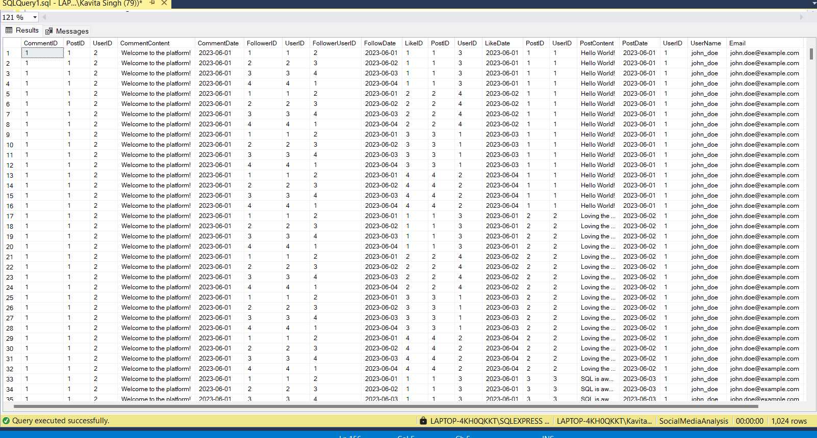
Data Set All Table

Slide 5

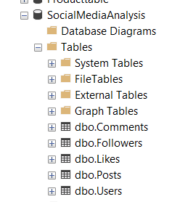
Create a Database Social Media Analysis

Slide 6
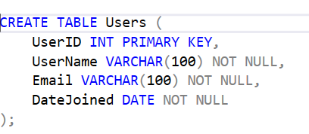
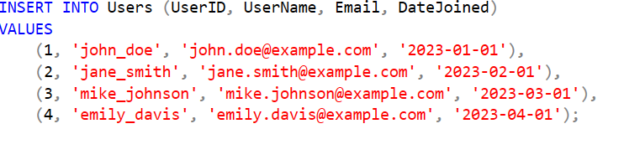
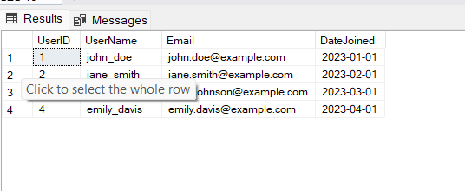
Create A User Table and Insert Data

Slide 7
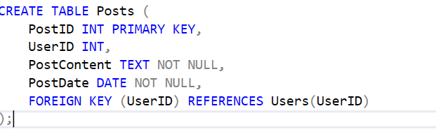
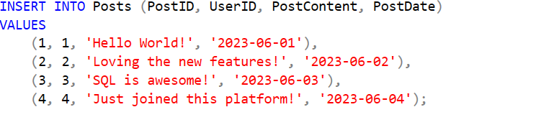
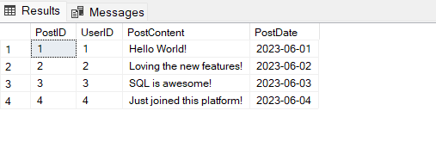
Create A Post Table and Insert Data

Slide 8
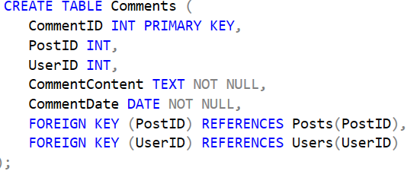
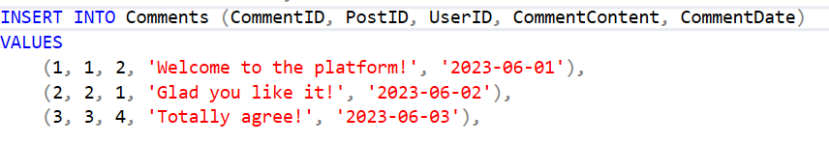
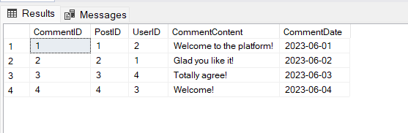
Create A Comment Table and Insert Data

Slide 9
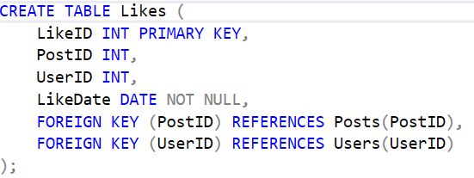
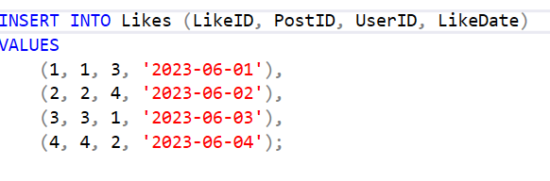
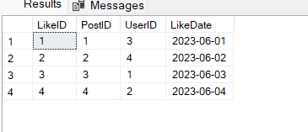
Create A Like Table and Insert Data

Slide 10
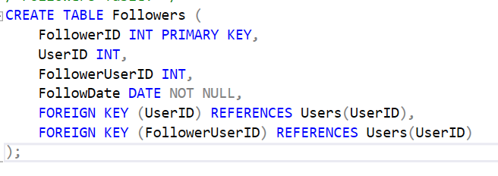
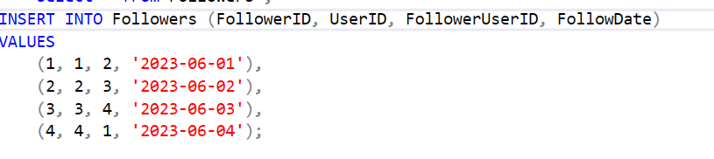
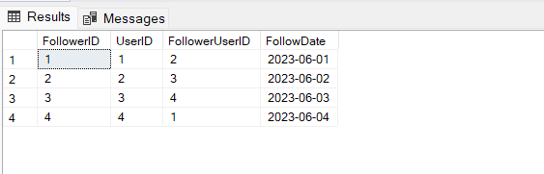
Create A Followers Table and Insert Data

Slide 11

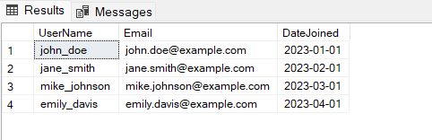
Retrieve all Users:

Slide 12

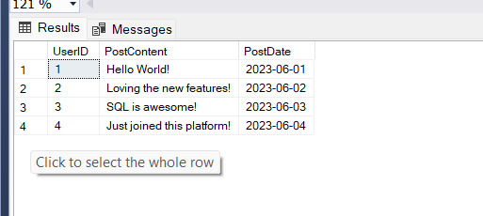
Get all Posts and their Content

Slide 13

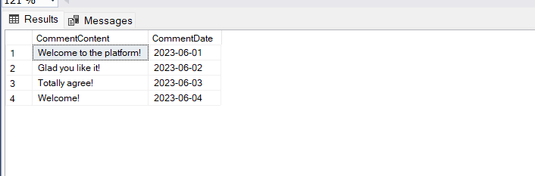
List all Comments

Slide 14
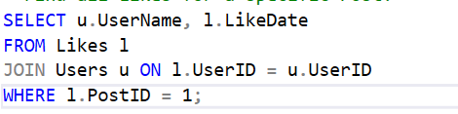
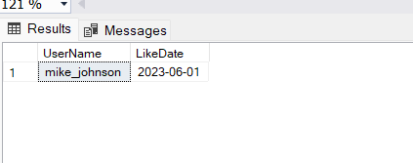
Find all Likes for a specific Post:

Slide 15
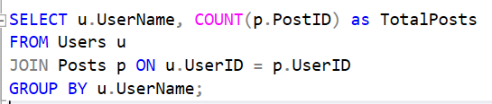
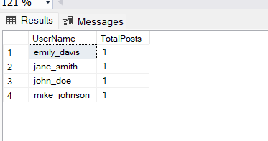
Calculate the Total Number of Posts by each User:

Slide 16
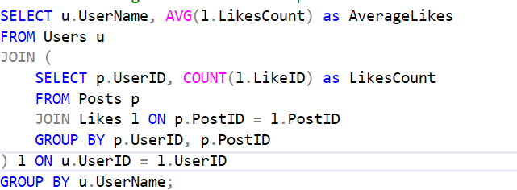
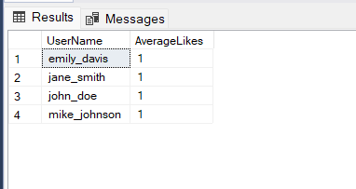
Get the average number of Likes per Post for each User

Slide 17
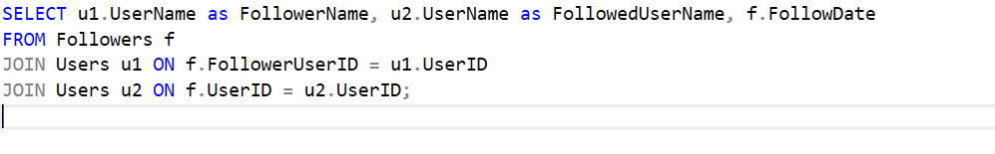
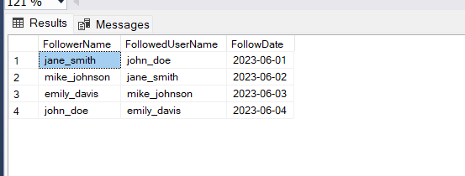
Retrieve detailed information about Followers including Follower Name, Followed User Name, and Follow Date:

Slide 18
THANK YOU

