Slide 1





Blockchain Technology
Understanding Distributed Ledger Systems
Course:
Advanced Computer Science / Cryptography
Learning Objective:
Understand blockchain fundamentals, mechanics, and applications
Instructor:
Dr. Mohammed Tawfik
Duration:
Key Question:
60 minutes (Lecture + Interactive Demo)
"How can we create trust in a trustless digital environment?"
Ajloun National University
Dr. Mohammed Tawfik
Slide 1

Slide 2

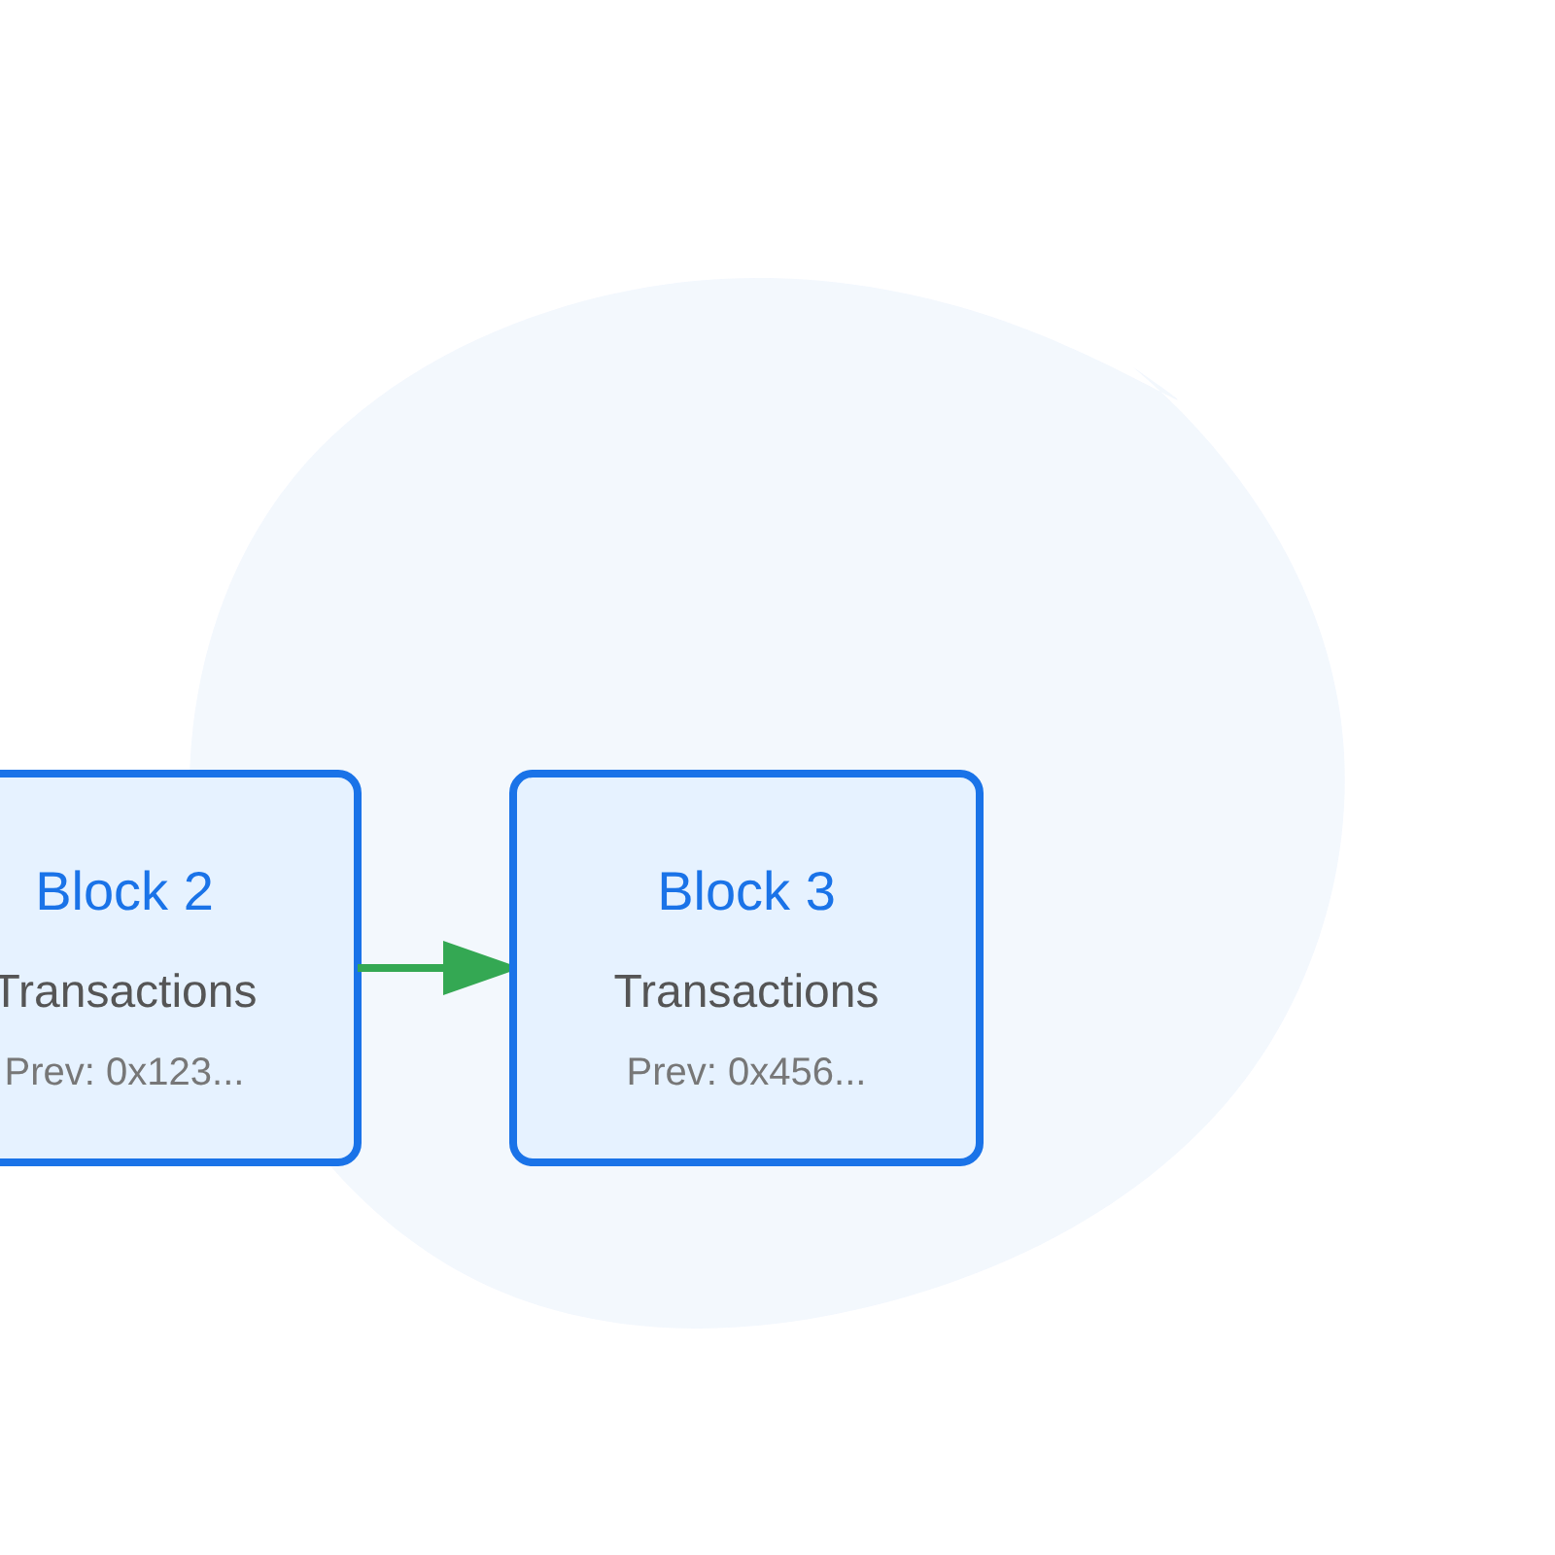
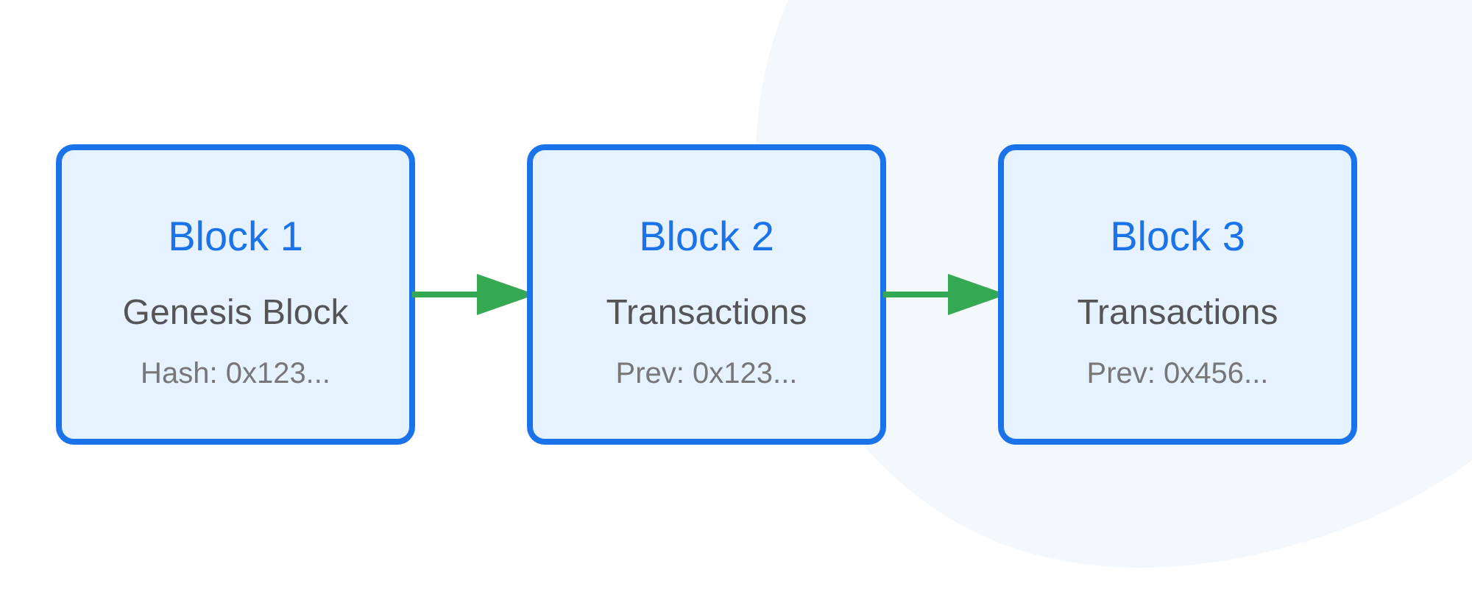

What is Blockchain?
Main Definition:
"A distributed, immutable ledger that maintains a continuously growing list of records (blocks) linked using cryptography"
Key Properties:
Distributed
No central authority or single point of failure
Analogy:
Immutable
"Imagine a notebook that's photocopied to thousands of people. To change one page, you'd need to convince the majority to agree to the change."
Records cannot be altered once confirmed
Transparent
All transactions visible to network participants
Cryptographically Secured
Traditional Database vs Blockchain
Uses hash functions and digital signatures
Traditional Database
Centralized control
Blockchain
Distributed control
Traditional Database
Single point of failure
Blockchain
Redundant and resilient
Dr. Mohammed Tawfik
Slide 2

Slide 3

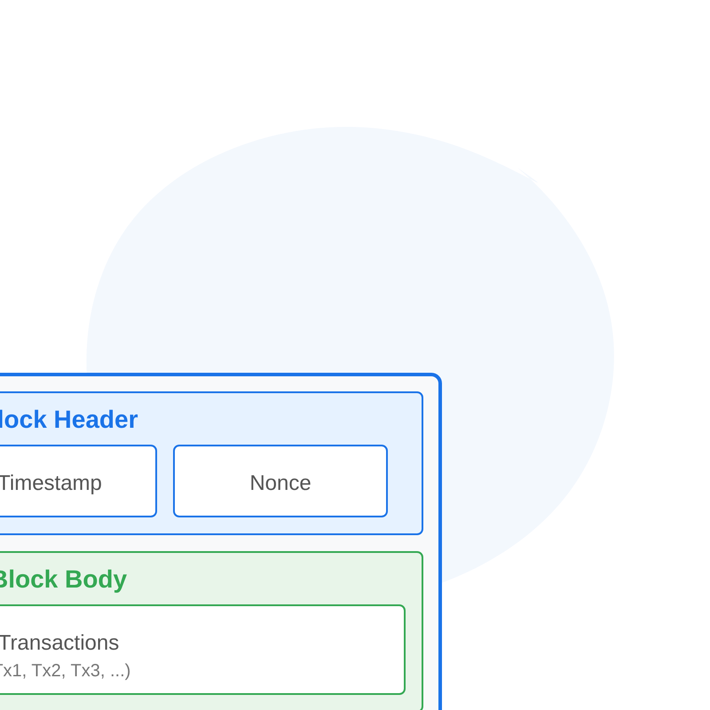

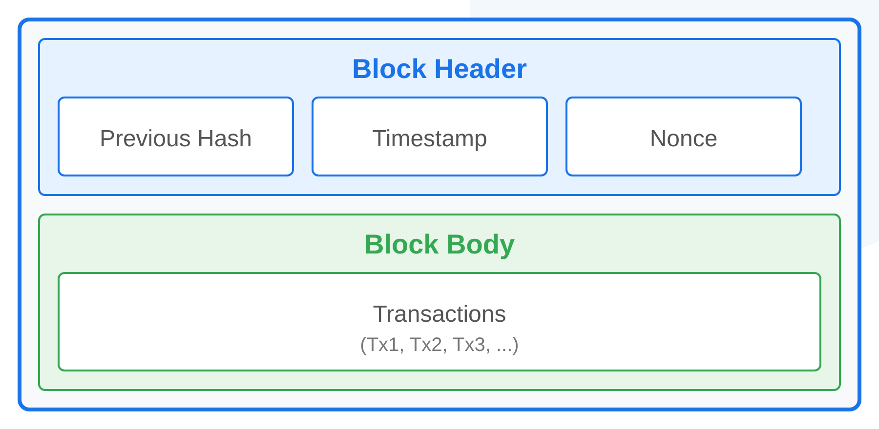






Core Components & Architecture
Essential Elements:
Block Anatomy
Blocks
Containers holding transaction data
Hash Functions
Cryptographic fingerprints ensuring data integrity
Digital Signatures
Proof of transaction authorization
Merkle Trees
Technical Details:
Efficient transaction organization
Block Structure:
Header (previous hash, timestamp, nonce) + Body (transactions)
Consensus Mechanisms
Cryptographic Linking:
Each block references the previous block's hash
Network agreement protocols
Network Nodes:
Full nodes, light nodes, and mining nodes
Peer-to-Peer Network
Network Topology Illustration
Decentralized node communication
Dr. Mohammed Tawfik
Slide 3

Slide 4

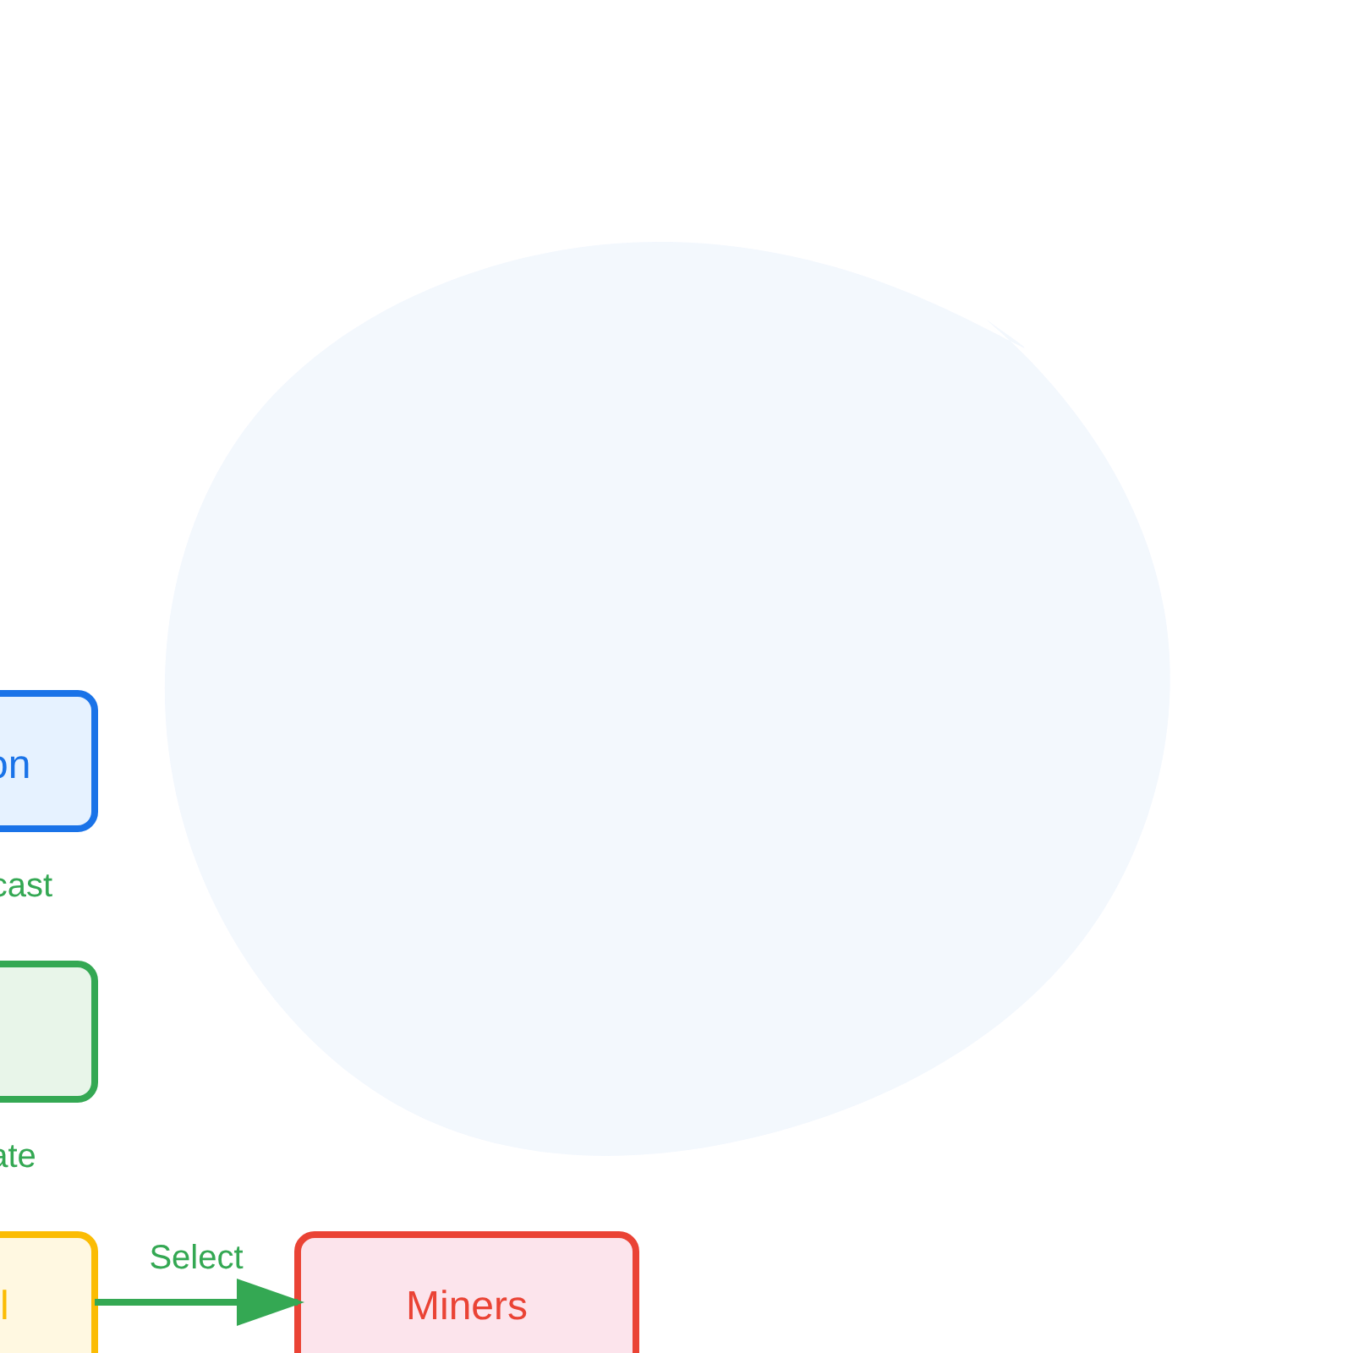
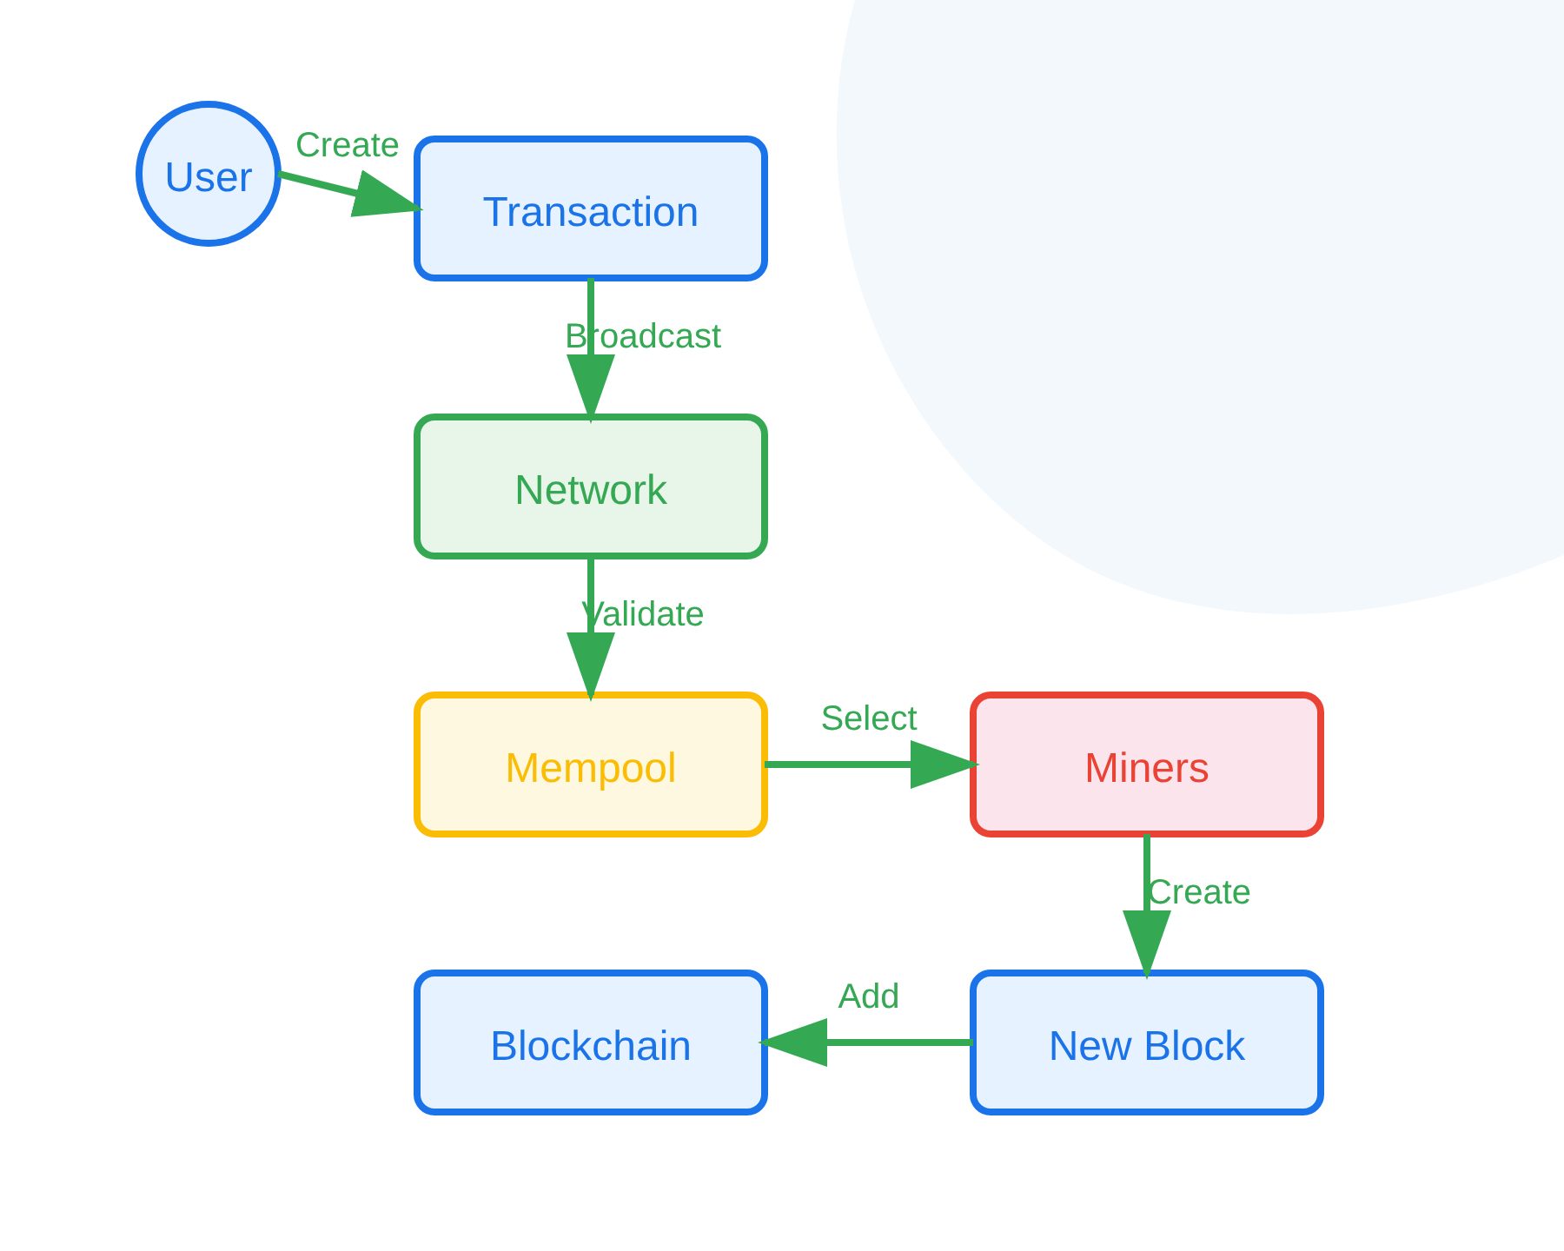




How Blockchain Works - Transaction Lifecycle
1
Initiation
User creates and signs a transaction
2
Broadcasting
Transaction sent to network nodes
3
Validation
Nodes verify digital signatures and balances
4
Pool
Valid transactions added to mempool
5
Mining
Miners compete to create new block
6
Consensus
Network validates the new block
7
Confirmation
Block added to chain, transaction complete
Key Mechanisms:
Transaction States Timeline:
Digital Signatures:
Public/private key cryptography
Hash Verification:
Ensuring data integrity
Network Propagation:
P2P message distribution
Created
Broadcast
Pending
Mined
Confirmed
Interactive visualization tool demonstration
Dr. Mohammed Tawfik
Slide 4

Slide 5














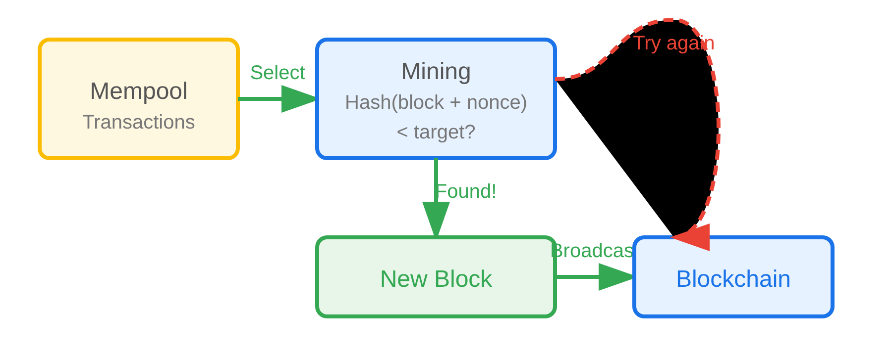
Mining & Consensus Mechanisms
Proof of Work (PoW)
Proof of Stake (PoS)
Concept:
Computational puzzle solving competition
Concept:
Validators chosen based on stake ownership
Process:
Miners search for nonce value to create valid hash
Process:
Random selection weighted by stake amount
Difficulty:
Network adjusts target based on block time
Energy:
Much lower energy consumption
Reward:
First solver gets block reward + transaction fees
Penalties:
Slashing for malicious behavior
Examples:
Bitcoin, Ethereum (legacy)
Examples:
Ethereum 2.0, Cardano
Mining Process:
Comparison:
Aspect
PoW
PoS
Energy Use
High
Low
Security
Battle-tested
Newer approach
Scalability
Limited
Better
Centralization Risk
Mining pools
Wealth concentration
Energy Consumption Graph
Dr. Mohammed Tawfik
Slide 5

Slide 6

























Types of Blockchain Networks
Public Blockchain
Private Blockchain
Access:
Open to everyone
Access:
Restricted to organization
Control:
Fully decentralized
Control:
Centrally managed
Examples:
Bitcoin, Ethereum
Examples:
Hyperledger Fabric
Use Cases:
Cryptocurrencies, DeFi, NFTs
Use Cases:
Enterprise databases, supply chain
Bitcoin
Ethereum
Hyperledger
Consortium Blockchain
Hybrid Blockchain
Access:
Semi-decentralized (group control)
Access:
Combination of public and private
Control:
Shared among consortium members
Control:
Selective transparency
Examples:
R3 Corda
Examples:
IBM Food Trust
Use Cases:
Banking consortiums, industry groups
Use Cases:
Supply chain with public verification
Banking Consortium
Supply Chain
Comparison
Public
Private
Consortium
Hybrid
Decentralization
High
Low
Medium
Medium-High
Performance
Lower
Higher
Higher
Medium
Dr. Mohammed Tawfik
Slide 6

Slide 7


















Real-World Applications & Use Cases
Financial Services
Supply Chain & Logistics
Cryptocurrencies
Product Traceability
Digital money (Bitcoin, Ethereum)
From origin to consumer
DeFi
Authentication
Decentralized finance protocols
Anti-counterfeiting measures
Cross-border Payments
Quality Assurance
Faster, cheaper international transfers
Immutable quality records
CBDCs
Central Bank Digital Currencies
Digital Identity & Healthcare
Emerging Applications
Identity Management
Voting Systems
Self-sovereign identity
Transparent, tamper-proof elections
Medical Records
Real Estate
Secure, portable patient data
Property ownership and transfer records
Credential Verification
IoT Integration
Academic certificates, professional licenses
Device authentication and data integrity
Market Adoption Statistics:
$2.3T
65%
48%
$19.9B
Total Market Cap
Enterprise Interest
Financial Sector Adoption
Investment (2023)
Dr. Mohammed Tawfik
Slide 7

Slide 8















Conclusion & Next Steps
Key Takeaways:
Interactive Blockchain Visualization Demo
1
Trust Without Authority
Blockchain enables trust in trustless environments
Demo Screenshot Placeholder
2
Cryptographic Security
Math-based security rather than institution-based
Create Transaction
Mine Block
Consensus
Parameters
3
Decentralization Benefits
Resistance to censorship and single points of failure
Access the web-based simulation tool
4
Trade-offs Exist
Create transactions and mine blocks
Scalability, energy consumption, and complexity challenges
Observe consensus mechanisms in action
Experiment with network parameters
5
Rapid Evolution
Technology continues to develop and improve
Next Steps
Future Considerations:
Assignment
Scalability Solutions:
Layer 2 solutions, sharding
Use visualization tool to create and mine 3 blocks
Interoperability:
Cross-chain communication protocols
Reading
Regulation:
Government policies and compliance frameworks
Assigned papers on consensus mechanisms
Environmental Impact:
Sustainable consensus mechanisms
Project
Design blockchain application for specific use case
QR Code
Dr. Mohammed Tawfik
Slide 8

Slide 9





Questions?
Thank you for your attention!
Contact Information
Email
kmkhol@gmail.com
Office Hours
Tuesdays & Thursdays, 2:00 PM - 4:00 PM
Course Website
www.anu.edu.jo
References and additional resources available on the course website
Dr. Mohammed Tawfik
Slide 9

