Slide 1
System Forensics, Investigation, and Response
Lesson 4
Collecting, Seizing, and Protecting Evidence

Slide 2
Learning Objective
Outline the proper approach to collecting, seizing, and protecting evidence.

Slide 3
Key Concepts
Proper forensic procedure
Evidence handling
Storage formats
Forensically imaging a drive
RAID acquisitions

Slide 4
Proper Procedure Overview
Shut down the computer.
Transport the computer to a secure location.
Prepare the system.
Document the hardware configuration of the system.
Mathematically authenticate data on all storage devices.

Slide 5
Shutting Down the Computer
Before you shut the computer down:
  Check for running processes
    In Windows, use Task Manager
  Take a picture of the screen for your records
  Check for live connections to the system:
    netstat
    net sessions
    open files (critical to run)
Notes:
Check to see what processes are running:
Press Ctrl+Alt+Delete keys at the same time.
Select Task Manager.
Select the Process tab.
Checking for live connections to the system in Linux and Windows:
netstat—Shows network statistics and any current connections. Look for external connections from outside the current network.
net sessions—Shows established network communications sessions, such as someone logging on to that system.
openfiles—Indicates whether there are any shared files or folders open and who has them open.
Run each of these commands and photograph the results before shutting down the machine. Also document that you ran them, the time, and the results. Then power down the machine.
Powering down the computer:
Simply pull the plug. Doing so interrupts normal operations. If there is some malware on the computer, it could delete files, clear the swap, or otherwise destroy evidence if the computer is powered down and then powered up normally.

Slide 6
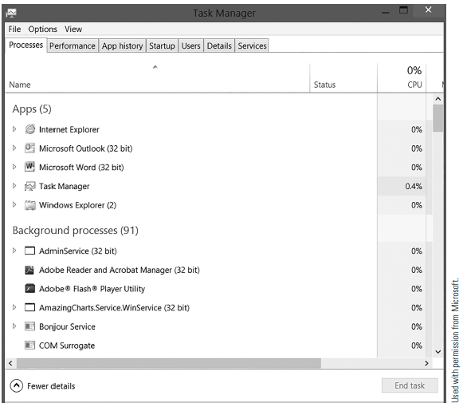
Task Manager Running Processes

Slide 7
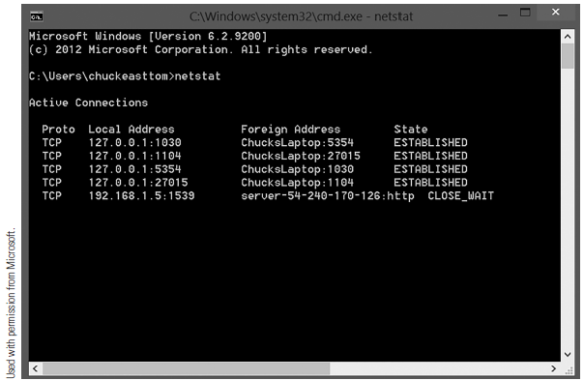
netstat Command
Notes:
The netstat command shows network statistics and any current connections.
Shows even meaningless connections, such as your computer opening a web browser.

Slide 8
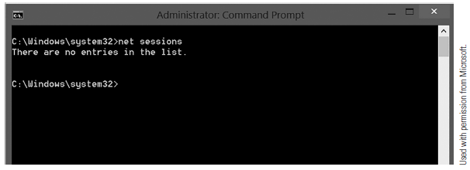
net sessions Command
Notes:
The net sessions command only shows established network communication sessions, such as someone logging on to that system.

Slide 9
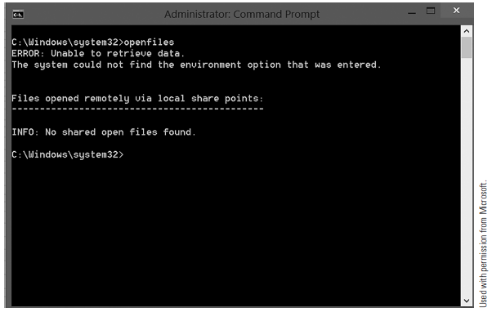
openfiles Command
Notes:
The openfiles command tells you if any shared files or folders are open and who has them open.

Slide 10
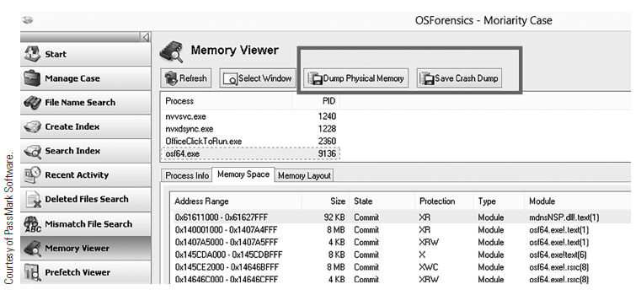
System Memory with OSForensics
Notes:
You can also capture system memory using OSForensics.

Slide 11
Transporting the Computer
Keep evidence in possession or control at all times
Document movement of evidence between investigators
Secure evidence appropriately so it can’t be tampered with or corrupted
Lock in a vehicle
Drive vehicle directly to lab
Notes:
You must have legal authority to seize and transport evidence.
A seized computer should be locked in a vehicle and the vehicle should be driven to the lab directly with no other stops along the way. The chain of custody must be maintained throughout transport.
Upon reaching the lab, the computer must be stored securely. If left unattended, the seized computer can be easily compromised. Evidence can be accidentally or purposely destroyed. Chain of custody must be maintained at all time to avoid accusations that evidence was planted on the suspect computer.

Slide 12
Preparing the System
For suspect computers:
  Remove the drive(s)
  Create an evidence form and/or a chain of custody form
For mobile devices:
  Remove SIM card, if necessary
  Some devices let you dock the phone examine it without removing SIM
Notes:
For computers, remove any drives even if they are not attached to any cabling and complete a chain of custody form. It is a good idea to photograph all drive connections, cable connections to the case, and general work area.
For cell phones, it may be necessary to remove the SIM card. However, some forensic devices allow you to dock the phone into the device and examine it without removing the SIM card.

Slide 13
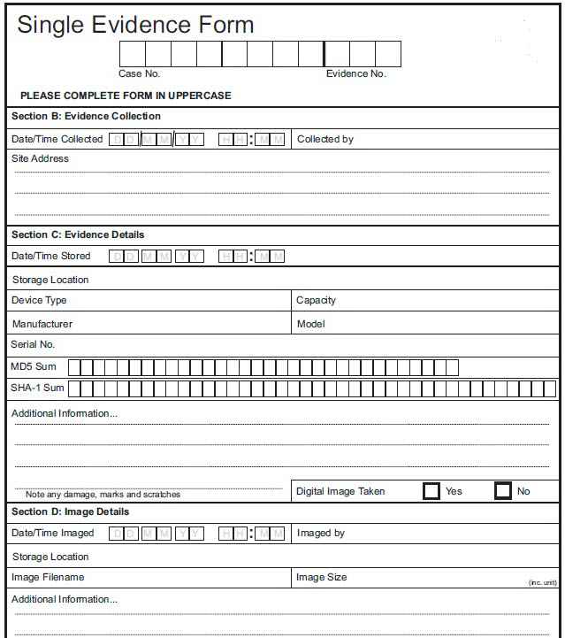
Evidence Form
© Jones & Bartlett Learning

Slide 14
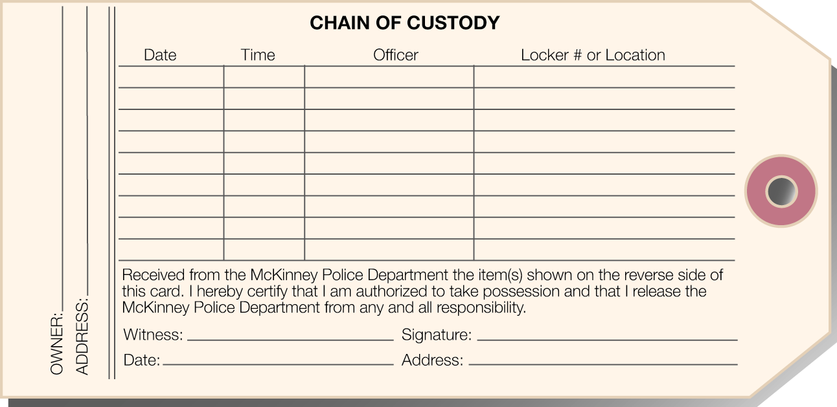
Chain of Custody Form
© Jones & Bartlett Learning

Slide 15
Documenting the Hardware Configuration of the System
Before dismantling the computer:
  Take pictures of computer from all angles
  Record BIOS system time and date in chain of custody form
After restoring power:
  Eject all removable media and fill out a separate chain of custody form for each
Notes:
Before dismantling the computer, take pictures from all angles to document the hardware components and how they are connected. Label each wire to make it easy to reconnect each one and restore the system to its original configuration.
Check the manufacturer’s website for information about how to access the BIOS information. Usually, this information is accessed during the initial boot screen by pressing Esc, Delete, and F2 (for some systems, it is F9, F10, or F11).
The BIOS time is important because it can significantly differ from the actual time and time zone set for the geographical area in which you are located.
If the BIOS time is different, note this and then adjust the times of any files you recover from the image to determine the actual time and date they were created, accessed, or modified.
After the power has been restored to the system, eject all media contained in drives that cannot be operated without power (such as CD-ROMs and DVD-ROMs) and remove them. Fill out a separate chain of custody form for each item removed.

Slide 16
Mathematically Authenticating Data on All Storage Devices
After imaging drive, create a hash of the original and the copy
Compare the hashes
If they don't match exactly, something was altered
Document hashing algorithm used and results
Notes:
Linux has built-in hashing tools. In addition, EnCase and Forensic Toolkit will hash the suspect drive after it has been imaged to check for copy errors.

Slide 17
Handling Evidence
Digital forensics specialist is responsible for finding, preserving, and preparing evidence
The specialist must:
  Collect data
  Document filenames, dates, and times
  Identify any file, program, and storage anomalies
  Gather evidence

Slide 18
Collecting Data
Three primary types of data that a forensic investigator must collect, in this order:
  Volatile data
  Temporary data
  Persistent data
Notes:
Collect volatile data first:
Swap file: The swap file is used to optimize the use of random access memory (RAM). Data is frequently found in the swap file. The details on how to extract data from the swap file vary depending on the installed operating system.
State of network connections: This data is captured before the system is shut down.
State of running processes: This data is captured before the system is shut down.
After collecting volatile data, collect temporary data—data that an operating system creates and overwrites without the computer user taking a direct action to save this data.
Then collect persistent data.

Slide 19
Documenting Filenames, Dates, and Times
Filenames, creation dates, and last modified dates and times can be relevant as evidence
Catalog all allocated and “erased” files
Sort files based on filename, file size, file content, creation date, and last modified date and time
Sorting provides a timeline of computer usage

Slide 20
Identifying File, Program, and Storage Anomalies
Text search programs can’t identify text data stored in binary format
  They require manual evaluation
Evaluate hidden partitions for evidence and document their existence
In Windows, also evaluate files in the Recycle Bin
Notes:
If you find relevant files, thoroughly document the issues involved. Those issues can include the following:
• How did you find the files?
• What condition were they in (i.e., did you recover the entire file or just part of the file)?
• When was the file originally saved?
Remember that the more information you document about evidence, the better.

Slide 21
Evidence-Gathering Measures
Avoid changing evidence
Determine when evidence was created
Search throughout a device
Determine information about encrypted and steganized files
Present evidence well
Notes:
Forensic specialists should take the following measures when gathering evidence:
Avoid changing the evidence—Forensic specialists should:
Photograph equipment in place before removing it
Label wires and sockets so computers and peripherals can be reassembled in a laboratory exactly as they were in the original location
Transport computers, peripherals, and media carefully to avoid heat damage or jostling
Avoid touching original computer hard disks and CDs
Make exact bit-by-bit copies and store the copies on a medium that cannot be altered, such as a CD-ROM
Determine when evidence was created—Forensic specialists should not trust a computer’s internal clock or activity logs. Before logs disappear, an investigator should capture:
The time a document was created
The last time it was opened
The last time it was changed
Trust only physical evidence—The physical level of magnetic materials is where the 1s and 0s of data are recorded. In system forensics, only this physical level is
real. A forensic specialist should consider everything else untrustworthy.
Search throughout a device—Forensic specialists must search at the bit level across a wide range of areas inside a computer, including:
Email and temporary files in the operating system and in databases
Swap files that hold data temporarily, logical file structures, and slack and free space on the hard drive
Software settings and script files that perform preset activities
Web browser data caches, bookmarks and history, and session logs that record patterns of usage
Present the evidence well—Forensic examiners must present computer evidence in a logical, compelling, and persuasive manner. The evidence should be solid enough that a defense counsel cannot rebut it. A forensic specialist must create a step-by-step reconstruction of actions, with documented dates and times. The specialist’s testimony must explain simply and clearly what a suspect did or did not do.

Slide 22
Physical and Logical Analysis
Physical Analysis
Logical Analysis
URLs
Email addresses
File formats
Damaged sectors
Data outside partitions
Partitions
File metadata
Context of data
File paths
File residue
Ambient data
Notes:
Physical analysis is offline analysis conducted on an evidence disk or forensic duplicate after booting from a CD or another system.
Logical analysis involves using the native operating system, on the evidence disk or a forensic duplicate, to peruse the data.
Put another way, physical analysis is looking for things that may have been overlooked, or are invisible, to the user. Logical analysis is looking for things that are visible, known about, and possibly controlled by the user.

Slide 23
Creating a Timeline
To reconstruct events that led to corruption of a system, create a timeline
Challenges with computers:
  Clock drift
  Delayed reporting
  Different time zones
Never change clock on a suspect system
Record clock drift and time zone in use

Slide 24
Storage Formats
Magnetic media
Solid-state drives
Digital audio tape (DAT) drives
Notes:
Magnetic media
Hard drives and floppy drives
Data is stored magnetically; drives are susceptible to magnetic interference
If drive is demagnetized, there is no way to recover data
Transport suspect drives in special transit bags that reduce electrostatic interference to decrease the chance of inadvertent loss of data
Magnetic drives have moving parts
Solid-state drives (SSDs)
Use microchips that retain data in non-volatile memory chips
Contain no moving parts
Drives are usually less susceptible to physical damage than magnetic drives
If internal, SSDs can use same interfaces as magnetic drives, including SCSI and SATA
If external, it is most common for them to have a universal serial bus (USB) connection
Digital audio tape (DAT) drives
Are among most common type of tape drives
Use 4-mm magnetic tape enclosed in a protective plastic shell
Tapes wear out just like audio tapes
Will most likely contain archived/backup data that you need to analyze
Forensically wipe target drive first so you can be sure that there is no residual data on that drive
Ten restore it to target hard drive (magnetic or solid state) in order to analyze it

Slide 25
Storage Formats (cont.)
Digital linear tape (DLT) and super DLT
Optical media
Universal serial bus (USB)
Notes:
DLT
Another type of magnetic tape storage
Relies on a linear recording method
Tape as either 128 or 208 total tracks
Used primarily to store archived data
Optical media
CD-ROMs use high and low polarization to set the bits of data; however, CDs have reflective pits that represent the low bit
If pit is nonexistent, data is a 1; if pit exists, it’s a 0
Laser mechanism detects the distance the light beam has traveled in order to detect the presence or absence of a pit; this is why scratches can be problematic for optical media
DVDs and Blu-ray discs are enhancements to original compact discs
Still utilize same optical process but have larger capacity
Should be forensically copied to a clean, forensically wiped drive for analysis
USB
Is actually a connectivity technology, not a storage technology
Can be used to connect to external drives that can be either magnetic or solid state
Have no moving parts, which means these drives are resilient to shock damage
Thumb drives can be easily erased or overwritten.
Copy data from USB drive to a target forensic drive for analysis

Slide 26
Magnetic and Solid State Drives
Host protected area (HPA) or
vendor-specific drive space
Master boot record (MBR) where empty drive sectors remain
Volume slack
Unallocated space
Good blocks marked as bad
File slack
Notes:
Files stored on disk (archives, files, folders, etc.)
Host protected area (HPA) or vendor-specific drive space (recovery volumes, etc.)
Master boot record (MBR) where empty drive sectors remain
Boot sectors in non-bootable partitions

Slide 27
File Formats
Advanced Forensic Format (AFF)
EnCase
iXImager
Generic Forensic Zip (Gfzip)
Notes:
The Advanced Forensic Format (AFF)
An open file standard with three variations: AFF, AFM, and AFD
AFF variation stores all data and metadata in a single file
AFM variation stores data and metadata in separate files
AFD variation stores data and metadata in multiple small files
EnCase
A proprietary format defined by Guidance Software for use in its EnCase tool to store hard drive images and individual files
Includes a hash of the file to ensure nothing was changed when it was copied from the source
The Generic Forensic Zip (Gfzip)
Open-source file format used to store evidence from a forensic examination
iXImager
A proprietary file format used by the iLook tool
Tool was developed by the U.S. Internal Revenue Service (IRS) and is restricted to law enforcement and government use only

Slide 28
Forensic Imaging
An image is an exact bit-by-bit copy of a disk
Used for evidence collection without altering original
Notes:
Digital forensics specialists should work with an image of any suspect storage media whenever possible to avoid damaging or altering any evidence.

Slide 29
Imaging with dd and netcat
Forensically wipe the drive:
  dd if=/dev/zero of=/dev/hdb1 bs=2048
Use netcat to set up the forensic server to listen:
  # nc –l –p 8888 > evidence.dd
Use the dd command to read the first partition:
  # dd if=/dev/hda1 | nc 192.168.0.2 8888 –w 3
Notes:
Once you have acquired a physical storage medium of some type, you need to image it. You always work with an image whenever possible. It is possible to create a forensic image utilizing open-source tools, specifically Linux commands.
First, you must forensically wipe the target drive (which is the drive to which you will copy the suspect drive contents) to ensure there is no residual data left from a previous case. You can do this with the Linux dd command: dd if=/dev/zero of=/dev/hdb1 bs=2048
dd is a common UNIX program whose primary purpose is the low-level copying and conversion of raw data at the bit level. If you do your copy through the file system/operating system, then you can see only the data that the operating system sees. You won’t get deleted files or slack space, so a basic file system copy is inadequate for forensic analysis. You must get a bit-level copy, and the dd utility is perfect for that.
You also need to use netcat to set up the forensic server to listen, so you have another Kali Linux CD boot up the suspect drive to copy it to the forensic server. At this point, both the suspect drive and the target forensic server have been booted into Linux using Kali.
Netcat reads and writes bits over a network connection. The command to run on the forensic server is as follows: # nc –l –p 8888 > evidence.dd.
This sets up the listen process on the forensic server prior to sending the data from the subject’s computer. The process listens (the –l flag) on port 8888 (the –p 8888 command) and takes all input and writes to a file called evidence.dd. You can always use another port or another filename if necessary. You must ensure the target drive is at least as big as the suspect drive.
On the suspect computer, use the dd command to read the first partition: # dd if=/dev/hda1 | nc 192.168.0.2 8888 –w 3.
You then pipe the output of the dd command to netcat, which sends the bits over the network to the specified network address and port on the listening forensic computer. The argument –w 3 indicates that netcat should wait 3 seconds before closing the connection upon finding no more data. This assumes that the suspect partition is hda1, but it might be a different partition.

Slide 30
Imaging with EnCase
Makes bit-level images and then mounts them for analysis
Preview mode allows investigator to use a null modem cable or Ethernet connection to view data on the subject machine safely
Doesn't alter evidence

Slide 31
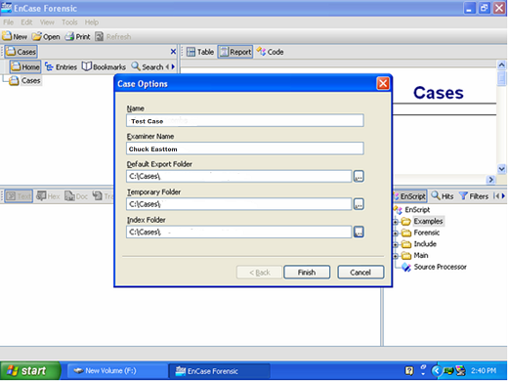
Imaging with EnCase
Courtesy of Guidance Software, Inc.
Notes:
Once you have the hard drive disconnected from the suspect machine, you can connect that drive to the forensic computer. In some cases, you first connect to a device that prevents writing to the suspect device. FastBlock and Tableau are two such devices that are widely used in forensics.
At the top of the EnCase window, click New on the toolbar to start the new case you will be working. The Case Options dialog box opens. Enter the case name and the examiner’s name. The text boxes are filled in automatically, but you have to click on the button on the right side next to each of the lower text boxes to select the paths. After selecting the paths, click the Finish button.

Slide 32
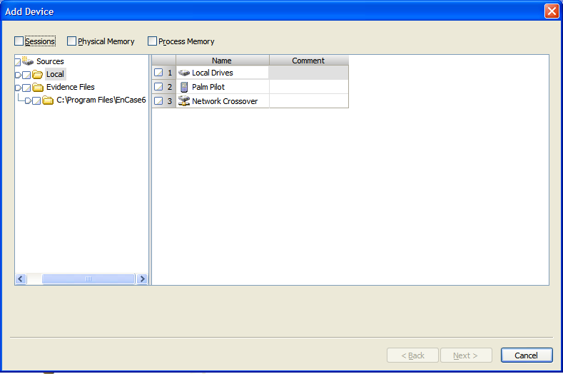
Imaging with EnCase
Courtesy of Guidance Software, Inc.
Notes:
After creating a case, save it by clicking the Save icon on the EnCase toolbar.
Select a path for the save location when prompted.
Now, you are ready to acquire evidence. On the EnCase toolbar, click the Add Device button. The Add Device window appears in EnCase, asking which device to add.
The left pane lists devices with subfolders, Local and Evidence Files. The right pane lists Local Drives, Palm Pilot, Parallel Port, and Network Crossover (note these options may be different on some systems). In this procedure, you check the Local Drives in the right pane.

Slide 33
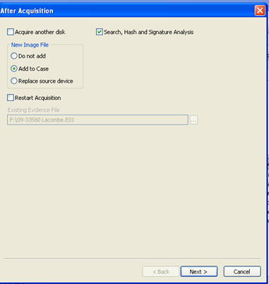
Imaging EnCase
Courtesy of Guidance Software, Inc.
Notes:
After EnCase reads the local drives, another window appears. Once you have added the device, it shows in the case.
Note that you can add multiple devices to a single case.

Slide 34
Imaging with Forensic Toolkit (FTK)
Takes snapshot of entire disk, makes bit-level copy for analysis
Inexpensive, easy to use, good all-in-one forensic tool
Offers Registry viewing, in-depth logging, standalone disk imaging, direct email and zip file analysis

Slide 35
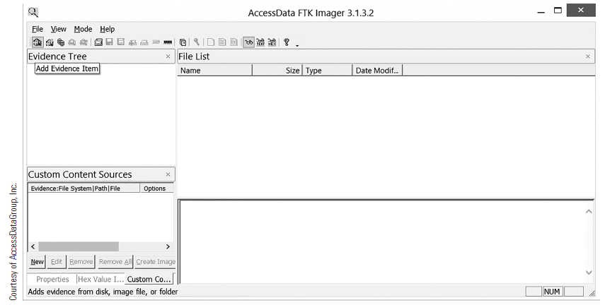
Imaging with FTK
Notes:
Once you have connected the suspect drive to the forensic machine, you simply have to add evidence. You now have to select specifically what you want to image. FTK offers a number of choices. The most common choice is a physical drive, but you can also add folders, logical drives, and even drive images, such as those made with the dd and netcat commander.

Slide 36
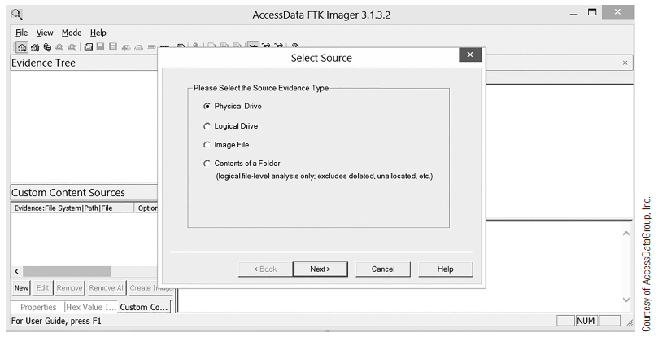
Imaging with FTK
Notes:
Select one of the Source Evidence Type options and then click the Next button.

Slide 37
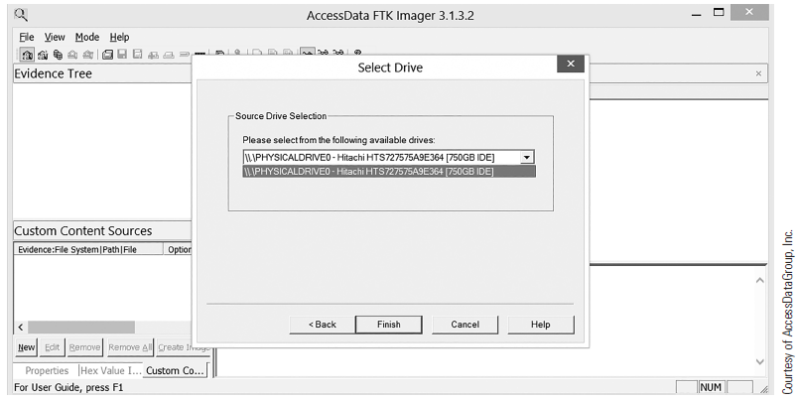
Imaging with FTK
Notes:
From the Select Drive drop-down, choose the specific drive you want to acquire and then click Finish. FTK mounts the drive and you can then see it in the evidence tree.

Slide 38
Imaging with OSForensics
Allows you to mount images created with other tools
Also allows you to create an image

Slide 39
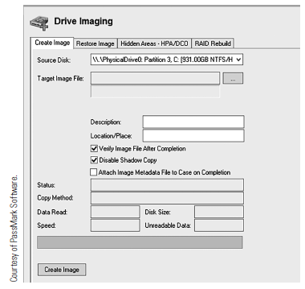
Imaging with OSForensics
Notes:
Select Drive Imaging from the main menu (not shown).
Select the source drive you wish to image, and the target where you want to put the image. Notice that Verify Image is checked by default. You should not uncheck this.
Start the process and an image of the source drive will be created and verified.

Slide 40
RAID Acquisitions
RAID 0, 1, 3, 4, 5, 6, 1+0
Can acquire RAID 1 disks separately
RAID 0, 3, 4, 5, and 6 use data striping across multiple disks
  Make a forensic image of the entire RAID array

Slide 41
Redundant Array of Independent Disks (RAID)
RAID 0
Distributes data across multiple disks
RAID 1
Mirrors disks
RAID 3 or 4
Combines three or more disks for fault tolerance
Includes parity
Improved data retrieval speed
Creates an identical copy of a drive
Notes:
RAID 0 (disk striping)—Distributes data across multiple disks in a way that improves data retrieval speed.
RAID 1—Mirrors the contents of the disks creating an identical copy of the drive running on the machine.
RAID 3 or 4 (striped disks with dedicated parity)—Combines three or more disks in a way that protects data against loss of any one disk. Fault tolerance is achieved by adding an extra disk to the array and dedicating it to storing parity information. The storage capacity of the array is reduced by one disk.

Slide 42
Redundant Array of Independent Disks (RAID)
RAID 5
Combines three or more disks
RAID 6
Combines four or more disks
Protects against loss of data on any two disks
Similar to RAID 3 but no parity
Notes:
RAID 5 (striped disks with distributed parity)—Combines three or more disks in a way that protects data against the loss of any one disk. It is similar to RAID 3, but the parity is not stored on one dedicated drive; instead, parity information is interspersed across the drive array. The storage capacity of the array is a function of the number of drives minus the space needed to store parity.
RAID 6 (striped disks with dual parity)—Combines four or more disks in a way that protects data against loss of any two disks.

Slide 43
Summary
Proper forensic procedure
Evidence handling
Storage formats
Forensically imaging a drive
RAID acquisitions

