Slide 1
System Forensics, Investigation, and Response
Lesson 2
Overview of Computer Crime

Slide 2
Learning Objective
Describe various computer crimes and how they are investigated.

Slide 3
Key Concepts
Common computer crimes
Forensic approaches to different crimes
Forensic strategies based on the specific crime

Slide 4
How Computer Crime Affects Forensics
Target
Instrument
Evidence Repository
Notes:
A computer or another device can play one of three roles in a computer crime:
• It can be the target of the crime.
• It can be the instrument of the crime.
• It can be an evidence repository that stores valuable information about the crime.

Slide 5
The Role of Computers in Crimes (Continued)
Instrument
Evidence Repository
Notes:
In some cases, a computer can have multiple roles. It can be the instrument of a crime and also serve as a file cabinet that stores critical evidence. For example, an attacker may use a computer as a tool to break into another computer and steal files. The attacker may then store the stolen files on the computer used to perpetrate the theft. When investigating a case, it is important that the investigator know what roles a computer played in the crime and then tailor the investigative process to those roles.

Slide 6
Types of Crimes Involving Computers
White-collar crimes
Violent crimes—murder, terrorism
Counterintelligence
Economic espionage
Counterfeiting
Child pornography
Drug dealing

Slide 7
Identity Theft
Use of another person’s identity
Typically performed for economic gain
Methods include phishing, spyware, and discarded information
Notes:
Identity theft is any use of another person’s identity. It is typically performed for economic gain, although it can be for other reasons as well. The simple act of wrongfully obtaining another person’s personal data is a crime, meaning that even unsuccessful identity theft is a crime.

Slide 8
Phishing
An attempt to trick a victim into giving up personal information
  Usually done by emailing the victim and claiming to be from some organization a victim would trust
  Is generally a process of reaching out to as many people as possible, hoping enough people respond
More targeted attacks: spear phishing and whaling
Notes:
In general, about as many people fall for scam emails as respond to other, legitimate, unsolicited bulk emails, or spam.
A good fictitious email gets a 1–3 percent response rate, according to the Federal Bureau of Investigation (FBI).

Slide 9
Spyware
Any software that can monitor activity on a computer
May involve taking screenshots or perhaps logging keystrokes
Can have legal or illegal applications
Notes:
There are legal applications for monitoring another person’s computer usage including:
- Parents monitoring their children’s computer activities
- Companies monitoring their employees’ use of company-owned computers
Illegal applications:
- Trojan horses
- Viruses
Therefore, there are a number of spyware products that are inexpensive to obtain, or free, and perfectly legal to use. Unfortunately, criminals can use these same software programs for illicit purposes. The challenge for criminals is to get the spyware onto a target system. They can do this by:
Trojan horses
Viruses
Physical installation

Slide 10
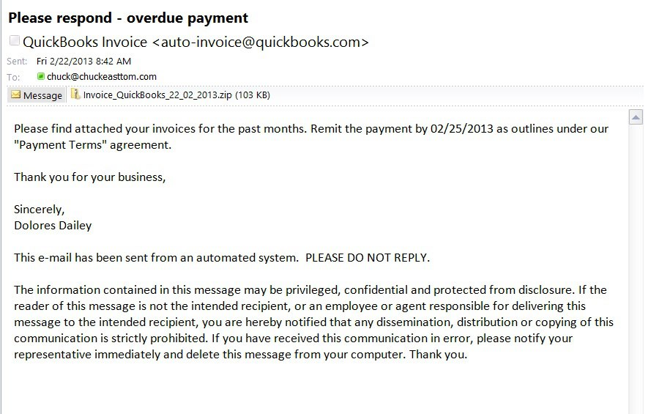
Spyware
Used with permission from Microsoft
Notes:
Spyware can be placed on the target’s machine by tricking the user into opening an email attachment, which can have a virus, spyware, or Trojan horse.

Slide 11
Discarded Information
Is another method that allows a hacker to gather information about a person’s identity
Often referred to as dumpster diving
Shred documents before throwing them out to avoid identity thief

Slide 12
How Identity Theft Affects Forensics
Look for spyware on the victim’s machine
If spyware exists, search for where the spyware is sending its data
  Periodic email with an attachment
  A stream of packets to a server the criminal has access to
If phishing, check email history on the victim’s computer as well as the web history

Slide 13
Hacking
A generic term that means breaking into a system
Is often performed remotely

Slide 14
Hacking via SQL Injection
Typical SQL statement
  SELECT * FROM tblUsers WHERE USERNAME = '" + txtUsername.Text +' AND PASSWORD = '" + txtPassword.Text +" '
Specific username and password:
  SELECT * FROM tblUsers WHERE USERNAME = 'thisuser' AND PASSWORD = 'letmein'
SQL injection example:
  SELECT * FROM tblUsers WHERE USERNAME = '' or '1' = '1' AND PASSWORD = '' or '1' = '1'
Notes:
Many websites seem secure because they have logon screens that require the user to enter a username and password. A database is then checked to make sure the username and password match. All modern databases speak SQL. The SQL code is separated from the programming code with quotation marks. A typical SQL statement might look something like this:
SELECT * FROM tblUsers WHERE USERNAME = ‘” + txtUsername.Text +’ AND PASSWORD = ‘” + txtPassword.Text +”’
If you enter username ‘thisuser’ and the password ‘letmein,’ this code produces the SQL command:
SELECT * FROM tblUsers WHERE USERNAME = ‘thisuser’ AND PASSWORD = ‘letmein’
If there is a match in the database, that means the username and password match. If no records are returned from the database, that means there was no match, and this is not a valid logon.
SQL injection involves creating a statement that is always true. A simplified example is entering ‘’ or ‘1’ = ‘1’ into the username and password boxes. This causes the program to create this query:
SELECT * FROM tblUsers WHERE USERNAME = ‘’ or ‘1’ = ‘1’ AND PASSWORD = ‘’ or ‘1’ = ‘1’.
All records are validated where the username and password are blank or if 1 = 1. Since 1 always equals 1, the intruder is able to log on to the website and do anything any authorized user can do. To prevent this from happening, the programmer should have written the logon to ignore or not allow the extra characters.

Slide 15
Hacking via Cross-Site Scripting
Perpetrator seeks out someplace on target website that allows end users to post text that other users will see, such as product reviews
Instead of posting a review or other text, the attacker posts JavaScript
If website does not filter user input before displaying, other users navigate to this review and script executes

Slide 16
Hacking via Ophcrack
When Windows boots up, system locks the SAM file so it cannot be copied or edited
A hacker can use Ophcrack to:
  Boot to a Linux Live CD
  Compares rainbow table against SAM file, searching for matching passwords
Ophcrack displays all passwords it finds
Notes:
Windows passwords are hashed and stored in the SAM file. The hash of the password is not the actual password; it is created from the password using a hashing algorithm. When you log on to Windows, the system hashes your password and compares it to the hash in the SAM file. If there is an exact match, you are given access. A rainbow table contains every possible combination of keyboard characters and their associated hashed versions.
When Windows boots up, the system locks the SAM file so it cannot be copied or edited. However, a hacker can use Ophcrack, which boots to a Linux Live CD and then scans its rainbow table searching for matches. Ophcrack displays all of the passwords it finds. With a valid password, the hacker can log on to that computer.

Slide 17
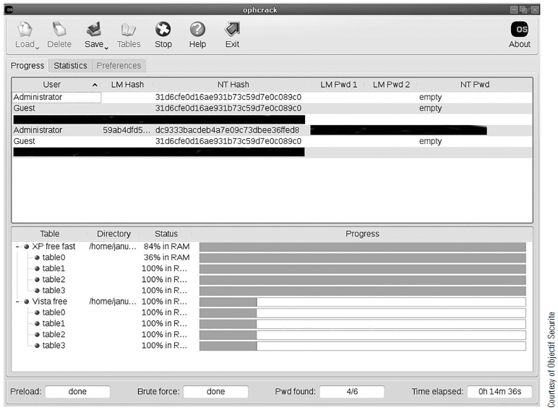
Hacking via OphCrack
Courtesy of Objectif Sécurité
Notes:
Note: This screenshot was taken from a live machine, so all nonstandard user accounts and all passwords were redacted.
There’s a lot to know about hashes and cryptography, but for now you just need to know that a hash is one-way; you don’t “unhash” something. When you log on to Windows, the system hashes whatever you type in, and compares it with whatever hash is in the SAM file. If there is an exact match, then you are given access.

Slide 18
Cyberstalking and Harassment
Using electronic communications to harass or threaten another person
Criteria for law enforcement officers:
  Is it possible? Is the threat credible?
  How frequent?
  How serious?

Slide 19
Fraud
Any attempt to gain
financial reward
through deception
Subclasses of fraud
Investment offers
Data piracy
Notes:
Fraud is a broad category of crime that can encompass many different illegal activities. Essentially, any attempt to gain financial reward through deception is fraud.

Slide 20
Non-Access Computer Crimes
Crimes that do not involve an attempt to actually access the target
Examples:
  Denial of service (DoS) attacks
  Viruses
  Logic bombs
Notes:
DoS attacks are designed to render the target unreachable by legitimate users, not to provide the attacker access to the site.
A virus or logic bomb does not require the attacker to attempt to hack into the target network.

Slide 21
Denial of Service (DoS) Attacks
Three-way handshake
  Client machine sends TCP packet to server with synchronize (SYN) flag turned on
  Server acknowledges the request to synchronize by sending back a TCP packet with two flags turned on: acknowledgment (ACK) flag and the SYN flag
  Client responds with a single ACK flag and communications begin
Notes:
The goal of a denial of service attack is to render a target system unusable. One of the most basic denial of service attacks is a SYN flood, which begins with a client machine sending a TCP packet to the server with a synchronize (SYN) flag turned on. The server sets aside enough resources to handle the connection and acknowledges the request to synchronize by sending back a TCP packet with two flags turned on: the acknowledgment (ACK) flag and the SYN flag. The client is supposed to respond with a single ACK flag and communications begin. This is called the three-way handshake.
In the SYN flood attack, the attacker keeps sending SYN packets but never responds to the SYN/ACK it receives from the server. Eventually, the server has opened up a number of connections for a client that never fully connects and can no longer respond to legitimate users.
Examples of tools to create denial of service attacks include:
The Tribe Flood Network and its new version TFN2K
Trin00
Voice over IP tools (used in Telephony Denial of Service attacks)

Slide 22
Denial of Service (DoS) Attacks
SYN flood
  Attacker keeps sending SYN packets but never responds to the SYN/ACK it receives from the server
  Eventually, server has so many open connections it can no longer respond to legitimate users
Notes:
The goal of a denial of service attack is to render a target system unusable. One of the most basic denial of service attacks is a SYN flood, which begins with a client machine sending a TCP packet to the server with a synchronize (SYN) flag turned on. The server sets aside enough resources to handle the connection and acknowledges the request to synchronize by sending back a TCP packet with two flags turned on: the acknowledgment (ACK) flag and the SYN flag. The client is supposed to respond with a single ACK flag and communications begin. This is called the three-way handshake.
In the SYN flood attack, the attacker keeps sending SYN packets but never responds to the SYN/ACK it receives from the server. Eventually, the server has opened up a number of connections for a client that never fully connects and can no longer respond to legitimate users.
Examples of tools to create denial of service attacks include:
The Tribe Flood Network and its new version TFN2K
Trin00
Voice over IP tools (used in Telephony Denial of Service attacks)

Slide 23
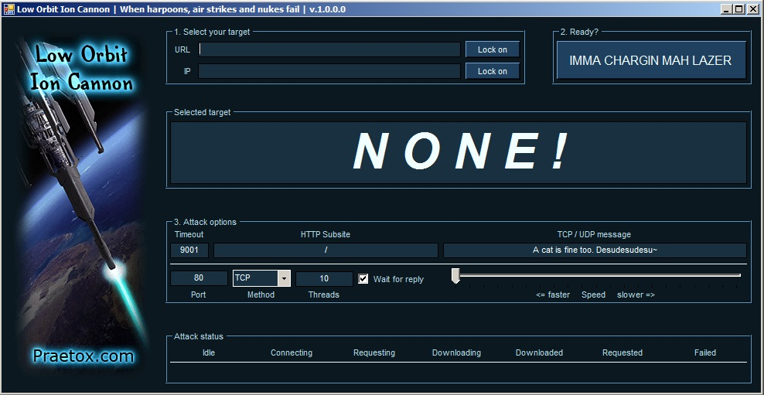
Low Orbit Ion Cannon
Courtesy of Praetox Technologies
Notes:
Tools can be used to create a DoS attack. One of the most easy to use is the Low Orbit Ion Cannon.

Slide 24
Viruses
Any software that self-replicates, like a human or animal virus
Recent viruses:
  FakeAV.86
  Flame
  Gameover ZeuS
  Rombertik
  Locky (ransomware)
Notes:
Types of viruses:
Macro
Memory resident
Multipartite
Armored
Sparse infector

Slide 25
Logic Bombs
Malware designed to harm a system when some logical condition is reached
Often triggered based on a specific date and time
Possible to distribute a logic bomb via a Trojan horse

Slide 26
Cyberterrorism
The unlawful use of the Internet to perform terrorist activities
Can include large-scale disruption of computer networks
China Eagle Union
  Group that consists of several thousand Chinese hackers whose stated goal is to infiltrate Western computer systems

Slide 27
Summary
Common computer crimes
Forensic approaches to different crimes
Forensic strategies based on the specific crime

Slide 28
Let’s Play:
Identify the Crime

Slide 29
Question 1
An attacker disseminates a virus from a rogue website that infects many computers.
Answer choices:
  Identity theft
  Hacking
  Cyberstalking and harassment
  Computer fraud
  Non-access computer crime
  Cyberterrorism

Slide 30
Answer 1
Non-Access
Computer Crime

Slide 31
Question 2
An attacker sends out false emails suggesting the receiver can make a large sum of with very little investment.
Answer choices:
  Identity theft
  Hacking
  Cyberstalking and harassment
  Computer fraud
  Non-access computer crime
  Cyberterrorism

Slide 32
Answer 2
Computer Fraud

Slide 33
Question 3
An attacker inserts SQL commands into text boxes, often using the username and password text fields on a logon screen.
Answer choices:
  Identity theft
  Hacking
  Cyberstalking and harassment
  Computer fraud
  Non-access computer crime
  Cyberterrorism

Slide 34
Answer 3
Hacking

Slide 35
Question 4
A criminal uses phishing to trick a victim into giving up personal information.
Answer choices:
  Identity theft
  Hacking
  Cyberstalking and harassment
  Computer fraud
  Non-access computer crime
  Cyberterrorism

Slide 36
Answer 4
Identity Theft

Slide 37
Question 5
A denial of service (DoS) attack is an example of this type of this crime.
Answer choices:
  Identity theft
  Hacking
  Cyberstalking and harassment
  Computer fraud
  Non-access computer crime
  Cyberterrorism

Slide 38
Answer 5
Non-access
Computer Crime

Slide 39
Question 6
Data piracy is an example of this type of crime.
Answer choices:
  Identity theft
  Hacking
  Cyberstalking and harassment
  Computer fraud
  Non-access computer crime
  Cyberterrorism

Slide 40
Answer 6
Computer Fraud

Slide 41
Question 7
An attacker remotely accesses a power plant's computer system and inserts a logic bomb.
Answer choices:
  Identity theft
  Hacking
  Cyberstalking and harassment
  Computer fraud
  Non-access computer crime
  Cyberterrorism

Slide 42
Answer 7
Hacking,
Non-access Computer Crime,
Cyberterrorism

Slide 43
Question 8
An attacker dumpster dives to look for a victim's personal information, such as in discarded mail, bills, and bank statements.
Answer choices:
  Identity theft
  Hacking
  Cyberstalking and harassment
  Computer fraud
  Non-access computer crime
  Cyberterrorism

Slide 44
Answer 8
Identity Theft

Slide 45
Question 9
A suspicious person in a chat room asks for your home address every time you are both online together.
Answer choices:
  Identity theft
  Hacking
  Cyberstalking and harassment
  Computer fraud
  Non-access computer crime
  Cyberterrorism

Slide 46
Answer 9
Cyberstalking/ Harassment

Slide 47
Question 10
A person from Nigeria emails you, asking to use your bank account to “park” some money temporarily.
Answer choices:
  Identity theft
  Hacking
  Cyberstalking and harassment
  Computer fraud
  Non-access computer crime
  Cyberterrorism

Slide 48
Answer 10
Computer Fraud

