Slide 1
System Forensics, Investigation, and Response
Lesson 5
Understanding Techniques for Hiding and Scrambling Information

Slide 2
Learning Objective
Explain techniques for hiding and scrambling information as well as how data is recovered.

Slide 3
Key Concepts
Steganography
Encryption

Slide 4
Steganography
  The art and science of writing hidden messages
  Goal is to hide information so that even if it is intercepted, it is not clear that information is hidden there
  Most common method today is to hide messages in pictures using the least significant bit (LSB) method

Slide 5
LSB Method
  Consider 11111111
  Change last digit to 0
  11111110 = 254 in decimal
  The last bit or least significant bit is used to store data
  Colored pixels in a computer stored in bits
Notes:
The LSB method depends on the fact that computers store things in bits and bytes.
Consider an 8-bit byte.
For example, consider 11111111. If you convert this to decimal numbers, it equals 255.
If you change the first 1 to a zero, you get 01111111. This equals 127 in decimal numbers, which is a pretty major change.
If you change the last zero instead, you get 11111110. This equals 254 in decimal numbers. This is a trivial change. That is why this last bit is called the least significant bit. Changing the least significant bit from a 0 to a 1 or from a 1 to a 0 makes the smallest change in the original information.

Slide 6
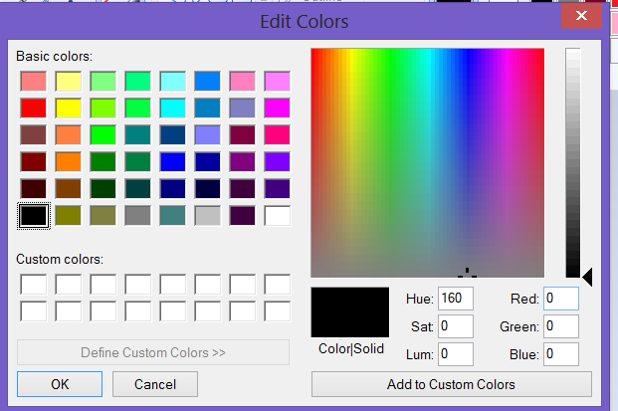
LSB Method
Used with permission from Microsoft
Notes:
Windows color palette in the Edit Colors dialog box
Colored pixels in a computer are stored in bits. In Windows, for example, 24 bit is the normal color resolution. If you examine the Windows color palette, you’ll find that you define a color by selecting three values between 0 and 255 in the Red, Green, and Blue text boxes.

Slide 7
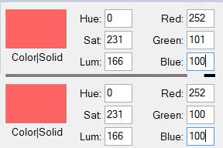
LSB Method
Used with permission from Microsoft
Notes:
Windows color changed by one bit.
If you change the least significant bit in a pixel, the image still looks the same. But a picture is made up of thousands—sometimes millions—of pixels. So by changing the least significant bit of many pixels, you can store data that is hidden in an image. This is the basis for modern image steganography.

Slide 8
Basic Steganography Terms
Payload
Carrier
Channel
Notes:
Payload
The information to be covertly communicated; the message the user wants to hide
Carrier
The signal, stream, or file in which the payload is hidden
Channel
The type of medium used. It can be a passive channel such as photos, video, or sound files. It can also be an active channel such as a streaming video connection.

Slide 9
Historical Steganography
Ancient Chinese wrapped notes in wax and swallowed them for transport
In ancient Greece, message written on slave's shaved head, then hair allowed to grow back
During World War II, French Resistance sent messages written on the backs of couriers using invisible ink
Notes:
7/2/2017
9

Slide 10
Other Forms of Steganography
Steganophony
Hiding messages in sound files
Video steganography
Hiding information in video files
Advanced steganography
Bit-plane complexity segmentation steganography (BPCS)
Notes:
Using digital images to hide messages is just one form of steganography. Steganography can also take these forms:
Steganophony—Hiding messages in sound files.
Video steganography—Hiding information in video files.
Advanced—With BPCS, carrier is often an image that stores colors in 24 bits, and this fact can be used to increase storage area for payload. The complex
areas on the bit planes are replaced with the payload.

Slide 11
Steganalysis
  The process of analyzing a file or files for hidden content
  Can show a likelihood that a given file has additional information hidden in it
  Common method for detecting LSB steganography is to examine close-color pairs
Notes:
Steganalysis is the process of analyzing a file or files for hidden content.
At one time, digital steganography was only used by computer professionals because it required writing specific computer program code to manipulate the bits in an image. That is not the case today. There are a number of tools readily available on the Internet that will enable a user to hide information in an image or detect steganography. Examples of steganalysis tools:
• StegSecret
• StegSpy
• Invisible Secrets
• MP3Stego

Slide 12
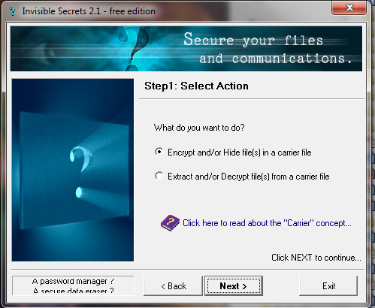
Invisible Secrets
Courtesy of NeoByte Solutions
Notes:
Choose whether you want to hide a file or extract a hidden file. For this example, suppose you want to hide a file. You select your chosen option in the Invisible Secrets Select Action dialog box.

Slide 13
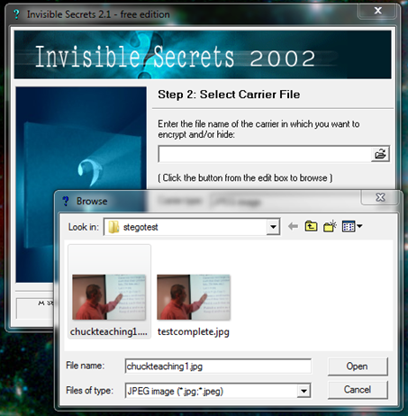
Invisible Secrets
Courtesy of NeoByte Solutions
Notes:
Select an image you want to use as the carrier file.

Slide 14
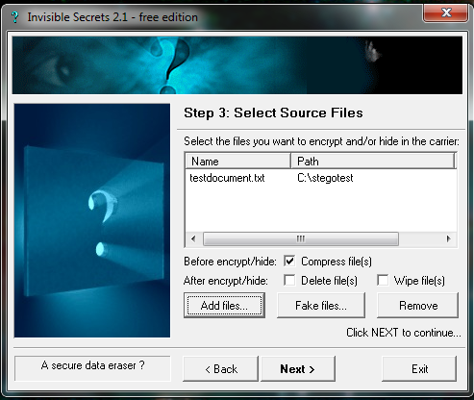
Invisible Secrets
Courtesy of NeoByte Solutions
Notes:
Select the file you want to hide. It can be a text file or another image file. You can also choose to encrypt as well as hide.

Slide 15
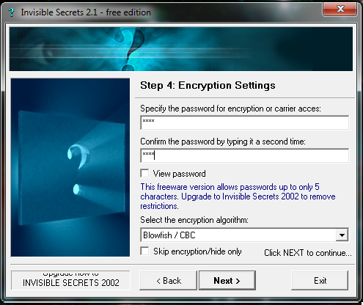
Invisible Secrets
Courtesy of NeoByte Solutions
Notes:
Select a password for your hidden file.

Slide 16
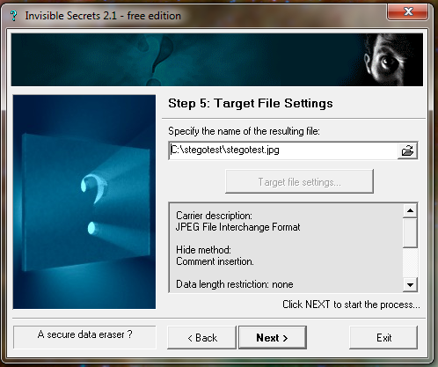
Invisible Secrets
Courtesy of NeoByte Solutions
Notes:
Pick a name for the resulting file that contains your hidden file.
That’s it!

Slide 17
Encryption
  Encryption obfuscates message so it cannot be read
  Cryptography is the study of writing secret messages
  The word cryptography derived from word kryptós, which means hidden, and the verb gráfo, which means write
Notes:
Encryption (or cryptography) has to do with obfuscating the message so that it cannot be read.
The concept of cryptography is simple: Messages must be changed in such a way that they cannot be read easily if intercepted but can be decoded easily by the intended recipient.

Slide 18
Encryption vs. Steganography
Steganography
Message hidden
Encryption/Cryptography
Message present but obfuscated
Notes:
With steganography, an examiner may not even be aware that a message is present. With cryptography, it is obvious that a message is present, but the message is not easily deciphered.

Slide 19
The Caesar Cipher
  Referred to as the substitution cipher
  A simple method of encryption and very easy to crack
  Choose some number by which to shift each letter of a text
  Substitute the new alphabetic letter for the letter being encrypted
Notes:
The Caesar cipher was used by the ancient Romans. It is also referred to as the substitution cipher because you choose some number by which to shift each letter of a text and substitute the new alphabetic letter for the letter being encrypted. It is a very simple method of encryption and very easy to crack.

Slide 20
Caesar Cipher Example
  Text is:
    A CAT
  You choose to shift by two letters, then A replaces C, E replaces C, C replaces A, and V replaces T; encrypted message is:
    C ECV
  If shift by three letters, message is:
    D FDW

Slide 21
The Caesar Cipher
  Introduced two key terms:
    Text you want to encrypt is referred to as plaintext
    After it has been subjected to the algorithm and key, resultant text is called ciphertext

Slide 22
The Atbash Cipher
  Reverses the alphabet—substituting the first letter of the alphabet for the last letter, the second letter for the second-to-last letter, and so on
  Is primitive and easy to break
Notes:
This cipher was used by Hebrew scholars copying the book of Jeremiah. This cipher simply reverses the alphabet—substituting the first letter of the alphabet for the last letter, the second letter for the second-to-last letter, and so on. It is primitive and easy to break.

Slide 23
The ROT13 Cipher
  A permutation of the Caesar cipher
  All characters are rotated 13 characters through the alphabet
  A CAT becomes N PNG

Slide 24
The Scytale Cipher
  Encrypts messages by wrapping a leather strip around a cylinder or baton, and writing across the leather
  Turning cylinder produced different ciphertexts
  Message decrypted by reading the message once placed over the same leather “key” wrapped around the same size cylinder
Notes:
The scytale is a physical cylinder or baton. It was used to encrypt messages by wrapping a leather strip around the cylinder and writing across the leather. Turning the cylinder produced different ciphertexts. The message was decrypted by reading the message once placed over the same leather “key” wrapped around the same size cylinder.

Slide 25
Playfair
  Works by encrypting pairs of letters, also called digraphs, at a time
  Uses a 5 × 5 table that contains a keyword or key phrase
  To use the Playfair cipher, one need only memorize that keyword and four rules
  Example: “Attack at dawn” becomes "At ta ck at da wn"
Notes:
To use the Playfair cipher, one need only memorize that keyword and four rules.
To use the cipher, first break the plaintext message into digraphs; so, for example, "Attack at dawn" becomes "At ta ck at da wn." If the final digraph is just a single letter, you can pad it with a letter z.

Slide 26
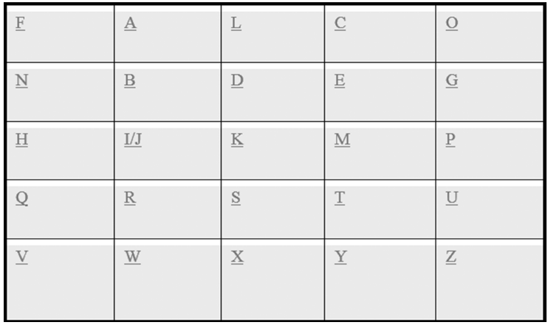
Playfair (Cont.)

Slide 27
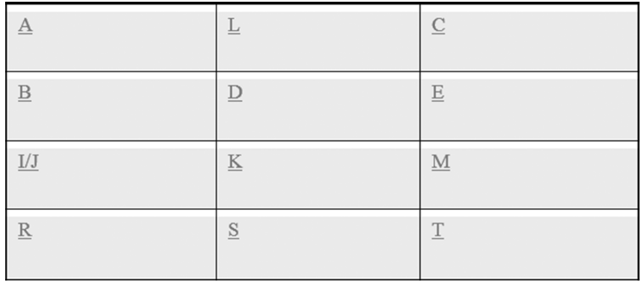
Playfair (Cont.)

Slide 28
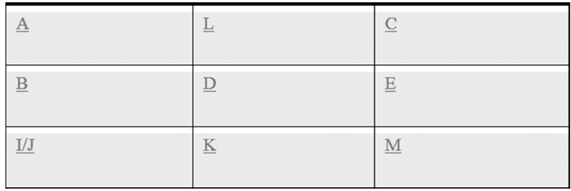
Playfair (Cont.)

Slide 29
Multialphabet Substitution
  Uses multiple numbers by which letters in plaintext are shifted
  Multiple substitution alphabets are created
  Represents a slight improvement on the Caesar cipher but is still easily cracked
Notes:
This cipher uses multiple numbers by which letters in plaintext are shifted. Multiple substitution alphabets are created. This cipher represented a slight improvement on the Caesar cipher but is still easily cracked.

Slide 30
Multialphabet Substitution Example
  If you select three substitution alphabets (+2, -2, +3)
  A CAT becomes C ADV
Notes:
Notice that the fourth letter starts over with another +2.
The first A was transformed to C and the second A was transformed to D.

Slide 31
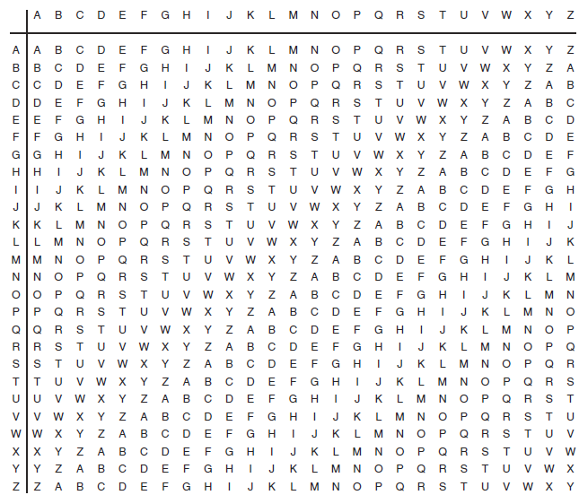
The Vigenère Cipher
© Jones & Bartlett Learning
Notes:
This method uses a table and a selected keyword to encrypt a message.
Match the letter of your keyword on the top with the letter of your plaintext on the left to find the ciphertext.
This type of multialphabet cipher is more secure than a single-alphabet substitution cipher but is still easily cracked by computers.
Example: if you are encrypting the word cat and your keyword is horse, then the ciphertext is jok.

Slide 32
The Enigma Machine
  World War II, electromechanical rotor-based cipher system
  Is a multialphabet substitution cipher using machinery to accomplish the encryption
  When operator pressed a key, encrypted ciphertext for plaintext was altered each time
Notes:
In World War II, the Germans used an electromechanical rotor-based cipher system known as the Enigma machine. It is a multialphabet substitution cipher using machinery to accomplish the encryption. The machine was designed so that when the operator pressed a key, the encrypted ciphertext for that plaintext was altered each time. The Enigma machine and its many variations were essentially mechanical implementations of multialphabet substitution.

Slide 33
Modern Cryptography
  Two main types: Symmetric and asymmetric
  Symmetric cryptography uses the same key to encrypt and decrypt plaintext
  Asymmetric cryptography uses different keys to encrypt and decrypt plaintext

Slide 34
Modern Cryptography (Cont.)
  Used every day by millions of consumers on the World Wide Web to buy products and services securely
  “https” at beginning of Web address or a padlock symbol indicates a secure protocol such as Transport Layer Security (TLS) is at work

Slide 35
Modern Cryptography (Cont.)
  Cryptography also used in:
    Antivirus software
    Wireless security (WPA and WPA2 encryption)
  Hard disk encryption using Microsoft Encrypting File System (EFS) is a form of cryptography
  Did you know your mobile phone transmissions are encrypted, as are your ATM and credit cards?

Slide 36
Symmetric Cryptography
Uses the same key to encrypt and decrypt plaintext
Can use two different encryption keys, one from sender to receiver and one from receiver to sender
  Same key is still used for encryption and decryption
  Having different keys in both directions provides additional security if keys are learned or disclosed

Slide 37
Substitution and Transposition
Swapping of blocks of ciphertext
All modern block-cipher algorithms use substitution and transposition
Combination of substitution and transposition increases security of resultant ciphertext by making cryptanalysis more complex
Notes:
All of the historical examples examined in this lesson have been simple substitution ciphers because each single character of plaintext is converted into a single character of ciphertext.
However, all modern block-cipher algorithms use both substitution and transposition, which is the swapping of blocks of ciphertext. This combination of substitution and transposition increases the security of the resultant ciphertext by making cryptanalysis more complex.

Slide 38
Block Ciphers and Stream Ciphers
Block cipher
Encrypts data in groups of bits, also known as blocks
Stream cipher
Encrypt data as a stream, one bit at a time
Notes:
There are two types of symmetric approaches: block ciphers and stream ciphers. A block cipher literally encrypts the data in groups of bits, also known as blocks. Stream ciphers encrypt the data as a stream, one bit at a time.
There are a few basic facts that are generally applicable to all block ciphers. Assuming the actual algorithm is mathematically sound, then the following is true:
Larger block sizes increase security.
Larger key sizes increase security against brute-force attack methods.
If the round function is secure, then more rounds increase security to a point.

Slide 39
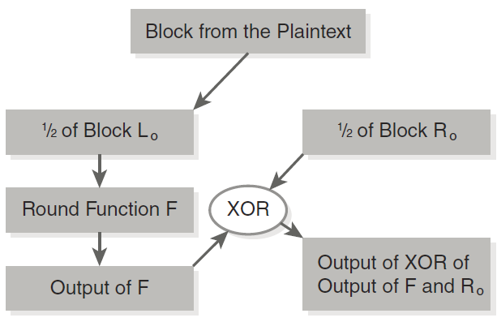
The Feistel Function

Slide 40
Data Encryption Standard (DES)
Data is divided into 64-bit blocks.
Data is manipulated by 16 separate steps of encryption involving substitutions, bit-shifting, and logical operations using a 56-bit key.
Data is then further scrambled using a swapping algorithm.
Data is transposed one last time.
Notes:
One of the oldest of the modern symmetric ciphers is the Data Encryption Standard (DES). It was developed by IBM in the early 1970s and is a block cipher. The basic concept of DES is:
1. Data is divided into 64-bit blocks.
2. That data is then manipulated by 16 separate steps of encryption involving substitutions, bit-shifting, and logical operations using a 56-bit key.
3. Data is then further scrambled using a swapping algorithm.
4. Data is finally transposed one last time.
These steps provide a simplified view of DES. As you can see, it works on splitting the block into two sections, as with all Feistel ciphers. The idea is to continually scramble the underlying message to make it appear as random as possible.

Slide 41
What Happened to 2DES?
2DES basically does DES two times
Was not much more secure than DES
Took more time and computer resources to implement
Not widely used

Slide 42
Triple DES (3DES)
Was created as an interim solution to DES
Does DES three times, with three different keys
Notes:
Eventually, it became obvious that DES would no longer be secure. The U.S. federal government began a contest seeking a replacement cryptography algorithm. In the meantime, Triple Des (3DES) was created as an interim solution. Essentially, it does DES three times, with three different keys.

Slide 43
Why 4DES Was Never Implemented
Early simulations indicated it was too scrambled
Blocks of original plaintext appeared in the final ciphertext
One of the driving factors behind searching for a new algorithm not in the DES line
Notes:
4DES was never implemented because early simulations indicated that 4DES was too scrambled—so scrambled, in fact, that blocks of the original plaintext appeared in the final ciphertext. This was one of the driving factors behind searching for a new algorithm not in the DES line.

Slide 44
Advanced Encryption Standard (AES)
Also known as the Rijndael block cipher
Can have three different key sizes:
  128, 192, or 256 bits
Referred to as AES 128, AES 192, and AES 256
Notes:
The Advanced Encryption Standard (AES) is also known as the Rijndael block cipher. It was officially designated as a replacement for DES in 2001. AES can have three different key sizes: 128, 192, or 256 bits. The three different implementations of AES are referred to as AES 128, AES 192, and AES 256. All three operate on a block size of 128 bits.
Unlike both DES and 3DES, AES is not based on a Feistel network. AES uses a substitution-permutation matrix rather than a Feistel network. AES operates on a 4×4 column matrix of bytes, termed the state (versions of AES with a larger block size have additional columns in the state).

Slide 45
AES Steps
Key expansion
Initial round
AddRoundKey
Rounds
SubBytes
Final round
SubBytes
ShiftRows
MixColumns
AddRoundKey
ShiftRows
AddRoundKey

Slide 46
Cryptographic Hashes
Hashing is a type of cryptographic algorithm with some specific characteristics
  It is one-way, not reversible
  It is a fixed-length output no matter what input is given
  The algorithm must be collision resistant
Notes:
A collision occurs when two different inputs to the same hashing algorithm produce the same output (called a hash or digest).
Ideally we would like to have no collisions. But the reality is that with a fixed-length output, a collision is possible.
The goal is to make it so unlikely as to be something we need not think about.

Slide 47
Asymmetric Cryptography
Cryptography wherein two keys are used:
  One to encrypt the message
  Another to decrypt it

Slide 48
RSA
Described in 1977 by Ron Rivest, Adi Shamir, and Leonard Adleman at MIT
Perhaps the most widely used public key cryptography algorithm today
Is based on relationships of prime numbers
Security of RSA derives from fact that it is difficult to factor a large integer composed of two or more large prime factors
Notes:
RSA is perhaps the most widely used public key cryptography algorithm in existence today. It is based on some interesting relationships of prime numbers. The security of RSA derives from the fact that it is difficult to factor a large integer composed of two or more large prime factors.

Slide 49
Diffie-Hellmen
A cryptographic protocol that allows two parties to establish a shared key over an insecure channel
Often used to allow parties to exchange a symmetric key through some insecure medium, such as the Internet
Enabled all secure communications between parties that did not have a pre-established relationship, such as e-commerce
Notes:
The Diffie-Hellman algorithm is a cryptographic protocol that allows two parties to establish a shared key over an insecure channel. In other words, Diffie-Hellman is often used to allow parties to exchange a symmetric key through some insecure medium, such as the Internet. Diffie-Hellman enabled all secure communications between parties that did not have a pre-established relationship, such as e-commerce, and facilitated communications between parties with a pre-established relationship, such as e-banking.

Slide 50
Diffie-Hellmen (Cont.)
Groundbreaking research provided the foundation for secure transactions across the Internet
E-commerce sites like Amazon.com and Staples.com can provide secure electronic communications, thanks in great part to Diffie and Hellman
Notes:
The Diffie-Hellman algorithm is a cryptographic protocol that allows two parties to establish a shared key over an insecure channel. In other words, Diffie-Hellman is often used to allow parties to exchange a symmetric key through some insecure medium, such as the Internet. Diffie-Hellman enabled all secure communications between parties that did not have a pre-established relationship, such as e-commerce, and facilitated communications between parties with a pre-established relationship, such as e-banking.

Slide 51
Breaking Encryption
  Cryptanalysis is using techniques other than brute force to attempt to uncover a key
    Also referred to as academic or knowledge-based code breaking
  Cryptographic techniques may be used to test the efficacy of a cryptographic algorithm
    Such as to test hash algorithms for collisions

Slide 52
Frequency Analysis
  In natural languages, certain letters of alphabet appear more frequently than others
  By examining frequencies, can derive some information about the key used
  Method effective against classic
  ciphers, but not modern
  methods of cryptography
Notes:
This is the basic tool for breaking most classical ciphers such as the Caesar cipher, the Vigenère cipher, etc. In natural languages, certain letters of the alphabet appear more frequently than others. By examining those frequencies, you can derive some information about the key that was used. While this method is effective against classic ciphers, it is not effective against modern methods of cryptography.

Slide 53
Kasiski
  A method of attacking polyalphabetic substitution ciphers, such as Vigenère
  Can be used to deduce the length of the keyword used in a polyalphabetic substitution cipher
Notes:
Kasiski examination is a method of attacking polyalphabetic substitution ciphers, such as the Vigenère cipher. This method can be used to deduce the length of the keyword used in a polyalphabetic substitution cipher.

Slide 54
Kasiski (Cont.)
  When length of keyword is discovered, ciphertext is lined up in n columns, where n is keyword length
  Each column
    Treated as a monoalphabetic substitution cipher
    Can be cracked with frequency analysis
  Involves looking for repeated strings in the ciphertext
Notes:
Once the length of the keyword is discovered, the ciphertext is lined up in n columns, where n is the length of the keyword.
Then, each column can be treated as a monoalphabetic substitution cipher and each column can be cracked with simple frequency analysis.
The method simply involves looking for repeated strings in the ciphertext. The longer the ciphertext, the more effective this method will be.

Slide 55
Modern Methods
Known plaintext attack
Chosen plaintext attack
Ciphertext-only
Related-key attack
Notes:
The outcome of attempting to crack modern cryptographic methods will most likely be failure. However, with enough time and resources it is possible. Some techniques that can be employed in this process include:
Known plaintext attack—This method is based on having a sample of known plaintexts and their resulting ciphertexts, and then using this information to try and ascertain something about the key used.
Chosen plaintext attack—The attacker obtains the ciphertexts corresponding to a set of plaintexts of his own choosing. This can allow the attacker to attempt to
derive the key used and thus decrypt other messages encrypted with that key.
Ciphertext-only—The attacker only has access to a collection of ciphertexts. This is much more likely than known plaintext, but also the most difficult. The attack is successful if the corresponding plaintexts or, even better, the key can be deduced. However, obtaining any information at all about the underlying plaintext in this situation is considered a success.
Related-key attack—This attack is similar to a chosen plaintext attack, except the attacker can obtain ciphertexts encrypted under two different keys. This is actually a very useful attack if you can obtain the plaintext and matching ciphertext.

Slide 56
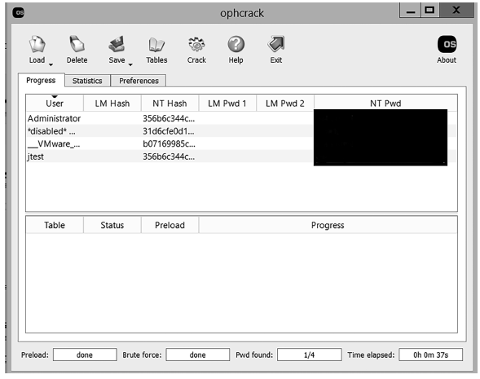
Rainbow Tables/Ophcrack
Notes:
The time of cryptanalysis can be reduced by using precalculated data stored in memory. Essentially, these types of password crackers work with precalculated hashes of all passwords available within a certain character space. These files are called rainbow tables because they contain every letter combination “under the rainbow.” They are particularly useful when trying to crack hashes. Popular hacking tools like Ophcrack depend on rainbow tables. Ophcrack is usually very successful at cracking Windows local machine passwords.

Slide 57
John the Ripper
A password cracker popular with network administrators and hackers
Enables user to select text files of word lists to attempt cracking a password
Command-line based, no Windows interface
Notes:
Although John the Ripper is less convenient to use because it is command-line based and has no Windows interface, it has been around for a long time and is well regarded by both the security and hacking communities.

Slide 58
Summary
Steganography
Encryption

