Slide 1
System Forensics, Investigation, and Response
Lesson 6
Recovering Data

Slide 2
Learning Objective
Explain techniques for hiding and scrambling information as well as how data is recovered.

Slide 3
Key Concepts
Undeleting data
Recovering information from damaged drives

Slide 4
Undeleting Data
Criminals who are not very technically savvy think that deleting a file will keep authorities from discovering it
Expect that evidence will frequently be deleted from computers you examine

Slide 5
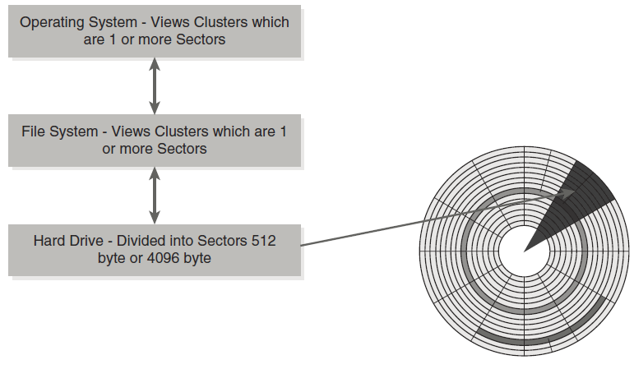
File Systems and Hard Drives
Notes:
Hard drives store data as a sector.
Modern hard drives use Advanced Format, which has 4096-byte sectors.
A sector is an area of one of the disk platters defined by two radii. This is how the hard drive views data.
File systems look at clusters, not sectors.
A cluster can be from 1 to 128 sectors.
Sectors are contiguous on a disk and are defined by two radii on the platter.
Clusters need not consist of contiguous sectors; for example, a 10-sector cluster may have sectors from many different locations.
The formal definition has been changed from cluster to allocation unit; however, in most technical literature the term cluster is still used.

Slide 6
Operating Systems
Current
Windows 10, 8, 7, Vista
Windows Server 2012, 2008
Legacy
Windows XP, 2000
Mac OS 8 or earlier
Mac OS 9 and 10
Notes:
Different operating systems have different file structures.
Linux distributions vary and are generally updated more frequently than Windows or Mac OS.

Slide 7
Windows
FAT16 and FAT32 used in pre-Windows 2000 versions
NTFS file system in use since Windows 2000
Uses a table to map files to specific clusters where they are stored on the disk
Notes:
Older versions of Windows use FAT and newer versions (since Windows 2000) use NTFS file systems. In both file systems, a table is used to map files to specific clusters where they are stored on the disk. A number of tools are available to recover deleted files from Windows computers.

Slide 8
Storing a File in Windows (FAT/FAT32)
Record cluster number for next cluster
Add EOC if at end of chain
Mark bad, reserved, open clusters
Notes:
1. The cluster number of the next cluster for this file is recorded.
2. If this cluster is the end of a chain, then it has a special end of cluster chain (EOC) entry.
3. Bad clusters have a special entry in the file allocation table.
4. Reserved clusters have a special entry in the file allocation table.
5. Open, or available, clusters are also marked in the file allocation table.

Slide 9
Deleting a File in Windows (FAT/FAT32)
When a file is deleted, data not removed from disk
FAT is updated to reflect clusters no longer in use
New data saved to those clusters may overwrite old information
Notes:
The more recently a file was deleted, the more likely you will be able to recover the file.
Over time, it becomes more likely that clusters marked as unused have had other information saved in them.
A cluster may have been deleted and saved over several times.
Recovering a deleted file is not always an all-or-nothing procedure. It is possible to recover just a portion of a file.

Slide 10
NTFS Fundamental Files
MFT
Master File Table
Cluster bitmap
A map of all the clusters on the hard drive
Describes all files on the volume

Slide 11
Storing a File in Windows (NTFS)
MFT contains one base file record for each file and directory
MFT serves same purpose as FAT
Cluster bitmap file maps all clusters on disk
Notes:
The cluster bitmap file map is an array of bit entries where each bit indicates whether its corresponding cluster is allocated/used or free/unused.

Slide 12
Deleting Files in Windows (NTFS)
When a file is deleted, data not removed from disk
Clusters are marked as deleted and “moved” to Recycle Bin
When Recycle Bin is emptied, clusters marked as fully available
Filename in the MFT is marked with a special character that means the file has been deleted
Notes:
When files are deleted from an NTFS system, the process is similar to what occurs in FAT. The main difference is that clusters are first marked as deleted, thus “moved” to the Recycle Bin. In NTFS prior to Vista, the Recycle Bin resides in a hidden directory called RECYCLER. In Vista and Windows 7, the name of the directory was changed to $recycle.bin.
Only when you empty the Recycle Bin is the cluster marked as fully available. More specifically, when a file is deleted, the filename in the MFT is marked with a special character that signifies to the computer that the file has been deleted. Just as with FAT systems, clusters in an NTFS system are more likely to be overwritten as more time elapses after deletion.

Slide 13
DiskDigger
Free and commercial versions
Free version recovers files one at a time
Notes:
DiskDigger is an easy-to-use tool for Windows. It can be downloaded free of charge and is fully functional. But when recovering files, you have to recover them one at a time. If you pay for the commercial version, you can recover as many files at one time as you want.

Slide 14
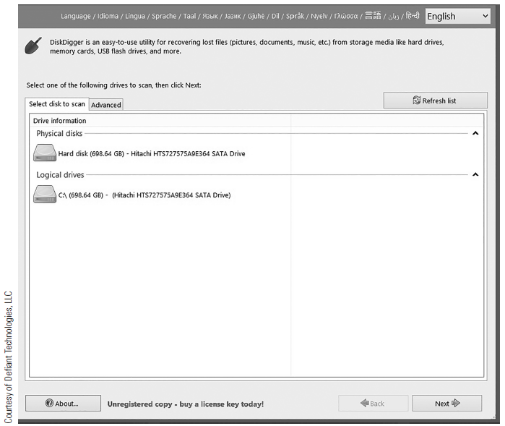
DiskDigger: Main Screen
Notes:
After launching the program, select the drive you want to examine.
You can select any file and recover it. On your screen the files will be in color. Green indicates that you should get the entire file back. Gray indicates a partial file. Red indicates very little of the file is left.

Slide 15
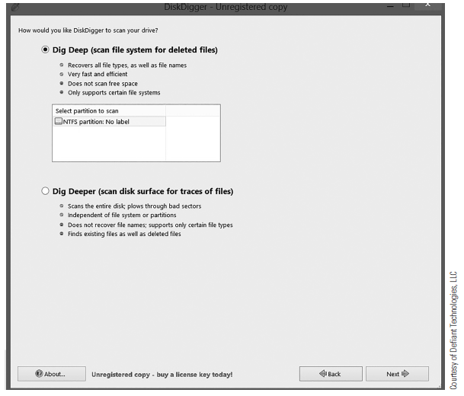
DiskDigger: Starting Data Recovery
Notes:
Choose Dig Deep or Dig Deeper. The difference is the level of recovery.

Slide 16
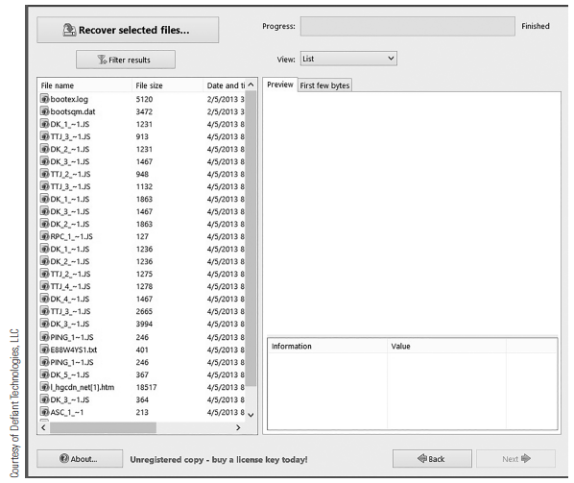
DiskDigger: Recovering an Individual File
Notes:
You can select any file and recover it. On your screen the files will be in color. Green indicates that you should get the entire file back. Gray indicates a partial file. Red indicates very little of the file is left.

Slide 17
WinUndelete
Easy to use
Wizard-driven

Slide 18
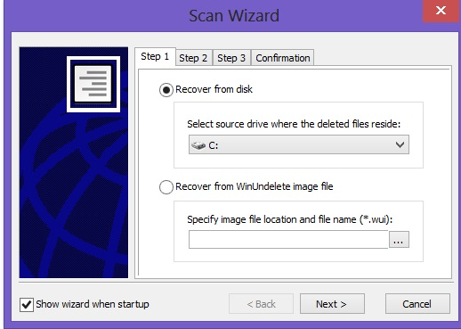
WinUndelete
Courtesy of WinRecovery Software
Notes:
Select the drive you want to recover.

Slide 19
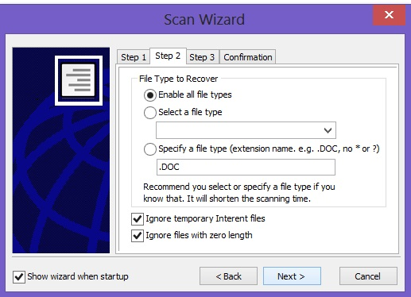
WinUndelete
Courtesy of WinRecovery Software
Notes:
Select the file types you want to recover.

Slide 20
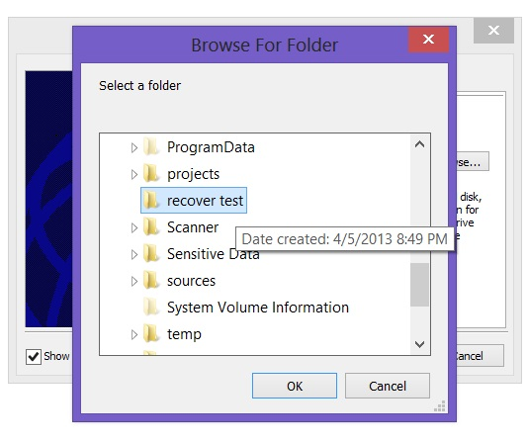
WinUndelete
Courtesy of WinRecovery Software
Notes:
Select a folder to place recovered files in. When WinUndelete has completed running the recovery process, you can go to that folder to see the files.

Slide 21
FreeUndelete
Free tool for personal use
Commercial version available
Notes:
FreeUndelete is a free Windows tool for personal use. There is a fee for commercial use.

Slide 22
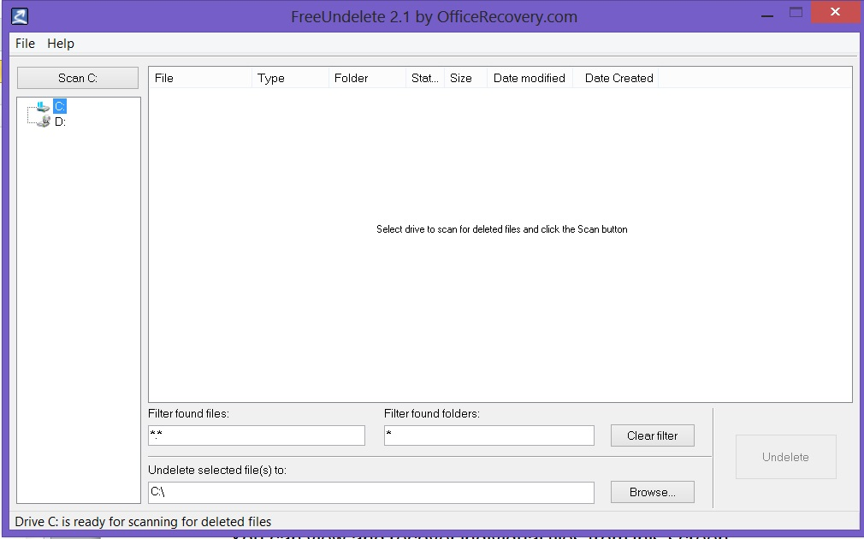
FreeUndelete
Courtesy of Recoveronix Ltd.
Notes:
When you launch this program, the first screen requires you to select the drive from which you want to recover files. Then you simply click the Scan button, and any files that can be fully or partially recovered will be listed.

Slide 23
OSForensics
A robust forensics tool that also provides for undeletion
Undelete from a mounted image or from a live system

Slide 24
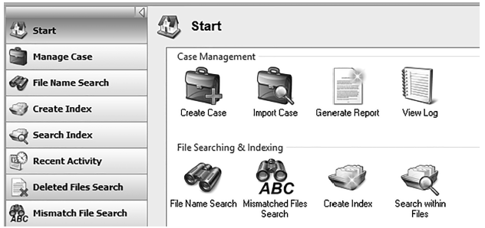
OSForensics Deleted Files Search
Courtesy of Recoveronix Ltd.
Notes:
The Deleted Files search is on the menu on the left side of the main OSForensics screen.

Slide 25
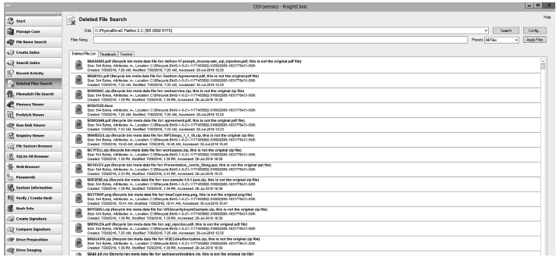
OSForensics Deleted Files Results
Courtesy of Recoveronix Ltd.
Notes:
The search result will be color-coded, indicating how likely it is that you can recover a given file. Some files will be so fragmented that recovery is unlikely.

Slide 26
Linux
File systems
  ext3
  ext4
Notes:
Linux stores files in contiguous blocks which are normally large enough to accommodate the content, so defragmentation is not required. In rare cases, the blocks need to be extended. The exact size of these blocks depends on the parameters used with the command to create that partition. There are prepackaged tools and some built-in commands for recovering deleted files from Linux operating systems.

Slide 27
Storing a File in Linux
Stores files in contiguous blocks
Blocks sometimes need to be extended
Exact size of blocks depends on parameters used with the command that creates the partition
Uses inodes and soft links
Notes:
Stores files in contiguous blocks which are normally large enough to accommodate the content, so defragmentation is not required.
In rare cases, the blocks need to be extended.
The exact size of these blocks depends on the parameters used with the command to create that partition. There are prepackaged tools and some built-in commands for recovering deleted files from Linux operating systems.
Hard drives that run Linux address blocks, or integer multiples of blocks, at a time. The specific block size is stored in the superblock. The entire partition is divided into an integral number of blocks, starting at 0.
Blocks are divided into groups. Each group uses one block as a bitmap to keep track of which block inside that group is allocated (used); thus, there can be at most 4,096 * 8 = 32,768 normal blocks per group. Another block is used as a bitmap for the number of allocated inodes. Inodes are data structures of 128 bytes that are stored in a table, (4,096 / 128 = 32 inodes per block) in each group.

Slide 28
Deleting a File in Linux
Inode hard link is integral
Inode links directly to a specific file
OS keeps a count of references to each hard link
When reference count reaches zero, file is deleted
Notes:
An inode can refer to a file or a folder/directory. In either case, the inode is really a link to the file. There are two basic types of links"
Hard link: An inode that links directly to a specific file. The operating system keeps a count of references to this link. When the reference count reaches zero, the file is deleted. In other words, you can have any number of names referencing a file, but if that number of references reaches zero (i.e., there is no name that references that file), then the file is deleted.
Soft link or symbolic link: Is not actually a file itself, but rather a pointer to another file or directory.

Slide 29
Recovering a File in Linux
Move system to single-user mode with init 1 command
Use grep to search for and recover files
Example:
  # grep -i -a -B10 -A100 'forensics' /dev/sda2 > file.txt
Notes:
Manual Recovery: Deleted files can be manually recovered using Linux commands without external tools. Unfortunately, there are variations between the Linux distributions, so there is no guarantee that this process will work on your specific Linux installation.
The first step is to move the system to single-user mode. If this is a network system, notify network users first with the wall command, which sends messages to all logged-in users. Then, you can move to single-user mode, using the init command: init 1.
The Linux/UNIX command grep can be used to search for files, contents of files, and just about anything you may want to search for. Grep is very flexible and quite popular with Linux users. For example: grep -b 'search-text' /dev/partition > file.txt will search for ‘search-text’ in a given partition and output the results to file.txt. You can also use this syntax: grep -a -B[size before] -A[size after] 'text' /dev/[your_partition] > file.txt.
To recover a text file starting with the word forensics on /dev/sda2, you can try the following command:
# grep -i -a -B10 -A100 'forensics' /dev/sda2 > file.txt.
In this case, grep is searching for this phrase, ignoring case, looking through binary files, and essentially looking to find the text, even if the file has been deleted.

Slide 30
extundelete
Works with both ext3 and ext4 partitions in Linux
Uses shell commands
Example: To restore all deleted files from sda1 partition:
  extundelete /dev/sda4 --restore-all

Slide 31
Scalpel
Works with Linux and Mac OS
Possible to compile source code to work in Windows

Slide 32
Scalpel (Cont.)
Install
Verify output directory is empty
Edit config file
Run scalpel command

Slide 33
Scalpel (Cont.)
Install the tool.
In the configuration file /etc/scalpel/scalpel.conf, uncomment the specific file format you want to recover.
Run the following command:
  sudo scalpel [device/directory/file name] -o [output directory]
Notes:
Before running Scalpel, make sure the output directory in which you want to store recovered files is empty to avoid errors.
The configuration file is /etc/scalpel/scalpel.conf. You will find that everything has been commented out—uncomment the specific file format that you want to recover. For example, if you want to recover deleted Zip files, then you need to uncomment the .zip file section in scalpel.conf.

Slide 34
Macintosh
Macintosh OS X and later versions are based on FreeBSD
  A UNIX clone, much like Linux
Mac OS X uses HFS+, or Hierarchical File System Plus
Earlier versions of Macintosh used HFS
Notes:
Macintosh OS X and later versions are based on FreeBSD, which is a UNIX clone, much like Linux. Therefore, some of the techniques that work for Linux also work with Macintosh. However, there are also some tools you can use that are made specifically for Macintosh.

Slide 35
MacKeeper
Recovers deleted files on Macintosh computers
Free, fully functional trial version available

Slide 36
MacKeeper
Open Files Recovery tool
Select volume
Select Undelete
Notes:
Once you download and install this tool, you can recover files in a few easy steps:
Open the Files Recovery tool.
Select the volume where your lost files were and start the scan.
Select Undelete.

Slide 37
Recovering Information from Damaged Media
Remove drive/connect to test system
Boot test system
Copy files from drive to test system
Notes:
Step 1: Remove the drive from the system on which it is installed and connect it to a test system. Make the connection without installing the drive but only connecting the data and power cables.
Step 2: Boot the test system from its own internal drive. Listen to the failed drive to determine whether the internal disks are spinning. A spinning disk generally means the disk has not experienced a catastrophic failure and the data can usually be recovered.
Step 3: Determine whether the failed drive is recognized and can be installed as an additional disk on the test system. If the drive installs, copy all directories and files to a hard drive on the test system. If a drive fails on one system but installs on another, the drive may be usable. The drive may have failed because of a power supply failure, corruption of the operating system, malicious software, or some other reason. If you can operate the drive, run a virus check on the recovered data and test for directory and file integrity.

Slide 38
Recovering Information from Damaged Media (Cont.)
Remove drive/connect to test system
Boot test system
Drive not recognized?
Perform repair
Image drive content
Notes:
Step 4: If the hard drive is not spinning or the test system does not recognize it, perform limited repair. You may be able to get the hard drive to start and it may be recognized by the test system. If you can repair the drive, use specialized software to image all data bits from the failed drive to a recovery drive. Use the extracted raw image to reconstruct usable data. Try open source tools such as DCFLdd to recover all data except for data in physically damaged sectors.
Step 5: If necessary, send the device to data recovery specialists who may be able to apply extraordinary recovery techniques.

Slide 39
Attempting Local Repair
Replace printed circuit board
Replace read/write head assembly
Transfer disk platters to healthy drive
Notes:
It is possible that the data is deemed “lost,” and there will be no increased loss if you attempt local repair and fail. If so, you can try the following:
a. Remove the printed circuit board and replace it with a matching circuit board from a known healthy drive.
b. Change the read/write head assembly with matching parts from a known healthy drive.
c. Remove the hard disk platters from the original drive and install them into a known healthy drive.

Slide 40
Recovering After Logical Damage
Logical damage
  May prevent host operating system from mounting or using the file system
  May cause system crashes and data loss
  May be caused by power outages, or turning off a machine while it is booting or shutting down

Slide 41
Recovering After Logical Damage (Cont.)
Microsoft Windows: chkdsk
Linux: fsck
Mac OS X: Disk Utility
The Sleuth Kit
TestDisk

Slide 42
Preventing Logical Damage
Journaling file systems
Use a consistency checker
Use disk controllers with battery backups

Slide 43
Consistency Checking
Involves scanning a disk’s logical structure to ensure that it is consistent with its specification
Verifies that dot (.) and dot-dot (..) entries point to correct directories
Checkers include chkdsk and fsck
Notes:
Consistency checking involves scanning a disk’s logical structure to ensure that it is consistent with its specification.
In most file systems, a directory must have at least two entries: a dot (.) entry that points to itself and a dot-dot (..) entry that points to its parent. A file system repair program reads each directory to ensure that these entries exist and point to the correct directories. If they do not, the program displays an error message, and you can correct the problem.
Both chkdsk and fsck work in this fashion.

Slide 44
Consistency Checking Problems
Can fail is file system is highly damaged
Chkdsk utility might delete files that are out of place or unexplainable
Notes:
Consistency checking problems:
A consistency check can fail if the file system is highly damaged. The repair program may crash, or it may believe the drive has an invalid file system.
The chkdsk utility might automatically delete data files if the files are out of place or unexplainable. The utility does this to ensure that the operating system can run properly. However, the deleted files may be important and irreplaceable user files.
The same type of problem occurs with system restore disks that restore the operating system by removing the previous installation. Avoid this problem by installing the operating system on a separate partition from the user data.

Slide 45
Zero-Knowledge Analysis
Few assumptions made about state of the file system
Scan drive
Match results to specs
Notes:
With zero-knowledge analysis, few assumptions are made about the state of the file system. The file system is rebuilt from scratch using knowledge of an undamaged file system structure. In this process, scan the drive of the affected computer noting all file system structures and possible file boundaries. Then match the results to the specifications of a working file system.
Zero-knowledge analysis is usually much slower than consistency checking. You can use it, however, to recover data even when the logical structures are almost completely destroyed. This technique generally does not repair the damaged file system but allows you to extract the data to another storage device.

Slide 46
File Carving
Can use file carving on a file that’s only partially recovered
Works on any file system
Is often used to recover data from a disk where there has been some damage or where the file itself is corrupt
File carving utilities look for file headers and/or footers, and then pull out data s found between the two boundaries
One popular file carving tool is Scalpel

Slide 47
Summary
Undeleting data
Recovering information from damaged drives

