Slide 1
System Forensics, Investigation, and Response
Lesson 7
Email Forensics

Slide 2
Learning Objective
Summarize various types of digital forensics.

Slide 3
Key Concepts
Email clients and servers
Email headers
Email tracing
Email server forensic examination
Laws related to email investigations

Slide 4
How Email Works
Sender uses a mail client to send a message
Message travels to multiple mail servers
  Each mail server sends the message closer to its destination
Destination mail server stores the message
Receiver uses a mail client to retrieve the message from mail server

Slide 5
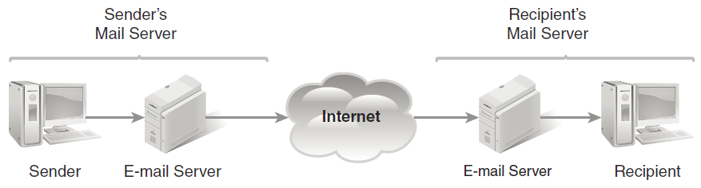
How Email Works
Notes:
Emails are generated by different types of devices and methods. Most commonly, a user composes a message on his or her computer and then sends it to his or her mail server. At this point, the user’s computer is finished with the job, but the mail server still has to deliver the message. The mail server sends and receives electronic mail. Most of the time, the mail server is separate from the computer where the mail was composed.
The sender’s mail server forwards the message through the organization’s network and/or the Internet to the recipient’s mail server. The message then resides on that second mail server and is available to the recipient. The software program used to compose and read email messages is the email client.
On the Internet, an email message can travel through many servers, referred to as "hops," that relay the message from the sender to the recipient.

Slide 6

What an Email Review Can Reveal
Email messages related to the investigation
Email addresses related to the investigation
Sender and recipient information
Information about those copied on the email
Content of the communications
Internet Protocol (IP) addresses

Slide 7
What an Email Review Can Reveal (Cont.)
Date and time information
User information
Attachments
Passwords
Application logs that show
evidence of spoofing

Slide 8
Email Protocols
Simple Mail Transfer Protocol (SMTP)
  Used to send email from a client to a mail server, and between servers
  Typically operates on port 25
  SMTPS (secure) operates on port 465

Slide 9
Email Protocols (Cont.)
Post Office Protocol version 3 (POP3)
  Used to receive email
  Operates on port 110, or 995 (secure)
  Designed to delete email on server as soon as user downloads email
Internet Message Access Protocol (IMAP)
    Used to receive email
    Operates on port 143
    User views email on the server, decides whether to download the mail; email is retained on server
Notes:
Latest version of IMAP is similar to POP3 but supports more features

Slide 10
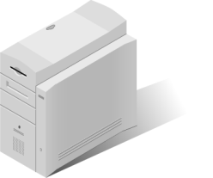


Email Protocol Process
Outbound Email
SMTP
SMTP
Internet
User
Server
Inbound Email
POP3/
IMAP
SMTP
Internet
Server
User

Slide 11
Faking Emails
Spoofing
Anonymous remailing
"Valid"
emails

Slide 12
Spoofing
Making an email message appear to come from someone or someplace other than the real sender or location
First machine to receive spoofed message records machine’s real IP address
Header contains both the faked IP and the real IP address
Notes:
Spoofing involves making an email message appear to come from someone or someplace other than the real sender or location. The email sender uses a software tool to cut out his or her IP address and replace it with someone else’s IP address.
However, the first machine to receive the spoofed message records the machine’s real IP address. Thus, the header contains both the faked IP and the real IP address—unless, of course, the perpetrator is clever enough to have also spoofed his or her actual IP address.

Slide 13
Anonymous Remailing
Suspect sends an email message to an anonymizer
  Anonymizer is email server that strips identifying information from message before forwarding it with anonymous mailing computer’s IP address
To find out who sent remailed email, must examine logs maintained by remailer or anonymizer companies
Notes:
This is an attempt to throw tracing or tracking attempts off the trail. A suspect using this technique sends an email message to an anonymizer, an email server that strips identifying information from an email message before forwarding it with the anonymous mailing computer’s IP address.
To find out who sent remailed email, look at any logs maintained by these remailer or anonymizer companies. Unfortunately, these services usually do not maintain logs. You can also closely analyze the message for embedded information that might give clues to the user or system that sent the message. Often the remailing servers are outside of the jurisdiction of U.S. law enforcement and may even be on another continent.

Slide 14
"Valid" Emails
Appears as through mail is from trusted source
Message content is suspicious
Content may contain URL that points to malicious site
Notes:
Emails may appear to be from a trusted source and seem to be valid in every respect, except for the content of the message. The email passes all of the normal validity checks such as header structure and content, and even comes from a good known nonspam email server. However, the message is suspicious. The website uniform resource locator (URL) pointed to in the message may be a hacker or phishing site. These messages usually contain no hidden URL, pictures, or attachments and are very short. However, clicking the URL can unleash malicious software or other negative results.

Slide 15
How to Fake an Email
Use free public Wi-Fi
Spoof IP address and MAC address
Send email through anonymous
email account
Notes:
Find a free public Wi-Fi in an area at least one hour from your home.
Spoof both your IP address and MAC address.
Send the email through an anonymous email account set up for that purpose.
It is, however, very common for criminals to actually send emails from their own computers without even bothering to spoof their IP address or MAC address. Even computer-savvy criminals, who think to spoof their IP addresses, might not think to spoof the MAC address.
Email address spoofing is only one kind of spoofing.

Slide 16
Email Message Components
Header
  Addressing information
  Source and destination
Body
  Contents of the message
Attachments
  External data that travels along with each message

Slide 17
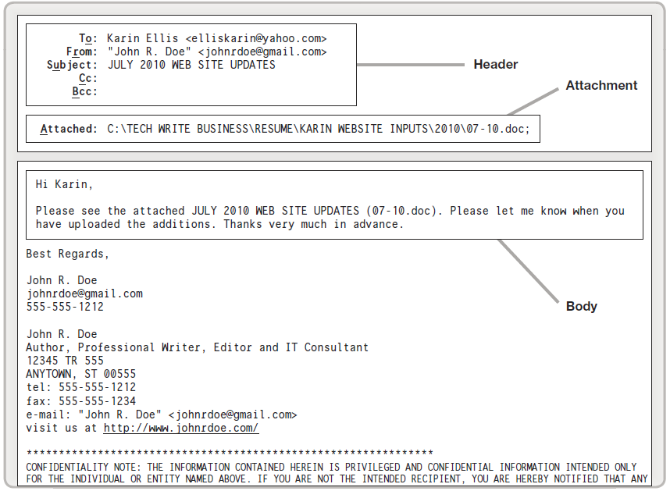
Email Message Components

Slide 18
Email Headers
RFC 2822
  Standard for email format, including headers
All email programs use the same email format, regardless of operating system
  Email from Outlook on a Windows 10 PC can be read by recipient using Hotmail on Android phone

Slide 19

Email Headers (Cont.)
Header keeps record of the message’s journey networks and mail servers
Each server adds information to the header
Each network device has an Internet Protocol (IP) address
  Identifies device
  Can be resolved to a
  location address
Notes:
The header for an email message tells you a great deal about the email. The header keeps a record of the message’s journey as it travels through the communications network. As the message is routed through one or more mail servers, each server adds its own information to the message header. Each device in a network has an Internet Protocol (IP) address that identifies the device and can be resolved to a location address. A forensic investigator may be able to identify IP addresses from a message header and use this information to determine who sent the message. So, the message header provides an audit trail of every machine through which the email has passed.

Slide 20
RFC 2822 Specifications for
Email Headers
Message header must include:
From field
The email address and, optionally, the name of the sender
Date field
The local time and date when the message was written

Slide 21
RFC 2822 Specifications for
Email Headers (Cont.)
Message header should include:
Message-ID field
An automatically generated field
In-Reply-To field
The message-ID of the message that this is a reply to
Notes:
In-Reply-To field: The message-ID of the message that this is a reply to; used to link related messages together

Slide 22
Email Header Fields (RFC 3864)
To
Subject
Cc/Bcc
Content-Type
Precedence
Received
References
Reply-To
Sender
Notes:
RFC 3864 describes message header field names. Common header fields for email include:
• To—The email address and, optionally, name of the message’s primary recipient(s)
• Subject—A brief summary of the topic of the message
• Cc—Carbon copy; a copy is sent to secondary recipients
• Bcc—Blind carbon copy; a copy is sent to addresses added to the SMTP delivery list while the Bcc address remains invisible to other recipients
• Content-Type—Information about how the message is to be displayed, usually
a Multipurpose Internet Mail Extensions (MIME) type
• Precedence—Commonly with values “bulk,” “junk,” or “list”; used to indicate that automated “vacation” or “out of office” responses should not be returned for this mail, for example, to prevent vacation notices from being sent to all other subscribers of a mailing list
• Received—Tracking information generated by mail servers that have previously handled a message, in reverse order (last handler first)
• References—Message-ID of the message to which this is a reply
• Reply-To—Address that should be used to reply to the message
• Sender—Address of the actual sender acting on behalf of the author listed in the From field

Slide 23
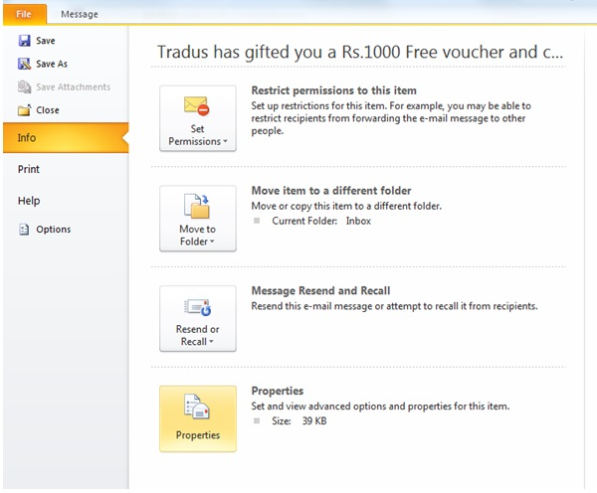
Find Microsoft Outlook 2010 Headers
Used with permission from Microsoft
Step 1
Notes:
It is relatively easy to view the headers using Outlook.
With a specific message open, select File and then Info. Then select Properties and you will be able to view the headers.
Older versions of Outlook have a different method to get to headers. With Outlook 2000/2003/2007, there are two methods:
Method #1—Right-click the message in the folder view, and then choose Options.
Method #2—In an open message, choose View and then Options.
With either method, you will see the Internet headers portion of the Message Options dialog box.

Slide 24
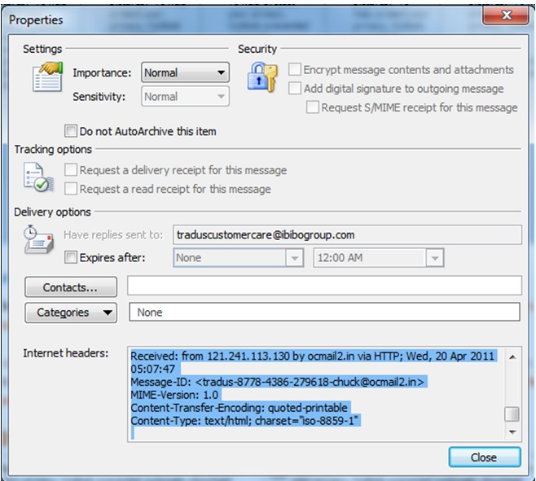
View Outlook 2010 Headers
Used with permission from Microsoft
Step 2
Notes:
It is relatively easy to view the headers using Outlook.
With a specific message open, select File and then Info. Then select Properties and you will be able to view the headers.
Older versions of Outlook have a different method to get to headers. With Outlook 2000/2003/2007, there are two methods:
Method #1—Right-click the message in the folder view, and then choose Options.
Method #2—In an open message, choose View and then Options.
With either method, you will see the Internet headers portion of the Message Options dialog box.

Slide 25
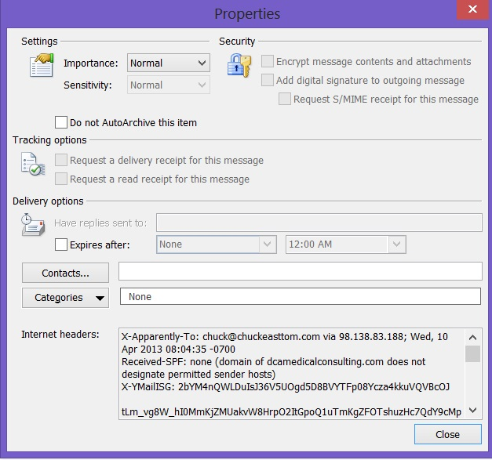
Microsoft Outlook 2010 Headers
Used with permission from Microsoft
Notes:
It is relatively easy to view the headers using Outlook.
With a specific message open, select File and then Info. Then select Properties and you will be able to view the headers.
Older versions of Outlook have a different method to get to headers. With Outlook 2000/2003/2007, there are two methods:
Method #1—Right-click the message in the folder view, and then choose Options.
Method #2—In an open message, choose View and then Options.
With either method, you will see the Internet headers portion of the Message Options dialog box.

Slide 26
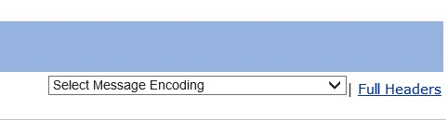
Find Yahoo! Headers
Courtesy of Yahoo!
Notes:
First open the message. On the lower right, there is a link named Full Headers. Clicking on that link allows you to see the headers for that email.

Slide 27
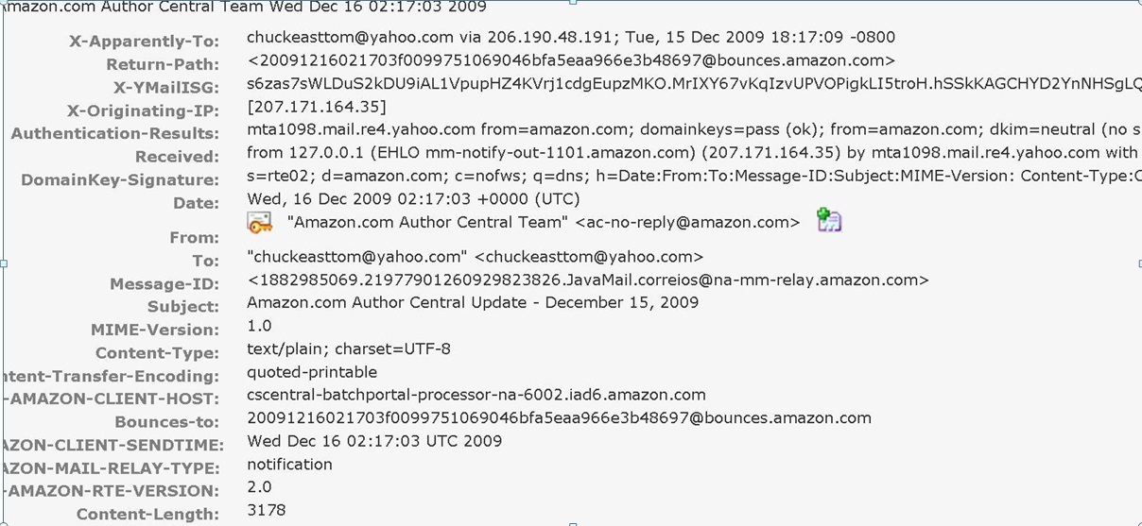
View Yahoo! Headers
Courtesy of Yahoo!

Slide 28
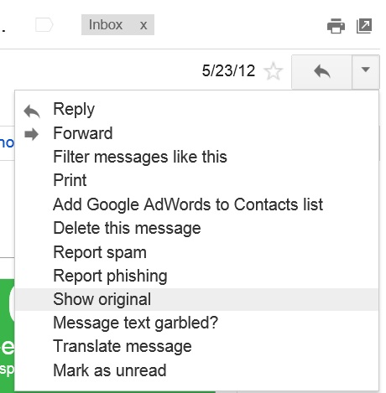
Find Gmail Headers
Google and the Google logo are registered trademarks of Google Inc.,
used with permission
Notes:
Viewing email headers in Gmail is fairly simple. Follow these steps:
1. Log on to Gmail.
2. Open the message for which you want to view headers.
3. Click the down arrow next to Reply, at the top of the message pane.
4. Select Show Original.
The headers appear in a separate window.

Slide 29
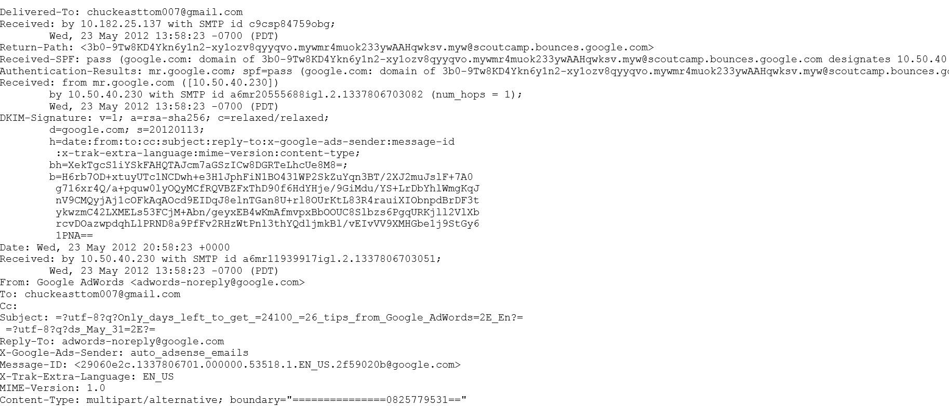
View Gmail Headers
Google and the Google logo are registered trademarks of Google Inc.,
used with permission
Notes:
The headers appear in a separate window.

Slide 30
View Hotmail Email Headers
Select Inbox from the menu on the left.
Right-click the message for which you want to view headers, and select View Message Source.
The full headers will appear in a new window.

Slide 31
View Apple Mail Email Headers
Open Apple Mail.
Click on the message for which you want to view headers.
Go to the View menu.
Select Message, then Long Headers.
The full headers will appear in the window below your Inbox.

Slide 32
Email Files
.pst
(Outlook)
.ost
(Offline Outlook Storage)
.mbx or .dbx
(Outlook Express)
.mbx
(Eudora)
.emi
(common to several email clients)

Slide 33
Paraben’s Email Examiner
Exclusively for email forensics
Works like the more complete forensic suites (Forensic Toolkit and EnCase) in that evidence is grouped by case

Slide 34
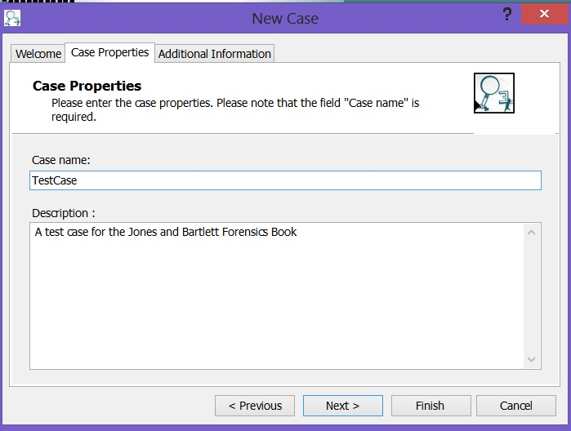
Creating a Paraben Case
Courtesy of Paraben Corporation
Notes:
When you first start Paraben, you select New and then create a new case.

Slide 35
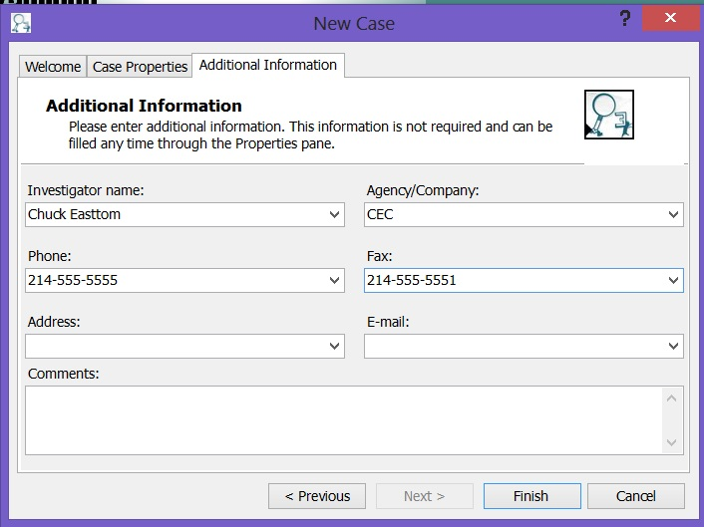
Adding the Investigator
Courtesy of Paraben Corporation
Notes:
Paraben will associate information about the investigator along with the case information.

Slide 36
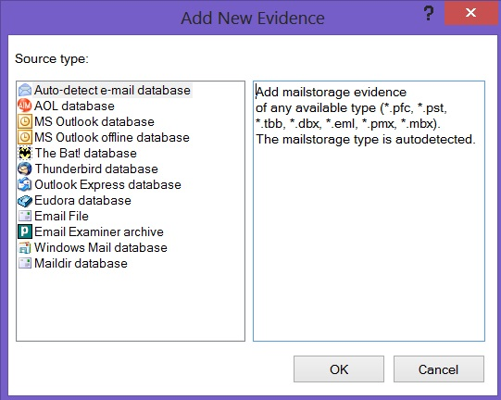
Selecting an Email Database
Courtesy of Paraben Corporation
Notes:
Next, select the type of email database you are going to be working with. The major email clients are all represented.
At this point, you select the database you want to work with, and it is added to the case.
From within Paraben, you can sort, search, scan, and otherwise work with the email data.

Slide 37
Tracing Email
Looking at each point through which an email passed and working step by step back to the originating computer
Notes:
Tracing email In some ways, forensic email tracing is similar to traditional detective work. Tracing email involves looking at each point through which an email passed and working step by step back to the originating computer and, eventually, the perpetrator.
Email header information is typically examined to look for clues about where a message has been. Investigators often use audits or paper trails of email traffic as evidence in court. Many investigators recommend use of the tracert command. However, because of the dynamic nature of the Internet, tracert does not provide reliable, consistent, or accurate routing information for an email.
It may also be useful to determine the ownership of the source email server for a message. A number of whois databases are available on the Web that an investigator can use to find out to whom a given IP address is registered.

Slide 38
Email Server Forensics
Examining email servers
  Searching through deleted emails retained by the server
Many servers have a retention policy
Notes:
At some point, you will need to check the email server. Even if the sender and the recipient have deleted the relevant emails, there is a good chance a copy is still on the email server. Many servers have a retention policy, which may be governed by law in certain industries. There are a variety of email server programs that could be in use. Microsoft Exchange is a very common server. Lotus Notes and Novell GroupWise are also popular email server products.

Slide 39
Email Laws
The Fourth Amendment to the U.S. Constitution
The Electronic Communications Privacy Act (ECPA)
The CAN-SPAM Act
18 U.S.C. 2252B
Communication Assistance for Law Enforcement Act (CALEA)
Foreign Intelligence Surveillance Act (FISA)
The USA PATRIOT Act
Notes:
The Fourth Amendment to the U.S. Constitution
The Fourth Amendment to the U.S. Constitution as well as state requirements govern the seizure and collection of any email messages that reside on a sender’s or recipient’s computer or other device. Does the person on whose computer the evidence resides have a reasonable expectation of privacy on that computer? If so, the Fourth Amendment requires a search warrant or one of the recognized exceptions to the search warrant requirements, such as consent from the device owner.
The Electronic Communications Privacy Act
If an Internet service provider (ISP) or any other communications network stores an email, retrieval of that evidence must be analyzed under the Electronic Communications Privacy Act (ECPA). The ECPA creates statutory restrictions on government access to such evidence from ISPs or other electronic communications service providers.
The ECPA requires different legal processes to obtain specific types of information:
Basic subscriber information—This information includes name, address, billing information, telephone number, etc. An investigator can obtain this type of information with a subpoena, court order, or search warrant.
Transactional information—This information includes websites visited, email addresses of others with whom the subscriber exchanged email, and buddy lists. An investigator can obtain this type of information with a court order or search warrant.
Content information—An investigator who has a search warrant can obtain content information from retrieved email messages and also acquire unretrieved stored emails.
Real-time access—To intercept traffic as it is sent or received, an investigator needs to obtain a wiretap order.
The CAN-SPAM Act
This was the first law meant to curtail unsolicited email, referred to as spam. However, the law has loopholes.
You do not need permission before sending email. This means that unsolicited email is not prohibited.
It applies only to commercial emails—emails that are trying to sell some product or service. Therefore, mass emailings for political, religious, or ideological purposes are not covered by the Act.
The only requirement of CAN-SPAM is that the sender must provide some mechanism whereby the receiver can opt out of future emails and that method cannot require the receiver to pay in order to opt out.
Restrictions on how the sender can acquire the recipient’s email address and how the sender can actually transmit the email:
A message cannot be sent through an open relay.
A message cannot be sent to a harvested email address.
A message cannot contain a false header.
These methods are often used by people who send spam email. Tracking down the original sender of the email is the first step in investigating spam. Unfortunately, the email is sometimes sent from offshore sites or relayed through an innocent third party’s servers. This makes prosecuting spam very difficult and enforcing a judgment almost impossible in most cases.
18 U.S.C. 2252B
This law is about perpetrators who attempt to hide the pornographic nature of their website, often to make it more accessible to minors.
This is a very serious concern, and one that sometimes arises in child predator cases.
Communication Assistance for Law Enforcement Act (CALEA)
CALEA is a U.S. wiretapping law. Its purpose is to allow law enforcement and intelligence agencies to lawfully conduct electronic surveillance by requiring that telecommunications carriers and manufacturers of telecommunications equipment modify and design their equipment, facilities, and services to ensure that they have built-in surveillance capabilities, allowing federal agencies to monitor all telephone, broadband Internet, and VoIP traffic in real time.
Foreign Intelligence Surveillance Act (FISA)
This U.S. law prescribes procedures for the physical and electronic surveillance and collection of “foreign intelligence information” between foreign powers and agents of foreign powers, which may include American citizens and permanent residents suspected of espionage or terrorism.
The law does not apply outside the United States but may be encountered by a forensic investigator in researching intelligence even if it does not specifically regard espionage or terrorism. The law is an important part of many agencies’ approaches to information gathering. It has been amended frequently so it is important to stay current on the latest revisions and court cases.
The USA PATRIOT Act
The USA PATRIOT Act of 2001 was passed into law as a response to the terrorist attacks of September 11, 2001. The Act:
Reduced restrictions on law enforcement agencies’ intelligence gathering within the United States
Expanded the Secretary of the Treasury’s authority to regulate financial transactions
Broadened the discretion of law enforcement and immigration authorities in detaining and/or deporting immigrants suspected of terrorism and related acts
Expanded the definition of terrorism to include domestic terrorism, thus enlarging the number of activities to which the PATRIOT Act’s extended law enforcement powers can be applied
In May of 2011, President Barack Obama signed a four-year extension of three key provisions in the USA PATRIOT Act: roving wiretaps, searches of business records, and conducting surveillance of individuals suspected of terrorist-related activities not linked to terrorist groups.
The PATRIOT Act gives law enforcement dramatically enhanced powers for information gathering and should be a part of the knowledge base for any forensic investigator.

Slide 40
Summary
Email clients and servers
Email headers
Email tracing
Email server forensic examination
Laws related to email investigations

