Slide 1
System Forensics, Investigation, and Response
Lesson 9
Linux Forensics

Slide 2
Learning Objective
Summarize various types of digital forensics.

Slide 3
Key Concepts
Linux file systems
What to look for in Linux system logs
Forensically interesting Linux directories
Important Linux shell commands
How to undelete files from Linux

Slide 4
History of Linux
1969
UNIX created
1972
UNIX released
1983
GNU
Notes:
1969: UNIX created at Bell Laboratories
1972: UNIX operating system released
1983: Richard Stallman creates GNU (GNU’s Not UNIX

Slide 5
History of Linux (Cont.)
1987
Minix
1991
Linux
2017
Hundreds of Linux distros
Notes:
1987: Andrew S. Tanenbaum creates Minix, another UNIX variant
1991: Linus Torvalds begins creating Linux
2017: Hundreds of Linux distributions are available

Slide 6
Linux Shells
Bourne shell (sh)
Bourne-again shell (Bash)
C shell (csh)
Korn shell (ksh)
Notes:
Many Linux administrators work entirely in the shell without ever using a graphical user interface (GUI). Linux offers many different shells, such as:
Bourne shell (sh)—This was the original default shell for UNIX. It was first released in 1977.
Bourne-again shell (Bash)—This is the most commonly used shell in Linux. It was released in 1989.
C shell (csh)—This shell derives its name from the fact that it uses very C-like syntax. Linux users who are familiar with C will like this shell. It was first released for UNIX in 1978.
Korn shell (ksh)—This is a popular shell developed by David Korn in the 1980s. The Korn shell is meant to be compatible with the Bourne shell, but to also incorporate true programming language capabilities.

Slide 7
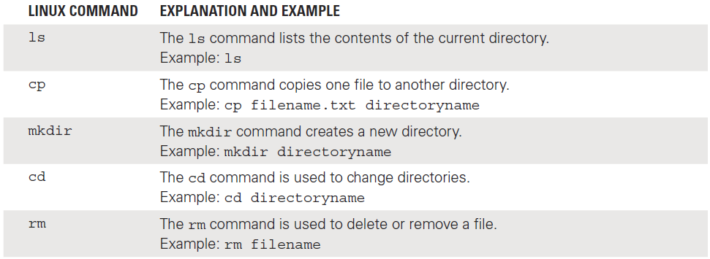
Common Linux Shell Commands

Slide 8
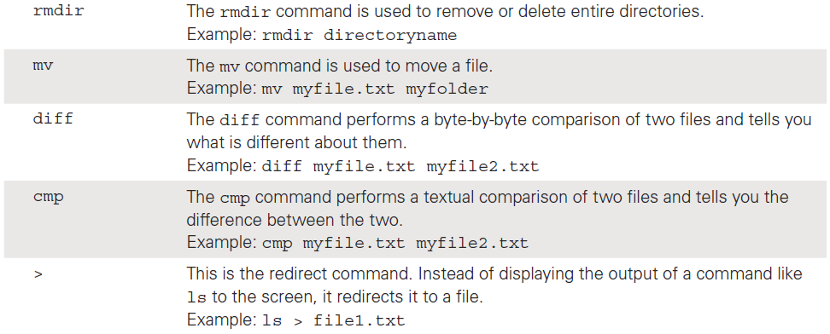
Common Linux Shell Commands (Cont.)

Slide 9
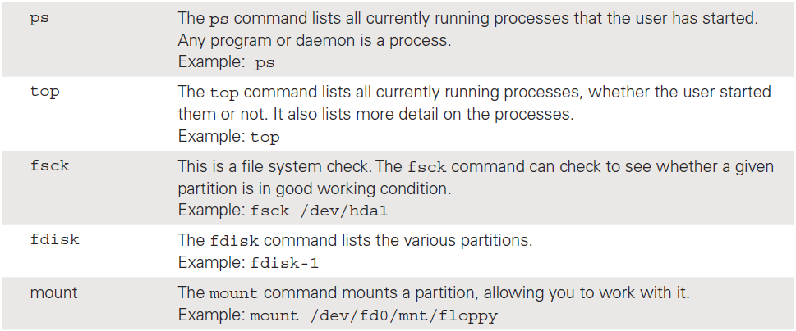
Common Linux Shell Commands (Cont.)

Slide 10
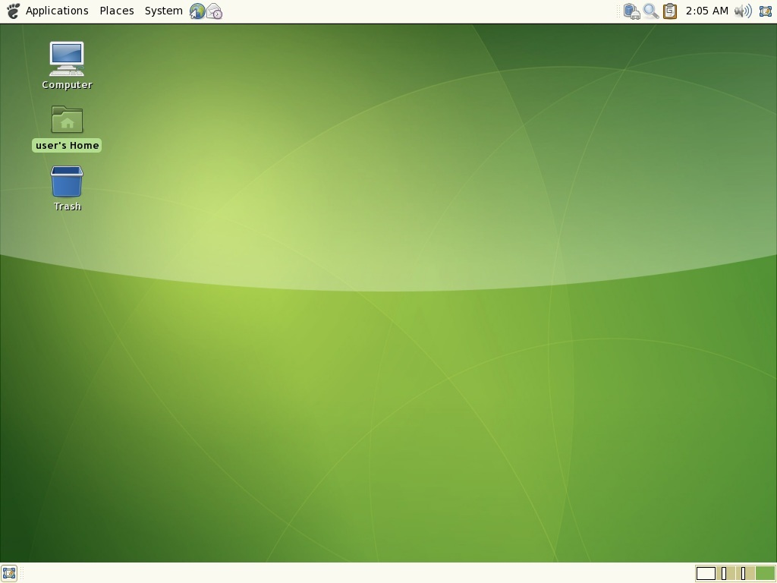
GNU Network Object Model Environment (GNOME)
Courtesy of The GNOME Project
Notes:
GNU Network Object Model Environment (GNOME)
Most Linux distributions include GNOME
Is built on GTK+
Is a cross-platform toolkit for creating graphical user interfaces
Includes hundreds of free applications, including Inkscape (drawing program), Gimp (paint program), and Banshee (music and video player)
One of the two most popular GUIs for Linux

Slide 11
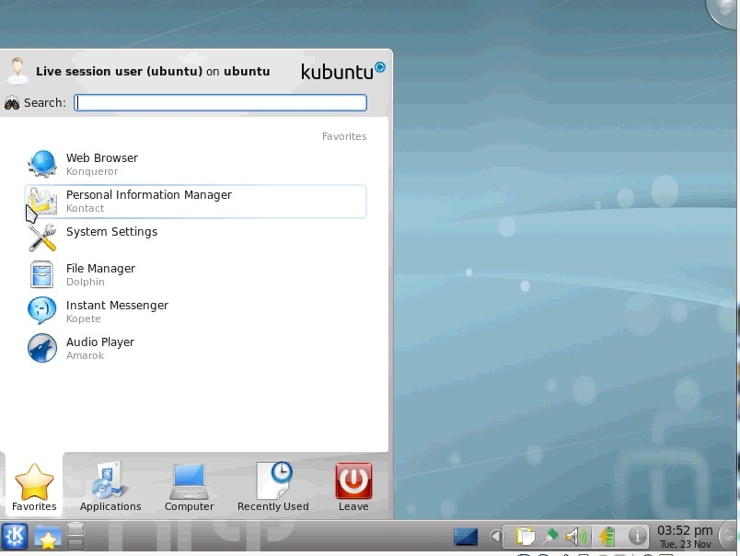
K Desktop Environment (KDE)/Plasma
Courtesy of TKDE
Notes:
K Desktop Environment (KDE)
Most Linux distributions ship with either KDE or GNOME, or both.
Is built on the Qt framework, a multiplatform GUI framework written in C++.
The name KDE was intended as a word play on the Common Desktop Environment (CDE) available for UNIX systems. Today, the K stands for nothing and the acronym stands for K Desktop Environment.
Like GNOME, KDE includes hundreds of free applications, such as Karbon14 (scalable graphics program), KolourPaint (paint program), and KPlayer (multimedia player)

Slide 12
Other Linux GUIs
Common Desktop Environment (CDE)
  Originally developed in 1994 for UNIX systems
  Based on HP’s Visual User Environment (VUE)
Enlightenment
  Relatively new
  Designed for graphics developers

Slide 13
Linux Boot Process
BIOS
POST
MBR
GRUB
LILO
Kernel
Initializes devices
Real mode to protected mode
Notes:
Step 1
Linux is often used on embedded systems, even smartphones. In such cases, when the system is first powered on, the first step is to load the bootstrap environment. On a PC, booting Linux begins in the BIOS (basic input/output system) at address 0xFFFF0.
Just as with Windows, the first sector on any disk is called the boot sector. It contains executable code that is used in the boot process. A boot sector also has the hex value 0xaa55 in the final two bytes. Also, as in Windows, after the BIOS has been loaded and the power-on self test (POST) has completed, the BIOS locates the master boot record (MBR) and passes control to it.
Step 2
The MBR then loads up a boot loader program, such as LILO (Linux Loader) or GRUB (Grand Unified Bootloader). Often boot loaders are larger than a single sector, so they are loaded in stages. When a bootable device is found, the first-stage boot loader is loaded into random access memory (RAM) and executed.
In Linux, there are actually two boot loaders.
The first boot loader is less than 512 bytes in length (a single sector), and its job is to load the second-stage boot loader.
The second boot loader is responsible for loading the Linux kernel.
Step 3
When the second-stage boot loader is loaded into RAM and executing, a splash screen is commonly displayed. At this point, the Linux image is loaded into RAM. When the images are loaded, the second-stage boot loader passes control to the kernel image and the kernel is decompressed and initialized.
At this point, the second-stage boot loader checks the system hardware and any attached peripherals. Once the devices are enumerated, the second-stage boot loader can attempt to mount the root device and load the necessary kernel modules.
Step 4
The second-stage boot loader loads the kernel image. This is called the kernel stage of the boot process. The kernel must initialize any devices the system has. Even devices that have been initialized by the BIOS must be reinitialized. The system then switches the CPU from real mode to protected mode. The system now loads the compressed kernel and calls the decompress_kernel() function. It is at this point that you may see the “Uncompressing Linux...” message displayed on the screen. Now the start_kernel() function is called, and the uncompressed kernel displays a large number of messages on the screen as it initializes the various hardware items and processes such as the scheduler.

Slide 14
Linux Boot Process (Cont.)
INIT
Runlevels
Notes:
Step 5
Once the kernel is initialized, the first user program starts. In PC-based Linux systems, that first process is called init. The kernel_thread() function is called next to start init. The kernel goes into an idle loop and becomes an idle thread with process ID 0. The process init() begins high-level system initialization. Note that unlike PC systems, embedded systems have a simpler first user process than init.
Step 6
The boot process then inspects the /etc/inittab file to determine the appropriate run level. Based on the run level, the init process then executes the appropriate start-up script. Those scripts are located in subdirectories of the /etc/rc.d directory. Scripts used for run levels 0 to 6 are located in subdirectories /etc/rc.d/rc0.d through /etc/rc.d/rc6.d, respectively. The default boot run level is set in the file /etc/inittab with the initdefault variable. At this point, the boot process is over, and Linux is up and running!

Slide 15
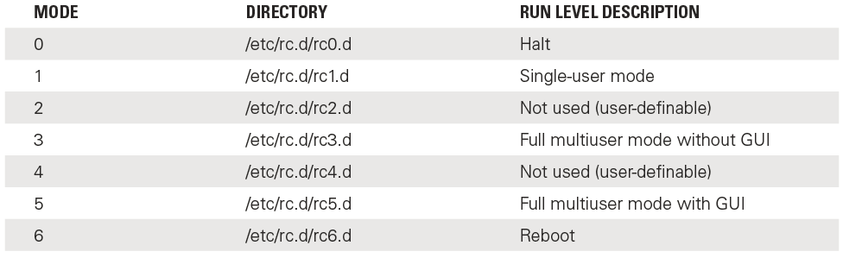
Run Levels

Slide 16
Logical Volume Manager
An abstraction layer that provides volume management for the Linux kernel
On a single system (like a single desktop or server), primary role is to allow:
  The resizing of partitions
  The creation of backups by taking snapshots of the logical volumes

Slide 17
Linux Distributions
Open source operating system
Popular distributions:
  Ubuntu
  Red Hat Enterprise Linux (RHEL)
  OpenSUSE
  Debian
  Slackware
Notes:
Linux is open source, so a number of different distributions are available. They all have the same Linux shells but they each have differences.
Ubuntu—Very popular with beginners
Red Hat Enterprise Linux (RHEL)—Often used with large-scale servers
openSUSE—A popular, general-purpose Linux distribution
Debian—Another popular, general-purpose Linux distribution
Slackware—Becoming more popular

Slide 18
Linux File Systems
Extended File System (ext)
  Current version is 4
ext4 supports volumes up to 1 exabyte and single files up to 16 terabytes
ext3 and ext4 support three types of journaling:
  journal (most secure)
  ordered
  writeback (least secure)
Notes:
Journaling levels:
The most secure and safe level is called journal–With the journal level, metadata and file contents are written to the journal before being written to the main file system.
The next level is called ordered–It is slightly less secure than journal. With the ordered level only metadata is written to the journal; however, changes to files are not journaled until they have been committed to the disk.
The least secure level is writeback–With the writeback level, only metadata is written to the journal, and it might be written to the journal before or after it is actually committed. Ext4 added checksums in the journal to prevent errors.

Slide 19
Linux File Systems (Cont.)
Reiser File System
  Supports journaling
  Performs well when hard disk has large number of smaller files
Berkeley Fast File System
  Also known as UNIX File System
  Developed at UC-Berkeley for Linux
  Uses a bitmap to track free clusters, indicating availability
Notes:
The Reiser File System (ReiserFS) was first introduced as a part of the Linux kernel version 2.4.1. ReiserFS has always supported journaling. ReiserFS performs very well when the hard drive has a large number of smaller files. In fact, when you are dealing with files that are under 4 KB in size, ReiserFS outperforms ext2 and ext3.
The Berkeley Fast File System is also known as the UNIX File System. It was developed at University of California, Berkeley specifically for use with Linux. This system uses a bitmap to track free clusters, indicating which clusters are available and which are not.

Slide 20
Linux Logs
Log | Contents
/var/log/faillog | Failed user logins
/var/log/kern.log | Messages from the operating system’s kernel
/var/log/lpr.log | Items that have been printed
/var/log/mail.* | Email activity
/var/log/mysql.* | MySQL database server activity
Notes:
/var/log/faillog
This log file contains failed user logins. This can be very important when tracking attempts to crack into the system. Numerous failed login attempts, or even frequent failed login attempts that occur at diverse times, can be an indicator of someone trying to compromise access to the system. It is also worth noting the times of failed login attempts. If an employee normally works from 8:00 a.m. to 5:00 p.m. and there are failed login attempts at 11:00 p.m., that may be a warning sign.
/var/log/kern.log
This log file is used for messages from the operating system’s kernel. This log is less interesting forensically. It is more likely to show systemwide problems. However, it is possible for someone to mistake system issues for some intrusion or malware. If you have odd behavior on a target system and find related messages in the kern.log, it may allow you to rule out malware.
/var/log/lpr.log
This is the printer log. It can give you a record of any items that have been printed from this machine. That can be useful in many cases. For example, corporate espionage cases often involve the criminal printing out sensitive documents.
/var/log/mail.*
This is the mail server log. It can be very useful in any computer crime investigation. Email can also be useful in criminal investigations (such as cyberstalking cases) as well as in civil litigation cases.
/var/log/mysql.*
This log records activities related to the MySQL database server. These are of most interest in crimes involving database attacks. For example, SQL injection attacks might leave a record in the database log.

Slide 21
Linux Logs (Cont.)
Log | Contents
/var/log/apache2/* | Apache web server activity
/var/log/lighttpd/* | Lighttpd web server activity
/var/log/apport.log | Application crashes
Intrusion detection system logs | Suspicious traffic
Notes:
/var/log/apache2/*
If the machine is running the Apache web server, then this log shows related activity. This can be very useful in tracking attempts to hack into the web server. You can examine the log to see attempts at buffer overflow attacks, denial of service attacks, and a variety of other attacks.
/var/log/lighttpd/*
If the machine is running the Lighttpd web server, then this log shows related activity. This can be very useful in tracking attempts to hack into the web server.
/var/log/apport.log
This log records application crashes. Sometimes these can reveal attempts to compromise the system or the presence of malware. Of course, it can also simply reveal a buggy application.
Other logs
Any other applications running on the Linux computer that store logs can be useful in your forensic examination. For example, if you are using an intrusion detection system (IDS) such as Snort, it keeps logs of all suspicious traffic. That can be very useful in your investigation.

Slide 22
Viewing Logs
Text editor in GUI
Any of these commands work from the shell:
  dmesg | lpr
  # tail -f /var/log/lpr.log
  # less /var/log/ lpr.log
  # more -f /var/log/ lpr.log

Slide 23
Linux Directories
Key directories are important to the functioning of every operating system
Directories are also important places to seek out evidence in an investigation

Slide 24
/root
Home directory for the root user
  Contains data for the administrator
Linux root user is equivalent to Windows Administrator

Slide 25
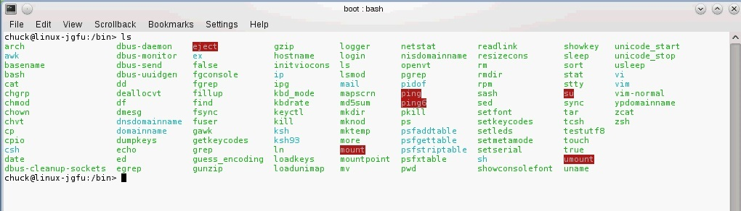
The /bin Directory
Notes:
Holds binary or compiled files used by ordinary users
Can include malware

Slide 26
/sbin
Similar to /bin
Contains binary files not intended for the average computer user
Notes:
For example, the mke2fs command, a file system utility that is usually utilized by administrators, is in this directory.

Slide 27
/etc
Contains configuration files, such as for web servers, boot loaders, security software, and many other applications
Notes:
The /etc folder contains configuration files. Most applications require some configuration when they start up. The web servers, boot loaders (LILO and GRUB), and many other applications have configuration files. Obviously, an intruder into a system may want to change how a given application behaves. web server, boot loader, and security software configuration files would be attractive targets for any hacker.

Slide 28
/etcinittab File
Sets boot-up process and operation
  Example: init level for the system on start-up
label
run_level
action:a
process
boot
bootwait
initdefault
sysinit
Notes:
inittab entries:
• label—A unique identification label of up to four characters.
• run_level—The init level at which the entry is executed.
• action:a—A keyword indicating the action that init is to take on the process.
• process—The process init executes upon entering the specified run level.
• boot—Starts the process and continues to the next entry without waiting for the
process to complete. When the process dies, init does not restart the process.
• bootwait—Starts the process once and waits for it to terminate before going on to the next inittab entry.
• initdefault—Determines which run level to enter initially, using the highest number in the run_level field. If there is no initdefault entry in inittab, then init requests an initial run level from the user at boot time.
• sysinit—Starts the process the first time init reads the table and waits for it to terminate before going on to the next inittab entry.

Slide 29
/dev
Contains device files
  Interfaces to devices
All devices should have a device file in /dev
Device naming conventions:
  hd = hard drive
  fd = floppy drive
  cd = CD
  Example: Main hard drive can be /dev/hd0

Slide 30
/mnt
Many devices are mounted in /mnt
Drives must be mounted prior to use
Checking this directory lets you know what is currently mounted on system
Notes:
Many devices, such as floppy and CD-ROM drives, are mounted in the /mnt directory. Any drive must be mounted prior to its use. The process of mounting a drive simply involves the operating system accessing it and loading it into memory. Modern Linux distributions do this for you. From a forensic perspective, checking this directory lets you know what things are currently mounted on the system.

Slide 31
/boot
Contains files critical for booting
Boot loader (LILO or GRUB) looks in this directory
Kernel images commonly located in /boot
Notes:
The boot directory contains those files critical for booting. Your boot loader (whether it is LILO or GRUB) looks in this directory. It is a common practice to keep kernel images in this directory.

Slide 32
/usr
Contains subdirectories for individual users
Notes:
This directory contains the subdirectories for individual users. In cases of suspected corporate espionage, these directories might contain valuable evidence.

Slide 33
/var and /varspool
/var
  Contains data that is changed during system operation
/varspool
  Contains the print queue
Notes:
The /var directory contains data that is changed during system operation. This directory is only useful on a live system. Once you shut down the system, the contents of this directory will be different the next time the system is booted up.
The /varspool directory contains the print queue, so it can be very important if something is currently in the print queue.

Slide 34
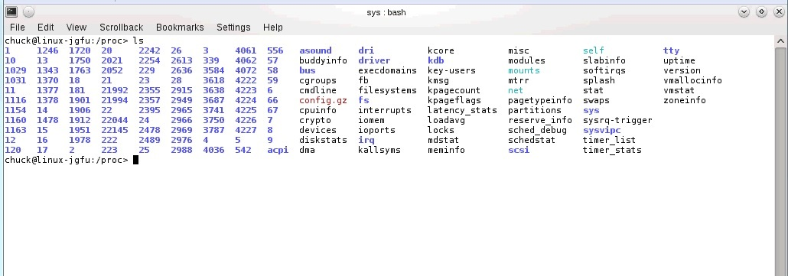
The /proc Directory
Notes:
Not stored on hard disk
Is created in memory and keeps information about currently running processes
Contains subdirectories that can be used to recover files and evidence
Assume that an intruder has downloaded a password cracker and is attempting to crack system passwords. The tool is attempting a number of passwords
in a text file called pass. The intruder subsequently deletes both the executable and the text file, but the process is still running in memory. You can use ps or pstree to find the running processes and get the process ID. Assume the process ID is 3201. Now in the /proc directory, you can find /proc/3201. If you simply copy the executable from /proc to some other directory, it recovers that deleted executable. Of course, this works only on a live system, prior to shutting it down.

Slide 35
Shell Commands for Forensics
Linux has hundreds of shell commands
Some can be very useful in forensic investigations

Slide 36
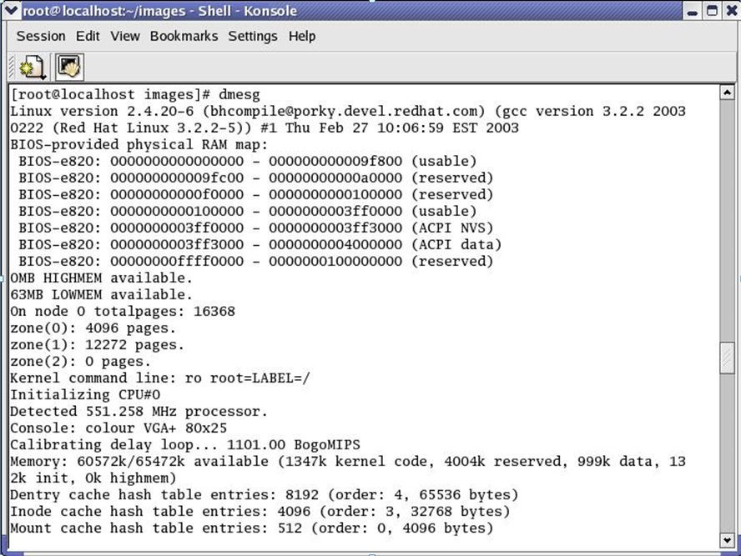
The dmesg Command
Notes:
When your system boots up, you see a lot of information telling you what processes are starting, what processes failed, what hardware is being initialized, and more. This can be invaluable information to a forensic investigation. You can use the dmesg command to view all the messages that were displayed during the boot process.
The command dmesg displays the messages for you. However, it does tend to fill up multiple screens. It is recommended that you simply pipe the output to some file (for example, dmesg>myfile.txt) and then search that file.

Slide 37
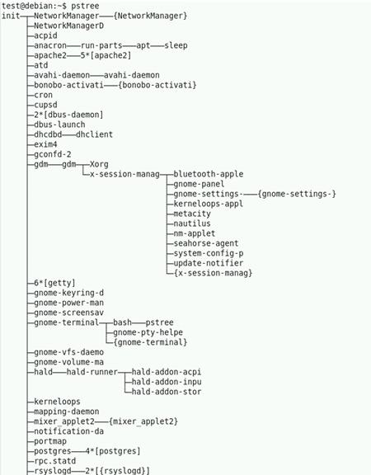
The pstree Command
Notes:
The pstree command is similar to the ps command, except it shows all the processes in the form of a tree structure.
The tree format gives more information particular to a given forensic investigation.
Not only will you know what processes are running, but also which process initiated those processes.

Slide 38
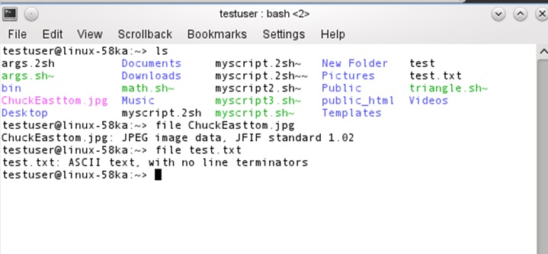
The file Command
Notes:
The file command can tell you exactly what a file is regardless of whether or not it has been renamed or had its extension changed. This can be very important in a forensic investigation. The file command will help you in situations where the criminal has changed the file extension to make the file appear to be something other than what it is.

Slide 39
Undeleting Linux Files: Manually
Move system to single-user mode
Use grep or similar command
Example: grep -b ‘search-text’ /dev/partition > file.txt
Use command-line editor to view file
Notes:
When you refer to a file by name, the operating system uses the filename to look up the corresponding inode, which then enables the system to obtain the information it needs about the file to perform further operations.
From the operating system’s perspective, a filename is really just an entry in a table with inode numbers. The name is just a human-readable method of locating the inode number. The inode is a link to the file. The operating system keeps a count of references to this link. When the reference count reaches zero, the file is deleted. This is why deleted files can sometimes be recovered.
There are many methods for recovering deleted files in Linux. One manual method is to:
1. Move the system to single-user mode. The init command can be used for this purpose.
2. Once you have moved to single user mode, there are several methods you might use. The following is a rather traditional UNIX/Linux method using the grep
command. Use the following grep syntax:
grep -b ‘search-text’ /dev/partition > file.txt
or
grep -a -B[size before] -A[size after] ‘text’ /dev/[your_partition] > file.txt
The flags used are defined as follows:
-i—Ignore case distinctions in both the PATTERN and the input files; that is,
match both uppercase and lowercase characters.
-a—Process a binary file as if it were text.
-B—Print number lines/size of leading context before matching lines.
-A—Print number lines/size of trailing context after matching lines.
For example, to recover a text file starting with “criminalevidence” on /dev/sda1, you can try the following command:
# grep -i -a -B10 -A100 ‘criminalevidence’ /dev/sda1 > file.txt
3. Use a command-line text editor to view the file contents, such as file.txt. You can then save that file.

Slide 40
Let’s Play:
Identify the Shell Command

Slide 41
Command 1
Displays the commands that have previously been entered
Answer choices:
  dmesg
  grep
  history
  ls

Slide 42
Answer 1
history
Notes:
The history command allows you to see the commands that have previously been entered. By default, this command returns the last 500 shell commands. This command can be very useful on a live system. When you first locate a Linux machine that is suspect, this is one of the commands you might want to run and record the results of before powering down the system.

Slide 43
Command 2
Shows all the processes in the form of a tree structure
Answer choices:
  ps
  pstree
  ls
  top

Slide 44
Answer 2
pstree
Notes:
The pstree command is very similar to the ps command, except it shows all the processes in the form of a tree structure. The tree format gives more information particular to a given forensic investigation. Not only will you know what processes are running, but also which process initiated those processes.

Slide 45
Command 3
Takes the name you provide and returns the ID for that process; can work with partial names
Answer choices:
  pgrep
  dd
  grep
  file

Slide 46
Answer 3
pgrep
Notes:
The pgrep command takes the name you provide it and returns the ID for that process. It can even work with partial names. This is useful as many other commands require the process ID, so pgrep can help you retrieve that if you know the name of a process.

Slide 47
Command 4
Lists the processes in the order of how much CPU time the process is utilizing
Answer choices:
  ps
  ls
  su
  top

Slide 48
Answer 4
top
Notes:
The top command is similar to the ps command, except it lists the processes in the order of how much CPU time the process is utilizing. When examining a drive for the presence of malware, this can be a useful command. A virus or worm may be using up an excessive amount of CPU time, thus slowing down the infected machine.

Slide 49
Command 5
A criminal changes a file extension. This command can identify the file.
Answer choices:
  history
  ls
  file
  mount

Slide 50
Answer 5
file
Notes:
The file command can tell you exactly what a file is regardless of whether it has been renamed or had its extension changed. This can be very important in a forensic investigation. The file command will help you in situations where the criminal has changed the file extension to make the file appear to be something other than what it is.

Slide 51
Command 6
Halts a running process based on the process ID (PID) you provide
Answer choices:
  kill
  dmesg
  ps
  finger

Slide 52
Answer 6
kill
Notes:
The kill command is perhaps the simplest command of all. You simply type in the word kill followed by the process ID (PID) to halt a running process. For example:
kill 1045

Slide 53
Command 7
Invokes the super user mode
Answer choices:
  who
  grep
  finger
  su

Slide 54
Answer 7
su
Notes:
At times, you may be at a Linux machine where someone has logged in, and you need to perform some task that requires the privileges of the root user. Logging out, then logging back in as the root, can be tedious. Fortunately, you don’t have to do that. You can simply invoke the super user mode. If you type in su at the shell, you are asked for the root password. If you can successfully supply it, you will then have root privileges.

Slide 55
Command 8
Provides information about a specific user
Answer choices:
  finger
  who
  su
  grep

Slide 56
Answer 8
finger
Notes:
The finger command is used to get back information regarding a specific user. This is often useful for a system administrator. For example, if you run top, and see that one specific user is spawning several processes on your server, and those processes are consuming resources, then you may want to find out about that user. This is great to use along with the who command. After you know who is on your system, you can find out specific information about that user.

Slide 57
Kali Linux
Has a number of forensics tools
Can use as quality control tool to complement OSForensics, FTK, or Encase
Includes Autopsy, a web-based graphical user interface for the command-line tool Sleuth Kit

Slide 58
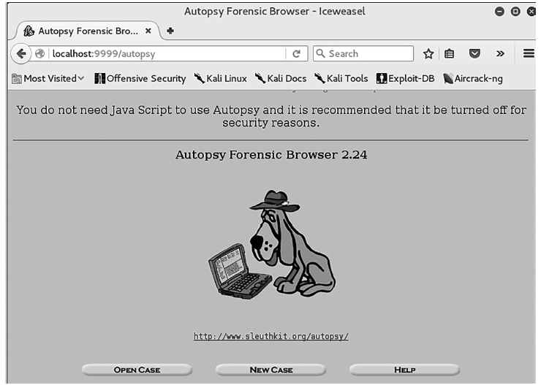
Autopsy

Slide 59
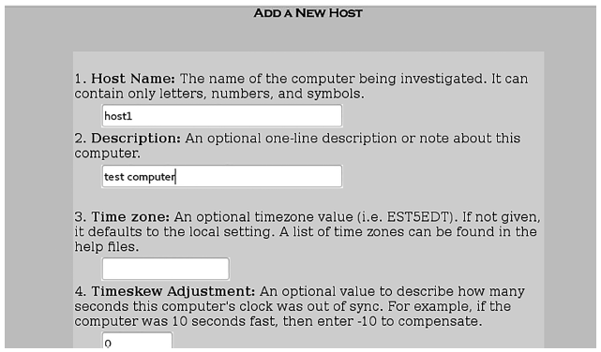
Autopsy (Cont.)
Notes:
The file command can tell you exactly what a file is regardless of whether or not it has been renamed or had its extension changed. This can be very important in a forensic investigation. The file command will help you in situations where the criminal has changed the file extension to make the file appear to be something other than what it is.

Slide 60
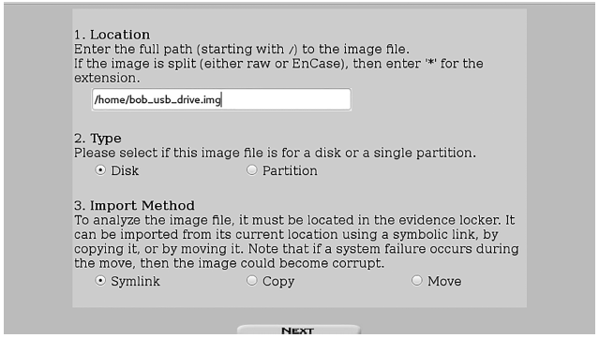
Autopsy (Cont.)
Notes:
The file command can tell you exactly what a file is regardless of whether or not it has been renamed or had its extension changed. This can be very important in a forensic investigation. The file command will help you in situations where the criminal has changed the file extension to make the file appear to be something other than what it is.

Slide 61
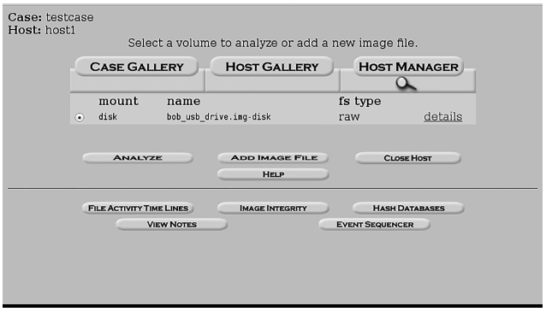
Autopsy (Cont.)
Notes:
The file command can tell you exactly what a file is regardless of whether or not it has been renamed or had its extension changed. This can be very important in a forensic investigation. The file command will help you in situations where the criminal has changed the file extension to make the file appear to be something other than what it is.

Slide 62
Summary
Linux file systems
What to look for in Linux system logs
Forensically interesting Linux directories
Important Linux shell commands
How to undelete files from Linux

