Slide 1
System Forensics, Investigation, and Response
Lesson 10
Macintosh Forensics

Slide 2
Learning Objective
Summarize various types of digital forensics.

Slide 3
Key Concepts
Macintosh basics
Where to find the logs in Macintosh
Forensically interesting Macintosh directories
Forensic techniques for Macintosh
How to undelete files in Macintosh

Slide 4
History of Apple/Macintosh
1975
First Apple computer
1985
First Macintosh computer released
2007
Apple iPhone released
1998
iMac released
Notes:
Apple I
In 1975, Steve Wozniak and Steve Jobs finished the prototype of the first Apple computer. Wozniak worked for Hewlett-Packard (HP) and his employment contract required him to give his employer first right of refusal on any of his inventions. However, HP was not interested and released the technology to Wozniak. Apple Computer was formed in April 1976 by Steve Jobs, Steve Wozniak, and Ronald Wayne. The Apple I, created by Wozniak, had an 8-bit microprocessor running at just below 1 MHz. The Apple I had a built-in video terminal, sockets for 8 kilobytes of onboard RAM, a keyboard, and a cassette board meant to work with regular cassette recorders.
Apple II
This computer was based on the same microprocessor but came in a plastic case with the keyboard built in. It was also the first personal computer with color graphics. Apple II was followed by a series of enhancements, including the Apple IIGS in 1986, which was 16-bit rather than 8-bit. There were multiple operating systems for the Apple II.
Beyond the Apple II
The company changed the name of the product to Macintosh and took a new direction with its computers, including:
The Macintosh—Had an 8-MHz Motorola processor, a black-and-white monitor, and a 3.5-inch floppy drive. The operating system was System 1, which eventually led to the Macintosh II running System 7.
System 7—Allowed text dragging between applications, viewing and switching applications from a menu, a control panel, and cooperative multitasking.
Mac OS for PowerPC—Introduced the System 7.1.2 operating system.
AIX for PowerPC—Used a variation of the IBM AIX system. It also used the Common Desktop Environment, a graphical user interface that is popular in the UNIX world. This product did not do well in the market and was discontinued in 1997.

Slide 5
History of Mac OS X
2001
Mac OS X v10.0 (Cheetah)
2011
Mac OS X v10.7 (Lion)
2017
Mac OS X 10.12 (Sierra)
Notes:
Mac OS X—This represented a major change and is still used in Macintosh computers today. The operating system was based on FreeBSD, a UNIX clone. When using Mac OS X, you can navigate to a shell and run UNIX/Linux shell commands. The initial release of OS X was followed by periodic improvements, each with an animal name. More recent releases include:
Tiger (Mac OS X v10.4)—Had built-in support for FireWire, a new dashboard, and updated mail program.
Leopard (Mac OS X v10.5)—Had over 300 new features, support for Intel x86 chips, and support for the new G3 processor.
Snow Leopard (Mac OS X v10.6)—Included mostly performance enhancements, such as support for multicore processors, rather than new features.
Lion (Mac OS X v10.7)—Included a major interface change that made it more like the iOS interfaces used on iPhone and iPad.
Mountain Lion (Mac OS X v10.8)—Had built-in support for iCloud, to support cloud computing.
Yosemite (Mac OS X v10.10)—Released in October 2014. The most important part of this release, from a forensics standpoint, is that it allowed users who have iPhones with iOS 8.1 or later to pass certain tasks to their Macintosh computer.
Sierra (Mac OS X v10.12)—The most recent version (as of March 2017). It is meant to be more in synch with the style of other Apple systems, such as iOS and WatchOS.

Slide 6
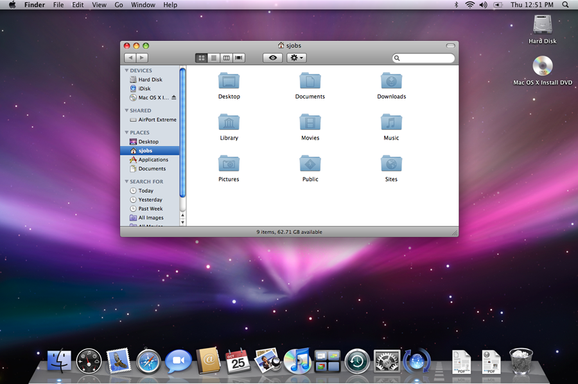
Mac OS X Desktop
Screenshot reprinted with permission from Apple Inc.

Slide 7
Macintosh File Systems
Macintosh File System (MFS)
Older technology no longer in use
Hierarchical File System (HFS)
Used on Macintosh Plus
Hierarchical File System Plus (HFS+)
Enhancement of HFS
Beginning with Mac OS 8.1, replaced by HFS+
Preferred file system on Mac OS X
Notes:
Macintosh File System (MFS)
Macintosh File System (MFS) shipped with the first Macintosh in 1984. It has not been used in more than 15 years and you are unlikely to encounter it.
Hierarchical File System (HFS)
The Hierarchical File System (HFS) was used on the Macintosh Plus. Apple introduced this file system in 1985, specifically to support its new Apple hard drive. It replaced the earlier Macintosh File System.
Hierarchical File System Plus (HFS+)
This is an enhancement of the HFS file system. HFS+ is the preferred file system on Mac OS X.

Slide 8
Hierarchical File System Plus
(HFS+)
Supports journaling
Supports disk quotas
Has hard and soft links
Uses 32 bits for allocation blocks
Supports long filenames, up to 255 characters
Uses Unicode
Notes:
It supports journaling. Journaling file systems are fault tolerant because the file system logs all changes to files, directories, or file structures.
It also supports disk quotas. That allows the administrator to limit the amount of disk space a given user can use, keeping that user from taking up all the space. HFS+ also has hard links and soft links.
HFS+ is architecturally similar to HFS, however there are some key differences. HFS+:
Uses 32 bits for allocation blocks, rather than 16 bits.
Supports long filenames, up to 255 characters.
Uses Unicode rather than ASCII.

Slide 9
Hierarchical File System Plus (HFS+) and Forensics
Supports aliases
Performs defragmentation on a per-file basis
Notes:
Aliases are like symbolic links; they allow you to have multiple references to a single file or directory.
Regarding defragmentation, the following conditions are checked, and if met, the file is defragmented when it is opened:
• The file is less than 20 megabytes in size.
• The file is not already in use.
• The file is not read-only.
• The file is fragmented.
• The system uptime is at least three minutes.

Slide 10
Supported File Systems
ISO9660 (extensions)
Microsoft Disk Operating System (MS-DOS)
New Technology File System (NTFS)
Universal Disk Format (UDF)
UNIX File System (UFS)
Notes:
ISO9660 is the file system used by compact discs (CDs). ISO9660 is not Macintosh specific, but Apple does have its own set of ISO9660 extensions.
Mac OS X includes support for Microsoft Disk Operating System (MS-DOS) file systems FAT12, FAT16, and FAT32.
Mac OS X includes read-only support for the New Technology File System (NFTS). This means if you have a portable drive that is NTFS, Mac OS X can read that partition
Universal Disk Format (UDF) is the file system used by DVD-ROM discs (both video and audio). Like ISO9660, this only guarantees that Mac OS X can read the partition or drive; it does not guarantee that Mac OS X can read the files.
UNIX File System (UFS) is the file system used by FreeBSD and many other UNIX variants. Being based on FreeBSD, Mac OS X can read UFS volumes.

Slide 11
Partition Schemes
GUID Partition Table
Apple Partition Map
Master Boot Record (MBR)
Notes:
GUID Partition Table
The GUID Partition Table (GUID stands for “globally unique identifier”) is used primarily with computers that have an Intel-based processor. It requires OS X v10.4 or later. Intel-based Macintosh machines can boot only from drives that use the GUID Partition Table.
Apple Partition Map
The Apple Partition Map is used with any PowerPC-based Mac. Intel-based Macs can mount and use a drive formatted with the Apple Partition Map, but cannot boot from the device. PowerPC-based Macs can both mount and use a drive formatted with the Apple Partition Map, and can also use it as a start-up device.
Master Boot Record
The master boot record (MBR), contained in the boot sector, is used when DOS- or Windows-based computers start up. The MBR contains important information such as a partition table, bootstrap code, and other information.

Slide 12
Macintosh Logs
/var/log/
General log repository
Data on removable media and serial numbers
/var/spool/cups
Information about printed documents
/Library/Receipts
Information about system and software updates
Name of document, user who printed
Notes:
/var/log log
This directory has many logs in it. The /var/log/daily.out contains data on all mounted volumes, including the dates they were mounted. This is very important in cases involving stolen data. You can see what devices have been attached and potentially get data from them. This folder includes data on removable media, including serial numbers.
/var/spool/cups folder
In this folder, you will find information about printed documents, including the name of the document printed and the user who printed it.
/Library/Receipts folder
This folder contains information about system and software updates. Though less useful for a forensic investigation than some of the other folders, it does include information about if and when a given patch was applied, which might be of some interest in investigating malware crimes.

Slide 13
Macintosh Logs (Cont.)
/Users/<user>/
.bash_history
Information on Bash shell activity
/var/vm
Contains subfolder named app profile
/Users/
User files and preferences
Lists of recently opened applications, temporary data used by applications
Notes:
/Users/<user>/.bash_history log
This log will show you a variety of commands, such as rm (removing or deleting something) and dd (indicating the user might have tried to make an image of the drive).
var/vm folder
In this folder, you will find a subfolder named app profile, which will contain lists of recently opened applications as well as temporary data used by applications.
/Users/ directory
This is where various users’ files are stored. It is a good idea to check in this directory to find out if users have saved data here that could be used as evidence.
/Users/<user>/Library/Preferences/ folder
This folder contains user preferences, including the preferences of programs that have been deleted. This could be a valuable place to get clues about programs that have been deleted from the system.

Slide 14
Directories
Macintosh has a number of important directories
Some are relevant to a forensic examination of a Macintosh machine

Slide 15
/Volumes
Contains information about mounted devices
Includes data regarding:
  Hard disks
  External disks
  CDs
  Digital video discs (DVDs)
  Virtual machines (VMs)

Slide 16
/Users, /Applications, /Network, and /etc
/Users
User accounts and associated files
/Applications
All applications
/Network
Information about servers, network libraries, and network properties
/etc
Configuration files
Notes:
/Users directory
This directory contains all the user accounts and associated files.
/Applications directory
This directory is where all applications are stored. It can hold important information about any malware.
/Network directory
This directory contains information about servers, network libraries, and network properties.
/etc directory
Just as in Linux, this is where configuration files are located. Cybercriminals often adjust the system’s configuration. Sometimes this is done in order to facilitate the criminal’s return to the system later.

Slide 17
/Library/Preferences/System
Configuration/dom.apple.preferences. plist
Contains the network configuration data for each network card
Notes:
This file contains the network configuration data for each network card. This is important information to document before beginning your search for evidence.

Slide 18
Macintosh Forensic Techniques
Target Disk mode
Searching virtual memory
Shell commands

Slide 19
Target Disk Mode
Create a forensically sound copy of disk contents
  dd and netcat
  Imaging tools within EnCase or Forensic Toolkit
Begin in Target Disk Mode
  Cannot write to disk
  No chance of altering source disk
  Connect to the suspect computer with via USB or FireWire and image the disk
Notes:
Target Disk Mode allows you to preview the computer on-site, so you can do a quick inspection before disconnecting and transporting the computer to a forensic lab. This is important because you will want to check running systems’ processes before shutting the machine down. You simply have to reboot the machine in Target Disk Mode.

Slide 20
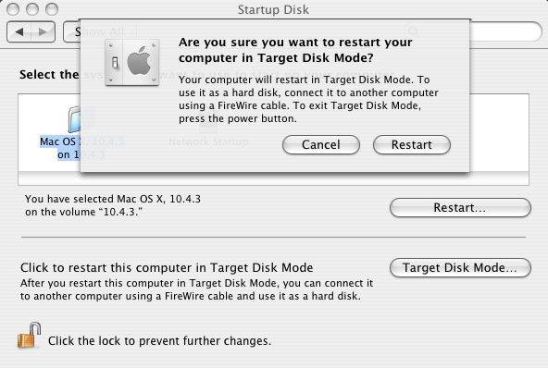
Target Disk Mode (Cont.)
Screenshot reprinted with permission from Apple Inc.

Slide 21
Searching Virtual Memory
Swap file/virtual memory is in /var/vm/
Check it with Linux commands
  ls returns list of files
  ls –al returns list of all files in virtual memory, who launched program and when
  grep lets you search in virtual memory folder
Notes:
With Macintosh OS X, the swap file/virtual memory is located in the folder /var/vm/. You can check it with Linux commands like ls (for listing files). The option ls —al gives you a listing of all the files in virtual memory as well as who launched the program and when. You can use the grep search tool to search in the virtual memory folder.

Slide 22
Using Shell Commands
date
Returns current date and time zone
ls /dev/disk?
Lists current device files in use
/hdiutil partition /dev/disk0
Lists the partition table for the boot drive
Notes:
The date command returns the current date and time zone. It is good for documenting when exactly you begin your forensic examination. If you need the date in Coordinated Universal Time (UTC), then use date −u.
The ls /dev/disk? command lists the current device files that are in use. You should document this information before shutting the system down for transport to the forensic lab.
The /hdiutil partition /dev/disk0 command lists the partition table for the boot drive. It is important to know the partitions the machine recognizes upon boot-up.

Slide 23
Using Shell Commands (Cont.)
system_
profiler SPHardware
DataType
Returns hardware information for host system
system_
profiler
SPSoftware
DataType
Returns information about the operating system
Notes:
The system_profiler SPHardwareDataType command returns the hardware information for the host system. This provides information useful for the basic documentation of the system prior to beginning your forensic examination. There are related commands, such as system_profiler
SPSerialATADataType. This command gives information on all the attached Serial Advanced Technology Attachment (SATA) devices.
The system_profiler SPSoftwareDataType command is related to system_profiler SPHardwareDataType. The system_profiler SPSoftwareDataType command returns information about the operating system. This is also important for documenting the system prior to starting the forensic examination.

Slide 24
How to Examine a Mac
Many forensics tools are less effective in extracting data on a Macintosh than in Windows.
One technique is to create a copy of the forensic image and then mount it as a read-only virtual machine (VM).
  Mount it as read only.

Slide 25
Deleting Files on Macintosh
Similar to Windows, when file is deleted, references to file are gone and clusters might be used and overwritten
Even if data is overwritten, data might exist in unallocated space and in index nodes
Deleted files moved to the trash folder, similar to Recycle Bin in Windows
Macintosh trash folder is .Trash, a hidden folder on the root directory of file system

Slide 26
Undeleting Files on Macintosh (Cont.)
Recover deleted files from .Trash by copying or moving to other location
  or
Use tools to recover files, even after trash bin has been emptied
  Mac Undelete
  Free Undelete
  MacKeeper

Slide 27
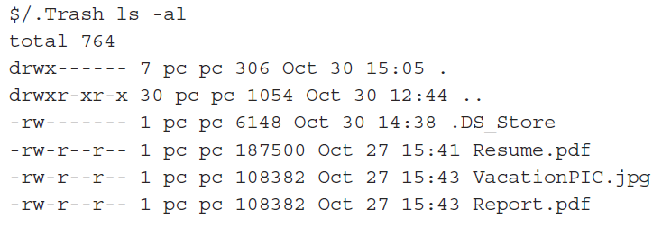
Listing Contents of .Trash

Slide 28
Summary
Macintosh basics
Where to find the logs in Macintosh
Forensically interesting Macintosh directories
Forensic techniques for Macintosh
How to undelete files in Macintosh

