Slide 1
System Forensics, Investigation, and Response
Lesson 11
Mobile Forensics

Slide 2
Learning Objective
Summarize various types of digital forensics.

Slide 3
Key Concepts
Mobile device concepts
Evidence that can be obtained from a mobile device
How to seize evidence from a mobile device

Slide 4
Cellular Device Concepts
Mobile switching center (MSC)
The switching system for the cellular network
Base transceiver station (BTS)
The part of the cellular network responsible for communications between the mobile phone and the network switching system
Home location register (HLR)
A database used by the MSC that contains subscriber data and service information
Notes:
A mobile switching center (MSC) is the switching system for the cellular network. MSCs are used in 1G, 2G, 3G, and Global System for Mobile (GSM) communications networks. You will learn about 3G and GSM networks later in this section. The MSC processes all the connections between mobile devices and between mobile devices and landline phones. The MSC is also responsible for routing calls between base stations and the public switched telephone network (PSTN).
The base transceiver station (BTS) is the part of the cellular network responsible for communications between the mobile phone and the network switching system. The base station system (BSS) is a set of radio transceiver equipment that communicates with cellular devices. It consists of a BTS and a base station controller (BSC). The BSC is a central controller coordinating the other pieces of the BSS.
The home location register (HLR) is a database used by the MSC that contains subscriber data and service information.
It is related to the visitor location register (VLR), which is used for roaming phones.

Slide 5
Cellular Device Concepts (Cont.)
Subscriber identity module (SIM)
A memory chip that stores the International Mobile Subscriber Identity (IMSI)
Electronic serial number (ESN)
A unique identification number developed by the U.S. Federal Communications Commission (FCC) to identify cell phones
Personal unlocking code (PUK)
A code used to reset a forgotten PIN
Notes:
The subscriber identity module (SIM) is a memory chip that stores the International Mobile Subscriber Identity (IMSI). It is intended to be unique for each phone and is what you use to identify the phone. Many modern phones have removable SIMs, which means you could change out the SIM and essentially have a different phone with a different number.
A SIM card contains its unique serial number—the ICCID—the IMSI, security authentication, and ciphering information. The SIM will also usually have network
information, services the user has access to, and two passwords. Those passwords are the personal identification number (PIN) and the personal unlocking code (PUK).
Electronic serial numbers (ESNs) are unique identification numbers developed by the United States Federal Communications Commission (FCC) to identify cell phones. They are now used only in code division multiple access (CDMA) phones, whereas GSM and later phones use the International Mobile Equipment Identity (IMEI) number. The first 8 bits of the ESN identify the manufacturer, and the subsequent 24 bits uniquely identify the phone. The IMEI is used with GSM and Long Term Evolution (LTE) as well as other types of phones.
The personal unlocking code (PUK) is a code used to reset a forgotten PIN. Using the code returns the phone to its original state, causing loss of most forensic data. If the code is entered incorrectly 10 times in a row, the device becomes permanently blocked
and unrecoverable.
Each SIM is identified by its integrated circuit card identifier (ICCID). These numbers are engraved on the SIM during manufacturing. This number has subsections that are very important for forensics. This number starts with the issuer identification number (IIN), which is a seven-digit number that identifies the country code and issuer, followed by a variable-length individual account identification number to identify the specific phone, and a check digit.

Slide 6
Network: Cellular
2G
GSM
3G
UMTS
4G
2G+
EDGE
LTE
Notes:
Global System for Mobile (GSM) communications is a standard developed by the European Telecommunications Standards Institute (ETSI). Basically, GSM is the 2G network.
Enhanced Data Rates for GSM Evolution (EDGE) does not fit neatly into the 2G-3G-4G continuum. It is technically considered 2G, but was an improvement on GSM (2G), so it can be considered a bridge between 2G and 3G technologies.
Universal Mobile Telecommunications System (UMTS) is a 3G standard based on GSM. It is essentially an improvement of GSM.
Long Term Evolution (LTE) is a standard for wireless communication of high-speed data for mobile devices. This is what is commonly called 4G.

Slide 7
Wi-Fi
Most cellular phones and other mobile devices can connect to Wi-Fi networks
Free Wi-Fi hotspots in restaurants, coffee shops, hotels, homes, and many other locations

Slide 8
Operating Systems
iOS
iPhone
iPad
Android
Samsung Galaxy
Windows 8
Microsoft Mobile/
Nokia
iPod
Blackberry 10
Blackberry
Many more

Slide 9
iOS
Derived from OS X
Interface based on touch and gestures
In normal operations, iOS uses HFS+ file system
Can use FAT32 when communicating with a PC
Notes:
iOS
Originally released in 2007 for the iPod Touch and the iPhone. The user interface is based all on touching the icons directly. It supports what Apple calls gestures: swipe, drag, pinch, tap, and so on. The iOS operating system is derived from OS X.
In normal operations, iOS uses the HFS+ file system, but it can use FAT32 when communicating with a PC.

Slide 10
iOS (Cont.)
Four layers:
  Core OS layer: The heart of the operating system
  Core Services layer: Where applications interact with the iOS
  Media layer: Is responsible for music, video, and so on
  Cocoa Touch layer: Responds to gestures

Slide 11
iOS (Cont.)
Contains several elements in data partition:
  Calendar entries
  Contacts entries
  Note entries
  iPod_control directory (hidden)
  iTunes configuration
  iTunes music
iPod_control\device\sysinfo folder contains model number and serial number

Slide 12
Android
Linux-based operating system, completely open source
First released in 2003
Versions of Android named after sweets, such as Version 4.1–4.2 Jelly Bean and Version 7.0 Nougat
Similarity across versions
  Can perform similar forensic examinations on different versions
Notes:
A Linux-based operating system that is completely open source.
Android source code: http://source.android.com/
First released in 2003
Versions of Android named after sweets, such as Version 4.1–4.2 Jelly Bean and Version 7.0 Nougat
Differences from version to version usually involved adding new features. If you are comfortable with version 1.6 (Donut), you will be able to do forensic examination on version 4.2 (Jelly Bean).
Samsung Galaxy and many other mobile devices run Android

Slide 13
Windows
1996
Windows CE
2008
Windows Phone
2010
Windows Phone 7
2015
Windows 10 Mobile
Notes:
Windows mobile operating systems
1996: Windows CE
2008: Windows Phone; not compatible with many of the previous Windows Mobile apps
2010: Windows Phone 7
2012: Windows 8
2015: Windows 10 Mobile
Windows 10 (Windows 10 Mobile) is shipped on PCs, laptops, phones, and tablets. This means that once you are comfortable with the operating system on
one device, you are going to be able to conduct forensic examinations on other devices running Windows 8 or Windows 10.

Slide 14
Blackberry 10
Based on QRNX operating system
Supports major features similar to other mobile phones
  Drag and drop
  Gestures

Slide 15
Evidence You Can Get from a Cell Phone
Call history
Emails, texts, and/or other messages
Photos and video
Phone information
GPS information
Network information

Slide 16
Mobile Device States
Semi-Active
Quiescent
Active
Nascent
Notes:
The National Institute of Standards and Technology (NIST) guidelines list four different states a mobile device can be in when you extract data:
Nascent State—Devices are in the nascent state when received from the manufacturer—the device contains no user data and has its original factory
configuration settings.
Active State—Devices that are in the active state are powered on, performing tasks, and able to be customized by the user and have their filesystems
populated with data.
Semi-Active State—The semi-active state is a state partway between active and quiescent. The state is reached by a timer, which is triggered after a period of
inactivity, allowing battery life to be preserved by dimming the display and taking other appropriate actions.
Quiescent State—The quiescent state is a dormant mode that conserves battery life while maintaining user data and performing other background functions. Context information for the device is preserved in memory to allow a quick resumption of processing when returning to the active state.

Slide 17
Rules for Seizing Evidence from a Mobile Device
If you plug device into a computer, make sure device does not synchronize with the computer
Touch evidence as little as possible
Document what you do to the device
Don’t accidentally write data to the mobile device
Notes:
If the forensic workstation is a Windows machine, you can use the Windows Registry to prevent the workstation from writing to the mobile device. Before connecting to a Windows machine, find the Registry key HKEY_LOCAL_MACHINE\System\CurrentControlset\StorageDevicePolicies, set the value to 0x00000001, and restart the computer. This prevents that computer from writing to mobile devices that are connected to it.

Slide 18
Mobile Device Forensic Products
Oxygen Forensics
Cellabrite
Data Doctor
Device Seizure
Forensic SIM Cloner
MobileEdit
Notes:
Although Forensic Toolkit and EnCase can both image a phone for you, there are other products made specifically for phone forensics:
Oxygen Forensics—A full forensic tool capable of imaging and examining iPhones and Android phones. It provides a number of user-friendly tools for extracting specific data such as contacts, social media data, and the like.
Cellabrite—The most widely known phone forensics tool. Used heavily by federal law enforcement. It is a very robust and effective tool. Downside: the high cost. It is the most expensive phone forensics tool on the market.
MobileEdit—There are several variations of this product. MobileEdit Lite is the most forensically advanced version of MobileEdit. This is a very easy-to-use tool that can aid a forensic examiner in extracting data from cell phones.
Data Doctor—Recovers all Inbox and Outbox data and all contact data, and has an easy-to-use interface. It has a free trial version, but there is a cost for the full version. Data Doctor retrieves Inbox and sent message data as well as contact data.
Device Seizure—Available from Paraben Software. There is a license fee associated with this product. Paraben makes a number of forensic products.
Forensic SIM Cloner—This tool is used to clone SIM cards, allowing you to perform forensic analysis of the SIM card.

Slide 19
The iPhone: Seizing Evidence
iPhone has four-digit pin
  10,000 possible combinations of the digits 0–9
Can use automated process to break iPhone passcode, such as XRY
Tools specifically for iOS devices:
  Pwnage
  Recover My iPod

Slide 20
The iPhone: Seizing Evidence (Cont.)
If forensic workstation has iTunes:
  Plug iPhone (or iPad/iPod) into the workstation
  Use iTunes to extract information about the device

Slide 21
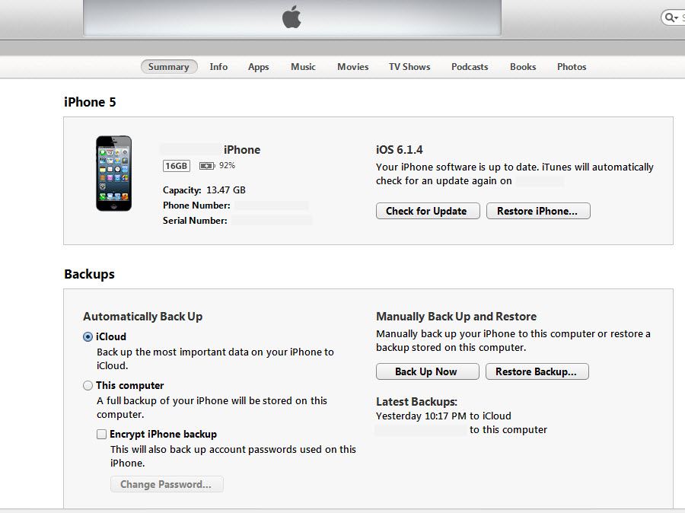
Apple iPhone iTunes Display
Screenshot reprinted with permission from Apple Inc.
Notes:
Three important items to document:
1. The iOS version number
2. The phone number (redacted in this figure)
3. The serial number (redacted in this figure)
Notice you can also see where the phone is backed up. That can indicate yet another place you should search during your forensic investigation.

Slide 22
Seizing Evidence from an iPhone
Information from a device image:
  Library_CallHistory_call_history.db
    Contains entire call history
  Library_Cookies_Cookies.plist
    Contains cookies
    Give you a history of the phone user’s Internet activities
Notes:
If you have imaged the phone and you then search for information, you may have to look more closely to find some data:
Library_CallHistory_call_history.db has the entire call history. If you cannot view that directly on the phone itself, the database file has all call information.
Cookies are in the file Library_Cookies_Cookies.plist. This can give you a history of the phone user’s Internet activities.
These, and other files, are actually copied to a PC during synchronization. Here are a few of those files:
Library_Preferences_com.apple.mobileipod.plist
Library_Preferences_com.apple.mobileemail.plist
Library_Preferences_com.apple.mobilevpn.plist
The mobileemail.plist file gives you information about email sent and received from the phone.
The mobilevpn.plist file can indicate if the user has used the phone to communicate over a VPN.

Slide 23
Seizing Evidence from an iPhone
Information from a device image:
  Library_Preferences_com.apple.mobileipod.plist
  Library_Preferences_com.apple.mobileemail.plist
    Gives you information about email sent and received from the phone
  Library_Preferences_com.apple.mobilevpn.plist
    Indicates if user used device to communicate over a VPN
Notes:
If you have imaged the phone and you then search for information, you may have to look more closely to find some data:
Library_CallHistory_call_history.db has the entire call history. If you cannot view that directly on the phone itself, the database file has all call information.
Cookies are in the file Library_Cookies_Cookies.plist. This can give you a history of the phone user’s Internet activities.
These, and other files, are actually copied to a PC during synchronization. Here are a few of those files:
Library_Preferences_com.apple.mobileipod.plist
Library_Preferences_com.apple.mobileemail.plist
Library_Preferences_com.apple.mobilevpn.plist

Slide 24
Seizing Evidence from an iPhone
Deleted files
  When a file is deleted on iPhone/iPad/iPod, moved to.Trashes\501 folder
  Data exists until overwritten

Slide 25
Seizing Evidence from a Blackberry
Download and install BlackBerry Desktop Manager
Steps to create complete backup image:
Open BlackBerry’s Desktop Manager. Click Options then Connection Settings.
If the Desktop Manager hasn’t already done so, select USB-PIN: Device # for connection type. Click OK.

Slide 26
Seizing Evidence from a Blackberry (Cont.)
Select Backup and Restore.
Click the Back Up button for a full backup of the device or use the Advanced section for specific data.
Select your destination (such as workstation) and save the .ipd file.
Examine data and perform a forensic analysis.

Slide 27
JTAG
Joint Test Action Group (JTAG)
An Institute of Electrical and Electronics Engineers (IEEE) standard for testing chips
Test access points (TAPs) used to directly access the chip and extract data
Forensic examiner takes back off of phone, and then connects wires by soldering or by using some other means to the TAPs of the phone’s memory chip
Wires also connected to a JTAG device that uses software to extract the data directly from the memory chip

Slide 28
Summary
Mobile device concepts
Evidence that can be obtained from a mobile device
How to seize evidence from a mobile device

