Slide 1
System Forensics, Investigation, and Response
Lesson 14
Trends and Future Directions

Slide 2
Learning Objective
Identify trends in and resources for digital forensics.

Slide 3
Key Concepts
Technical trends
Legal and procedural trends

Slide 4
Technical Trends: Moore's Law
Based on prediction by Gordon E. Moore:
  Number of transistors on an integrated circuit would double every two years for the next 10 years
  Trend would continue for at least 10 more years
Notes:
Gordon E. Moore noted that the number of components in integrated circuits had doubled every 18 to 24 months from the invention of the integrated circuit in 1958 until 1965. He predicted that the trend would continue for at least 10 more years.

Slide 5
Technical Trends: Moore's Law (Cont.)
Capacity and capability of integrated circuits have doubled and cost has been halved every 18 to 24 months since Moore noted the trend
Capacity
Cost
Notes:
Each doubling of capacity was done at half the cost. This means that a component that cost $100 would have twice the capability but would cost only $50 within 18 to 24 months.
Moore’s law proved to be an accurate representation of a trend that continues today. Specifically, the capacity and capability of integrated circuits have doubled and the cost has been halved every 18 to 24 months since Moore noted the trend.

Slide 6

Technical Trends: Moore's Law (Cont.)
Can be seen in hundreds of modern digital devices:
  DVD players
  Cell phones/smartphones
  Computers
  Medical equipment

Slide 7
Technical Trends: Moore's Law (Cont.)
Also applies to other primary drivers of computing capability:
  Storage capacity
  Processor speed
  Cost
  Fiber optic communications
  More

Slide 8
Moore's Law and Digital Forensics
Investigations require analysis of an increasing volume of data from an increasing number of digital devices
Forensic specialists must develop the following to perform forensic assessments:
  New techniques
  New software
  New hardware
Notes:
Digital storage capacity for a particular device might double in a year. The data that you might need to analyze could easily experience double that growth level.
A standard point-and-shoot digital camera now takes 5-megapixel photos. High-end cameras take 16-megapixel—or larger—photos. A typical Windows XP build
consumes roughly 4 GB of disk space. A typical Windows 8 build consumes 8 GB to 10 GB. Although a single copy of a file or data record might be maintained for active use, you must often locate and examine all prior copies of that file.
Selectivity is not unique to the digital world. It is the same concept that investigators have used for years to follow leads. For example, they often start by interviewing the most likely suspects and follow where the data leads to reach a conclusion. However, the U.S. legal system, helped by advertising and popular
television, expects digital forensics to be unconstrained by such mundane factors as time, money, and available technology.

Slide 9
Moore's Law and Digital Forensics (Cont.)
New techniques should simplify documentation of chain of custody
Must determine what techniques have the greatest potential for obtaining needed information
Must selectively evaluate data
  Analyzing all available data would too costly

Slide 10
Software as a Service (SaaS)
Software0use models
  Bundled software
  Time-sharing software
  SaaS
SaaS
  Software that a provider licenses to customers as a service on demand, through a subscription model
Notes:
Over the years, several models for selling software have emerged:
Bundled product—Includes hardware, software, maintenance, and support sold together for a single price. It wasn’t long before the industry recognized that it could sell software products individually. This resulted in the rise of companies such as Microsoft.
Time-sharing—The price of the software was essentially embedded in a mathematical algorithm, and a user paid for software based on his or her usage profile. This pricing model continued into personal computer (PC) and server technology. Then the pricing algorithm was changed to address a number of concurrent users, a number of instances, or some other model.
Software as a Service (SaaS)—A provider licenses software to customers as a service on demand, through a subscription model.

Slide 11
Software as a Service (SaaS) (Cont.)
Who owns the software?
How can you get access to the program code?
What assurance do you have of the safety of a software product?
How can you keep the status of shared software static until the forensic investigation is complete?
Notes:
Who owns the software?
Know whom to contact to obtain information regarding the functionality and patch levels of software.
How can you get access to the program code?
When software is obtained as a shared service, access is usually not possible. In such cases, use alternative techniques.
What assurance do you have of the safety of a software product?
You need to know that a particular software product doesn’t contain malware that could alter the investigation.

Slide 12

The Cloud
The concept of connectivity or a simplified way of thinking about networks
Internet is complex mesh of routers and paths
Can be drawn simply as a cloud
Cloud refers to Internet as a
whole, or networks
available over the Internet
for the purpose of providing
special services

Slide 13
The Cloud’s Affect on Forensics
It makes data acquisition more complicated.
Investigator must be aware of rules of seizure, privacy, and so forth in each location from which he or she will retrieve data.
Notes:
Data acquisition complications
Each hosted server is usually in a separate virtual machine.
For forensics, must be imaged.
But virtual machine is hosted on a host server. In addition to the virtual machine’s logs, you will need to retrieve the logs for the host server or servers.
Legal complications
Because a cloud could potentially reach across multiple states or even nations, the investigator must be aware of the rules of seizure, privacy, and so forth in each location from which he or she will retrieve data.

Slide 14
The Cloud (Cont.)
Resolves high availability issues encountered during disasters with ordinary networks and SANs
Cloud uses:
  Multiple redundant servers in diverse geographic areas
  Data redundantly stored on several servers

Slide 15
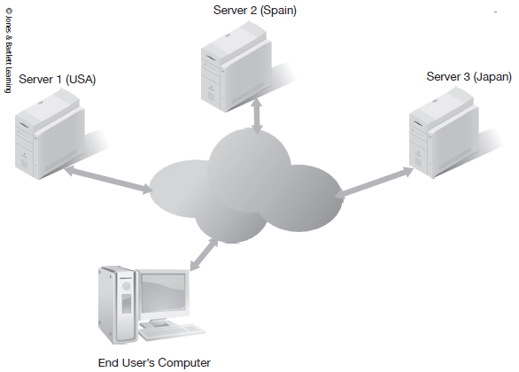
Basic Architecture of a Cloud

Slide 16
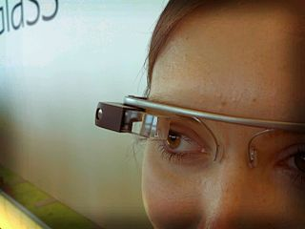
Google Glass
Introduced in 2013
A wearable computer
Includes permanent
storage via a small
hard drive
Can record images
and video
Could contain photographic or video evidence of a crime
Antonio Zugaldia/Wikipedia
Notes:
Google Glass includes permanent storage via a small hard drive and has the ability to record images and video. At a minimum, Google Glass could contain photographic or video evidence of a crime. It uses an Android operating system, which is Linux-based. This means that you can execute Linux commands to create an image of the Google Glass partition. After the partition is imaged, it can be examined forensically, just as any Linux partition would be.

Slide 17
Cars
Global positioning system (GPS) in mobile devices and cars
GPS in vehicles have hard drives to store and play music
GPS data might establish that a suspect’s car was at the scene of a crime when the crime took place

Slide 18
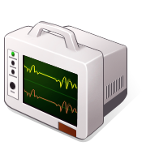

Medical Devices
Some insulin pumps and heart monitors send data to a computer via a wireless connection

Slide 19
Medical Devices (Cont.)
Medical wireless communications can be compromised
  Hacker could change dosage delivered via wireless insulin pump
Might need to be examined forensically, similar to a mobile device seized in relation to a crime

Slide 20
Augmented Reality
Pokémon was first widespread use of augmented reality
More applications that fuse digital world with real world will be forthcoming
Blurs the line between the digital and the physical, and will have implications for forensics

Slide 21
Legal and Technical Trends
Laws can alter requirements for:
  A warrant
  Exceptions to warrant requirements
  Issues of consent to search

Slide 22
The USA Patriot Act
Designed to combat terrorism
Has affected computer crime
Internet service providers (ISPs) can choose to notify law enforcement if they reasonably believe they have evidence of an imminent crime that would endanger lives
Notes:
The USA Patriot Act has had profound impact on digital forensics.
Though it was designed to combat terrorism, the Patriot Act has affected computer crime.
Prior to the Patriot Act, Internet service providers were very limited in what they could share with law enforcement without warrants or subpoenas. Now, they can choose to notify law enforcement if they reasonably believe that they have found evidence of an imminent crime that would endanger lives.

Slide 23
The USA Patriot Act (Cont.)
Section 816, "Development and Support of Cybersecurity Forensic Capabilities”
  Calls for U.S. Attorney General to establish regional computer forensics laboratories
  Led to creation of the Electronic Crimes Task Force with computer forensics labs in many major cities

Slide 24
Private Labs
Handle forensic examinations for private companies, attorneys, and sometimes for law enforcement agencies
Can process evidence for civil litigation
Becoming more common for smaller police departments to outsource computer forensics to private labs
Notes:
Private forensic labs are becoming more common. These laboratories handle forensic examinations for private companies, for attorneys, and sometimes for law enforcement agencies. Private labs can gather evidence, analyze it, and produce reports regarding their findings. This data might be used in civil litigation or simply to ascertain the cause of an incident.
Defense attorneys often want their own lab to examine evidence in order to challenge the findings of the state’s lab. The goal may be to confirm or deny what the prosecution has presented or to find some flaw in the methodology utilized by the prosecution.
In some cases, the defense is simply seeking grounds for a reasonable doubt that the defendant committed the crime. For example, if the defendant is accused of sending a virus to a victim, and if that virus, along with virus creation utilities, is found on his or her computer, it may seem a hopeless case. However, if the defense can show that other people had access to the computer, or even that other users logged on around the time the virus was sent, this provides reasonable doubt.
In addition, it is becoming increasingly common for smaller police departments to outsource their computer forensics to private labs because it is often more cost effective.

Slide 25
International Issues
Cases of bank fraud, identity theft, and money laundering frequently cross national boundaries
Cybercrime can involve multiple, national jurisdictions
Follow the most restrictive national laws pertinent to case to satisfy legal requirements of less-restrictive jurisdictions

Slide 26
Techniques
Daubert standard
  Requires scientific evidence presented in court to be generally accepted in relevant scientific field
New techniques need to be verified before being used in court
Forensic investigators must be aware of changes in technology and have at least a basic familiarity with emerging technologies and techniques
Notes:
Techniques are always evolving. Because the Daubert standard requires that scientific evidence presented in court be generally accepted in the relevant scientific field, new techniques need to be verified before being used in court. Forensic investigators should be aware of changes in technology and have at least a basic familiarity with emerging technologies and techniques. Even if they are not currently being used in court, they could be soon.

Slide 27
Summary
Technical trends
Legal and procedural trends

