Slide 1
IT3201: GridCipher
Kyle Matthew Laurence C. Burce
Ridenzel T. Yu
Francis Thomas Comar
Darryl Swzast

Slide 2
Introduction

Slide 3
Similar Ciphers
Caesar Cipher
Pigpen Cipher
Polybius Square
Vernam Cipher

Slide 4
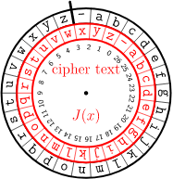
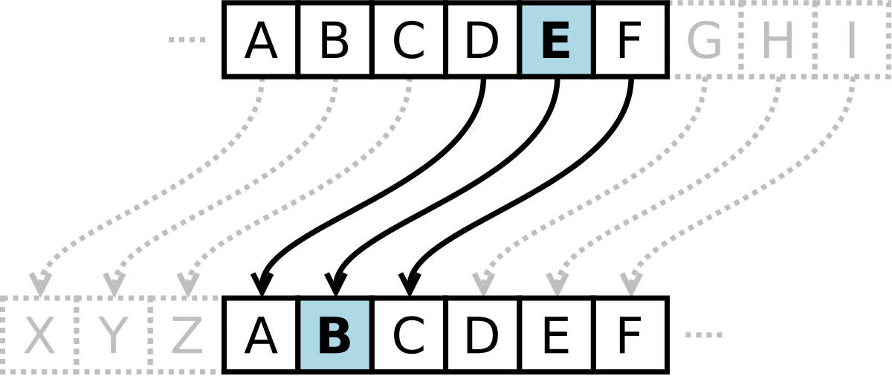
Caesar Cipher
Involves shifting letter to get new set
Implementation wise, quite easy

Slide 5
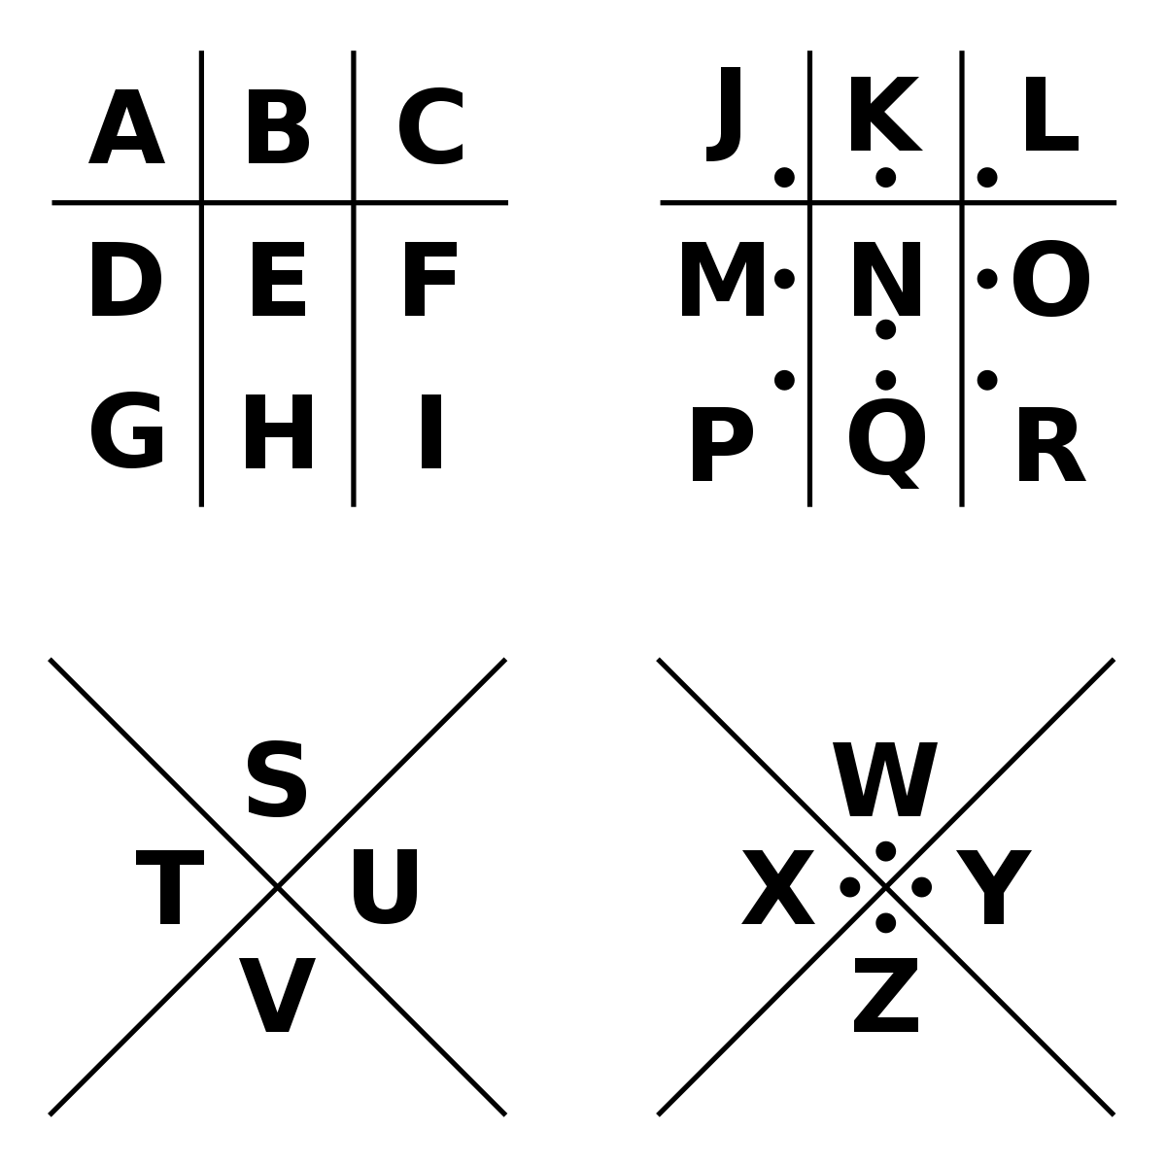
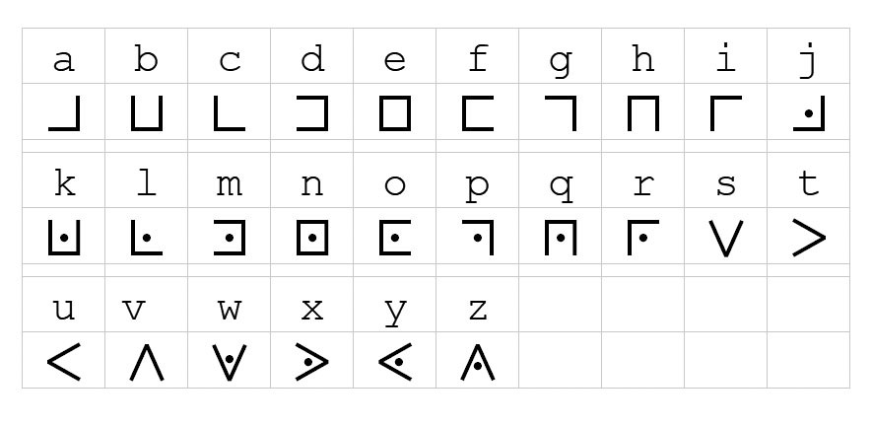
Pigpen Cipher
Involves a grid like structure
Not so secure
Involves special characters

Slide 6
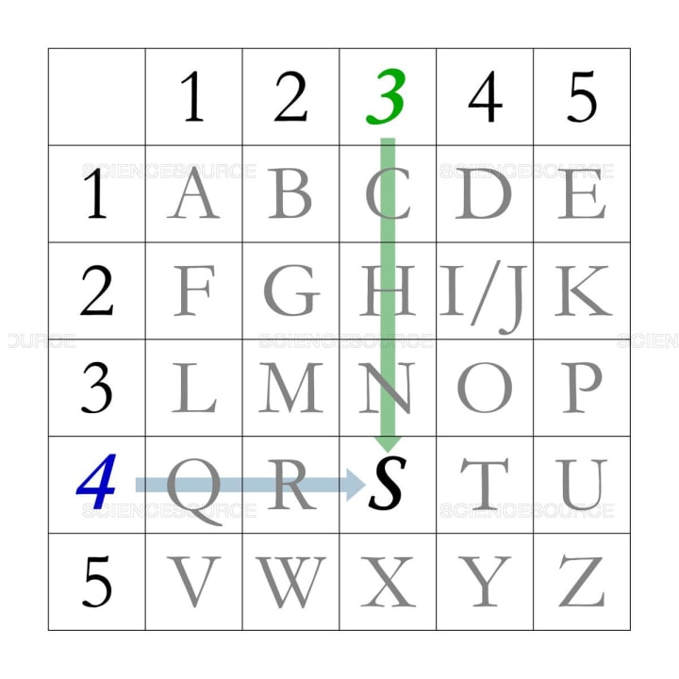
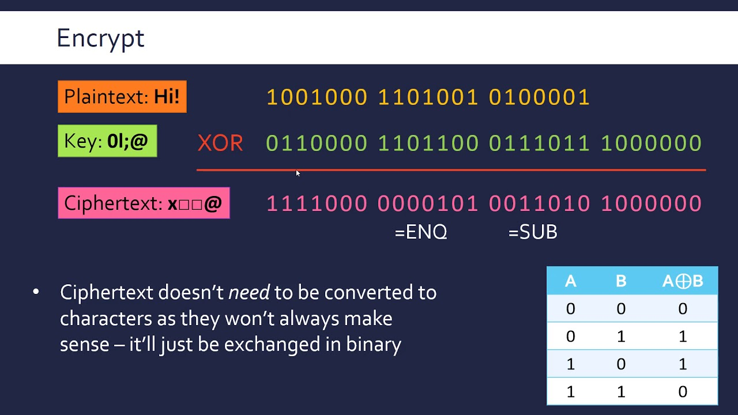
Polybius and Vernam Cipher
Polybius uses positional information to get result set
Vernam involves manipulation and calculation of bit values to encrypt a word

Slide 7
Grid Cipher
Uses Polybius Cipher’s character locator by using grid coordinates
Uses Caesar Cipher’s “swapping” to get a new value
Takes after Vernam Cipher’s bit value calculation in sequencing

Slide 8
Algorithm

Slide 9
Pseudo Code: Initializing
Initialize a 6x6 element 2d array
Assign the first 9 slots to be numbers (arrOrigin[0][0] to arrOrigin[1][3])
Assign the remaining elements to be each letter in the alphabet (A-Z)

Slide 10
arrOrigin[6][6]
0
1
2
3
4
5
6
7
8
9
A
B
C
D
E
F
G
H
I
J
K
L
M
N
O
P
Q
R
S
T
U
V
W
X
Y
Z

Slide 11
Pseudo Code: Mutating
Create a second 6x6 2d array
Initialize as the base values similar to arrOrigin
Create a function that handles input sequence or swapping algorithm
Swap row and column based on sequence result

Slide 12
arrMutate[6][6]
0
1
2
3
4
5
6
7
8
9
A
B
C
D
E
F
G
H
I
J
K
L
M
N
O
P
Q
R
S
T
U
V
W
X
Y
Z
Mutate based on sequence result

Slide 13
arrMutate[6][6]
0
1
2
3
4
5
1
0
5
3
6
7
8
9
A
B
7
6
B
9
C
D
E
F
G
H
D
C
H
F
I
J
K
L
M
N
J
I
N
L
O
P
Q
R
S
T
P
O
T
R
U
V
W
X
Y
Z
V
U
Z
X
Mutate based on sequence result (col-col)

Slide 14
arrMutate[6][6]
2
E
5
H
4
G
3
0
F
1
C
D
V
U
W
Z
Y
X
7
6
8
B
A
9
1
0
2
5
4
3
D
C
E
H
G
F
J
I
K
N
M
L
P
O
Q
T
S
R
8
B
A
9
6
W
Z
Y
X
7
U
V
Mutate based on sequence result (row-row)

Slide 15
arrMutate Result
arrMutate[6][6]
F
D
C
H
G
E
R
P
O
T
S
Q
3
1
0
5
4
2
L
J
I
N
M
K
9
7
6
B
A
8
X
V
U
Z
Y
W
For every sequence/mutation done, the moves done will be stored on a key[]

Slide 16
Comparison
arrOrigin[6][6]
arrMutate[6][6]
0
1
2
3
4
5
F
D
C
H
G
E
6
7
8
9
A
B
R
P
O
T
S
Q
C
D
E
F
G
H
3
1
0
5
4
2
I
J
K
L
M
N
L
J
I
N
M
K
O
P
Q
R
S
T
9
7
6
B
A
8
U
V
W
X
Y
Z
X
V
U
Z
Y
W

Slide 17
Pseudo Code: Comparison
Get input from user
Find the coordinate for each character in arrOrigin,
Use coordinates found in arrOrigin to arrMutated

Slide 18
If word = “Cake”
arrOrigin[6][6]
0
1
2
3
4
5
C = [0][2]
A = [4][1]
K = [2][3]
E = [2][2]
6
7
8
9
A
B
C
D
E
F
G
H
I
J
K
L
M
N
O
P
Q
R
S
T
U
V
W
X
Y
Z

Slide 19
If word = “Cake”
arrMutate[6][6]
arrMutate[0][2] = 3
arrMutate[4][1] = S
arrMutate[2][3] = I
arrMutate[2][2] = 0
C = [0][2]
A = [4][1]
K = [2][3]
E = [2][2]
F
D
C
H
G
E
R
P
O
T
S
Q
3
1
0
5
4
2
L
J
I
N
M
K
9
7
6
B
A
8
X
V
U
Z
Y
W

Slide 20
The Problem

Slide 21
The Problem: Row-Col Swapping
Swapping each element in a row requires a tempArr[] that acts as a temporary holder for the elements
Usage of strcpy() to moved elements creates an error

Slide 22


Slide 23
End.
GitHub Repo: https://github.com/kmlcburce/GridCipher

