Slide 1

Final Presentation
Bank Marketing Campaign
01.10.2022
Kemal Cagin Sertkaya - Jinwen Li

Slide 2
Agenda
Executive Summary
Data Understanding
EDA & Data Transformation
EDA Recommendations
Model Building
Evaluating Models
Model Selection

Slide 3
Team member’s detail
Group Name: Kesimoji Names: Kemal Cagin Sertkaya, Jinwen Li Emails: cagin24@gmail.com, jinwen@uw.edu
Colleges: Bogazici University, University of Washington Specialization: Data Science Countries: Turkey, US

Slide 4
Summary
Problem Description: One bank wants to sell its term deposit product to customers before launching the product. To save their resource and time, they want to know what kind of customers they should focus on, and then they can put more advertisements to these customers, who have more chances of buying the product. Thus, our problem is to pick up this kind of customer, based on customers’ past interaction with this bank or other financial institutions. We will use the customers’ data to build machine learning models and then select customers who most likely buy the product.
● Analysis:
The Analysis is divided into the following parts:
○ Data Understanding
○ EDA: Data analysis
○ EDA Recommendations
○ Model recommendations

Slide 5
Data Understanding
Data Set Information:
The data is related with direct marketing campaigns of a Portuguese banking institution. The marketing campaigns were based on phone calls. Often, more than one contact to the same client was required, in order to access if the product (bank term deposit) would be ('yes') or not ('no') subscribed.
There are four datasets:
1) bank-additional-full.csv with all examples (41188) and 20 inputs, ordered by date (from May 2008 to November 2010), very close to the data analyzed in [Moro et al., 2014]
2) bank-additional.csv with 10% of the examples (4119), randomly selected from 1), and 20 inputs.
3) bank-full.csv with all examples and 17 inputs, ordered by date (older version of this dataset with less inputs).
4) bank.csv with 10% of the examples and 17 inputs, randomly selected from 3 (older version of this dataset with less inputs).
The smallest datasets are provided to test more computationally demanding machine learning algorithms (e.g., SVM).
The classification goal is to predict if the client will subscribe (yes/no) a term deposit (variable y).

Slide 6
Data Understanding
Attribute Information:
Input variables:
bank client data:
1 - age (numeric)
2 - job : type of job (categorical: 'admin.','blue-collar','entrepreneur','housemaid','management','retired','self-employed','services','student','technician','unemployed','unknown')
3 - marital : marital status (categorical: 'divorced','married','single','unknown'; note: 'divorced' means divorced or widowed)
4 - education (categorical: 'basic.4y','basic.6y','basic.9y','high.school','illiterate','professional.course','university.degree','unknown')
5 - default: has credit in default? (categorical: 'no','yes','unknown')
6 - housing: has housing loan? (categorical: 'no','yes','unknown')
7 - loan: has personal loan? (categorical: 'no','yes','unknown')
# related with the last contact of the current campaign:
8 - contact: contact communication type (categorical: 'cellular','telephone')
9 - month: last contact month of year (categorical: 'jan', 'feb', 'mar', ..., 'nov', 'dec')
10 - day_of_week: last contact day of the week (categorical: 'mon','tue','wed','thu','fri')
11 - duration: last contact duration, in seconds (numeric). Important note: this attribute highly affects the output target (e.g., if duration=0 then y='no'). Yet, the duration is not known before a call is performed. Also, after the end of the call y is obviously known. Thus, this input should only be included for benchmark purposes and should be discarded if the intention is to have a realistic predictive model.

Slide 7
Data Understanding
# other attributes:
12 - campaign: number of contacts performed during this campaign and for this client (numeric, includes last contact)
13 - pdays: number of days that passed by after the client was last contacted from a previous campaign (numeric; 999 means client was not previously contacted)
14 - previous: number of contacts performed before this campaign and for this client (numeric)
15 - poutcome: outcome of the previous marketing campaign (categorical: 'failure','nonexistent','success')
# social and economic context attributes
16 - emp.var.rate: employment variation rate - quarterly indicator (numeric)
17 - cons.price.idx: consumer price index - monthly indicator (numeric)
18 - cons.conf.idx: consumer confidence index - monthly indicator (numeric)
19 - euribor3m: euribor 3 month rate - daily indicator (numeric)
20 - nr.employed: number of employees - quarterly indicator (numeric)
Output variable (desired target):
21 - y - has the client subscribed a term deposit? (binary: 'yes','no')

Slide 8
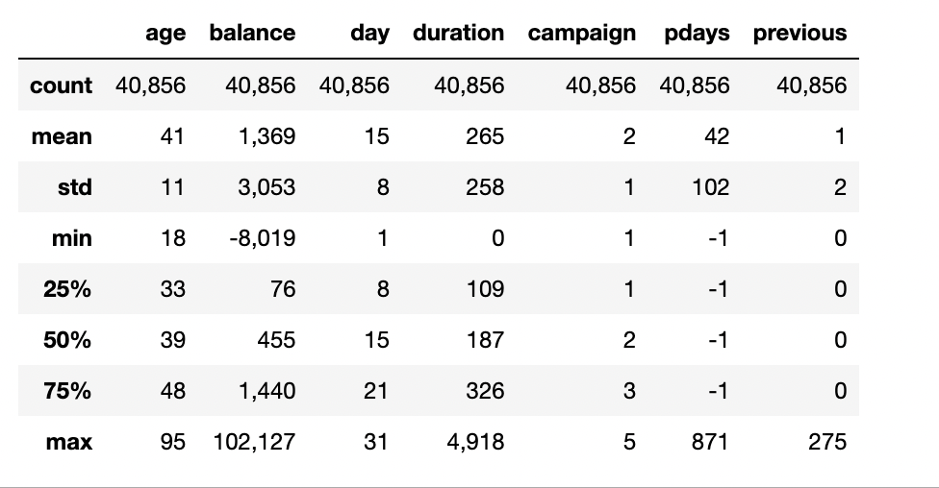
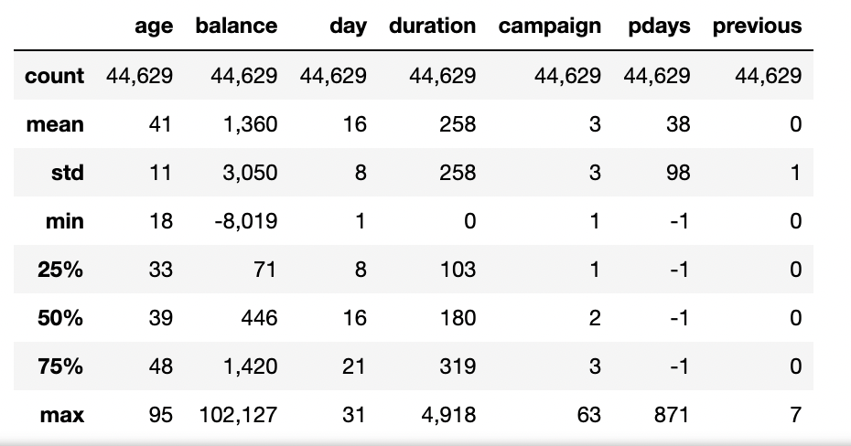
EDA- Outlier Detection and Handling
In order to detect and remove outliers, here we use two statistical methods: Interquartile range(IQR) and Standard Deviation.
Interquartile range(IQR) statistical method
Standard Deviation statistical method

Slide 9
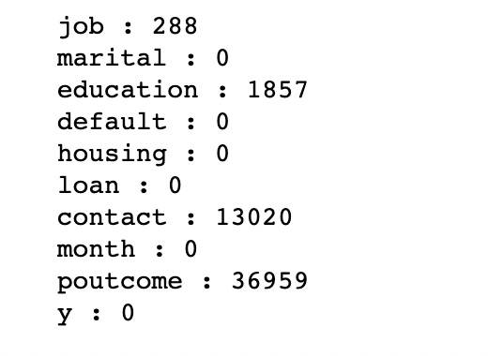
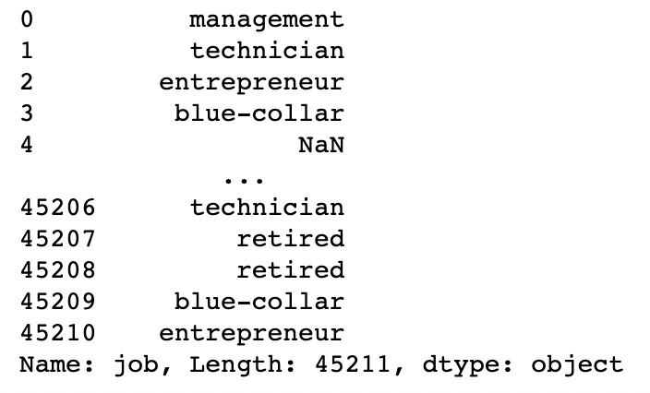
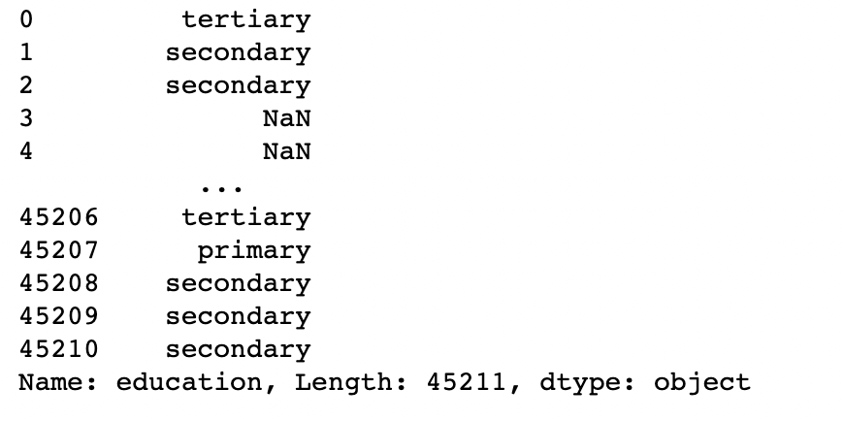
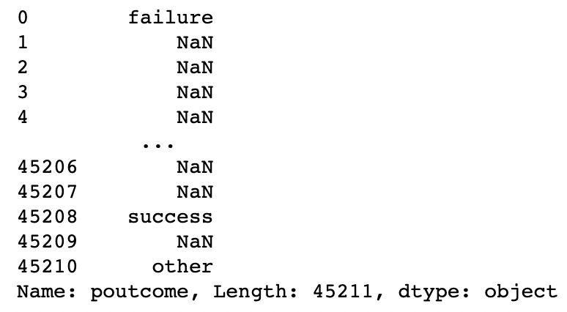
EDA- NA Detection and Handling
In order to detect and handle N/A (unknown) values, here we also use two methods:
Drop N/A and using mode value to fill N/A values.
Here we can see the original unknown values
Using mode value to fill N/A values

Slide 10
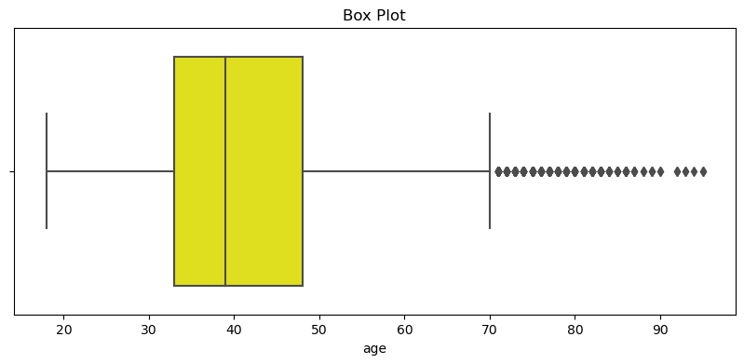
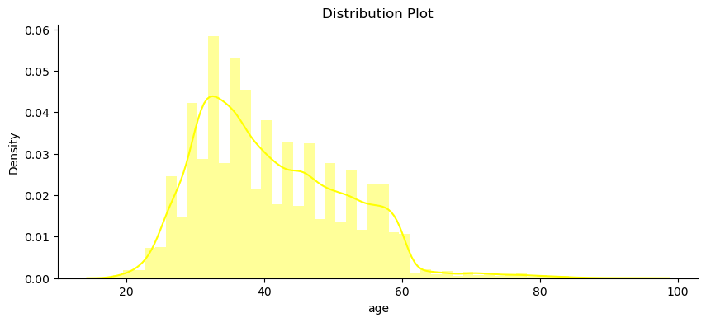
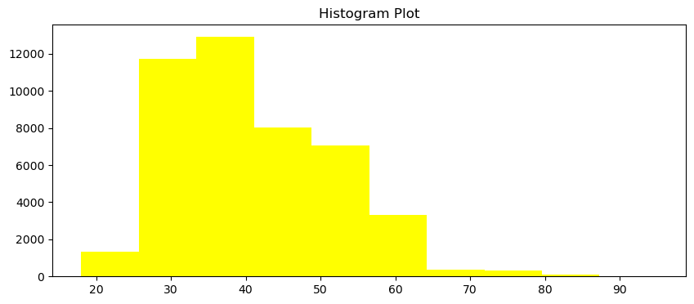
EDA- Categorical Columns-age
Here, for the age column, we can see the customers are mostly between ages 20-50.

Slide 11
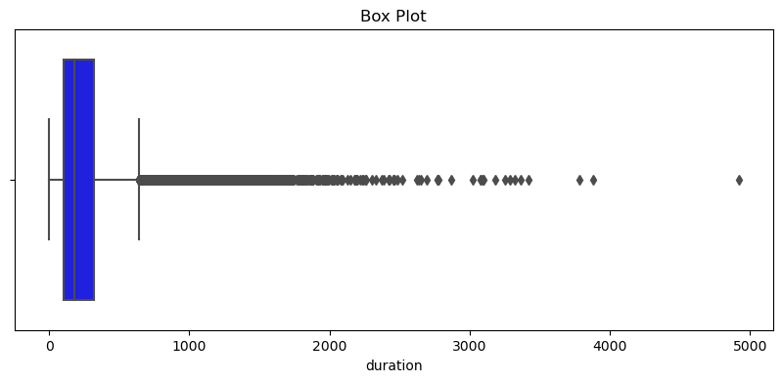
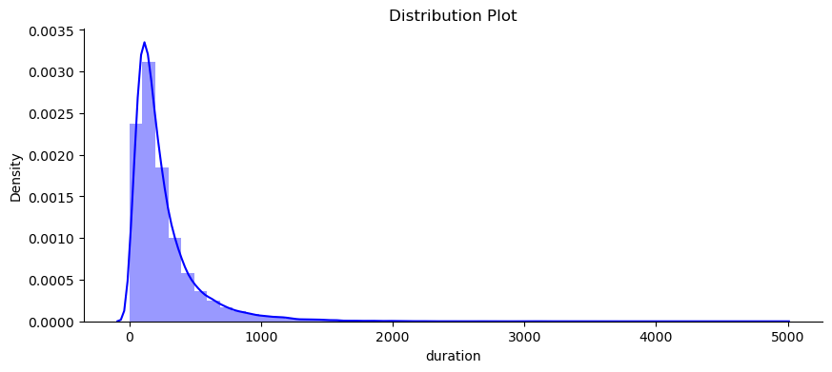
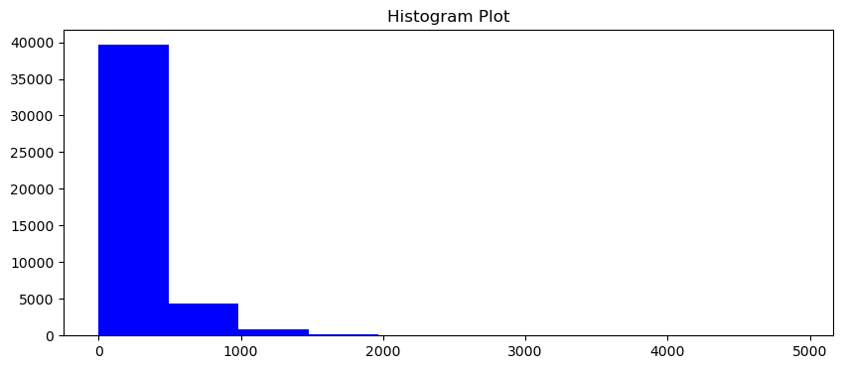
d
EDA- Categorical Columns-duration
Here, for the duration column, we can see the duration are mostly between the duration 0-500. We can also see we have a lot of unusual big ones.

Slide 12
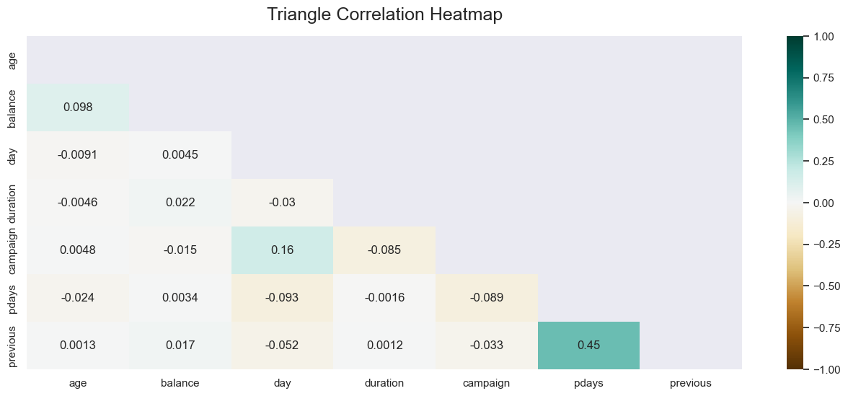
EDA Recommendations -1
Here, we can see from the correlation heat map, “pdays” and “previous” features have very high correlations between them. One of the two features can be dropped from the data since their existence will not be extra useful-providing good, new information- for the machine learning model which will be deployed in the next steps.

Slide 13
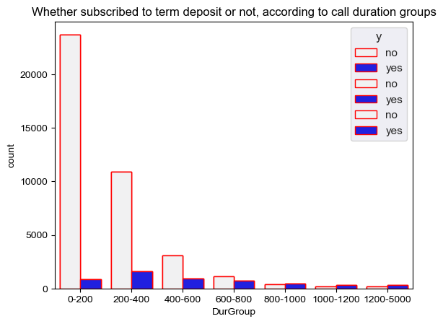
EDA Recommendations -2
X-label represents the duration of calls(in seconds) with customer, Y-label is count of that groups response to this campaign, It can bee seen that when call duration is increased getting “Yes” response probability is clearly increased as well

Slide 14
Model Building
We splitted the data into test and train dataset with the ratios 20% and 80% respectively. Then, we build following models on the data.
Linear Algorithms
Logistic Regression
Non-linear Algorithms
K-Nearest Neighbors
Decision Tree Classifier
Ensemble Methods
Random Forest Classifier
Support Vector Classifier
XGBoost
Gradient Boosting Classifier

Slide 15
Evaluating Models
After building and testing corresponding models, we noticed that ensemble methods gave better results comparing to linear and non-linear models.
Below, you can find the results of the corresponding models.
Linear Algorithms
Logistic Regression: 90.87 %
Non-linear Algorithms
Decision Tree Classifier: 89.16 %
Ensemble Methods
Random Forest Classifier: 91.36 %
Support Vector Classifier: 89.72 %
XGBoost: 91.50 %
Gradient Boosting Classifier: 90.65 %
Randomized Serach CV: 91.10 %
As it can be seen above, XGBoost gave the best results.

Slide 16
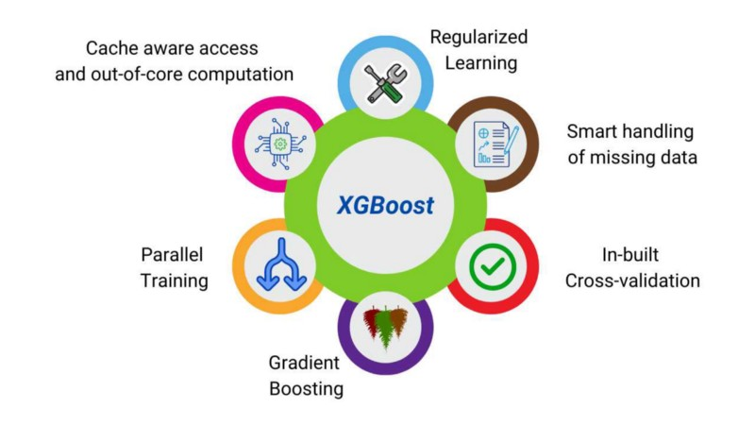
Model Selection
Since XGBoost gave the best results in previous steps, it can be used in order to achieve business goals efficiently.

Slide 17
Kemal Cagin Sertkaya Jinwen Li
Thank You

