Slide 1

Supply Chain Management System
SWENG 837 Software System Design
By: Kevin Malone

Slide 2
Problem Statement and Requirements
Problem Definition
Current supply chains lack transparency and traceability, leading to inefficiencies, fraud, and reduced consumer trust.
System Functionalities
Record Creation
Tracking
Verification
Inventory Management
Reporting

Slide 3
Problem Statement and Requirements (continued)
Target Users
Manufacturers
Transporters
Warehouse Managers
Retailers
Consumers
Business Goals
Increase transparency and trust in the supply chain.
Improve efficiency by reducing delays and errors.
Enhance product traceability from origin to consumer.
Support compliance with regulations and standards.

Slide 4
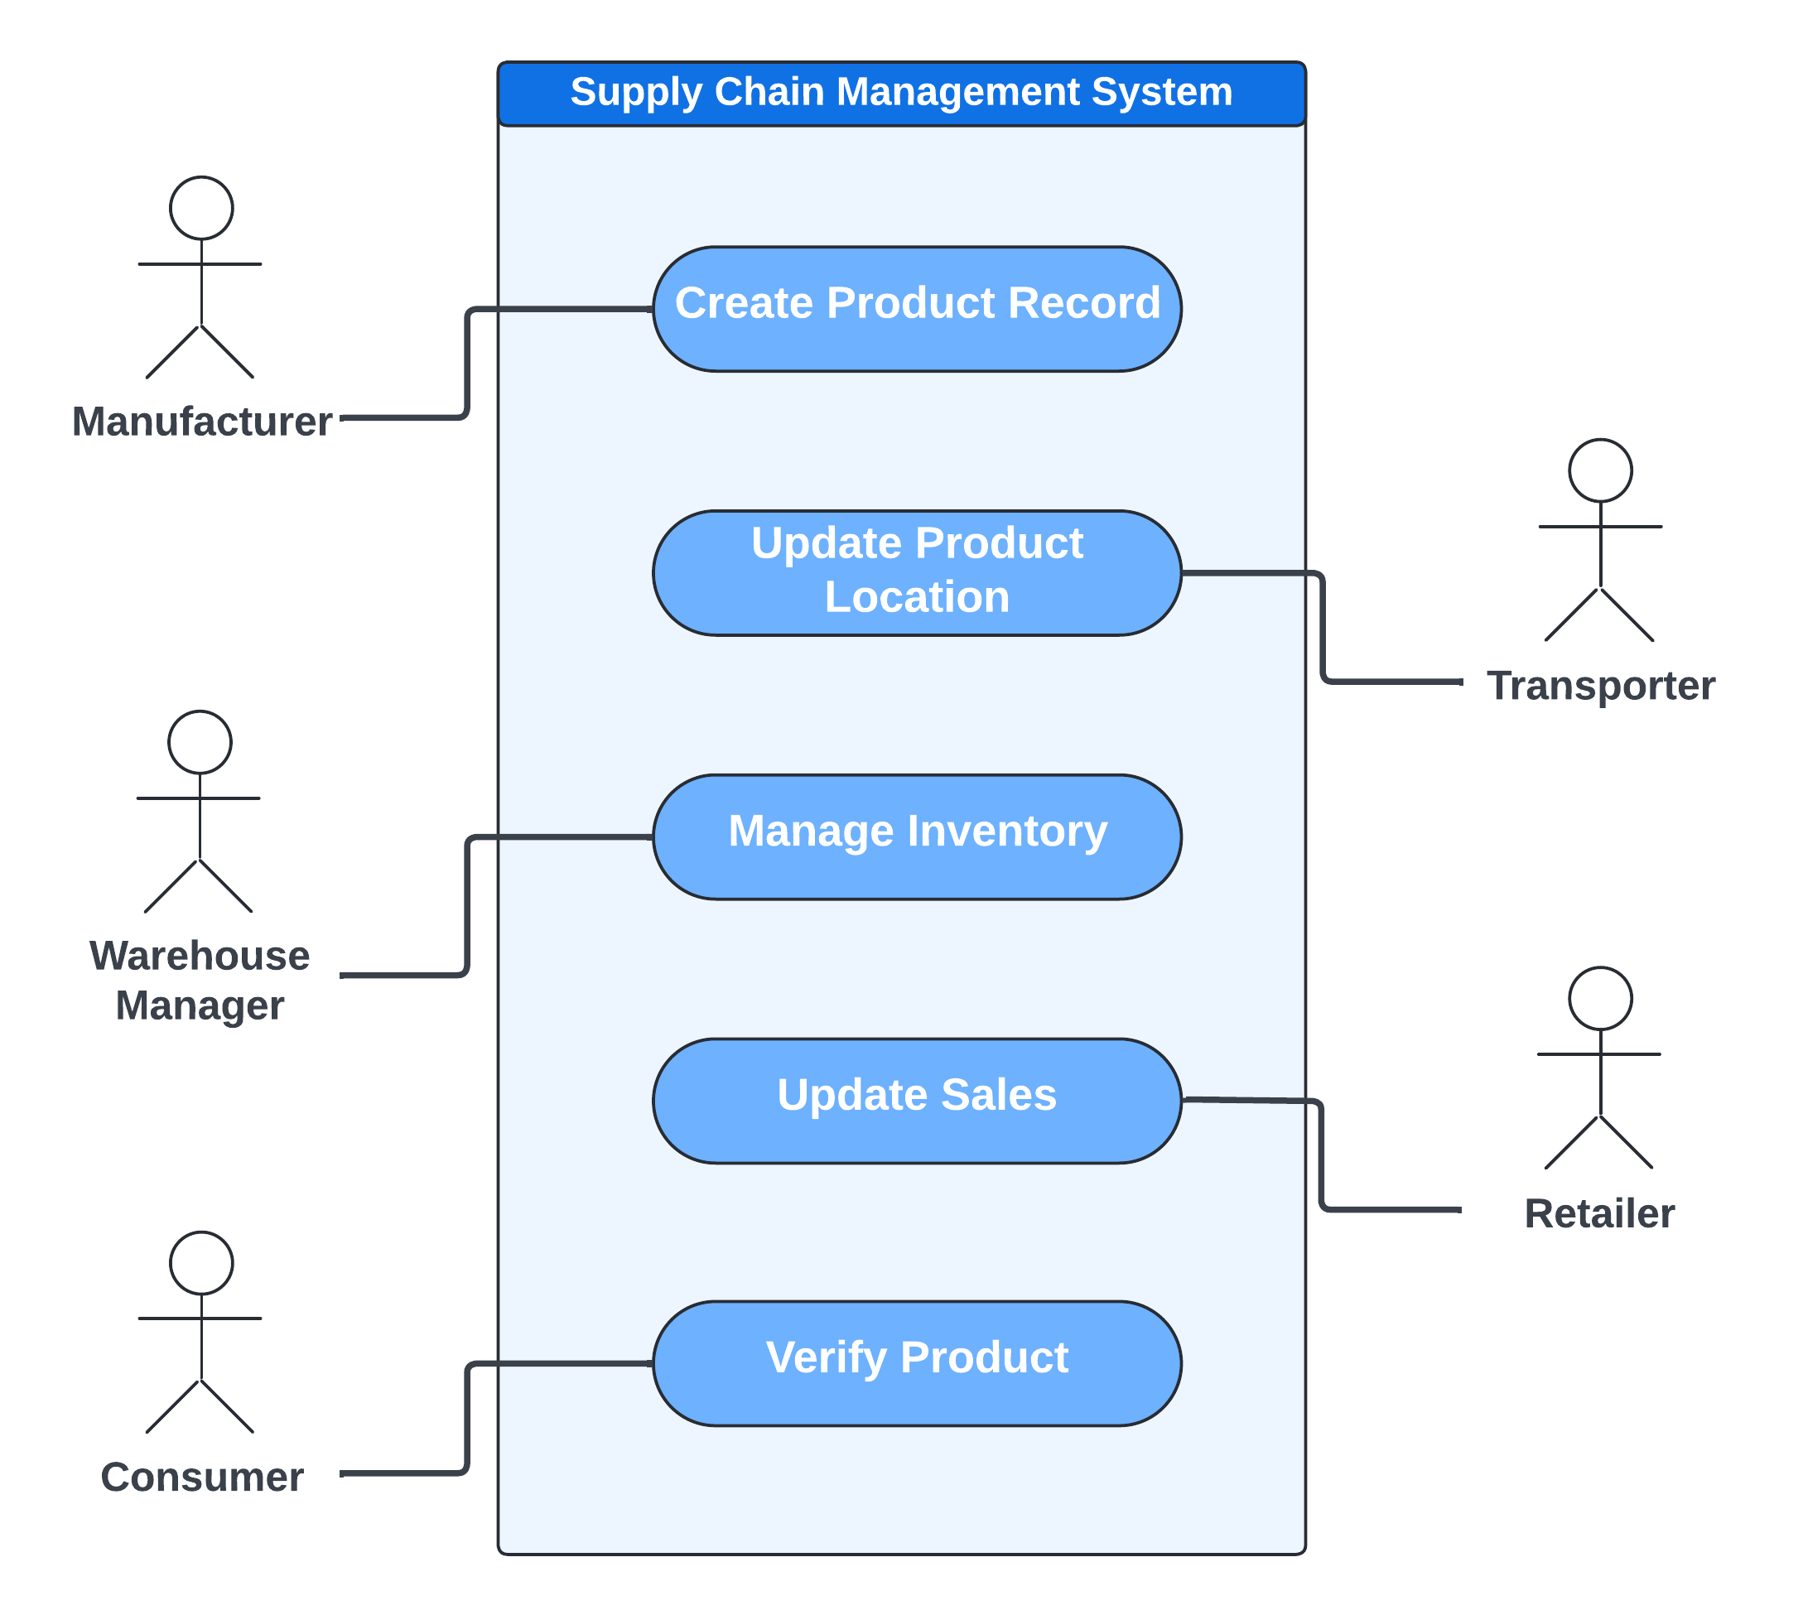
Use Case Diagram

Slide 5
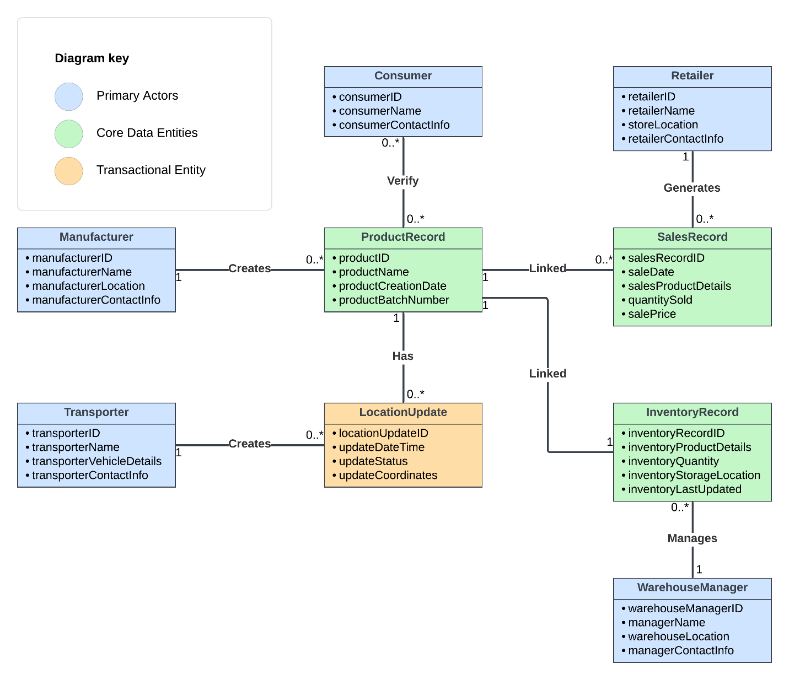
UML Domain Model

Slide 6
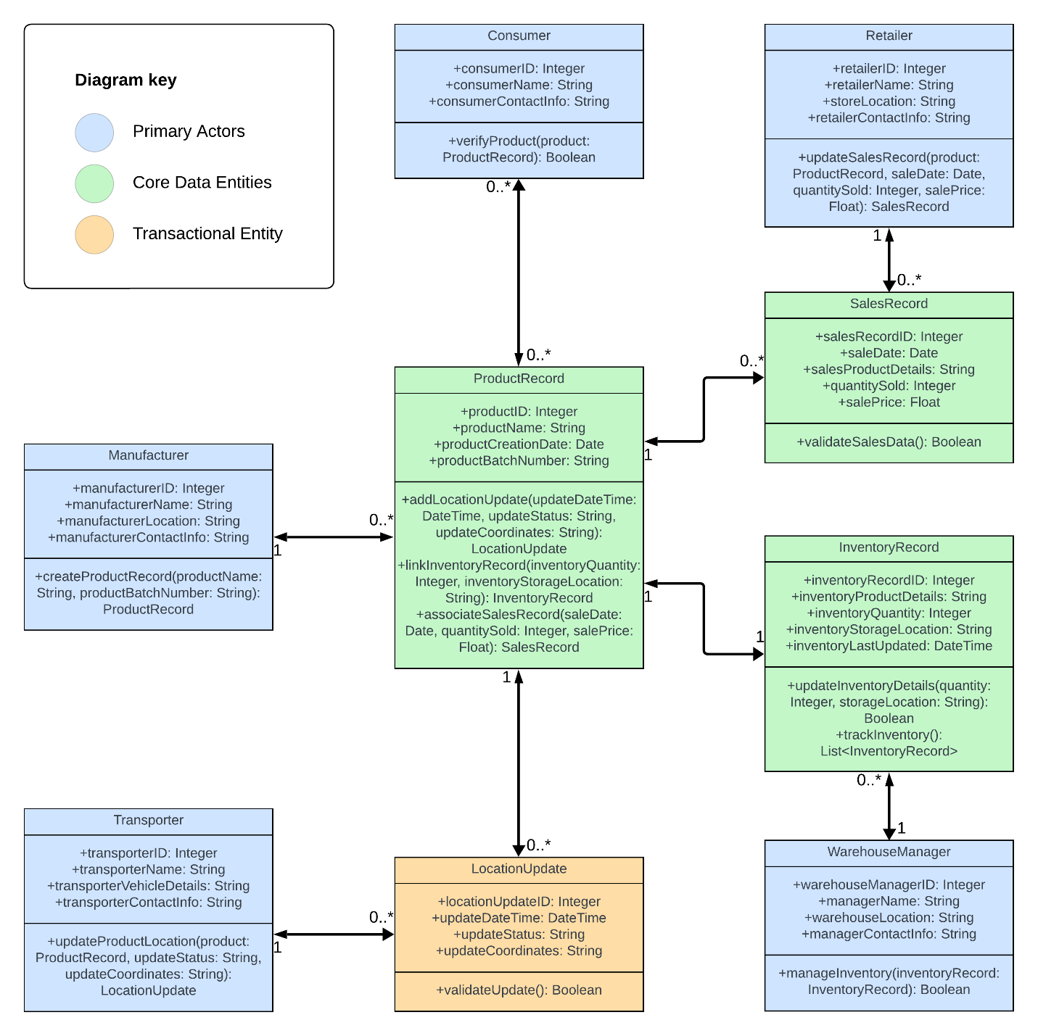
UML Class Diagram

Slide 7
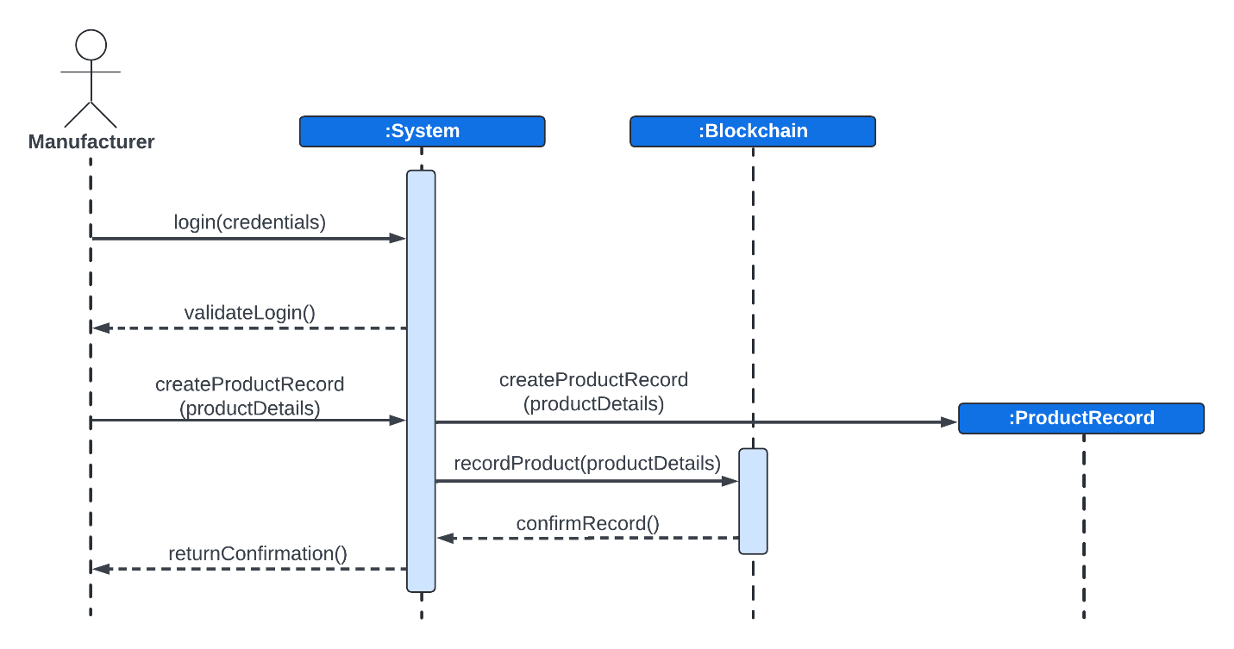
Create Product Record Sequence Diagram

Slide 8
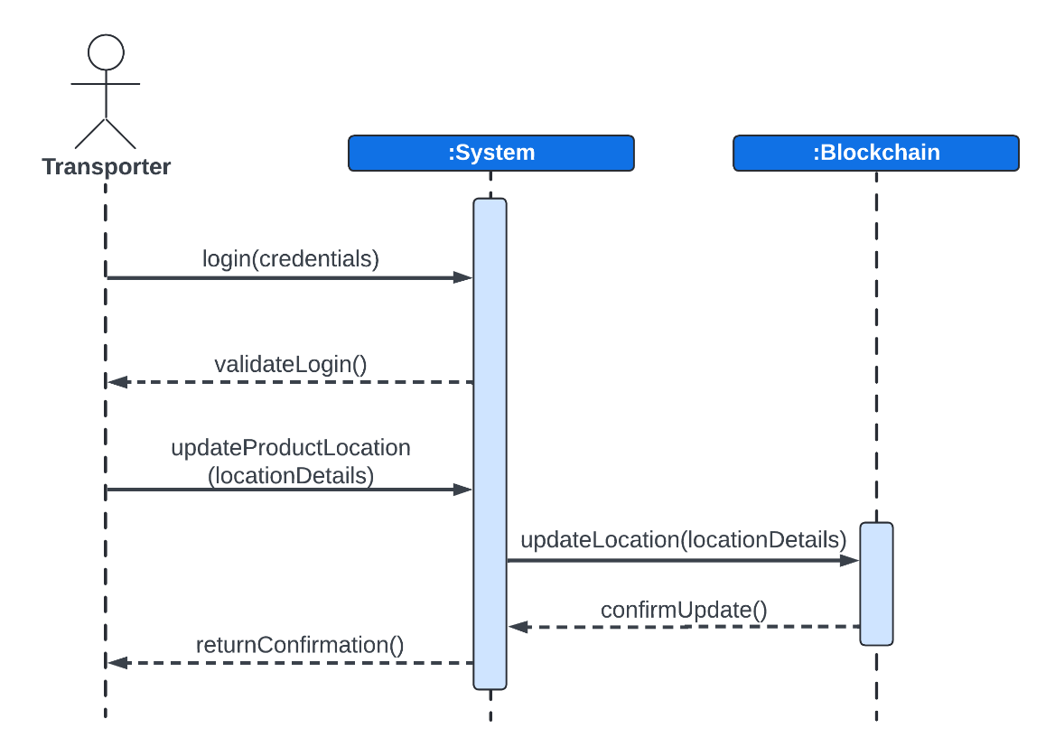
Update Product Location Sequence Diagram

Slide 9
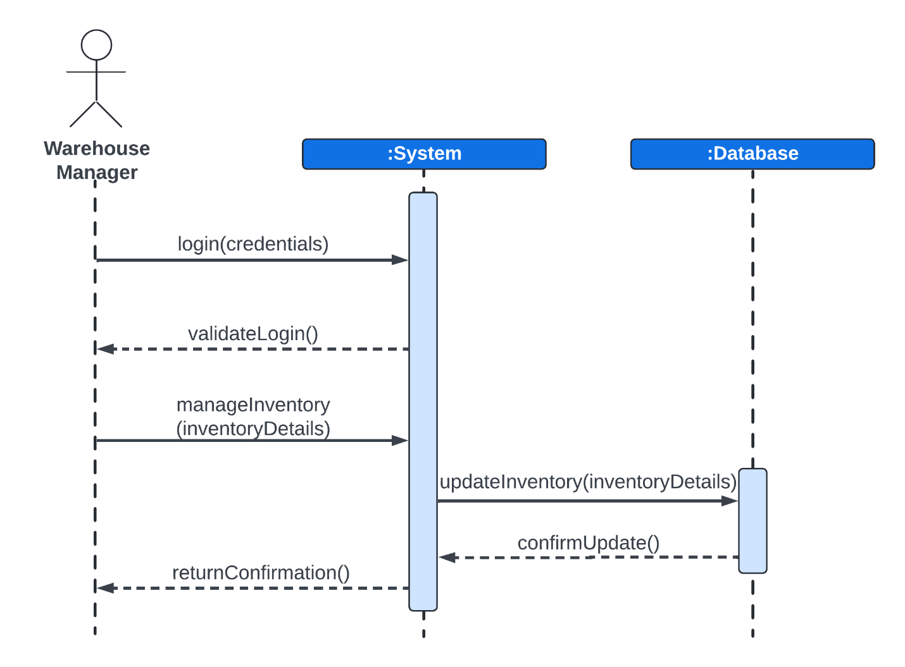
Manage Inventory Sequence Diagram

Slide 10
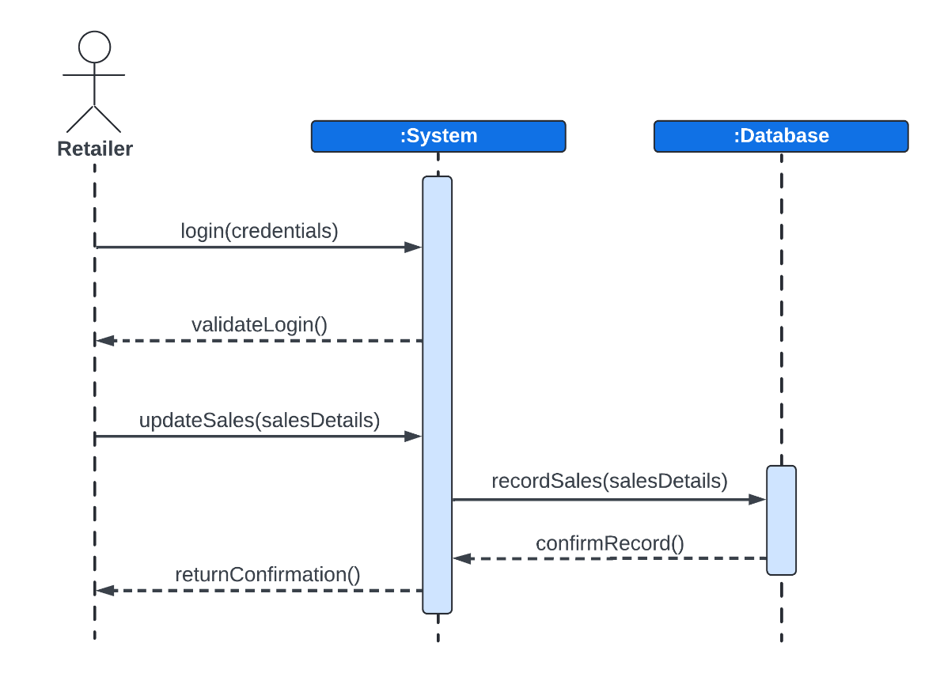
Update Sales Sequence Diagram

Slide 11
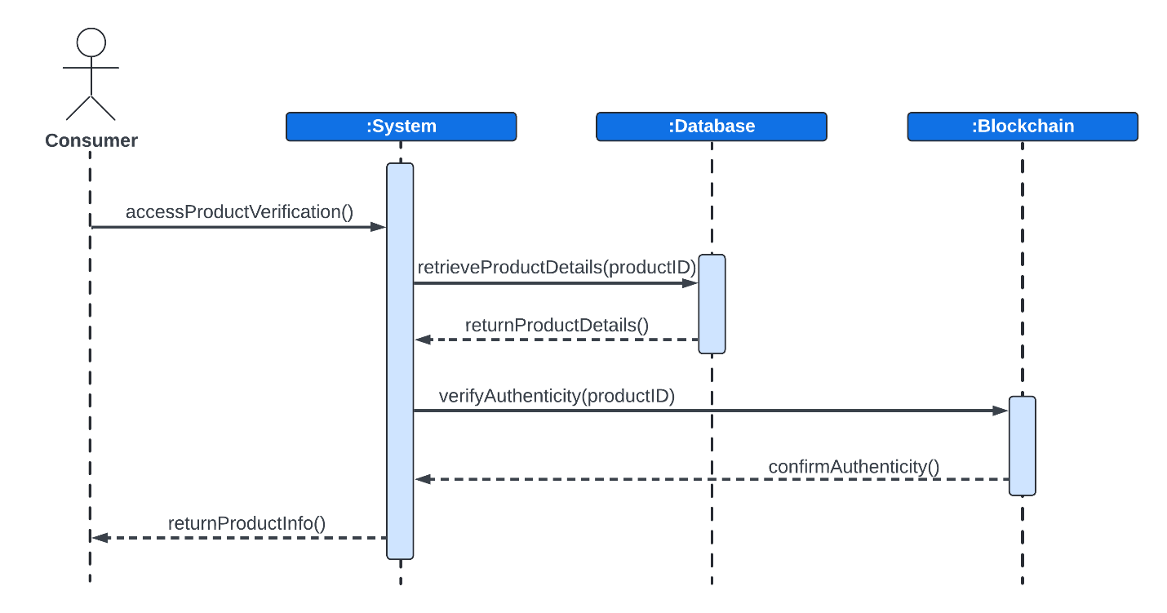
Verify Product Sequence Diagram

Slide 12
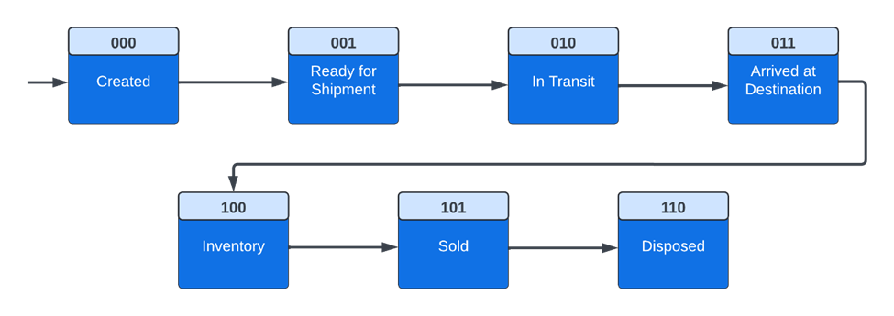
UML State Diagram

Slide 13
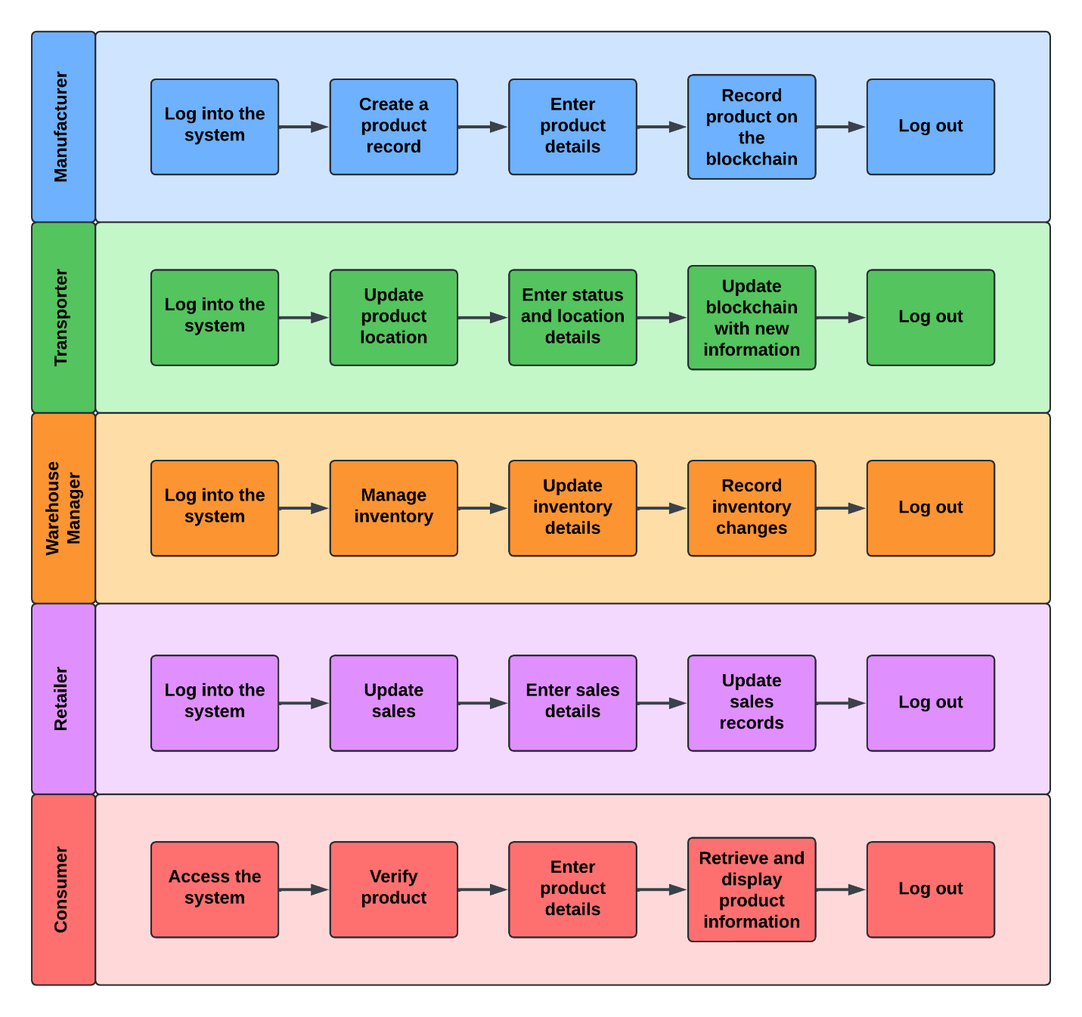
UML Activity Diagram (Swimlane Diagram)

Slide 14
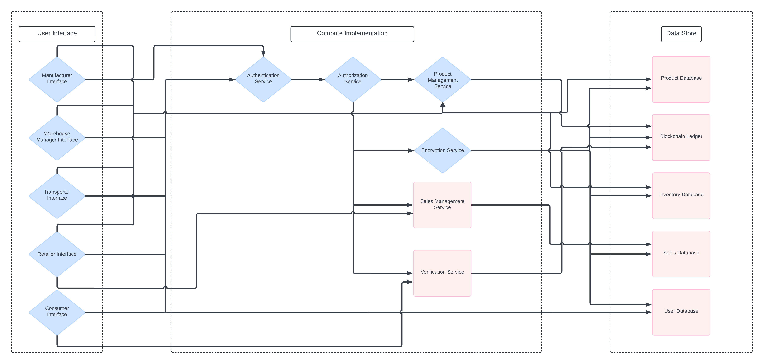
UML Component Diagram

Slide 15
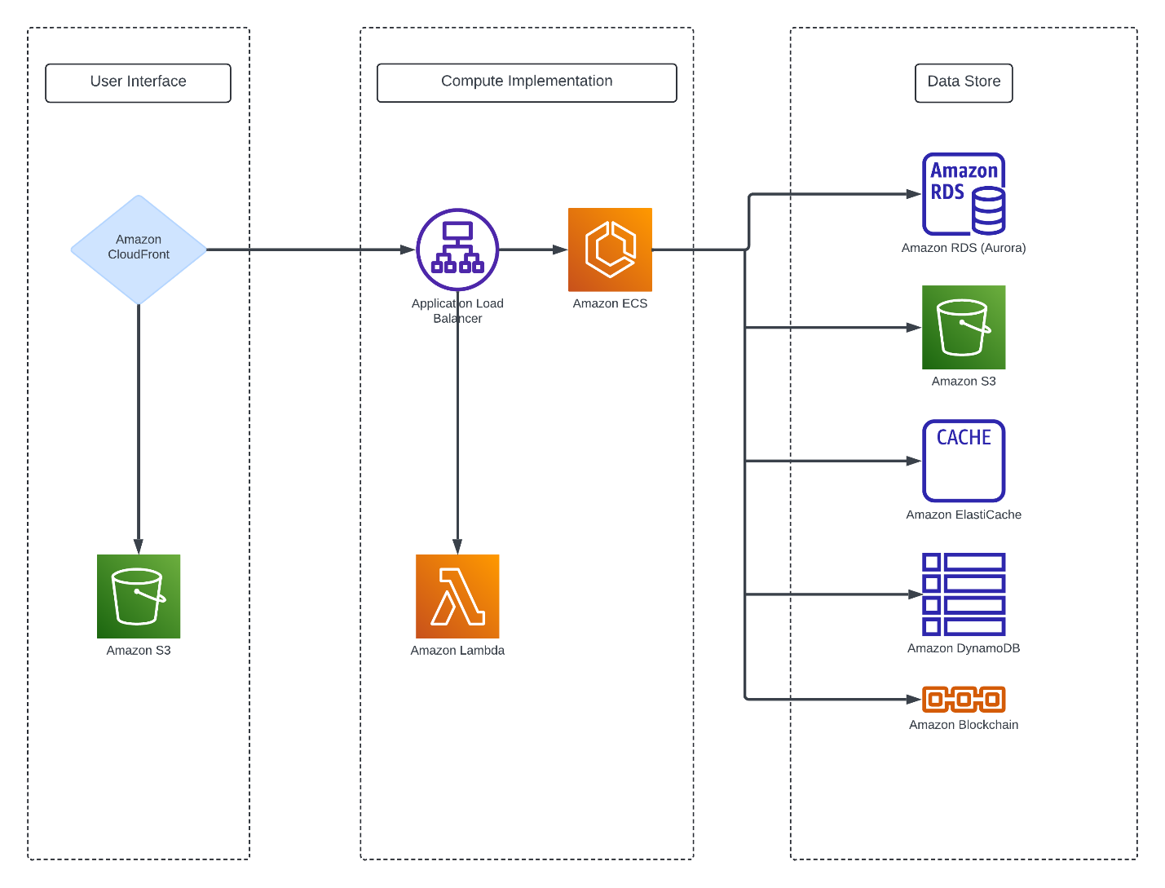
Cloud Deployment Diagram

Slide 16
Design Patterns
Design Pattern | Usage | Justification
Controller (GRASP) | Centralizes control in managing complex operations related to product records, inventory management, and location updates | By using a SupplyChainController, which coordinates actions like creating product records, updating locations, and verifying products, we maintain a clear separation of concerns, making the system easier to manage and extend.
Single Responsibility Principle (SRP) (SOLID) | Ensures that each class, such as ProductRecord, InventoryRecord, and SalesRecord, has a specific responsibility. | This principle is applied across the system to ensure that each class handles only one part of the business logic, like tracking product locations or managing inventory, which makes maintenance and future enhancements more straightforward.
Factory Method (GoF) | A factory method could be used to create different types of objects needed in the system, such as different types of database connections (e.g., for blockchain interaction or regular SQL databases). | This pattern supports the flexibility required to adapt to various backend services, enhancing the system's modularity and making it easier to switch or extend database services as needed.
Observer (GoF) | Could be used for monitoring changes across the supply chain, such as when a product’s location is updated or when inventory levels change. | By implementing observers for key events like location updates, stakeholders (e.g., Warehouse Managers, Retailers) can be notified in real-time, improving responsiveness and data accuracy.
Repository (DDD) | Centralizes data access logic for entities such as ProductRecord, InventoryRecord, and SalesRecord. | This pattern encapsulates data access and simplifies testing by decoupling the system’s business logic from the underlying data sources, making the system more resilient to changes in data storage technology.

Slide 17

Thank You

Slide 18
Video Link
https://youtu.be/cvqxdHpqlgw

