Slide 1
Brain Activity Classification in Coma Patients Using Wavelet and CST Features with CNN-based Analysis
PIP2001 Capstone Project
Review-0
Batch Number:
20211COM0066 | K.M.Madhushree
20211COM0052 | Misbah Anum
20211COM0086 | Syeda Taskiya Fathima
20211COM0061 | Suhana Anjum
Roll Number | Student Name
Under the Supervision of,
Dr. / Mr. / Ms. Assistant Prof. Mr. Arun Kumar S
Professor / Associate Professor / Assistant Professor
School of Computer Science & Engineering
Presidency University

Slide 2
Content
Problem Statement
Github Link
Analysis of Problem Statement
Timeline of the Project
References

Slide 3
Problem Statement Number:
Organization: Medical Field
Category (Hardware / Software / Both) :Software
Problem Description:Assessing brain activity in coma patients is challenging due to the complex and fluctuating nature of neurological signals. Traditional methods often provide limited insights, making it difficult to determine the patient’s condition accurately. This study proposes an advanced methodology that integrates wavelet transforms and Continuous Stockwell Transform (CST) for feature extraction, along with a Convolutional Neural Network (CNN) classifier for precise brain state classification. By leveraging high-resolution time-frequency representations of EEG signals, this approach aims to enhance accuracy, efficiency, and real-time monitoring, providing clinicians with a more reliable tool for predicting recovery and guiding treatment decisions.

Slide 4
Github Link
Github Link:
https://github.com/kmmadhushreee/8thsem-final-year-project.git

Slide 5
Analysis of Problem Statement
Technology Stack Components:
The proposed method for classifying brain activity in coma patients integrates advanced signal processing techniques, including wavelet transforms and Continuous Stockwell Transform (CST), with a Convolutional Neural Network (CNN) classifier to accurately detect and categorize brain states. The method aims to address the limitations of traditional approaches, offering a more accurate, efficient, and real-time solution for monitoring coma patients. The first key component of the proposed method is the feature extraction phase, which utilizes wavelet transforms and CST to analyze EEG signals. Wavelet transforms provide a high time-frequency resolution, allowing for the detection of both low- and high-frequency components at varying time scales. This is crucial for detecting transient brain activity patterns, which are common in coma patients. CST, a hybrid of Short-Time Fourier Transform (STFT) and wavelet analysis, further enhances this capability by providing a high-resolution representation of brain signals in both time and frequency domains. This allows for a more precise capture of short-lived or subtle fluctuations in brain activity, which are often difficult to detect with traditional methods.

Slide 6
Analysis of Problem Statement (contd...)
Software and Hardware Requirements:
Software: Matlab R2022b
Hardware:
Operating Systems:
• Windows 10
• Windows 7 Service Pack 1
• Windows Server 2019
• Windows Server 2016
Processors:
Minimum: Any Intel or AMD x86-64 processor
Recommended: Any Intel or AMD x86-64 processor with four logical cores and AVX2 instruction set support
Disk: Minimum: 2.9 GB of HDD space for MATLAB only, 5-8 GB for a typical installation
Recommended: An SSD is recommended a full installation of all Math Works products may take up to 29 GB of disk space
RAM:Minimum: 4 GB
Recommended: 8 GB

Slide 7
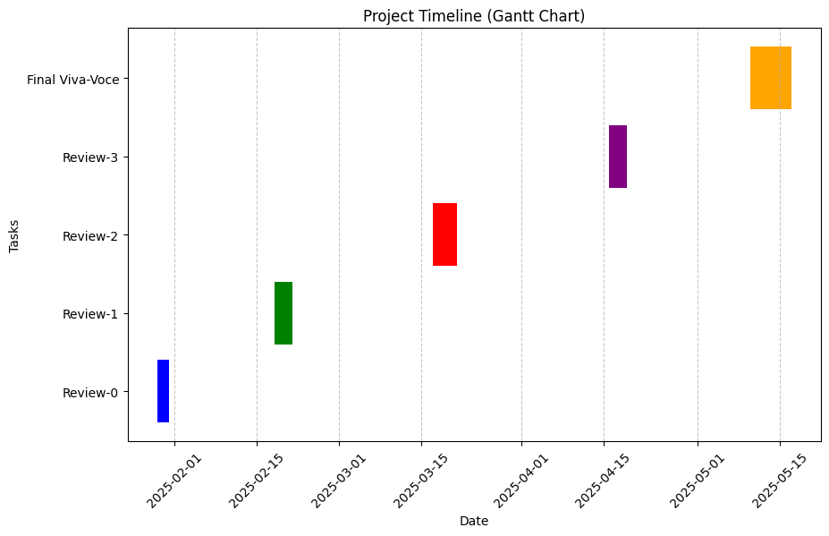
Timeline of the Project (Gantt Chart)

Slide 8
References (IEEE Paper format)
1.Niedermeyer, E., & da Silva, F. L. (2004). **Electroencephalography: Basic Principles, Clinical Applications, and Related Fields** (5th ed.). Lippincott Williams & Wilkins.
2. Mallat, S. (1999). **A Wavelet Tour of Signal Processing** (2nd ed.). Academic Press.
3. Stockwell, R. G., Mansinha, L., & Lowe, R. P. (1996). "Localization of the Complex Spectrum: The Continuous Stockwell Transform." **IEEE Transactions on Signal Processing**, 44(4), 998-1001.
4. LeCun, Y., Bengio, Y., & Hinton, G. (2015). "Deep Learning." **Nature**, 521(7553), 436-444.
5. Güler, I., & Zamboni, S. (2019). "EEG Signal Classification using Convolutional Neural Networks for Brain-Computer Interface Applications." **Neurocomputing**, 331, 30-37.

Slide 9


