Slide 1

Implementing and Improving on
“LocTree2 predicts localization for all domains of life”
Olle Holmberg
Daniel Plop
Kazi Mahbub

Slide 2
Overview
Data
●
Data & Profile Kernel
●
Data Prepossessing
Methods
●
Neural Net
●
Random forest
●
Evaluation
–
Accuracy
–
Per class accuracy
Results
●
Neural Net (final model, evaluation)
●
Random forest ()
Discussion
●
●
Conclusion
●
●

Slide 3
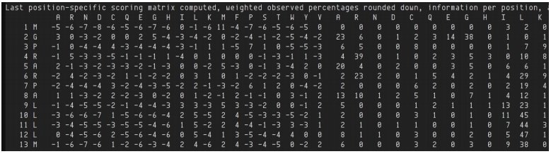
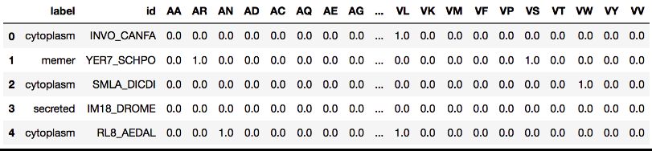
Data & Profile Kernel
Profiles of proteins from 3 kingdoms:
  Eukaryota 1682
  Archaea: 59
  Bacteria: 47
Feature generation using Profile Kernel

Slide 4
Data Preprocessing
Remove classes with low data point frequency
Remove data points with low sum of k-mer frequency
Scale input vectors individually to unit norm (vector length)

Slide 5
Methods

Slide 6
Models & Evaluation
Neural Nets motivation:
  State of the art
Random forest motivation:
  Low number of samples
  Good interpretability
Evaluation
  Accuracy: as in Loctree2 (e.g. Q18, 18 classes)
  Per class accuracy (confusion matrix)
  Statistical significance (bootstrap model error)
  Baseline(random predictor)

Slide 7
Results

Slide 8
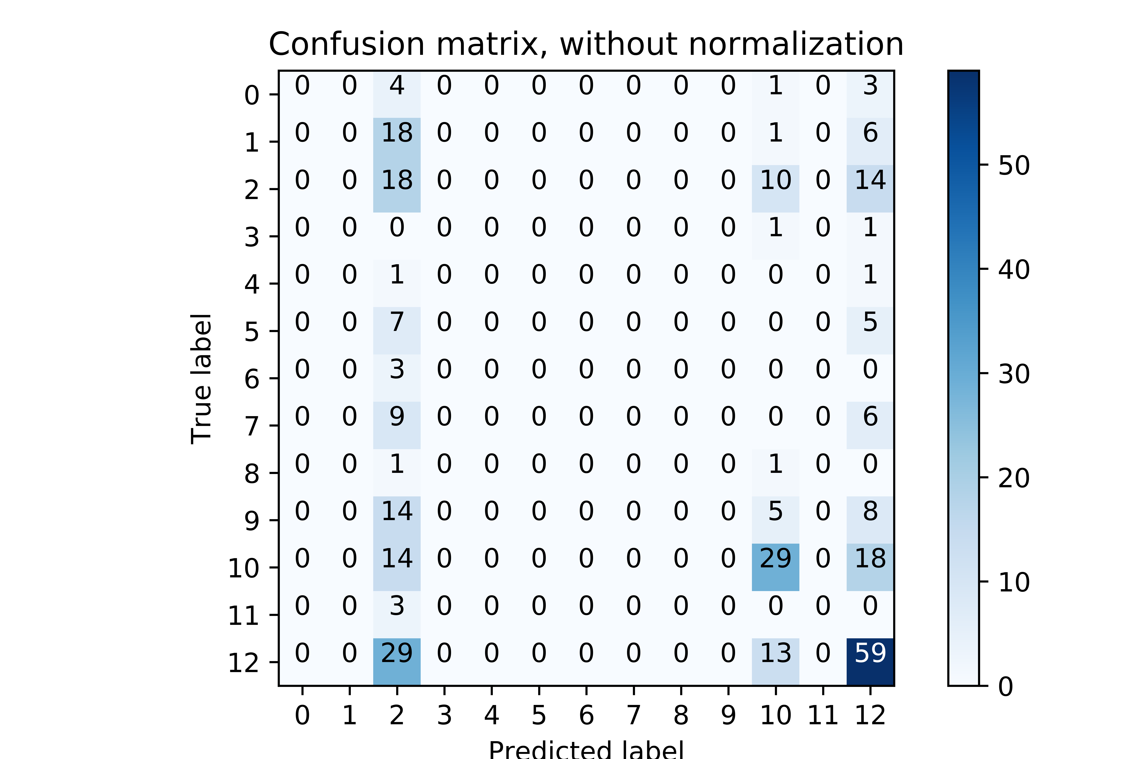
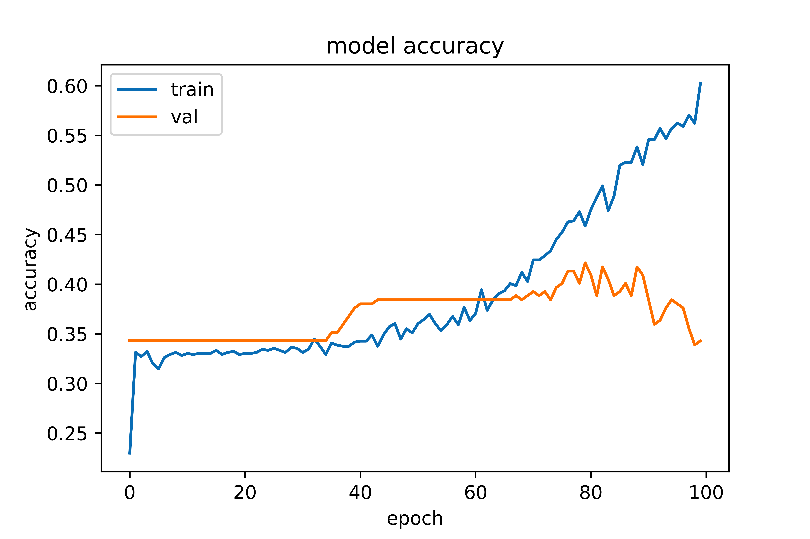
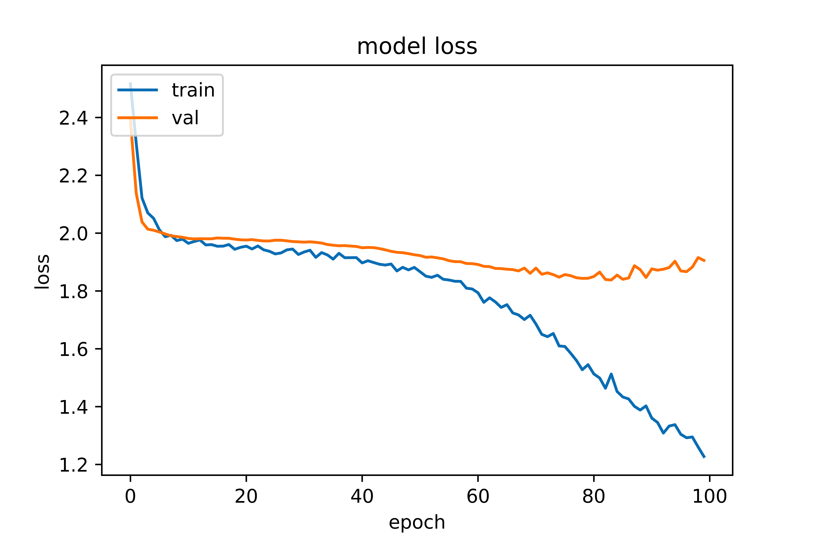
Neural Network – Eukaryota
Q13: 0.34983498349834985 +/- 0.027327633418269832
Random: 0.07920792079207921
Naive:0.22442244224422442

Slide 9
Neural Network – Eukaryota
Q13: 0.34983498349834985 +/- 0.027327633418269832
Random: 0.07920792079207921
Naive:0.22442244224422442

Slide 10
Neural Network – Eukaryota
Q13: 0.34983498349834985 +/- 0.027327633418269832
Random: 0.07920792079207921
Naive:0.22442244224422442

Slide 11
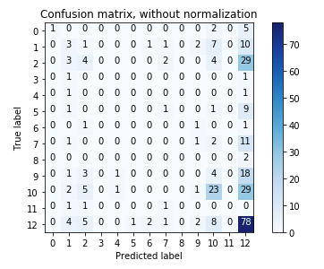
Random Forest – Eukaryota
Q13 = 0.35973597359735976 +/- 0.024508165237404622
Random: Q13: 0.082508250825082508
Naive: Q13: 0.22112211221122113

Slide 12
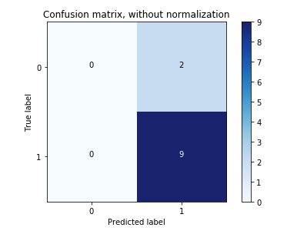
Random Forest – Archea
Q2: 0.81818181818181823 +/- 0.10897247358851687
Random: 0.36363636363636365
Naive: 0.54545454545454541

Slide 13
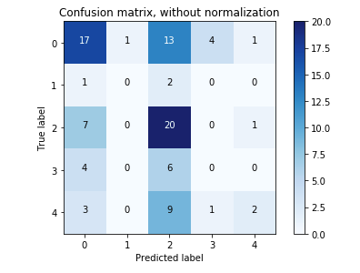
Random Forest – Bacteria
Q5: 0.42391304347826086 +/- 0.040368550069463022
Random: 0.15217391304347827
Naive:0.28260869565217389

Slide 14
Implementing and Improving on
“LocTree2 predicts localization for all domains of life”
Olle Holmberg
Daniel Plop
Kazi Mahbub

Slide 15
Thanks for listening!
(Questions)

