Slide 1

Shine School App Presentation
Powered By - Shine Track Pvt.Ltd.

Slide 2

What is
Shine School App

Slide 3
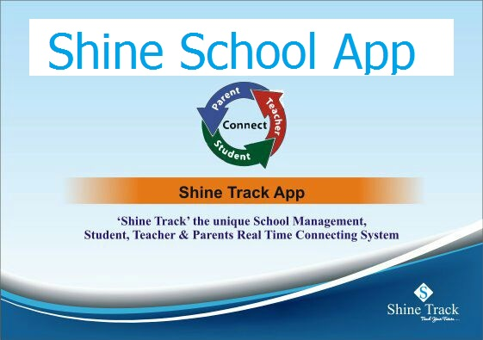

Slide 4
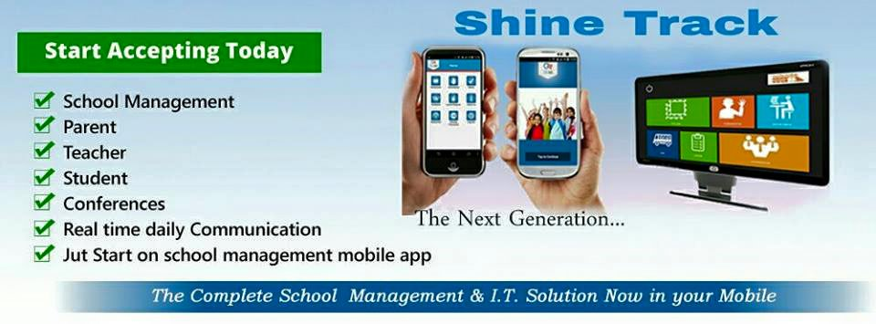
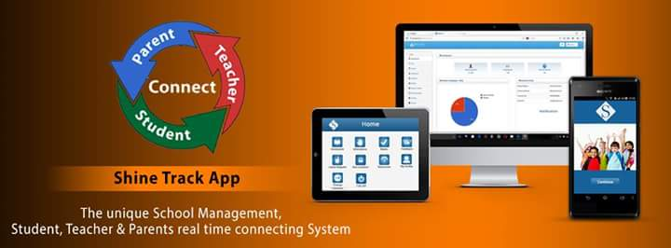
We provide…

Slide 5

Kids Are The Future
Future of Family
Future of Society
Future of country

Slide 6

We Help You
To Track Your
Ward’s / Kids/ Child
Academic/ Future/ Track/ Security
Academic Educational Information of Your Kids

Slide 7
How easily you get the information of your kid’s school activity?
Attendance
Exams/test information
Homework
Student’s feedback
E Leave
School bus location
School fee
Time table
Extra curriculum activity
School Functions
Parent Teacher’s Meeting

Slide 8
How frequent do you get these information?
We help you provide a unique platform with
A Real Time Connecting System where you can get the daily update of your children’s school activity .
No matter how busy you are , no matter how far you are , no matter you are on your business trip.
No Matter What !!!
SHINE SCHOOL APP KEEP YOU INFORMED.

Slide 9
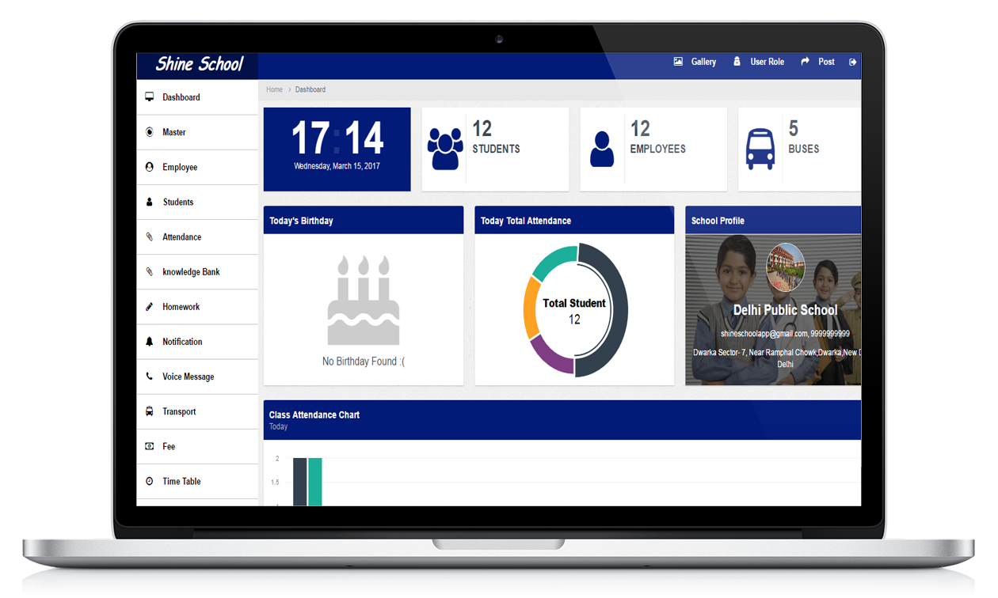
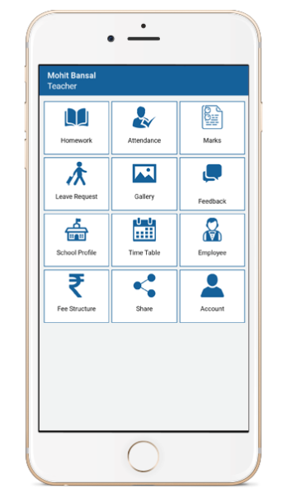

Slide 10
Shine School App : Features
Platform for Student, Parents and teacher to get updated.
Application not build only for Smart Phone user but also for Computer user with user friendly interfaces.
Real time Attendance : Parents would get notification/SMS if their child is Absent
Homework/Assignments : Parents can check homework/assignments for their children for the day from their Mobile.
Marks/Results : Parents can check progress of their child anytime from anywhere within their mobile.
Student Feedback : Parents get Feedback/Complains/Appreciations of their child within their mobile.

Slide 11
Notifications : School can schedule notifications for Fee/PTM/Events etc.
Bus Tracking : Parents can check the bus position on Google Map within their devices for their child root using GPS technology.
Fee Management : School admin having option to maintain the students fee within the application and print the receipt for student.
School Gallery : School admin would have option to add/update the pictures for any event in the application which will be available in the mobile for all users.
Web App Integrated : People do not have Smart Phone, can use web platform to access all the features available.

Slide 12
About App
Shine School-App is a medium to stay Connected and updated. We have entered the age of Digital technology. Where in technology is following and is waving a path for faster growth.
Shine School-App gives a Connect to parents on a regular base and gives them an opportunity to go hand in hand with the advanced world. It bridges the gap among teachers, parents and students who use technology.
Shine School-App is new online method for the schools is user friendly with an attractive interface for gaining the attention of students.
Shine School-App is the effective and updated application to make the education system simpler and more interactive. It is the mode of connection amongst the students, teachers and the parents of the students to get a better outcome

Slide 13
Not Just For Students
Parents can use app to:
      Check Attendance.
      Check Marks/Grades.
      Check Homework Assignments.
      Submit Leave Request for Child.
      Keep updated about fee dates, Examination and Events.
      Take notes, Track and alert for student meetings.
      Check Feedback for their child.
Teachers can use app to:
      Mark Attendance.
      Assign Homework.
      Approve/Deny Leave Request.
      Submit Feedback.

Slide 14
Mobile Screens
Features:
    Homework
    Attendance
    Marks
    Leave Request
    Reminder Notifications
    Bus Tracking
    Fee Structure
    Time Table
    Employee Details
    School Profile
    Gallery
    Feedback

Slide 15
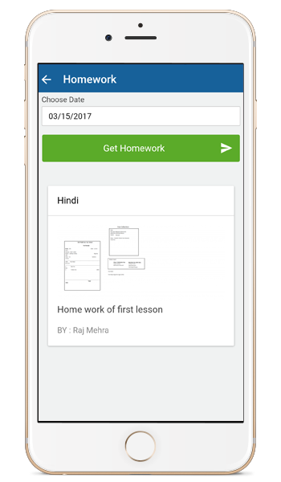
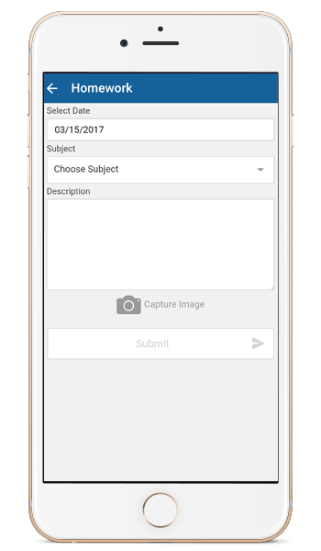
Homework
Parents and Student can stay updated of Homework Assignments
Teacher can assign Homework Assignments

Slide 16
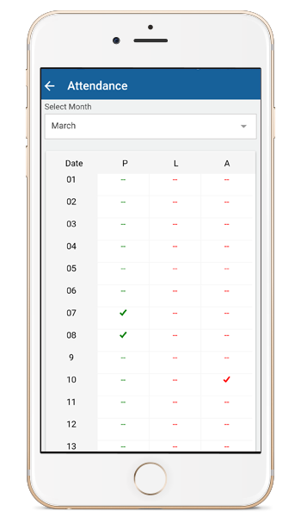
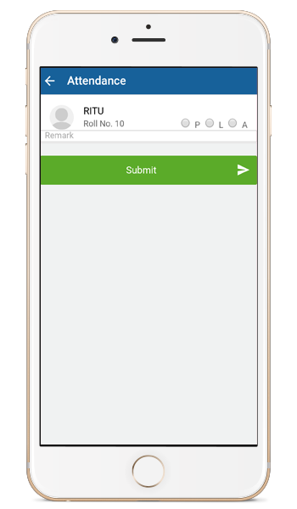
Attendance
Parents and Students can check day by day attendance or for the whole month
Teacher can mark attendance through Android App.
“If School has installed Automated attendance system then it will automatically updated into app and teacher can use this screen to update the attendance for the day.”

Slide 17
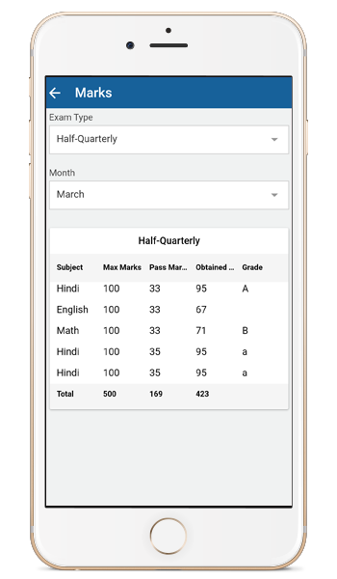
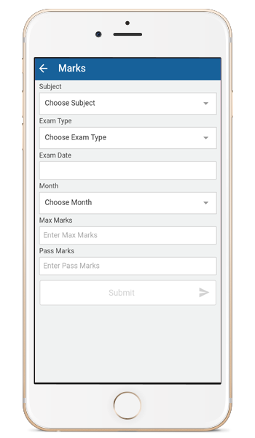
Marks/Result
Parents and Student can check academic performance.
Get Shine School App displays marks for every student subject
wise and option to view Detail Mark sheet also.

Slide 18
Notification
Parents and Students can get:
    Fee Notification
    Exam Notification
    Events Notification
    Leave Approved/Denied Notifications
    Parents meeting Notification and more…….
Teacher can get:
    Leave Request Notifications

Slide 19
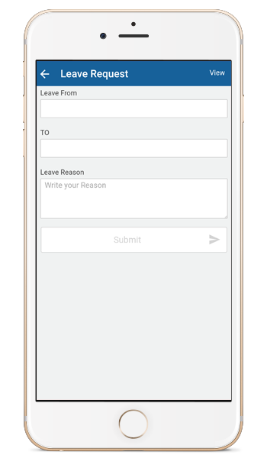
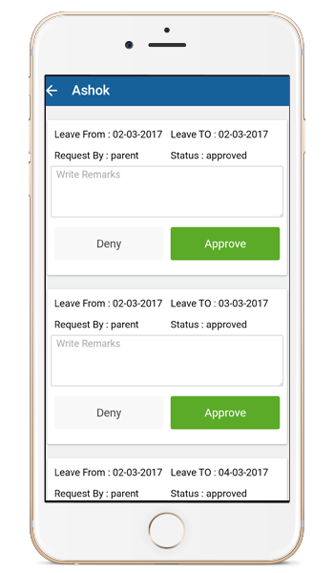
Leave Request
From this app parent can request for leave by submitting the leave request form
Teacher can Approve/Deny the leave request

Slide 20
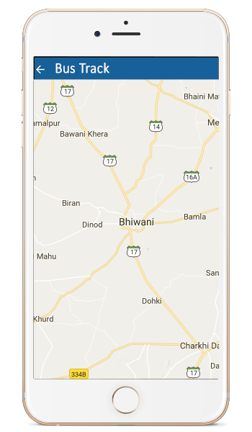
Bus Tracking
Parent and Student can get:
    Bus Running Details
    Bus Driver Details
    Bus Route/Stop
    Real-Time Bus Track

Slide 21
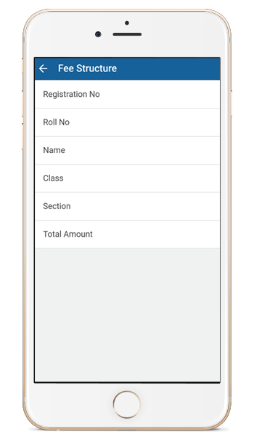
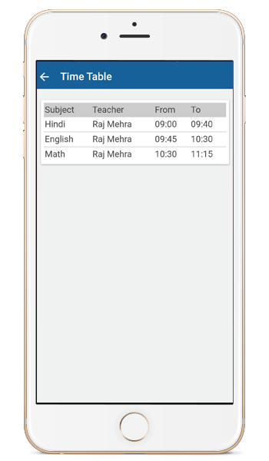
Fee Structure | Time-Table
    It display class wise fee structure of student on term(monthly, yearly…)
    Feature enables user to see updated time table according to the class.

Slide 22
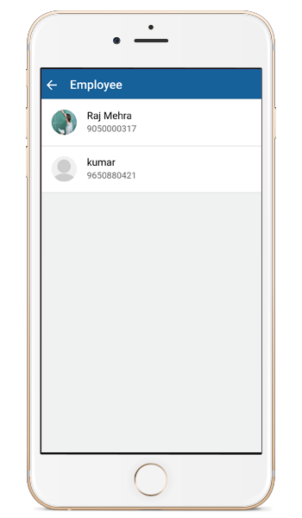
Employee Details
In This Section User can see Employee Details
    Name
    Designation
    Email ID
    Contact No

Slide 23
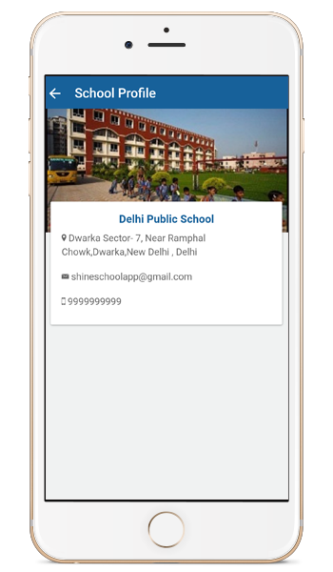
School Profile
    Can see the detail profile of the school like :
  Name of school
  Address
  Email ID
  Contact No
  School image

Slide 24

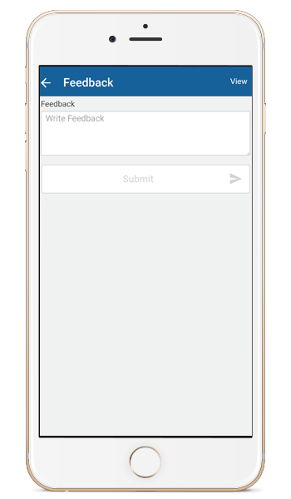
Gallery | Feedback
  In this section you can see various images regarding cultural program, events, architecture and more…
  Teacher can give feedback for students according to their performance.

Slide 25

SERVICES AND CHARGES
Sr. No. | Services | Particular | Price
1. | School App Web Portal Data Entry Informational Call to Parents Software Training | One Time | Rs25000/-
2. | Service Charges | Per month/ per student | RS 15 /-
3. | Website Designing | One Time (Excluding Domain and Hosting) | Free
4. | GPS (On Demand ) | Excluding VAT | Rs 5000 Per Device

Slide 26
Just Now Free Download This App From Play Store
“Shineschoolapp”
Thank you for your valuable time
Contact Us: +91-8929-333-444 | www.ShineSchoolapp.com
Shine Track Private Limited
C-383, First Floor ,Ramphal Chowk, Sector-7,Dwarka,New Delhi

