Slide 1

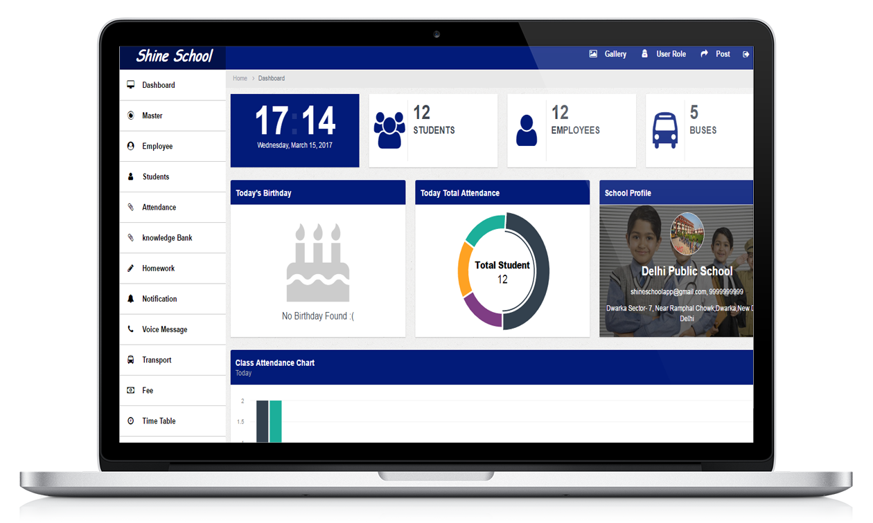
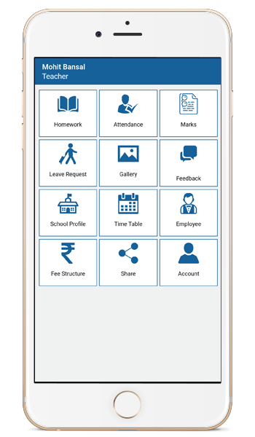

Slide 2
Shine School App : Features
Platform for Student, Parents and teacher to get updated.
Application not build only for Smart Phone user but also for Computer user with user friendly interfaces.
Real time Attendance : Parents would get notification/SMS if their child is Absent
Homework/Assignments : Parents can check homework/assignments for their children for the day from their Mobile.
Marks/Results : Parents can check progress of their child anytime from anywhere within their mobile.
Student Feedback : Parents get Feedback/Complains/Appreciations of their child within their mobile.

Slide 3
Notifications : School can schedule notifications for Fee/PTM/Events etc.
Bus Tracking : Parents can check the bus position on Google Map within their devices for their child root using GPS technology.
Fee Management : School admin having option to maintain the students fee within the application and print the receipt for student.
School Gallery : School admin would have option to add/update the pictures for any event in the application which will be available in the mobile for all users.
Web App Integrated : People do not have Smart Phone, can use web platform to access all the features available.

Slide 4
About App
ShineSchool-App is a medium to stay Connected and updated. We have entered the age of Digital technology. Where in technology is following and is waving a path for faster growth.
ShineSchool-App gives a Connect to parents on a regular base and gives them an opportunity to go hand in hand with the advanced world. It bridges the gap among teachers, parents and students who use technology.
ShineSchool-App is new online method for the schools is user friendly with an attractive interface for gaining the attention of students.
ShineSchool-App is the effective and updated application to make the education system simpler and more interactive. It is the mode of connection amongst the students, teachers and the parents of the students to get a better outcome

Slide 5
Not just for students
Parents can use app to:
Check Attendance.
Check Marks/Grades.
Check Homework Assignments.
Submit Leave Request for Child.
Keep updated about fee dates, Examination and Events.
Take notes, Track and alert for student meetings.
Check Feedback for their child.
Teachers can use app to:
Mark Attendance.
Assign Homework.
Approve/Deny Leave Request.
Submit Feedback.

Slide 6
Mobile Screens
Features:
Homework
Attendance
Marks
Leave Request
Reminder Notifications
Bus Tracking
Fee Structure
Time Table
Employee Details
School Profile
Gallery
Feedback

Slide 7
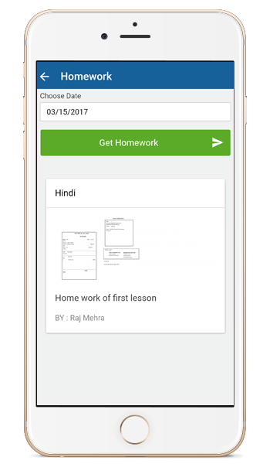
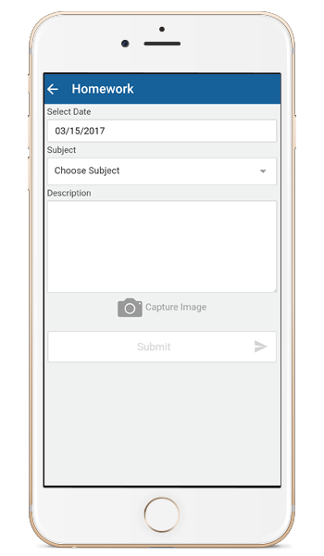
Homework
Parents and Student can stay updated of Homework Assignments
Teacher can assign Homework Assignments

Slide 8
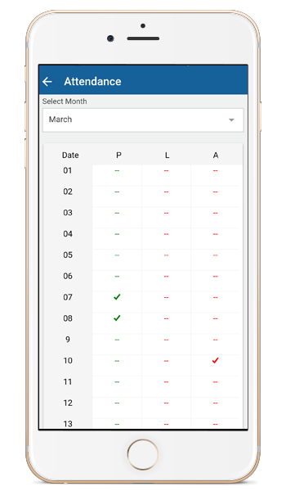
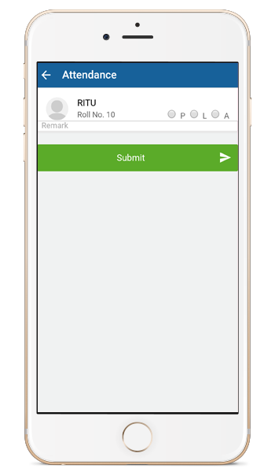
Attendance
Parents and Students can check day by day attendance or for the whole month
Teacher can mark attendance through Android App.
“If School has installed Automated attendance system then it will automatically updated into app and teacher can use this screen to update the attendance for the day.”

Slide 9
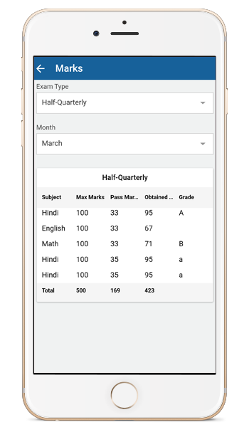
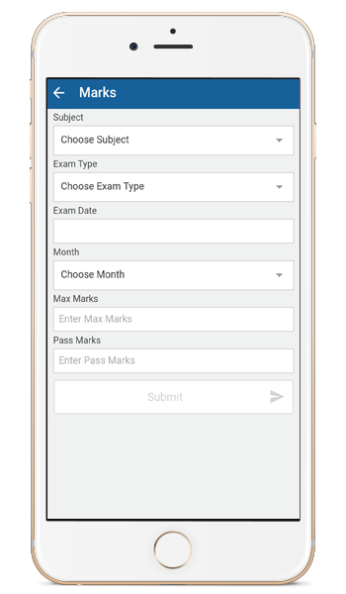
Marks/Result
Parents and Student can check academic performance.
GetEdu App displays marks for every student subject
wise and option to view Detail Mark sheet also.

Slide 10
Notification
Parents and Students can get:
Fee Notification
Exam Notification
Events Notification
Leave Approved/Denied Notifications
Parents meeting Notification and more…….
Teacher can get:
Leave Request Notifications

Slide 11
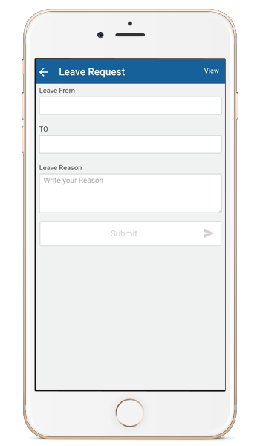
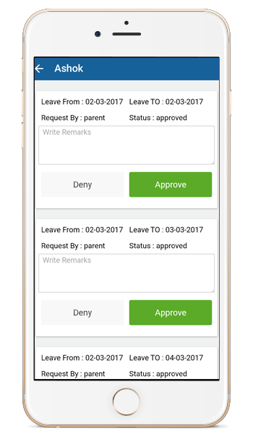
Leave Request
From this app parent can request for leave by submitting the leave request form
Teacher can Approve/Deny the leave request

Slide 12
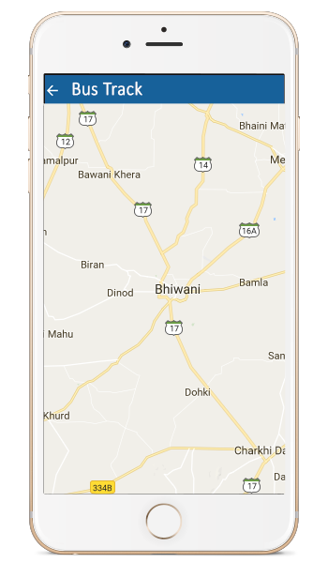
Bus Tracking
Parent and Student can get:
Bus Running Details
Bus Driver Details
Bus Route/Stop
Real-Time Bus Track

Slide 13
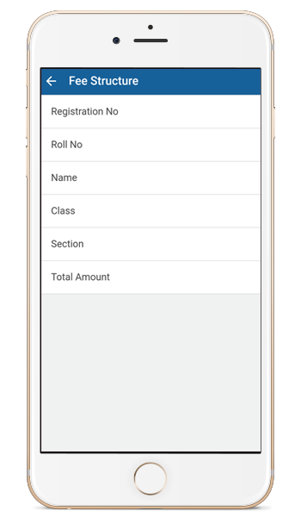
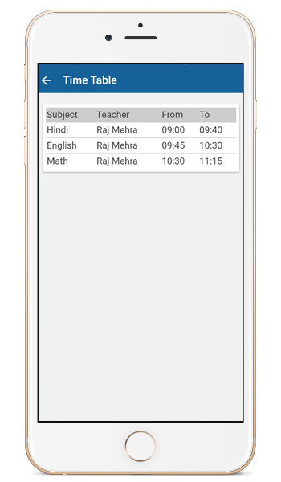
Fee Structure | Time-Table
It display class wise fee structure of student on term(monthly, yearly…)
Feature enables user to see updated time table according to the class.

Slide 14
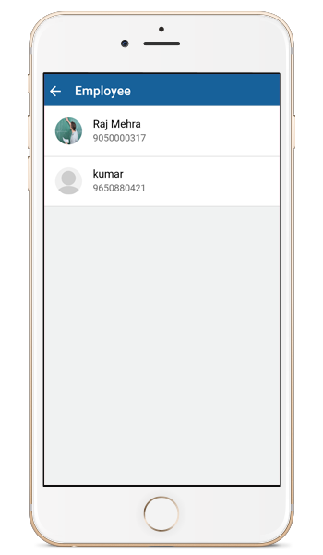
Employee Details
In This Section User can see Employee Details
Name
Designation
Email ID
Contact No

Slide 15
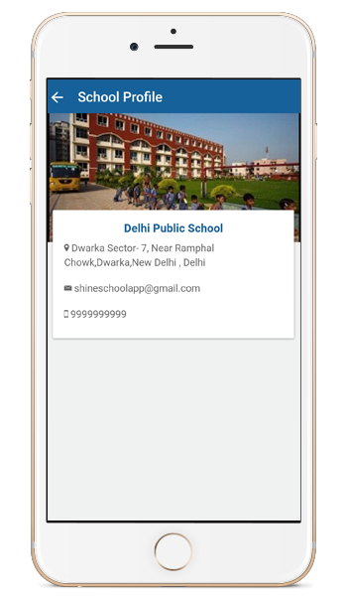
School Profile
Can see the detail profile of the school like :
Name of school
Address
Email ID
Contact No
School image

Slide 16
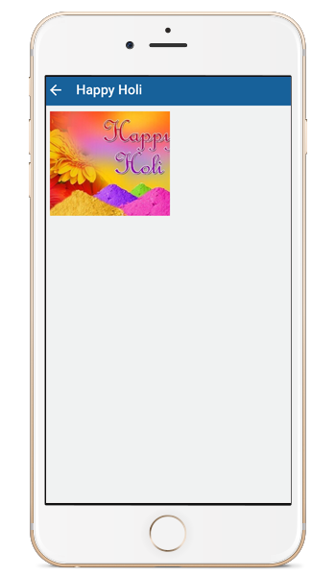
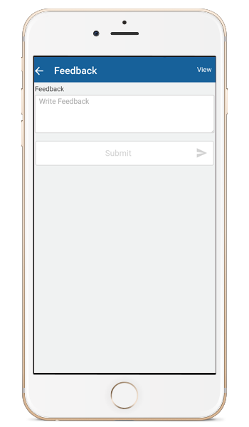
Gallery | Feedback
In this section you can see various images regarding cultural program, events, architecture and more…
Teacher can give feedback for students according to their performance.

Slide 17
Thank you for your valuable time
For any query please:
Visit:- www.ShineSchoolapp.com
or
Contact Us: +91 97283-31245, +91 98133-63615

