Slide 1

Shine Track
WELCOME TO SHINETRACK FAMILY.
ONLINE SCHOOL MANAGEMENT SYSTEM

Slide 2

What is
Shine School App

Slide 3


Slide 4
Imagine a World without Internet Information Technology
We will go back to stone age where messages will be sent through Pigeons.
Now the time has changed !!!
This is a era of Internet...
Everything is fast like light Information is passed
from one end of the earth to other by one click.

Slide 5
Why ??? we need shine school app
We help you provide a unique platform with
A Real Time Connecting System where you can get the daily update of your children’s school activity .
No matter how busy you are , no matter how far you are , no matter you are on your business trip.
No Matter What !!!
SHINE SCHOOL APP KEEP YOU INFORMED.

Slide 6

Kids Are The Future
Future of Family
Future of Society
Future of country

Slide 7
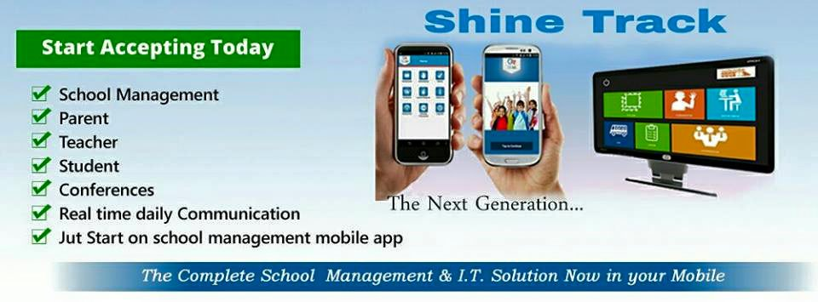
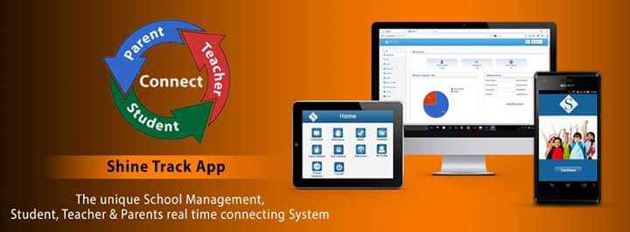
We provide…

Slide 8
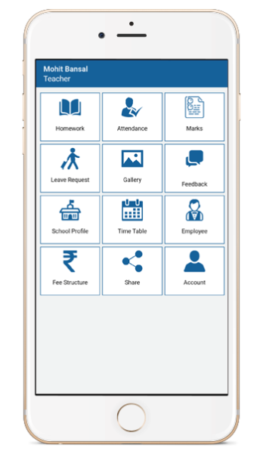

Who Can Use Shine Track
Teachers
Parents
SHINETRACK
management
Student

Slide 9
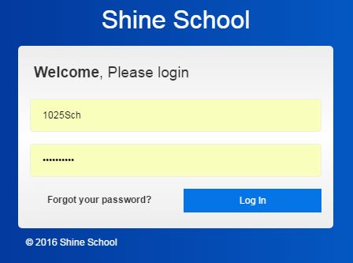
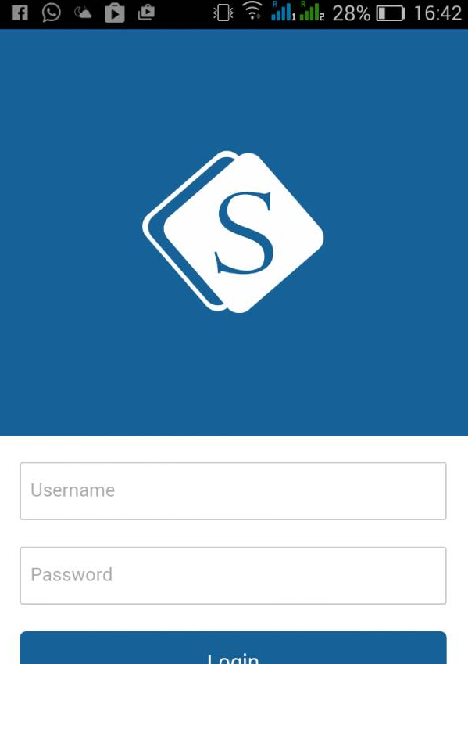
Shinetrack
SHINE TRACK
WEB ADMIN
MOBILE APP

Slide 10
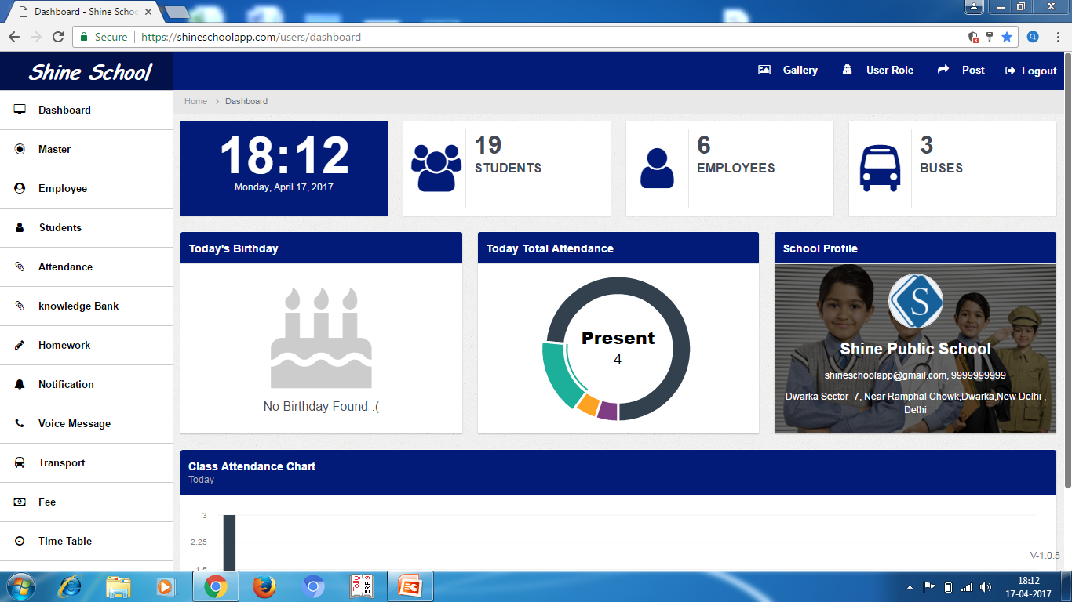
DASHBOARD
Teachers and School Busses
Graphical Reports of
Students, Employees etc.
Notification Reminders
Details of Student,
for Parents & Students
Birthday Reminders
Defaulter List

Slide 11
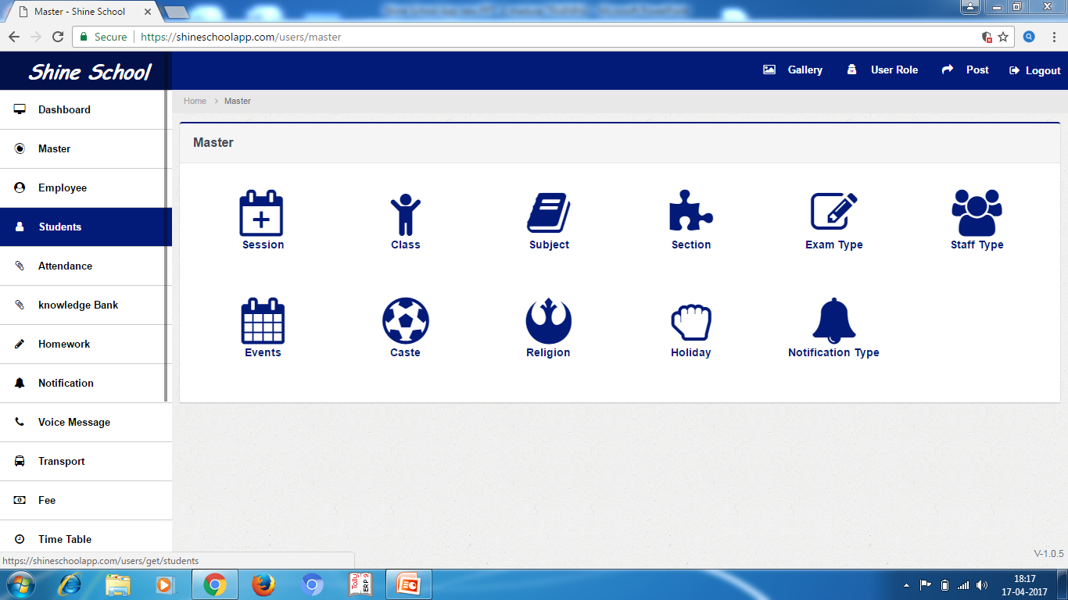
.
MASTER
Create categories like:
Events (Sports, Cultural Program etc.)
Subjects (English, Hindi etc.)
Class (First, Second etc.)
Exam Type (First Term, Sessional, Half Yearly etc.)
Staff Type (Principal, Teacher, Accountant etc.)
Blood Group (A, B, B+ etc.)

Slide 12
USER ROLE
CONTROLING USER PERMISSIONS WITH ROLES
Adding a role to a user
Removing a role from a user
Adding a cluster role to a user for all projects
Removing a cluster role from a user for all projects
Adding a role to a group
Removing a role to a group
Adding a cluster role to a group for all projects
Removing a cluster role from a group for all projects.

Slide 13
DATA MANAGER
Upload bulk of Students details in one go with Excel sheet Template
Upload bulk of Employees details in one go with Excel sheet Template
Insert holiday calendar for the whole year with Excel Sheet Template
Mark Attendance of students in one click for the day
Upload Results of classes in one go with Excel sheet Template

Slide 14
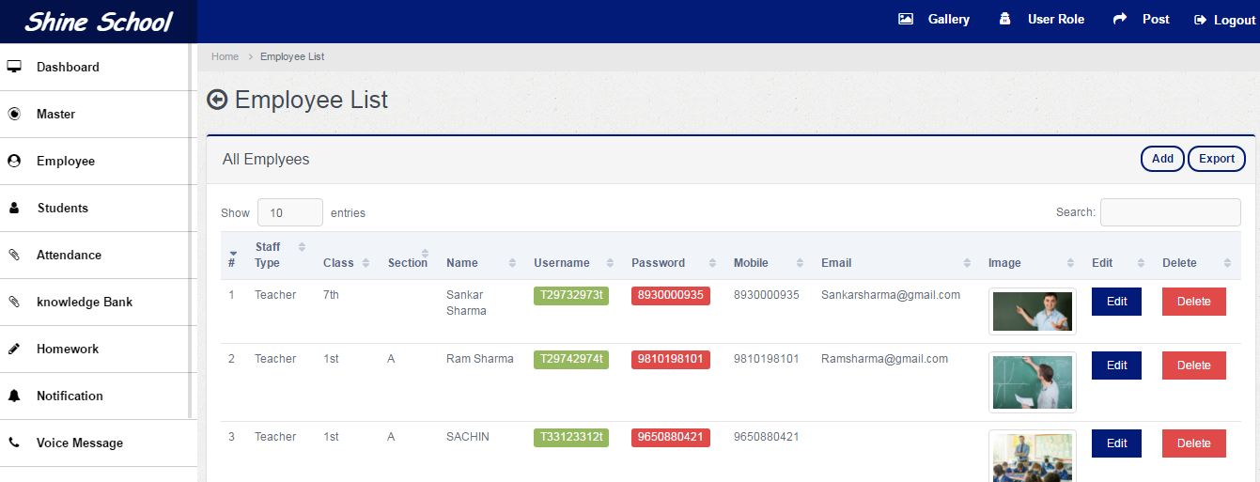
EMPLOYEE
Full list of all the employees with details like Name, Email, Contact No. etc.
Create, Update, Remove Employee from records
Get Username and Password and Update password

Slide 15
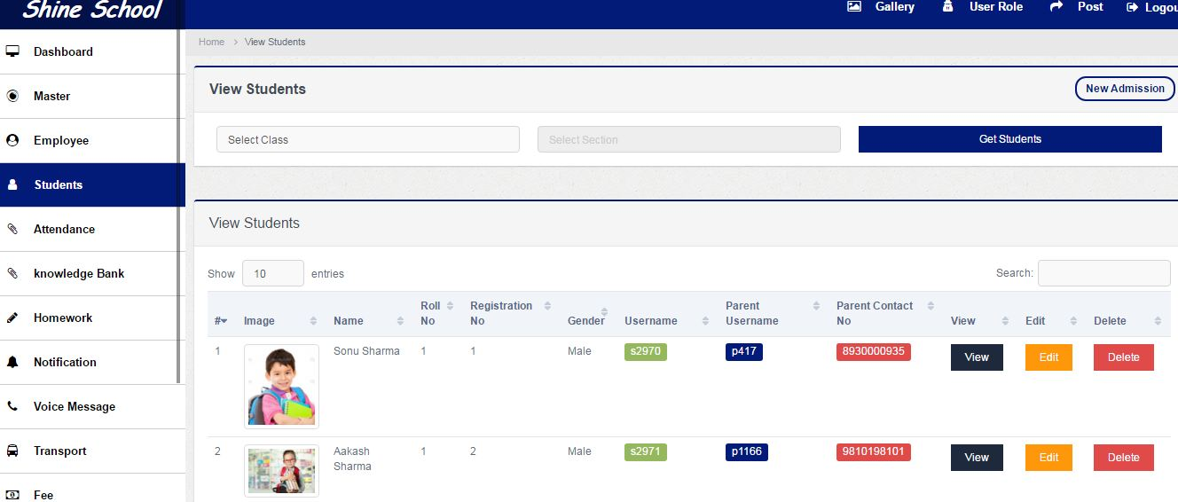
STUDENT
Full list of Students with details like Name, Address, Contact No. etc.
Parent details like Name, Email, Contact no. etc.
Create, Update, Remove Student from records
Get Username , Password & Update password

Slide 16
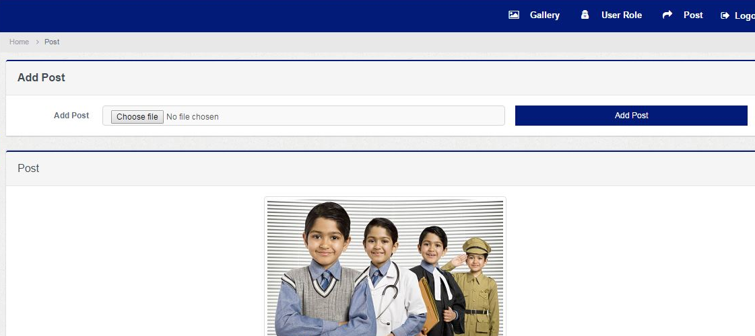
POST
Instant share of school profile picture on Mobile App splash screen
Upload the picture, Add Description

Slide 17

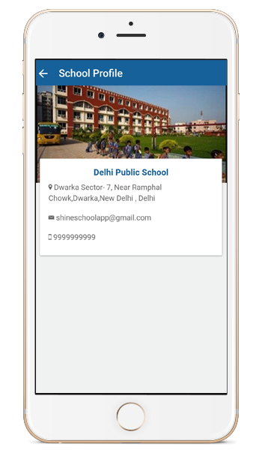
School Profile
Parents and Students can see the detail profile of the school like :
Name of school
Address
Email ID
Contact No
School image

Slide 18
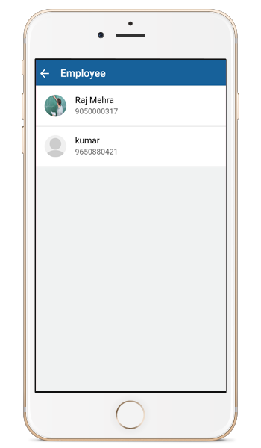
Employee Details
In This Section Parents and Students can see Employee Details according to his childrens class.
Name
Designation
Email ID
Contact No

Slide 19
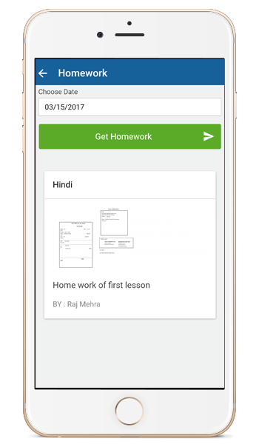
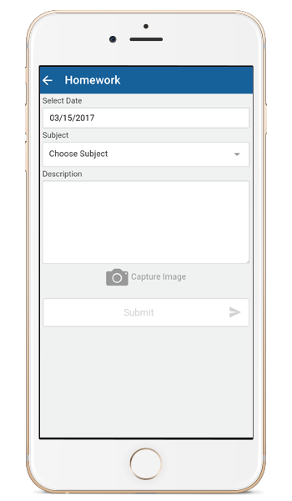
Homework
Parents and Student can stay updated of Homework Assignments.
Teacher can assign Homework Assignments

Slide 20
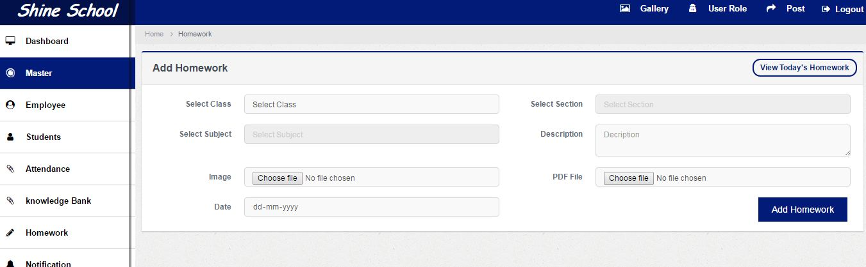
HOMEWORK
User can create homework for class
User can also delete homework for the class
User can also view all classes homework given by teachers.

Slide 21
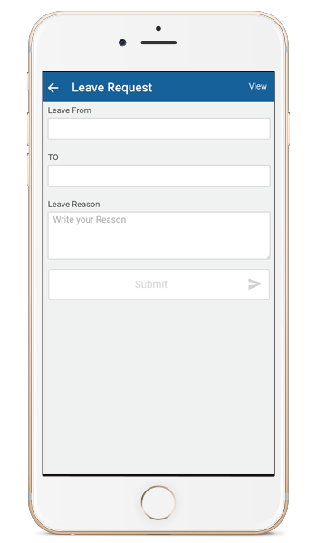
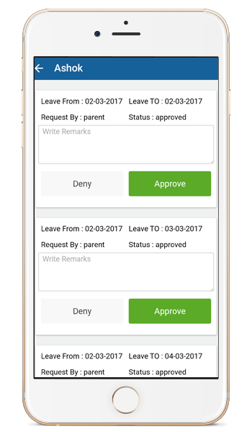
Leave Request
From this app parent can request for leave by submitting the leave request form
Teacher can Approve/Deny the leave request

Slide 22
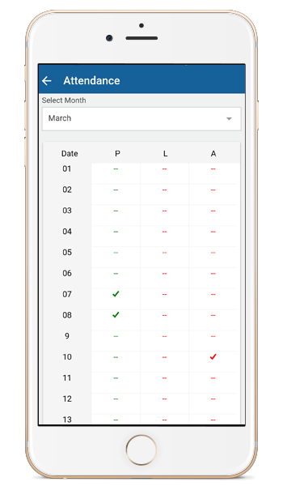
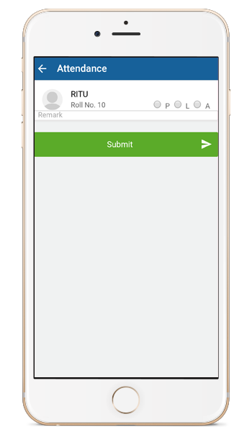
Attendance
Parents and Students can check day by day attendance or for the whole month
Teacher can mark attendance only absent or present students only.
system automatically put attendance total class of the students.

Slide 23
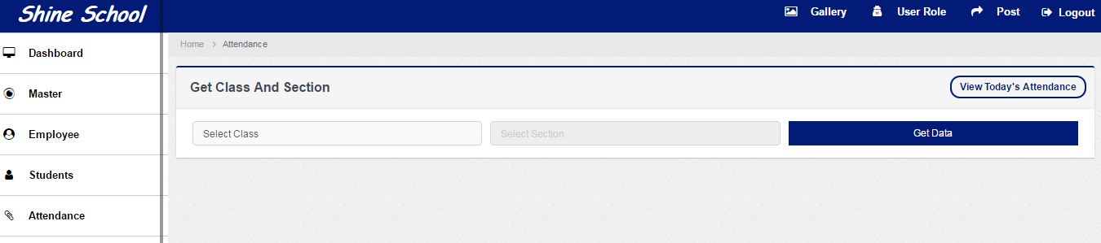
ATTENDANCE
User can mark attendance Class wise and Student wise.
User can check attendance class wise and school wise by given date.

Slide 24
KNOWLEDGE BANK
Parents and Students can check day by day question and answers for his subject
Teacher can create aptitude questions and answers for every subject.

Slide 25
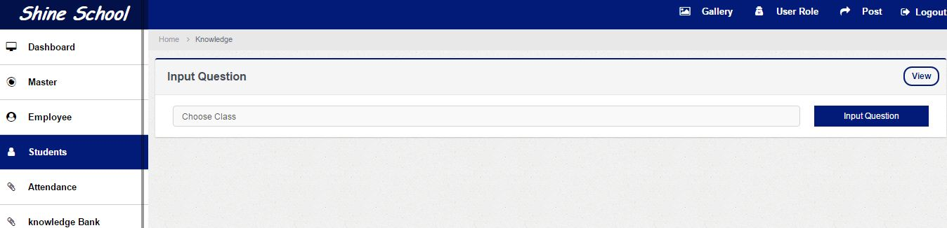
KNOWLEDGE BANK
Admin User can create , update, delete and view for aptitude test by class wise.

Slide 26
NOTIFICATION
See all the active notifications
Create, Update, Delete Notifications
Create category/groups for selected Student or Class
Create Notification type like Fee, Exam etc.
NOTIFICATION
Send Instant Notification on one click
Select whom you want to send(All, single Class, Multiple Class etc.)

Slide 27
Notification
Parents and Students can get:
Fee Notification
Exam Notification
Events Notification
Leave Approved/Denied Notifications
Parents meeting Notification and more…….
Teacher can get:
Leave Request Notifications

Slide 28
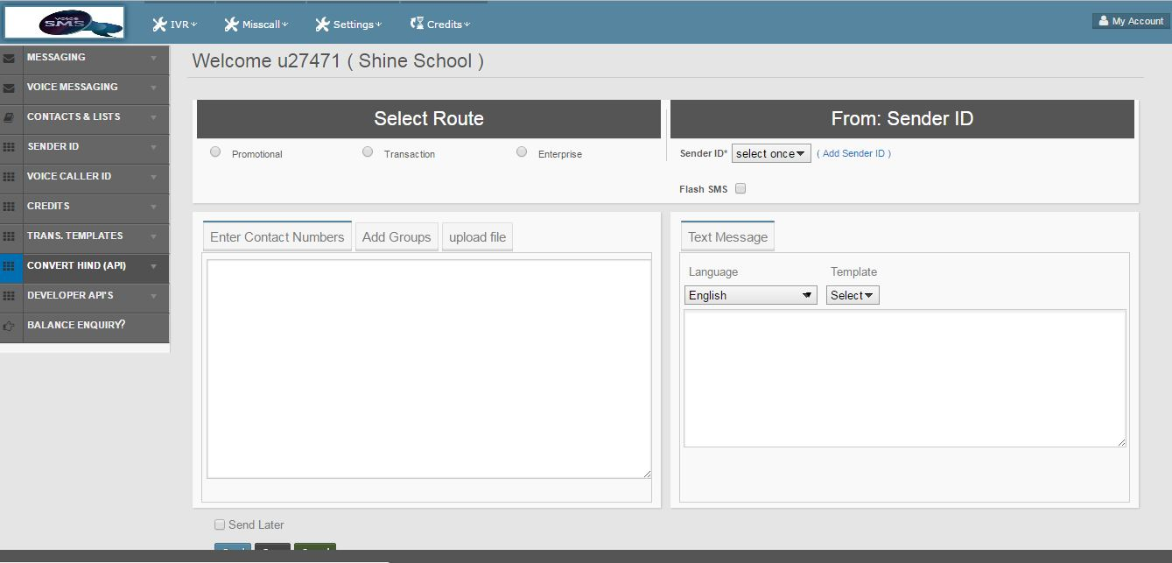
Voice sms
User can create voice calling by class wise, group wise and school wise.

Slide 29

VOICE CALLING
Parents , Students and Teachers can get calling from school.
Parents , students and Teachers can call reply to same nos.

Slide 30
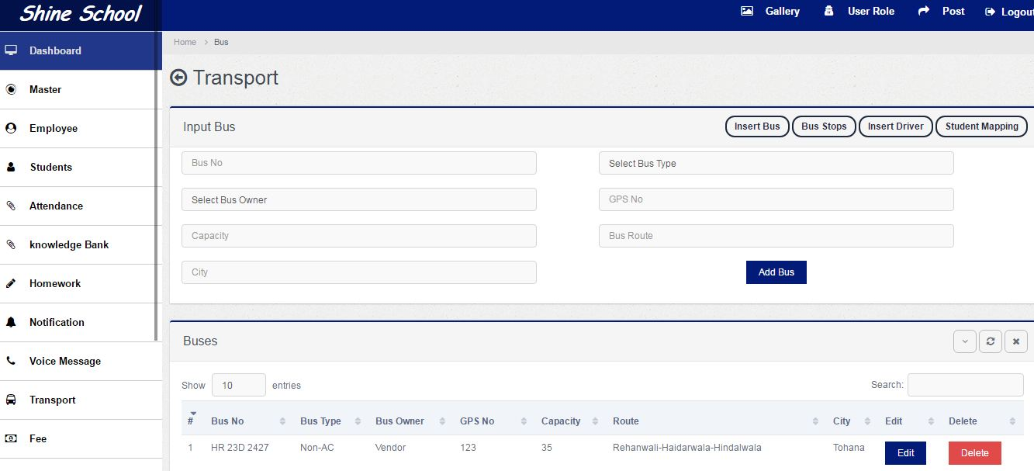
Transport
User can add, update , delete and view for buses, routes and stops.
User can add, edit, delete and view for driver details
User can assign bus by route wise and track by bus location.

Slide 31
BUS ROUTE
View all Busses and their Route Details
Create, Update, Delete Bus Route Details
Manage Route Stop Name, Bus Details, Driver Details
Map Students to Busses

Slide 32
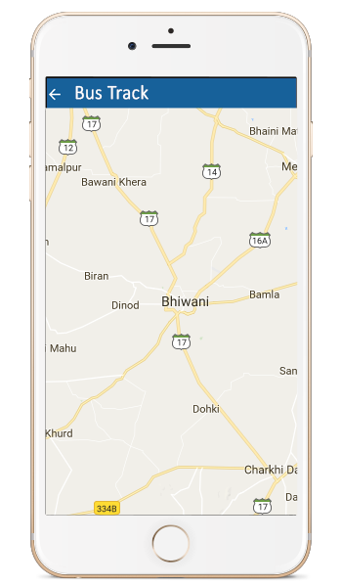
Bus Tracking
Parent and Student can get:
Bus Running Details
Bus Driver Details
Bus Route/Stop
Real-Time Bus Track

Slide 33
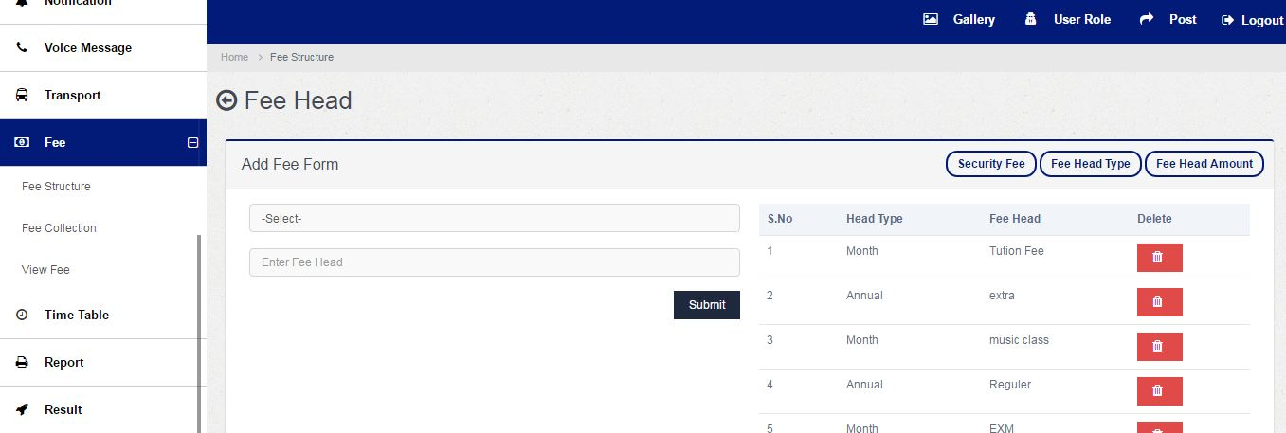
Fee Structure
Submit all types Fees from one place and in one click
Create fee category like New Admission, Regular Admission etc.
Create fee head (Tuition, Monthly etc.)
Create fee terms(January, February etc.)
You also get printout for receipt

Slide 34
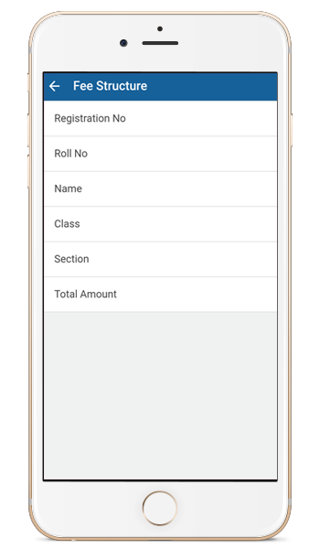
Fee Structure
Parents can check regularly updated fees details as per schedule of parents and management.

Slide 35
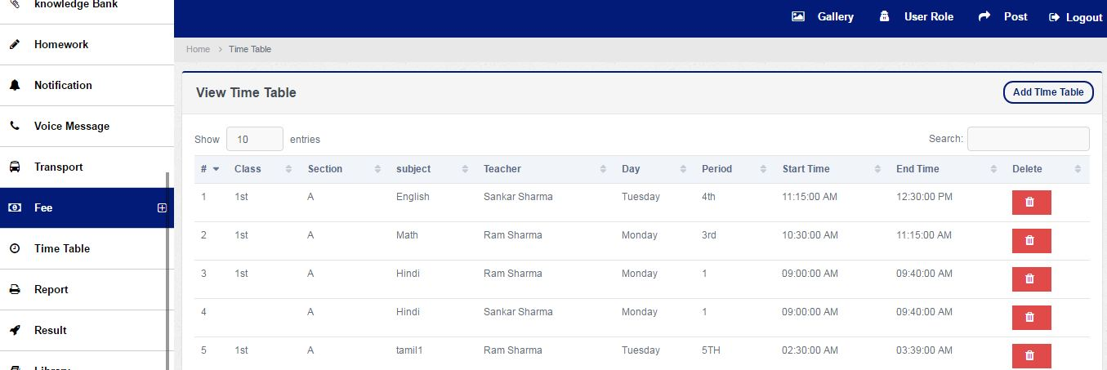
Time table
Admin User can create time table as per schedule of management such as daily ,period , subjects and times.

Slide 36
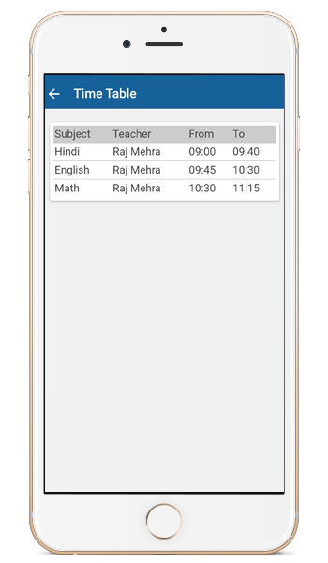
Time-Table
Students and Parents can check daily time table as per schedule management using his user name password.
Teachers also can check Time Table only using his/her username. Teachers can not check others timetable.

Slide 37
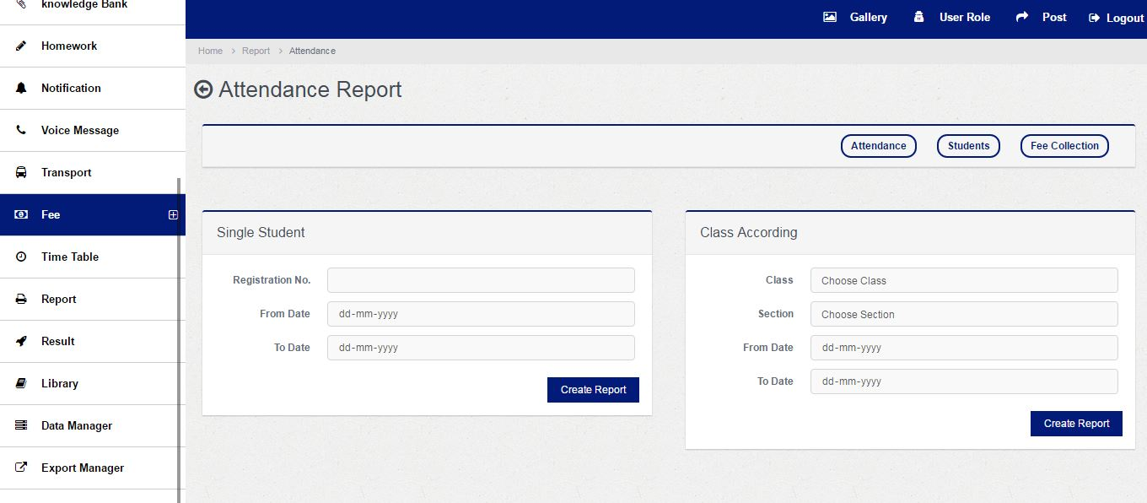
REPORT
Generate detailed Student Attendance report for any month
Generate detailed Fee report of students
View graphical reports of Fees and Attendance

Slide 38
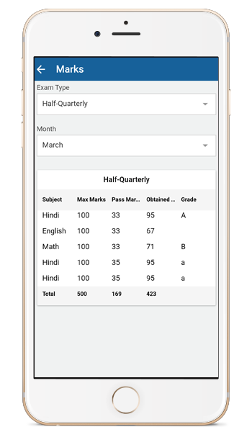
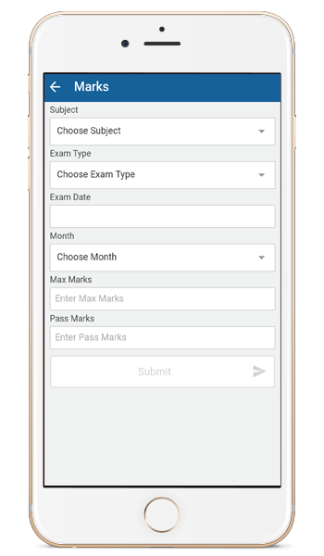
Marks/Result
Parents and Studentscan check academic performance i.e, marks, Grade and Pass/ Fail using his username.
Teachers can send marks, Grade and Pass/ Fail with student wise for his class.

Slide 39
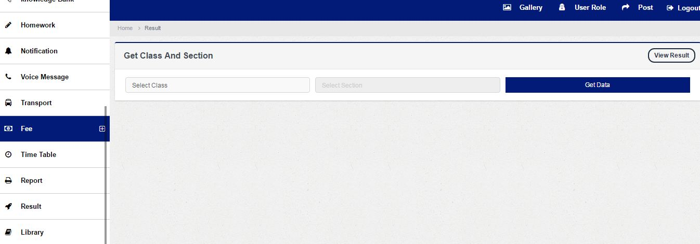
RESULT/MARKS
Detail subject mapping of result with class
Create, Update, Delete subject mapping
Create new subject map with classes
Copy subjects from one class to another in one click
Manage Grade setting(Create, Update, Delete)

Slide 40
LIBRARY
View Books inventory details
Add, Delete, Update Books
Issue/Return books to and from students
Manage Books
Search books Sort books with search box

Slide 41
GALLERY
View all event pictures
Manage pictures like ADD & DELETE
Upload pictures under available categories
Add Description to the pictures

Slide 42

Gallery
In this section Parents and Students can see various images regarding cultural program, events, architecture and more… using his username.

Slide 43
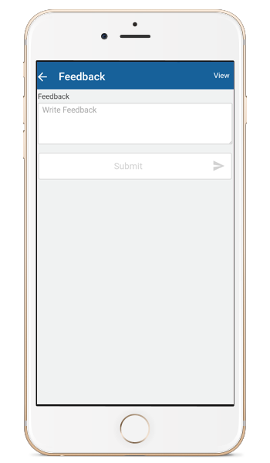
Feedback
Teacher can send and receive feedback from / To Parents for his/her students/ children according to their performance.
Parents also can send and receive feedback for his children performance to Teachers.

Slide 44
BENEFIT FOR MANAGEMENT
Dashboard
Post
Master
Employee
Student
Gallery
Data Manager
Holiday
Library

Slide 45
BENEFIT FOR MANAGEMENT
Notification
Send Notification
Transport
Fee Structure
Result
Report

Slide 46
BENEFIT FOR STUDENTS, PARENTS & TEACHERS
Homework
Attendance
Marks
Leave Request
Reminder Notifications

Slide 47
BENEFIT FOR STUDENTS, PARENTS & TEACHERS
.
Bus Tracking
Fee Structure
Time Table
Employee Details
School Profile
Gallery
Feedback

