Slide 1
HPML Final Project · Spring 2026
Skills and Knowledge Plugin MCP Servers for Optimized Industrial O&M Agents
Introducing Skills Marketplace and Knowledge Retrieval Plugin MCP Servers to optimize accuracy, latency and context efficiency of IBM AssetOpsBench -- ~ 68% to 92% increase in accuracy with KP over RAG
Team 3
Andrew Li · ayl2159
Kirthana Natarajan · kmn2161
Thai On · tqo2101
Trisha Maturi · tm3530
Yeshitha Bhuvanesh · yb2649
GitHub: https://github.com/kmn01/AssetOpsBench
Tracking: https://wandb.ai/kmn01-columbia-university/HPML%20Project
Dr. Kaoutar El Maghraoui · Columbia University · May 7, 2026
Notes:
Trisha

Slide 2
Motivation & Problem
Why this matters
Problem statement
We are surrounded by Industrial Assets that we don’t notice:
Data Centers use Chillers and Air Handling units to keep electronics operating efficiently
Hospitals have Backup Generators to maintain uninterrupted operations.
Assembly line downtime costs $1M+ per hour in assembly.
Static LLMs lack real-time asset knowledge to directly answer questions on industrial machines.
On the other hand, industrial environments are complex, high-stakes, and contain an overwhelming amount of telemetry data.
On AssetOpsBench HuggingFace workloads, we target the latency blow‑up from higher-accuracy KP runs, as accuracy rises, end‑to‑end time can jump from around 20s (HF) to around 114–146s (HF3 / official KP), largely driven by long tool execution.
In addition, plan-execute agents are bottlenecked by long planning loops, requiring handoff to deterministic workflows for improved efficiency.
We extend the Pareto frontier by evaluating the “llama-4-maverick-17b-128e-instruct-fp8” model across varying scenarios across various tool calls.
Goal: Achieve 90% accuracy or above on the AssetOpsBench HuggingFace benchmark while still using the same small or medium sized LLM.
HPML · Spring 2026
2 / 14
Notes:
Trisha
Our project focuses on industrial assets — chillers and air handling units in data centers, backup generators in hospitals, and assembly lines where downtime can cost over a million dollars per hour.
These environments produce massive telemetry: sensor readings, work orders, and equipment records. A static LLM lacks real-time knowledge of these assets, so it can't reliably answer questions about active sensors, failure modes, or relevant maintenance actions.
On AssetOpsBench, we observed a clear latency tradeoff: higher-accuracy Knowledge Plugin runs improved answer quality, but end-to-end time rose from ~20 seconds to over 100 seconds.
Our goal: extend the Pareto frontier — hit 90%+ accuracy on AssetOpsBench while keeping the same small or medium-sized LLM.

Slide 3
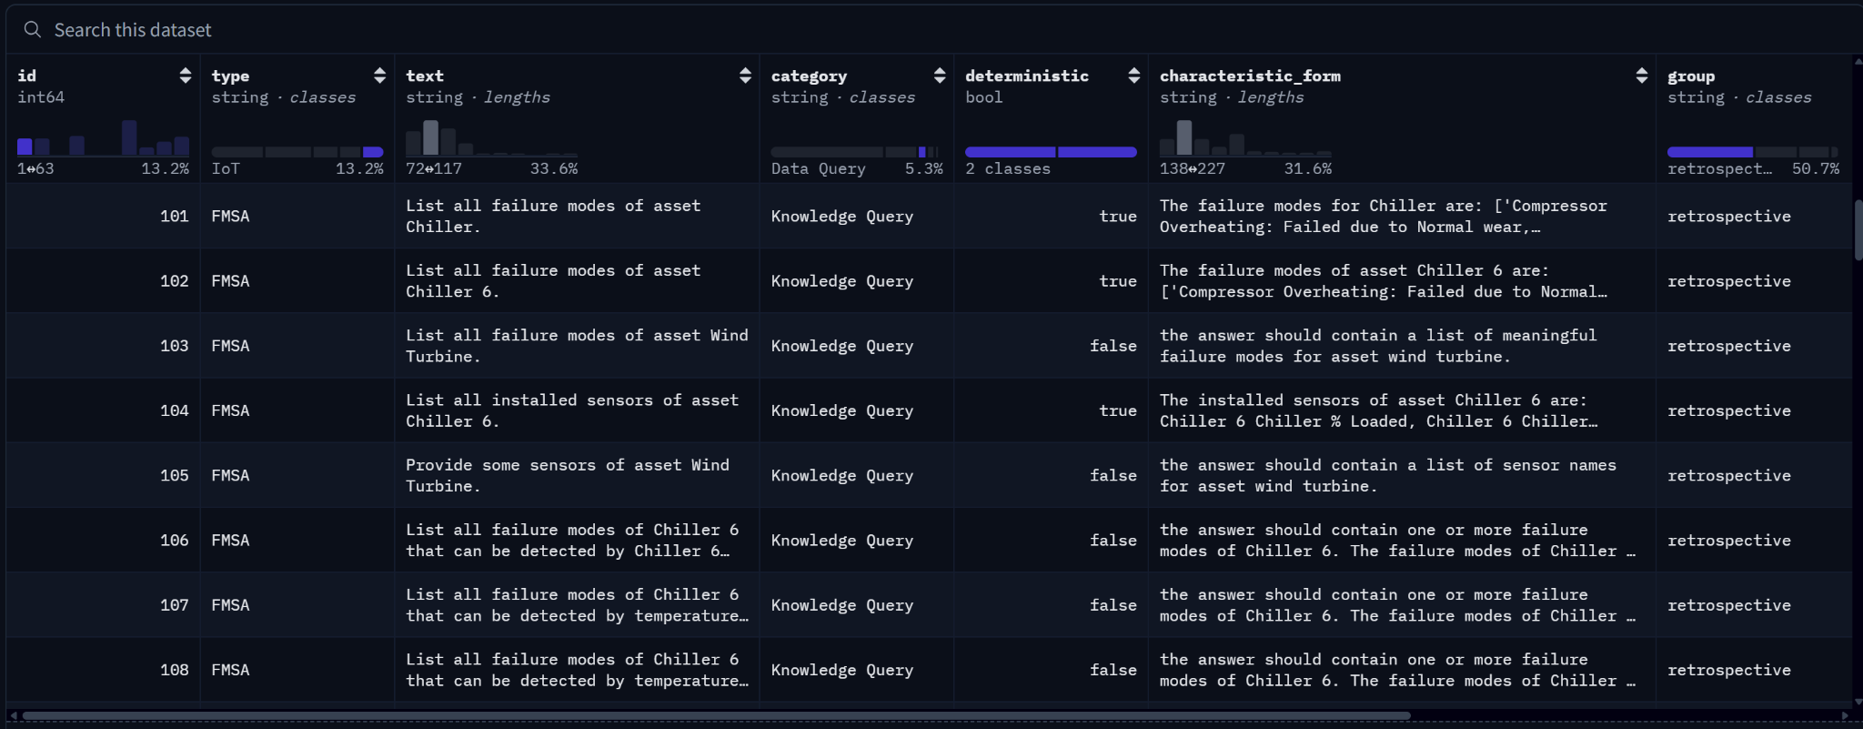
Technical Approach — Model & Data
Model
Dataset
Hardware
Model architecture: watsonx/meta-llama/llama-4-maverick-17b-128e-instruct-fp8; the runner also supports LiteLLM-backed models through --model-id.
Parameter Count: 17b
Framework: Python 3.12+, uv, Model Context Protocol / FastMCP, LiteLLM, IBM WatsonX, CouchDB, Pydantic, NumPy, Pandas, SciPy, ChromaDB, and sentence-transformers.
IBM AssetOpsBench Dataset on HuggingFace
License: Apache license 2.0
IBM’s WatsonX LLM API through LiteLLM
HPML · Spring 2026
3 / 14
Notes:
Trisha
For our technical approach, we built a tool-augmented agent using Model Context Protocol, or MCP. Our primary model was Llama-4 Maverick — a 17-billion-parameter model served through IBM WatsonX — with support for other models via LiteLLM.
The stack is Python 3.12, using FastMCP for agent-server communication, ChromaDB and CouchDB for retrieval and asset data, and sentence-transformers for embeddings.
Our dataset is IBM's AssetOpsBench on HuggingFace — realistic industrial asset tasks covering sensors, failure modes, work orders, and knowledge retrieval.

Slide 4
Technical Approach — Optimizations Applied
1.
MCP Skills Server
The MCP Skills Server targets the planning and arg resolution overhead bottleneck by turning repeated multi-tool maintenance workflows into discoverable skill calls, so the agent can invoke one namespaced skill instead of looping over multiple MCP servers to plan task execution.
2.
Knowledge Plugin
The Knowledge Plugin reduces retrieval overhead and improves answer grounding by pre-indexing asset documentation in ChromaDB, enabling targeted semantic lookup with citations instead of repeatedly searching through raw documents at inference time.
3.
Benchmarking
Added skill + knowledge benchmark scripts that record end-to-end latency, phase timings, per-step timings, tool-call success, token/context usage, heuristic accuracy, strict LLM-judge accuracy, and W&B logging.
HPML · Spring 2026
4 / 14
Notes:
Yeshitha

Slide 5
Profiling Methodology
Tools used, what you measured, how you ensured measurements are stable.
Tools
Metrics captured
Our own dashboard (the main focus!) - what the industry people wanted to see
Weights & Biases for run-level tracking
Docker + CouchDB
Most of our data are stored in the form of JSONL
Profiling: time.monotonic()
Scenario metadata: scenario_id, scenario_type, scenario_category, scenario_source, question, characteristic_form
Run metadata: model_id, runner_mode (kp vs rag)
Latency (timing): e2e_ms plus phase timings discover_ms, plan_ms, execute_ms, summarize_ms (and phase_ms)
Tooling/steps: plan_steps, history_steps, tool_calls_attempted, tool_calls_succeeded, step_timings_ms
Tokens/context: token_usage, token_total_tokens, token_prompt_tokens, token_completion_tokens, context_peak_prompt_tokens
Accuracy / judge results: accuracy_mode (llm-judge), accuracy_score, accuracy_pass, plus judge details like accuracy_judge_score, accuracy_judge_strict_pass, accuracy_judge_rationale
Output & reliability: candidate_answer, success, error, failed_steps
HPML · Spring 2026
5 / 14
Notes:
Yeshitha

Slide 6
Results — Headline Numbers
This is just the best subsets of all the scenarios sets we have
50% -> 90%
5-10x
2-10x
Number of test cases passed
more tokens
inference time
[baseline RAG → optimized KP]
[RAG vs KP, on Llama-4-Maverick]
[per scenario, s → s]
HPML · Spring 2026
6 / 14
Notes:
Thai: We did run many scenarios and different use cases pumping, vibration,... but we stick with the chiller that has the highest accuracy as this is the best result we can reach and develop our work on.

Slide 7
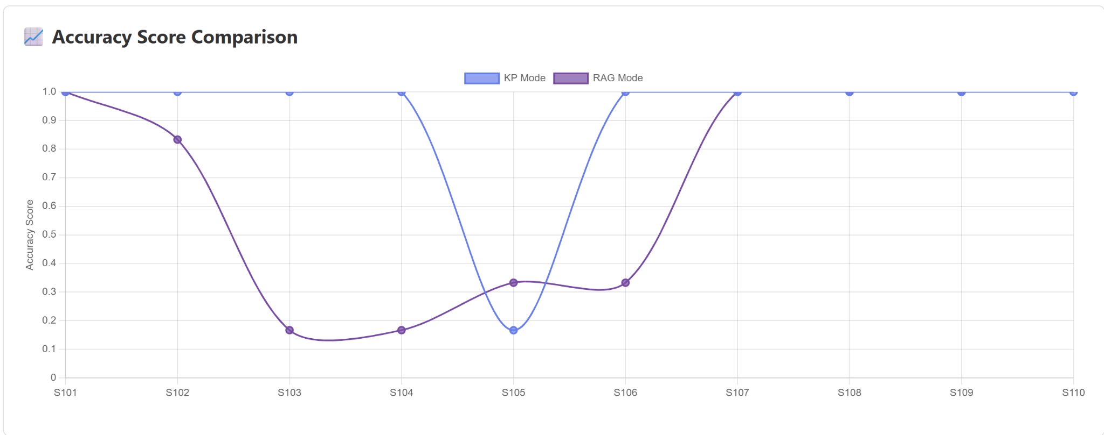
Results — Before vs. After
Chiller Scenarios
Takeaway
Knowledge plugin performs significantly better across many benchmarks - with a mean accuracy of 0.917 compared to a mean accuracy of 0.683 using RAG
HPML · Spring 2026
7 / 14
Notes:
Thai

Slide 8
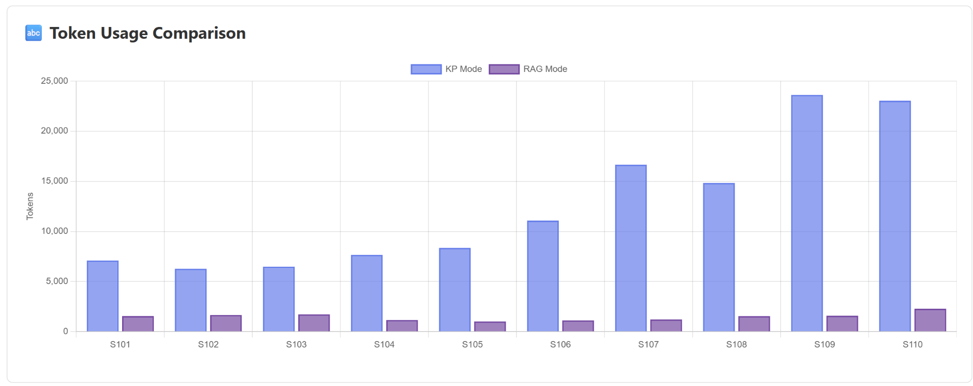
Results — Before vs. After
Takeaway
However, knowledge plugin uses 4.5x to 10x more tokens when compared to RAG
Knowledge plugin could be construed as a form of inference time scaling.
We let the model plan and execute over multiple steps and let it dynamically retrieve relevant maintenance manual snippets per scenario.
In comparison, RAG simply does retrieval as a single step in a plan, and then reasons over the retrieved chunks.
HPML · Spring 2026
7 / 14
Notes:
Thai

Slide 9
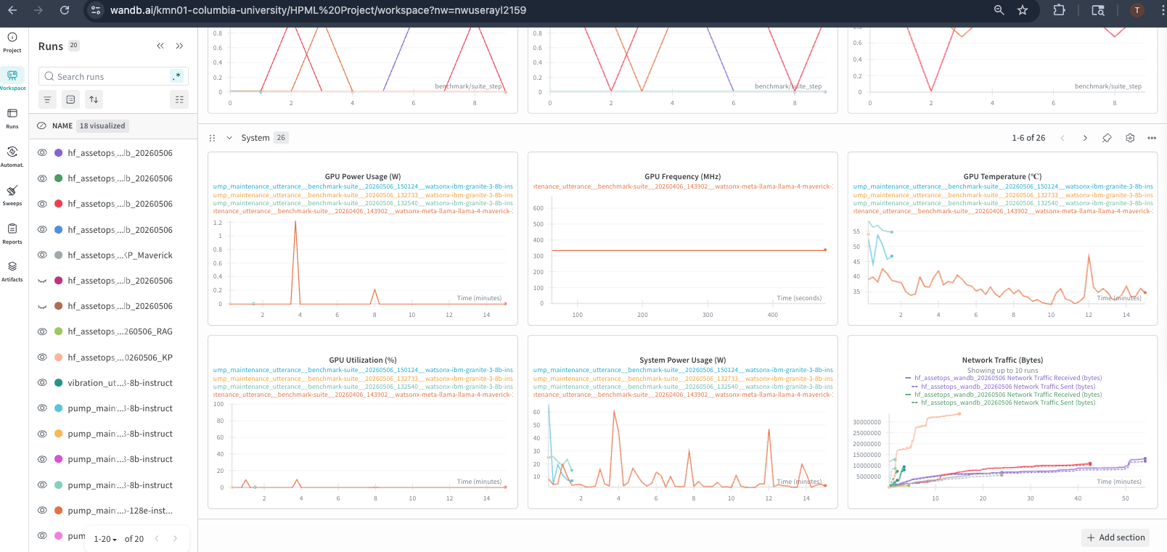
Profiler Evidence
Insert profiler trace screenshot, GPU timeline, or operator-level breakdown image.
[ Insert profiler trace, Nsight timeline, or torch.profiler chrome trace screenshot here ]
What to point at
Bottleneck before optimization
Kernel that disappeared / fused
Idle gap that shrank
Memory copy avoided
HPML · Spring 2026
8 / 14

Slide 10
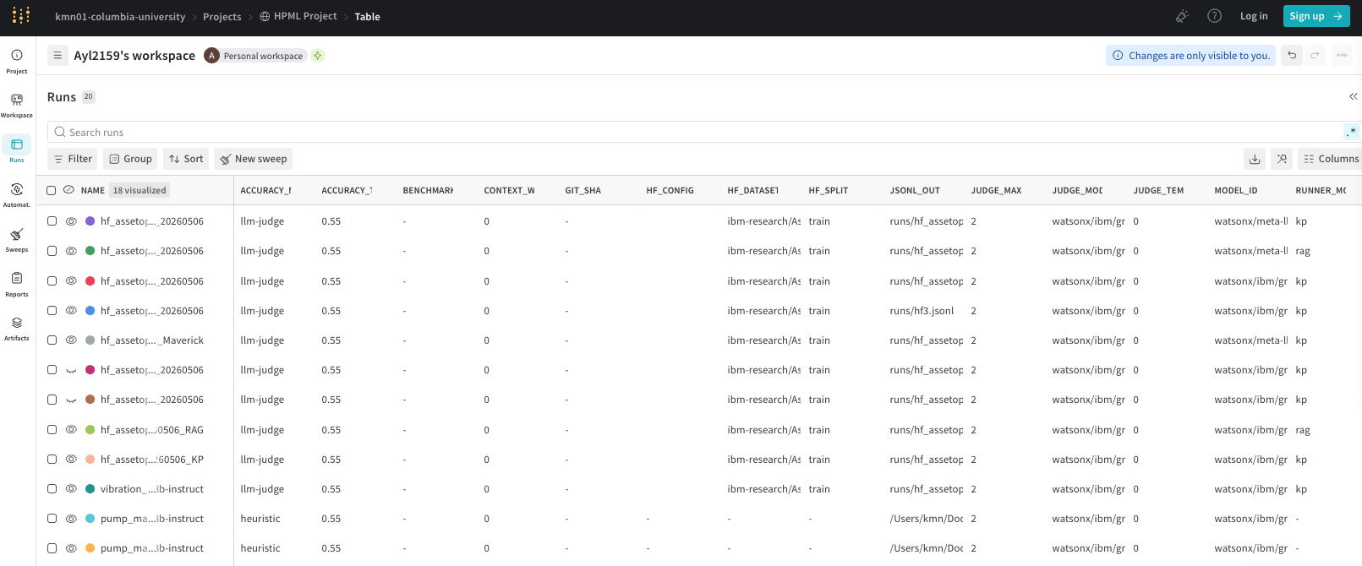

Slide 11
Demo / Visualization
Time budget: 1 minute. Live demo, animated comparison, or short recorded clip.
[ Demo / GIF / Screen recording / Live notebook ]
Have a fallback static image in case live demo fails
Pre-load any models or data — do not wait for downloads on stage
Narrate what to look at while it runs
HPML · Spring 2026
9 / 14
Notes:
Andrew: file://wsl.localhost/Ubuntu/home/andli/projects/kmn-AssetOpsBench/dashboards/hf3.html

Slide 12
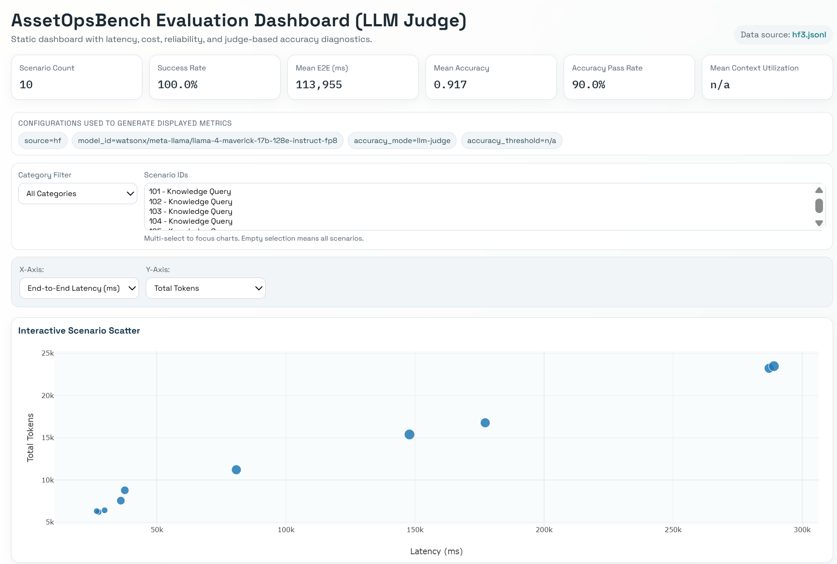
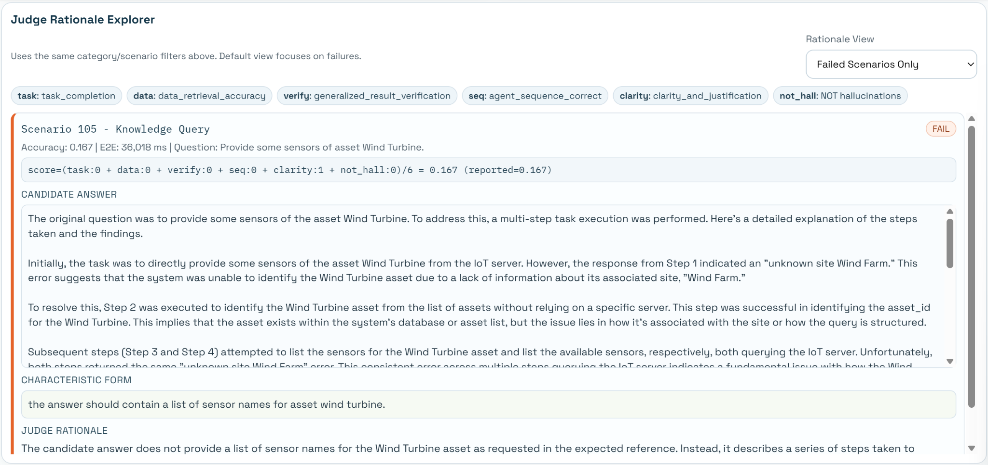
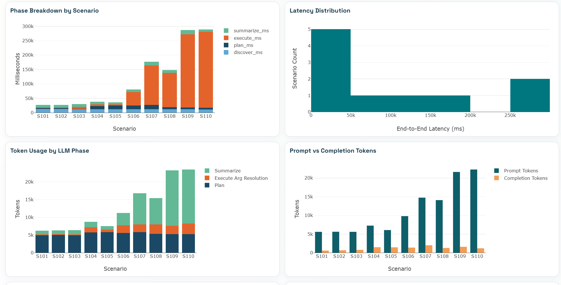
Demo / Visualization
Time budget: 1 minute. Live demo, animated comparison, or short recorded clip.
Key Visualization Modules:
Token Usage Tracking: Monitoring token consumption by LLM phases to optimize resource allocation.
Latency Per Tool: Detailed breakdown of prompt to completion time and tool-specific latency.
Scenario Analysis: Specific breakdowns for tokens and time based on different industrial knowledge scenarios.
Interactive Scatter Plots: Visualizing the relationship between cost and evaluation scores.
HPML · Spring 2026
9 / 14
Notes:
Andrew: file://wsl.localhost/Ubuntu/home/andli/projects/kmn-AssetOpsBench/dashboards/hf3.html

Slide 13
Lessons Learned
Time budget: 1 minute. What surprised you? What didn't work? Be honest.
What worked
What didn't work
Successfully built dashboard to compared RAG and KP (Latency, Tooling/steps, Tokens/context)
Profiling and understanding bottlenecks of the pipeline we built (wandb and dashboard)
Successfully developed RAG and KP pipelines that have acceptable accuracy
Developed a skills marketplace prototype that handles pre-defined multi-step operational workflows
RAG Maverick is consistently fast on HF (mean 8.9s), making it a good default when latency matters.
KP Maverick reaches high mean accuracy (0.917) with a high pass rate (90%) on the same HF suite size.
Across the HF iterations, HF3 achieves much higher mean accuracy (0.917) than HF/HF2 (0.70 / 0.683).
Accuracy - latency trade off: HF3’s higher accuracy (0.917) comes with much higher mean end-to-end (e2e) (114s) versus HF/HF2 (20–22s).
Official KP is very slow: KP Maverick mean e2e at 146s vs RAG Maverick 8.9s (even though KP is more accurate on average).
KP time is not just overhead: in the official KP run, mean execute time is 113s out of 146s, so the main cost is long tool execution/tool chains.
Official RAG Maverick mean accuracy is 0.683 with pass rate 50%, which may be insufficient if your target is “90%”.
HPML · Spring 2026
10 / 14

Slide 14
Next Steps
Time budget: 30 seconds. Be specific — vague "more experiments" is not next steps.
Make KP faster without losing too much accuracy: add caching/short-circuits and cap tool-chain length.
Possibly adopt a hybrid policy: use RAG for the fast path and escalate to KP only when needed for accuracy (since KP is slower but higher-accuracy).
Should find more data to train (and test) on so that RAG and KP have more data to retrieve and reference.
Add additional skills to the skills marketplace based on most commonly used workflows. Potentially build an automated scenario to skill generation pipeline.
HPML · Spring 2026
11 / 14

Slide 15
Teamwork & Contributions
Time budget: 30 seconds. Who did what. Required slide — graded individually.
Member | Primary contributions | Tools / artifacts
Andrew Li | Benchmarking, dashboard visualizations, bug fixes | runs/, dashboards/, a small amount in run_benchmark.py
Kirthana Natarajan | Observability infra, Baseline, Skills MCP Server | src/observability, servers/skills, updates in agents/plan_execute
Thai On | Benchmarking and commands, dashboard refinements | runs/, dashboards/, run_all_benchmarks.py, run_benchmark.py, reports
Trisha Maturi | Skills MCP server architecture | servers/skills, ‎src/agent/plan_execute/
Yeshitha Bhuvanesh | Baseline RAG, Knowledge Plugin | src/agent/plan_execute/rag_runner.py, src/servers/knowledge/, updates in agents/plan_execute, updates in src/agent/cli.py, updates in src/couchdb/
Collaboration: regular weekly meetings via Zoom, shared WhatsApp group.
HPML · Spring 2026
12 / 14

Slide 16
Thank you
Questions?
GitHub: https://github.com/kmn01/AssetOpsBench
Tracking: https://wandb.ai/kmn01-columbia-university/HPML%20Project
HPML · Spring 2026
13 / 14

Slide 17
Backup — Experimental Setup
Backup slide. Use for Q&A. Add more backup slides as needed.
Setting | Baseline | Optimized
Batch size | [32] | [64]
Precision | [FP32] | [BF16 + FP8]
Learning rate | [1e-4] | [1e-4 with warmup]
Sequence length | [2048] | [4096]
Epochs / steps | [3 epochs] | [3 epochs]
Hardware | [1× A100 80GB] | [1× A100 80GB]
Software stack | [PyTorch 2.5, CUDA 12.4] | [+FlashAttn-2, +bitsandbytes]
HPML · Spring 2026
14 / 14

Slide 18
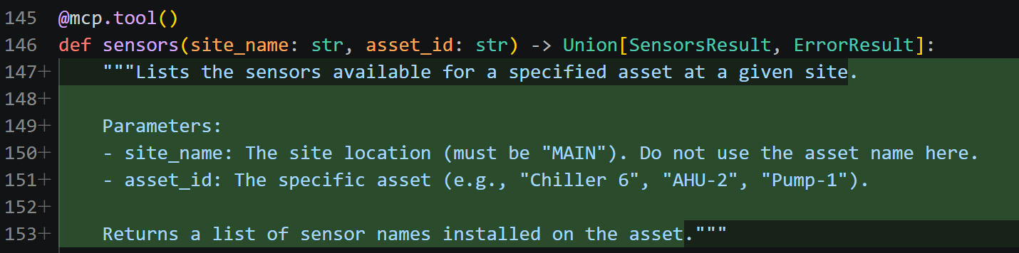
Errors encountered - “unknown site Chiller 6”
1.
MCP Skill Hints
We saw that there were several systematic errors when we ran our system on the scenarios. For example, below we see one of the errors we surface in our dashboard. It was related to data access:
It turns out that the LLM was using the MCP Server function incorrectly, using “Chiller 6” as a site when it should be an asset. We added a more descriptive function docstring as well as better hinting in our tool call prompt.
HPML · Spring 2026

Slide 19
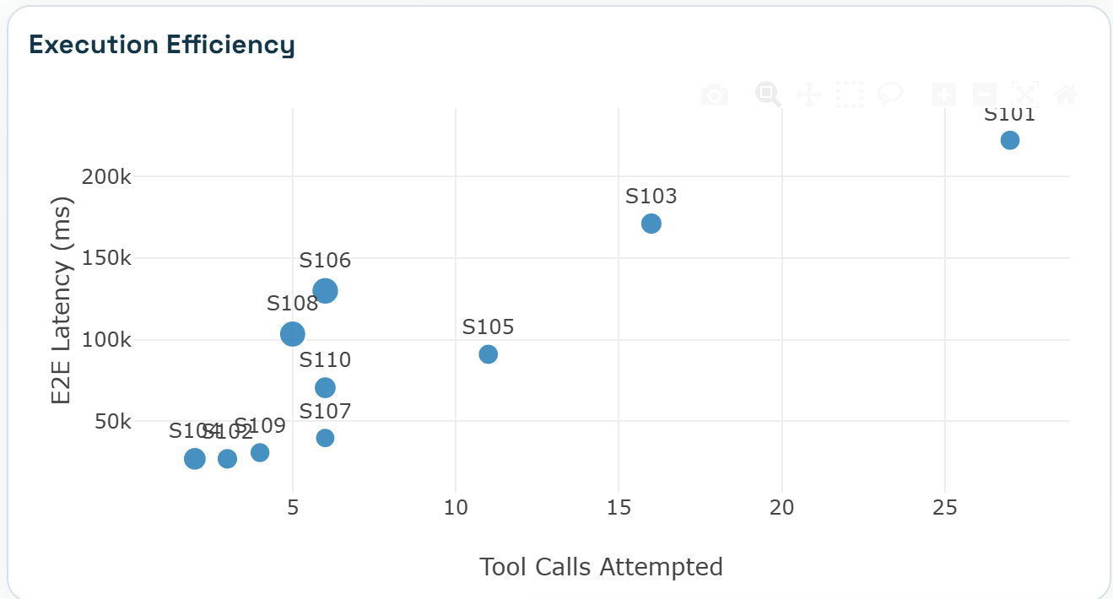
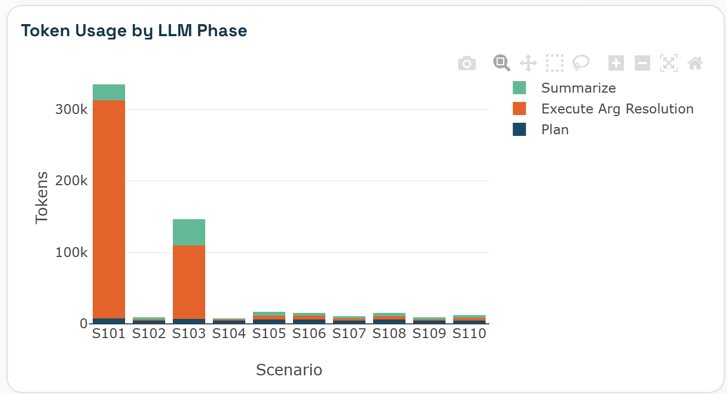
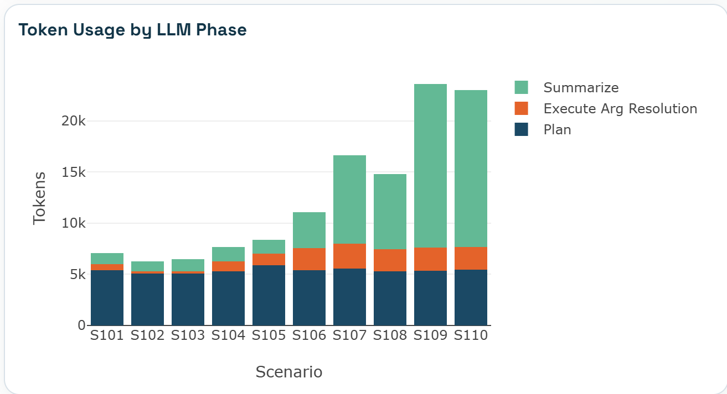
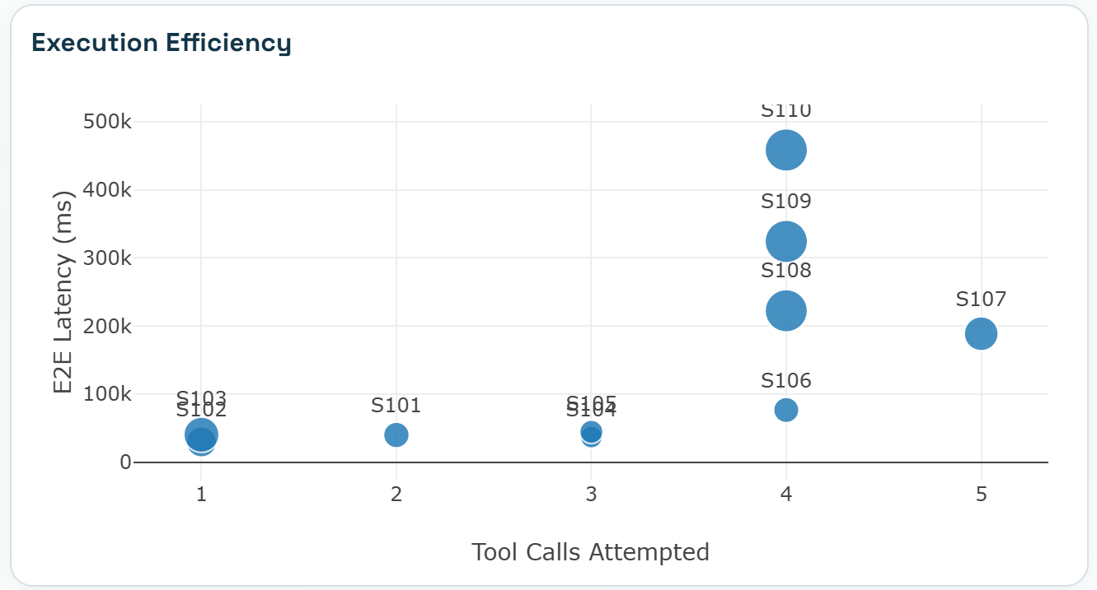
Different models gave significantly different results
watsonx/ibm/granite-3-8b-instruct
60% Accuracy
91,362 mean e2e (ms)
watsonx/meta-llama/llama-4-maverick-17b-128e-instruct-fp8
90% Accuracy
146,191 mean e2e (ms)
HPML · Spring 2026
Notes:
model_id=watsonx/ibm/granite-3-8b-instruct
vs
model_id=watsonx/meta-llama/llama-4-maverick-17b-128e-instruct-fp8

