Slide 1
Machine Learning & Predictive Analytics
Final Project
May 22, 2023
Manish Kumar

Slide 2
Pipeline Overview
Preprocessed Images
Image Embeddings
Regression Model
Images
VggFace2
Random Forest
XGBoost
Data Augmentation
SVM
BMI
Neural Network
Images
CASIA-WebFace
Linear Regression
Sample Impression:
Clear Lungs. No effusion or pneumothorax

Slide 3
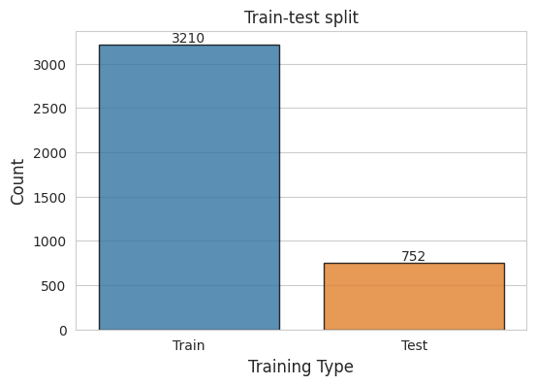
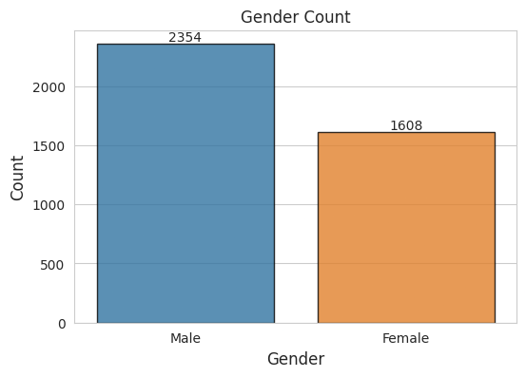
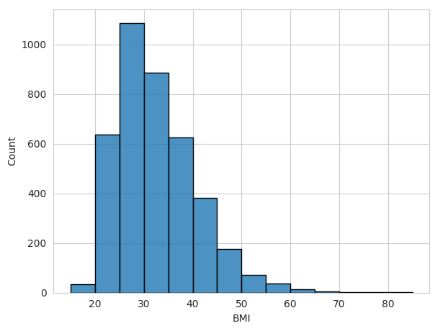
Exploratory Data Analysis
BMI Distribution

Slide 4
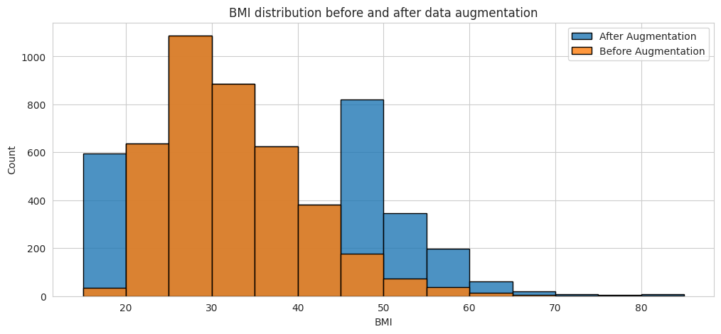
Data Augmentation

Slide 5
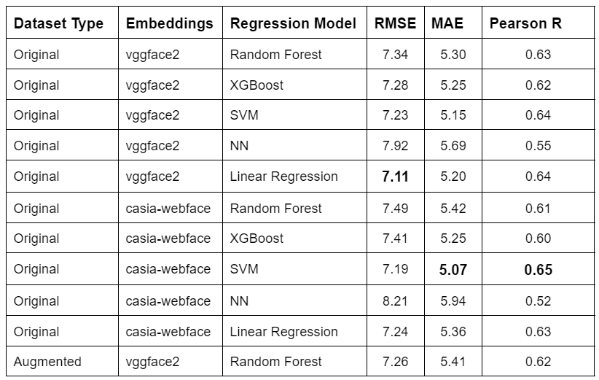
Results

Slide 6
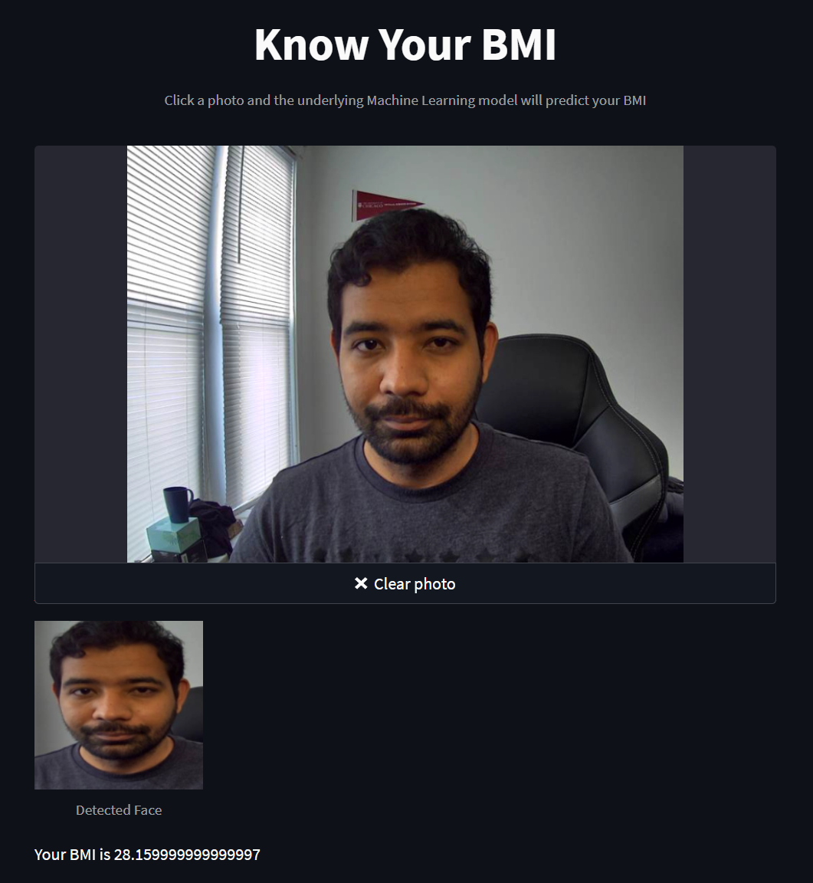
Web Interface

Slide 7
Presented by:
Manish Kumar
mnis@uchicago.edu
Thank You

