Slide 1

Global Mortality Analysis: A Machine Learning Approach
Understanding and predicting mortality rates across countries using advanced analytical models.
Presented by: Khaja Moinuddin Mohammed, Prasanth Gururaj, Sanjay Ramesh Kannan, Sowmya Polagoni, Venkat Saketh Kommi.

Slide 2
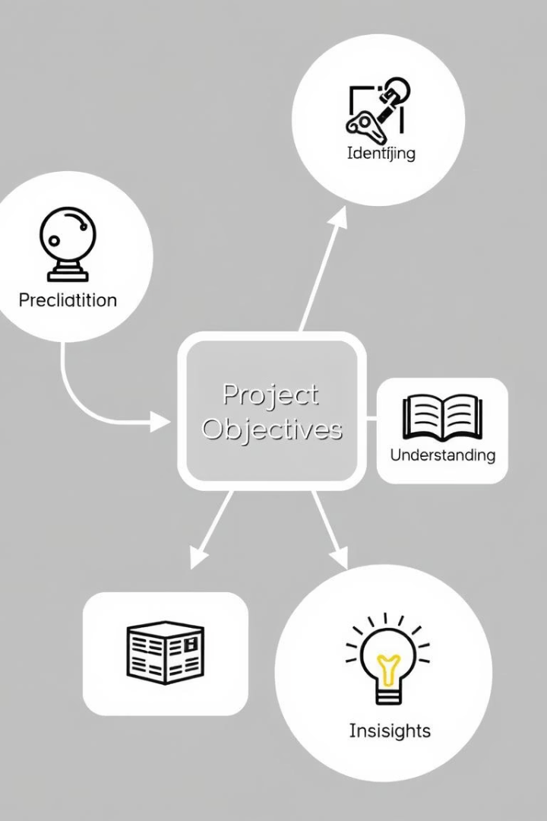


Project Goals
Primary Objective
Predict mortality rates using healthcare and socio-economic factors.
Secondary Objectives
Identify key factors influencing mortality.
Understand regional variations.
Provide insights for healthcare policy.

Slide 3





Data Sources Overview
IHME Global Burden of Disease (GBD) 2021
Healthcare infrastructure data
Economic indicators
Governance metrics
Quality of life measures

Slide 4
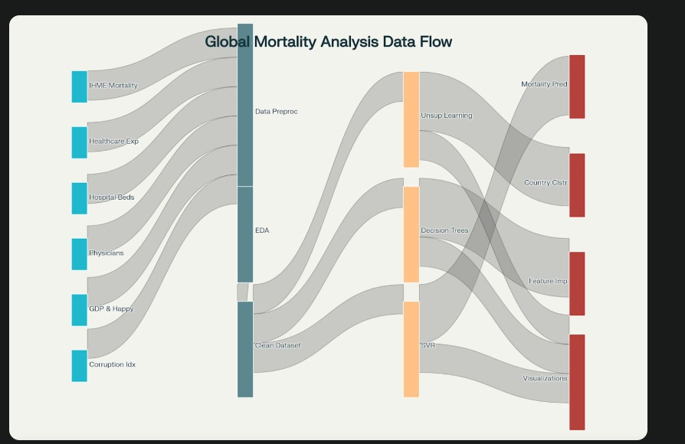
Data Challenges & Preprocessing
Missing value handling
Country code standardization
Feature engineering
Data cleaning steps

Slide 5
Random Forest & Gradient Boosting Regressors
What is Random Forest Regressor?
What is Gradient Boosting Regressor?
An ensemble learning method for regression that operates by constructing a multitude of decision trees at training time and outputting the mean prediction of the individual trees.
A machine learning technique for regression problems, which produces a prediction model in the form of an ensemble of weak prediction models, typically decision trees.
When are they used?
Key parameters
Both are used for complex regression tasks, handling non-linear relationships and interactions between features. Random Forest is good for high-dimensional data, while Gradient Boosting often achieves higher accuracy.
n_estimators: Number of trees in the forest/ensemble.
max_depth: Maximum depth of the tree.

Slide 6
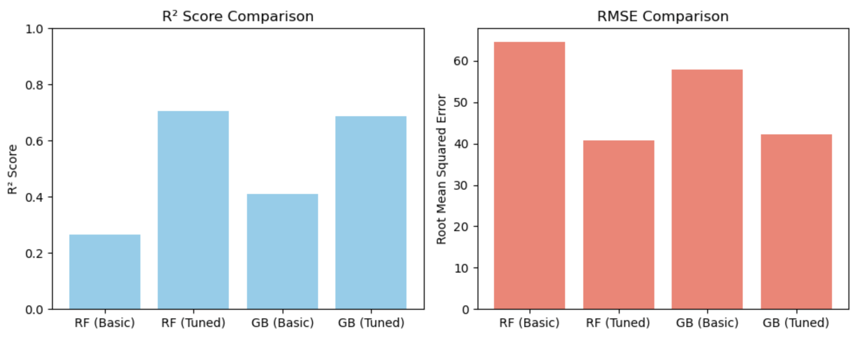
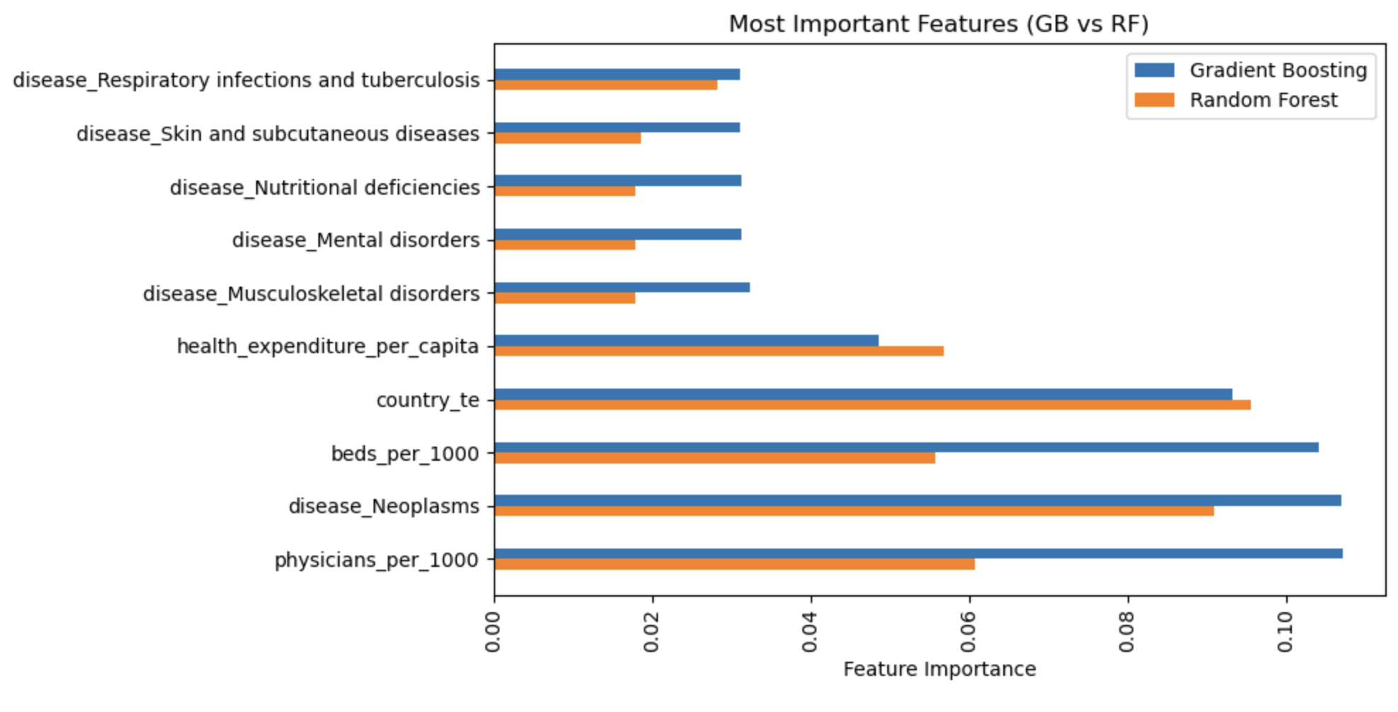
Random Forest & Gradient Boosting Results
Metrics | Random Forest | Gradient Boosting | Random Forest (Tuned) | Gradient Boosting (Tuned)
RMSE | 64.49 | 57.00 | 40.824 | 42.1
R-Squared | 0.21 | 0.41 | 0.706 | 0.687
Initial and tuned model performance (Train/Test RMSE, R²)
Best parameters after tuning
Top 10 important features

Slide 7
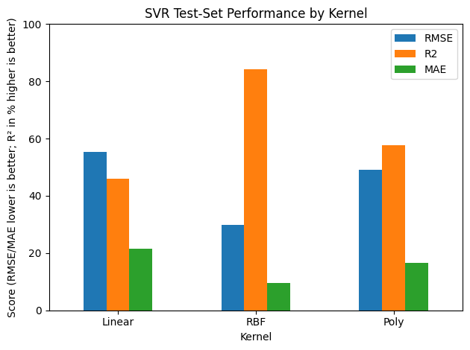
Support Vector Regressor
Parameter
Linear
Radial (RBF)
Polynomial
C
10
10
10
gamma
-
0.1
'scale'
degree
-
-
2
kernel
'linear'
'rbf'
'poly'
Evaluation Metrics
RMSE
55.3810
29.9740
49.0354
R² Score
0.4595
0.8417
0.5763
MAE
21.4257
9.5529
16.5027
Time to run
8.00 min
16.08 min
20.24 min
Key points: RBF best performance, polynomial slowest, linear fastest but least accurate.

Slide 8
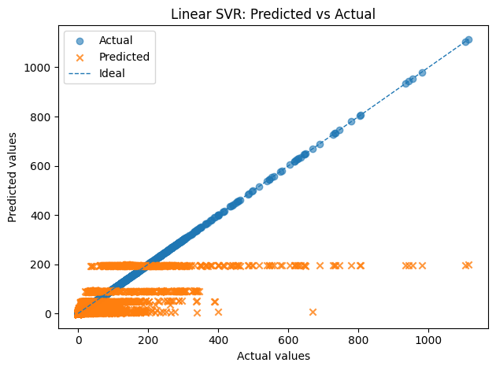
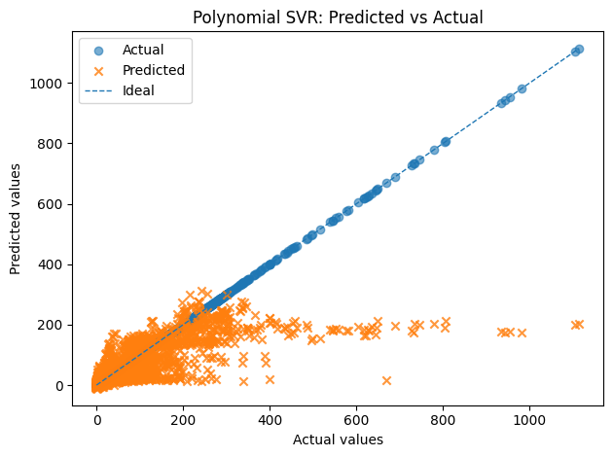
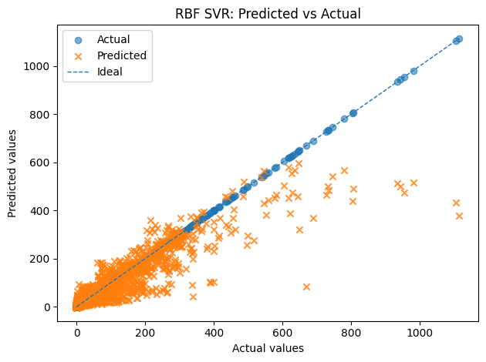
Polynomial SVR: Captures some non-linear relationships but still struggles with higher values. Moderate improvement over Linear SVR but limited generalization.
Linear SVR: Shows severe underfitting. The model fails to capture the non-linear patterns in the data, leading to significant prediction errors.
RBF SVR: Performs better than both Linear and Polynomial kernels in modeling complex patterns. However, there are still notable errors at higher target values, indicating the need for better parameter tuning or data normalization.

Slide 9
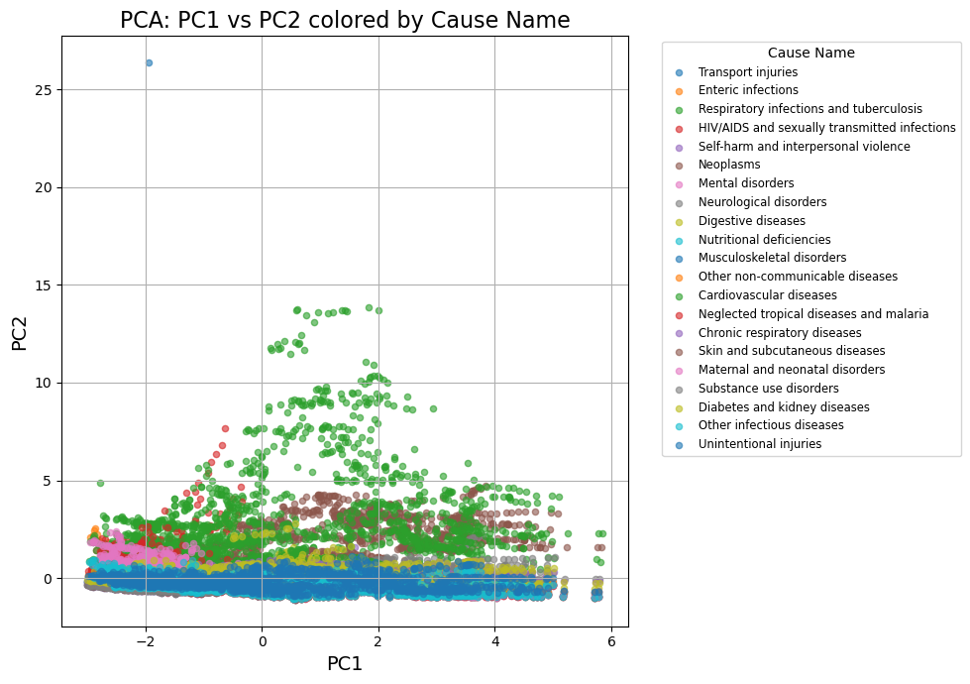
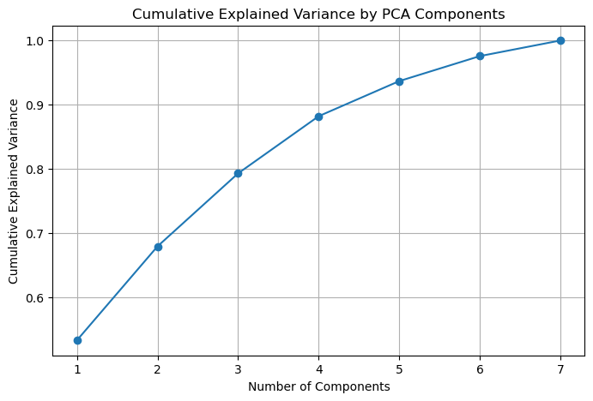
Unsupervised Learning - PCA Analysis
PCA 1 | PCA 2
Health Expenditure per Capita (0.47) | Mortality Rate (0.95)
Physicians per 1000 (0.44) | Beds per 1000 (0.23)
Happiness Score (0.42) | Corruption Index (0.08)
Percent GDP Spent on Health Care (0.37) | Physicians per 1000 (0.07)
Beds per 1000 (0.32) | Percent GDP Spent on Health Care (0.05)
Mortality Rate (0.02) | Health Expenditure per Capita (-0.08)
Corruption Index (-0.42) | Happiness Score (-0.16)

Slide 10
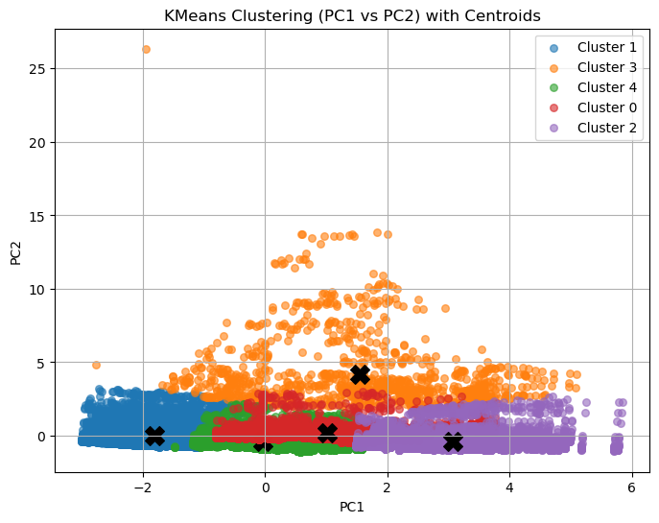
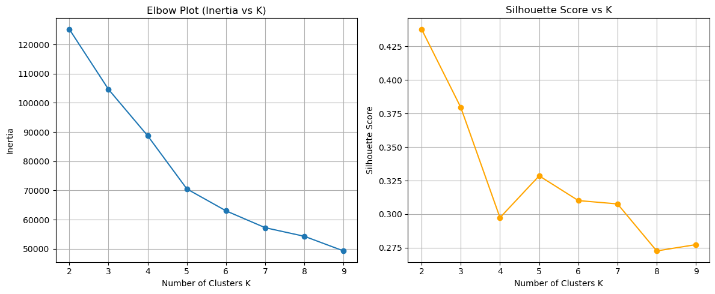
Unsupervised Learning - Clustering Results
K-Means Clustering (K=5)
Cluster characteristics
Key findings
Distinct patterns observed in feature values across the 5 clusters.
Identified natural groupings of countries based on their mortality-related characteristics.
Chosen by elbow and silhouette methods, indicating optimal number of clusters.

Slide 11
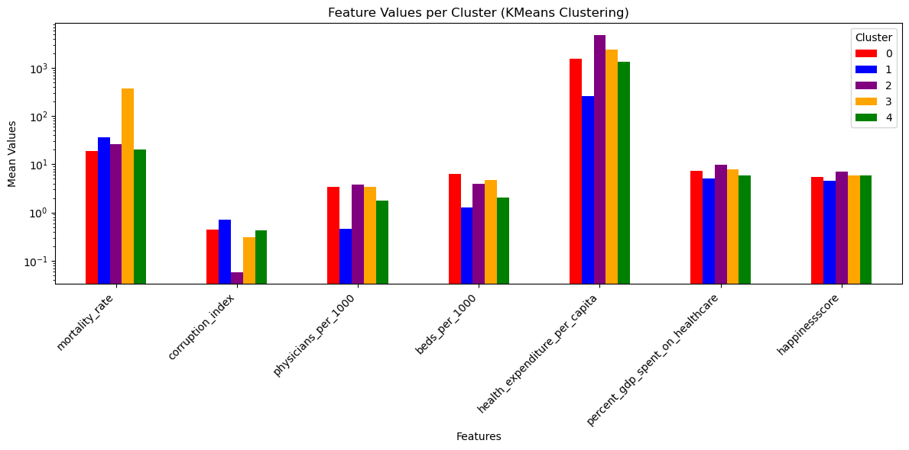
Cluster 0 | Upper Middle-Income Countries(Maldives, Poland)
Cluster 1 | Low Income Countries(India, Africa, etc.)
Cluster 2 | High Income Countries(Western Europe, USA, UK, etc.)
Cluster 3 | Developing Countries(Eastern Europe, Central Asia)
Cluster 4 | Developing Countries(Peru, Southeast Asia)

Slide 12
Limitations & Challenges
Data Quality & Gaps
Model Extrapolation
Evolving Factors
Incomplete or inconsistent data sources were a challenge. Regional data often lacked uniformity.
Predicting future mortality trends is complex. Models do not factor in unforeseen global events.
Socio-economic and health factors change constantly. This impacts long-term model reliability.

Slide 13




Future Work & Roadmap
Expand Data Sources
Conduct Deeper Analysis
Integrate diverse datasets for comprehensive global coverage.
Investigate regional nuances and new demographic factors.
Enhance Model Accuracy
Inform Policy Actions
Refine algorithms, explore ensemble methods for better predictions.
Translate insights into actionable public health strategies.

Slide 14
Conclusions: Key Learnings & Outlook
Actionable Insights
Model Robustness
Policy Implications
Healthcare access and economic stability critically influence mortality rates. Targeted interventions are essential for positive change.
The RBF kernel SVR model demonstrated superior predictive performance. It offers reliable forecasting capabilities.
Data-driven policies can significantly impact public health outcomes. Continuous data quality improvement is vital.

Slide 15

Q&A
Thank you for your attention. We welcome any questions you may have about our research.
Please feel free to contact us for further details or potential collaborations.

