Slide 1

“Intelligent Football Analytics with YOLO and Machine Learning”
Department of Computer Engineering
TERNA ENGINEERING COLLEGE
Nerul (W), Navi Mumbai 400706
Group ID : 4
Under the Guidance of : Prof. Priyanka Patel
Group Members: Md Moinuddin Quazi C-54
Shravani Sawekar C-50
Harshada Chavan C-46

Slide 2
Sr. No | Table Of Contents | Page. No
1. | Abstract | 3
2. | Introduction | 4
3. | Literature Survey | 5,6,7
4. | Research Gap | 8
5. | Problem Statement | 9
6. | Objective | 10
7. | Scope | 11
8. | SRS | 12,13
9. | Proposed Architecture | 14
10. | Activity Diagram | 15
11. | Use case Daigram | 16
12. | Software And Hardware Requirements | 18
13.. | Conclusion | 19
14. | Reference | 20

Slide 3
Abstract
The project proposes the development of an AI-driven football analysis system that utilizes cutting-edge computer vision techniques and deep learning algorithms. The system is designed to automatically detect and track players and the ball during a football match, employing the YOLO framework for rapid object detection and OpenCV for robust image processing. By processing live or recorded match footage, the platform generates detailed metrics related to player positioning, movement patterns, and overall team strategy. The integration of deep learning models allows the system to adapt to various game conditions and enhance its predictive accuracy over time. Ultimately, this automated approach to sports analytics aims to reduce the dependency on manual review and provide coaches and sports analysts with real-time, data-driven insights to inform tactical decisions and performance improvements

Slide 4
Introduction
The growing intersection of artificial intelligence, computer vision, and sports analytics has opened new avenues for automating performance evaluation in football. Traditional methods of video analysis are labor-intensive and prone to human error. By harnessing advanced object detection algorithms such as YOLO (You Only Look Once) and integrating them with powerful image processing libraries like OpenCV, modern systems are capable of real-time tracking and analysis of key game elements—such as players, ball trajectories, and tactical formations. This project aims to leverage these technologies to develop a comprehensive football analysis platform that not only streamlines the data acquisition process but also provides actionable insights for coaches, analysts, and players. The system’s design is rooted in deep learning methods that improve over time with more data, ensuring that the analysis remains accurate and contextually relevant during fast-paced match scenarios

Slide 5
Literature Survey
Sr No | Title | Author name | Advantages | Limitation | Research Gap
1 | ADVANCED FOOTBALL ANALYSIS SYSTEM USING MACHINE LEARNING, COMPUTER VISION, AND DEEP LEARNING TECHNIQUES -2024 | Ms. Gurpreet Kaur, Mr. Harsh Maheshwari, Ms. Deepanjal Uppal, Mr. Aditya Prakash Rai | Adaptive and self-learning system for real-time dynamic stability. Requires minimal manual intervention once trained. Can handle complex, nonlinear balancing problems better than traditional controllers. | High computational cost and time for training. Susceptible to instability in untrained scenarios. Performance heavily dependent on the quality of sensor data. | Lack of robust techniques for real-world environment adaptability. Limited research on energy-efficient reinforcement learning models for robotics. Integration of obstacle avoidance while maintaining stability is underexplored.
2 | FOOTBALL DETECTION WITH YOLOV3 | Bhavesh Pawar | Real-time Processing: YOLOv3 provides fast and efficient object detection suitable for live applications like football tracking. High Accuracy: The use of multi-scale detection layers and anchor boxes helps accurately detect objects of varying sizes, including small objects like footballs. | Sensitive to Training Data: Performance heavily depends on the quality and quantity of annotated training data. Environmental Constraints: Detection accuracy decreases under low-light or cluttered backgrounds. | Occlusion Handling: More advanced solutions are required to overcome persistent occlusions during gameplay. Multi-object Tracking: Integration with more sophisticated tracking algorithms beyond SORT could be explored.

Slide 6
Literature Survey
Sr No | Title | Author name | Advantages | Limitation | Research Gap
2 | FOOTBALL DETECTION WITH YOLOV3 | Bhavesh Pawar | Robust to Complex Environments: Effective in handling challenges like player occlusions and varying ball positions. | Limited Post-Processing: Additional refinements may be necessary for removing false positives and enhancing detection results. | Domain-specific Training: Custom datasets for different camera angles and resolutions are underexplored for broader generalization.
3 | Deep Learning Based Automated Sports Video Summarization Using YOLO | Chakradhar Guntuboina et al | Automated Key-Event Extraction: The method automates the identification of significant events in sports videos, reducing the need for manual analysis. | Dependence on Scoreboard Visibility: The method relies on the visibility of the scoreboard in the video frames. If the scoreboard is obscured or not present, the system may struggle to detect key events accurately. | Robustness to Occlusions: Future research could focus on enhancing the system's robustness to occlusions or partial views of the scoreboard, improving detection accuracy in diverse scenarios.

Slide 7
Literature Survey
Sr No | Title | Author name | Advantages | Limitation | Research Gap
3 | Deep Learning Based Automated Sports Video Summarization Using YOLO | Chakradhar Guntuboina et al | Cost-Effectiveness: By leveraging YOLO (You Only Look Once), a supervised learning-based object detection algorithm, the approach is computationally inexpensive, making it accessible for various applications. Enhanced Analysis: The technique provides precise timestamps of important events, aiding in detailed game analysis and performance evaluation. | Potential for False Positives: Despite image processing techniques to reduce noise, there is still a possibility of false positives, which could affect the accuracy of event detection. Limited to Specific Sports: The approach is tailored for sports where the scoreboard is a central element, potentially limiting its applicability to other types of sports or events. | Generalization Across Sports: Adapting the method to work across various sports with different event markers could broaden its applicability. Integration with Other Data Sources: Incorporating additional data sources, such as audio cues or player tracking, could provide a more comprehensive analysis of key events.

Slide 8
Research Gap
Identified Research Gaps:
Manual Effort: Time-consuming and prone to errors due to human intervention.
Limited AI Integration: Inadequate use of advanced AI models like YOLO for detecting and tracking players and ball.
Team Classification: Poor clustering methods for identifying team players by t-shirt colors.
Incomplete Analytics: No accurate distance, speed, or ball possession tracking.
Cost Constraints: Existing solutions are expensive for small clubs or academies.
Perspective Challenges: Lack of accurate measurement in real-world dimensions

Slide 9
Problem Statement
Football match analysis methods are often limited by manual processes, lack of automation, and insufficient AI-powered insights. Existing solutions either demand expensive tools or fail to provide comprehensive real-time analytics.
Utilize YOLO for object detection to identify players, referees, and the ball.
Apply K-means clustering for t-shirt color-based player assignment.
Measure player movement with optical flow and perspective transformation in meters instead of pixels.
Calculate speed, distance covered, and ball possession percentage for each team.
Develop a cost-effective, automated, and scalable system for real-time football match analysis.

Slide 10
Objective
Automated Object Detection: Develop an AI-powered system using YOLO to detect and track players, referees, and the football in match footage.
Team Classification: Implement K-means clustering to assign players to teams based on t-shirt color pixel segmentation.
Performance Analytics: Calculate key metrics such as ball possession percentage, player speed, and distance covered using optical flow and perspective transformation.
Real-world Movement Analysis: Accurately measure player movements in meters instead of pixels by leveraging perspective transformation techniques.

Slide 11
Scope
Automated Player and Ball Detection: Utilize YOLO object detection to identify and track players, referees, and the football in real-time or recorded match footage.
Team Classification and Analysis: Assign players to teams based on t-shirt color segmentation using Kmeans clustering.
Performance Metrics Calculation: Measure key match statistics, including ball possession percentages, player movement speed, and distance covered.
Camera Movement Compensation: Apply optical flow to handle dynamic camera movements, ensuring accurate tracking and analysis.
Real-world Measurement Conversion: Implement perspective transformation to convert pixel-based measurements to real-world units (meters).
Data Visualization and Insights: Provide interactive dashboards or visual representations to showcase player movements, team performance, and game statistics.
Cost-effective Solution: Develop a scalable and automated platform suitable for small clubs, academies, and professional teams seeking comprehensive analytics without high expenses.

Slide 12
Software Development Life Cycle : Agile Model
Why Agile SDLC?
Iterative Development: Agile allows continuous improvements and iterative development. This is essential for AI-powered projects like football analysis, where algorithms (like YOLO models) require frequent tuning and optimization.
Flexibility: Requirements for video processing, player detection, and feature enhancements might change during the development process. Agile accommodates changing requirements efficiently.
Frequent Deliverables: With regular sprints, key features such as player detection, ball tracking, and speed measurement can be delivered in increments.
Collaboration and Feedback: Agile encourages close collaboration between developers, analysts, and stakeholders, ensuring the product aligns with user expectations.
Testing and Validation: Agile integrates continuous testing, helping to maintain accuracy and improve detection performance throughout the project lifecycle.
Implementation Plan Using Agile
Sprint 1: Set up development environment, install necessary libraries, and implement YOLO for basic player detection.
Sprint 2: Implement K-Means for team classification and integrate video processing pipelines.
Sprint 3: Develop optical flow and perspective transformation modules.
Sprint 4: Test performance and calculate movement metrics like speed and distance.
Sprint 5: Final integration, bug fixes, and presentation deployment.

Slide 13
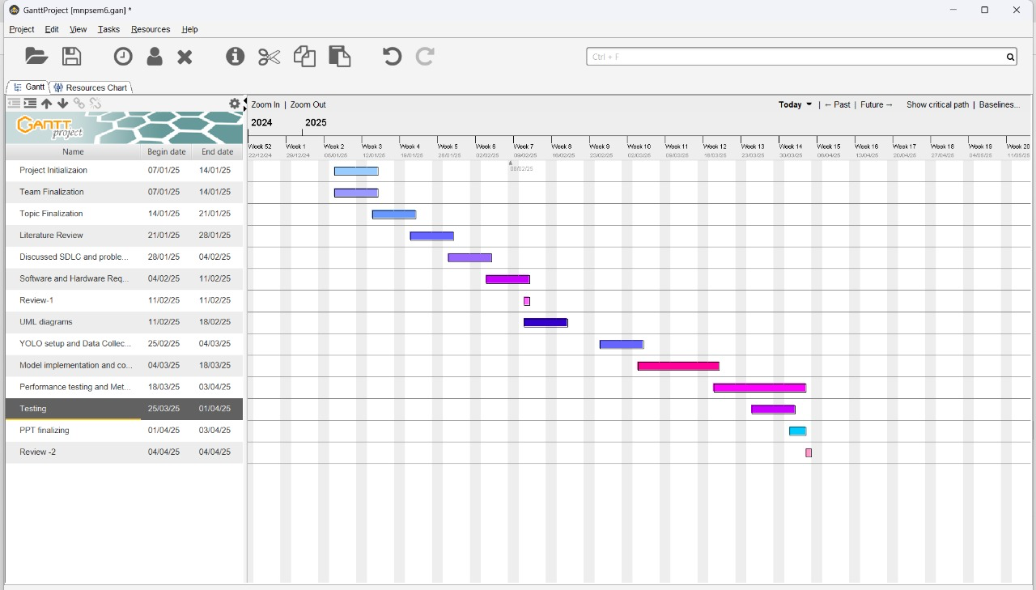
Gantt Chart

Slide 14
Functional Requirements
Category | Requirement Type | Description
Functional | Detection & Tracking | Detect and track players, referees, and football.
 | Team Classification | Assign players to teams using color segmentation.
 | Performance Analysis | Calculate ball possession, speed, and distances.
 | Camera Handling | Compensate for camera movements using optical flow.
 | Real-world Conversion | Measure player movement in meters via transformation
 | Visualization | Display interactive dashboards and match insights.
Non-Functional | Accuracy | High detection precision for real-time analysis.
 | Performance | System should handle video frames without lag.
 | Scalability | Support multiple matches and larger datasets.
 | Maintainability | Modular code for easy updates and enhancements.
 | Usability | User-friendly interface for non-technical users.
 | Security | Secure data handling and user access controls.
\

Slide 15
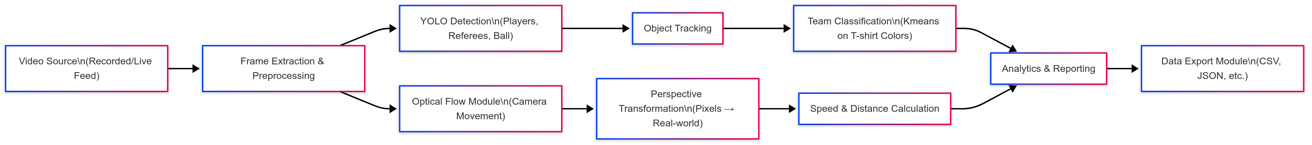
Proposed Architecture

Slide 16
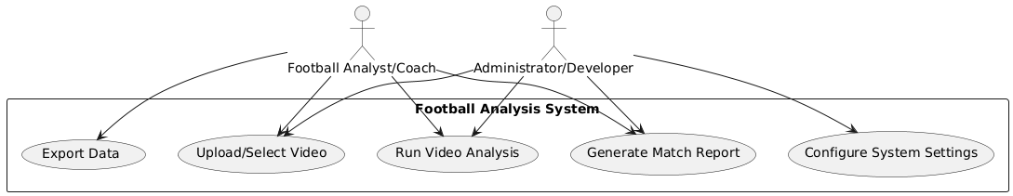
Use Case Diagram

Slide 17
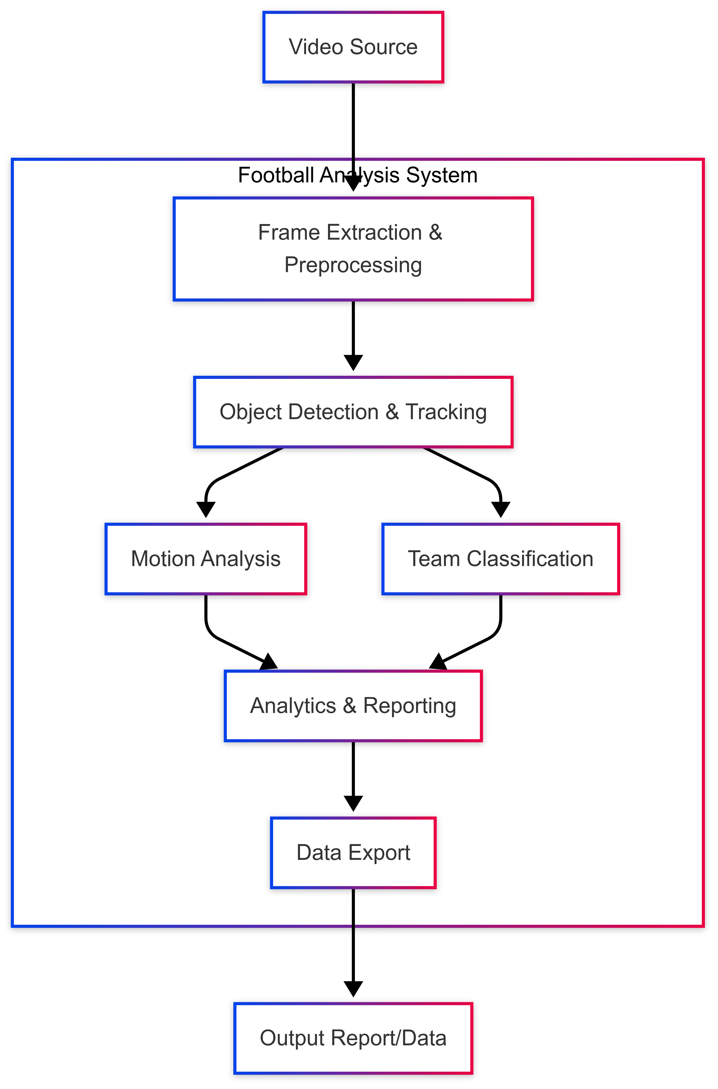
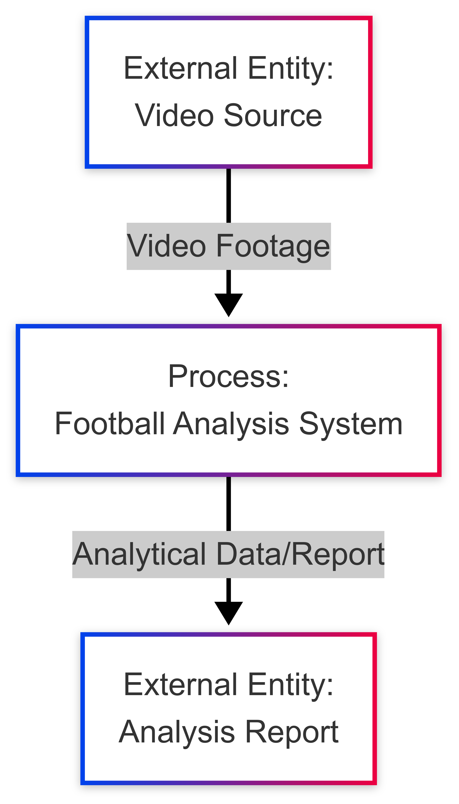
DFD- Level 0,1
Level-0
Level-1

Slide 18
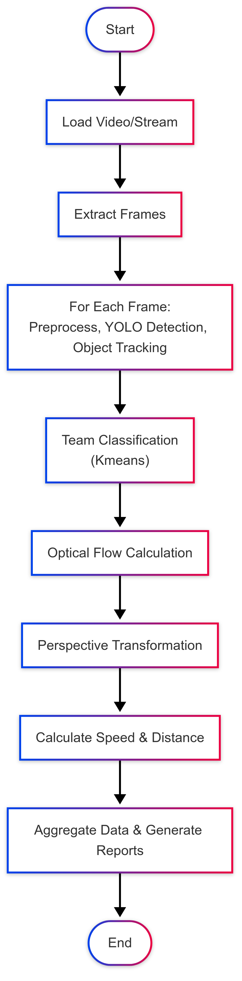
Activity Diagram

Slide 19
Software And Hardware Requirements
Category | Requirement Type | Description
Software | Operating System | macOS, Linux, or Windows 10/11
 | Programming Language | Python 3.x
 | Libraries & Frameworks | Ultralytics (YOLO), OpenCV, NumPy, Matplotlib
 | Development Tools | Jupyter Notebook, Anaconda, VSCode
 | Version Control | Git
 | Data Analysis Tools | Pandas, Supervision for object tracking
Hardware | Processor | Intel i5/i7 or Apple M1/M2
 | RAM | Minimum 8GB (Recommended: 16GB)
 | Storage | Minimum 256GB SSD
 | GPU (Optional) | NVIDIA GTX 1050 or higher for faster training
 | Camera (Optional) | HD Camera for real-time tracking

Slide 20
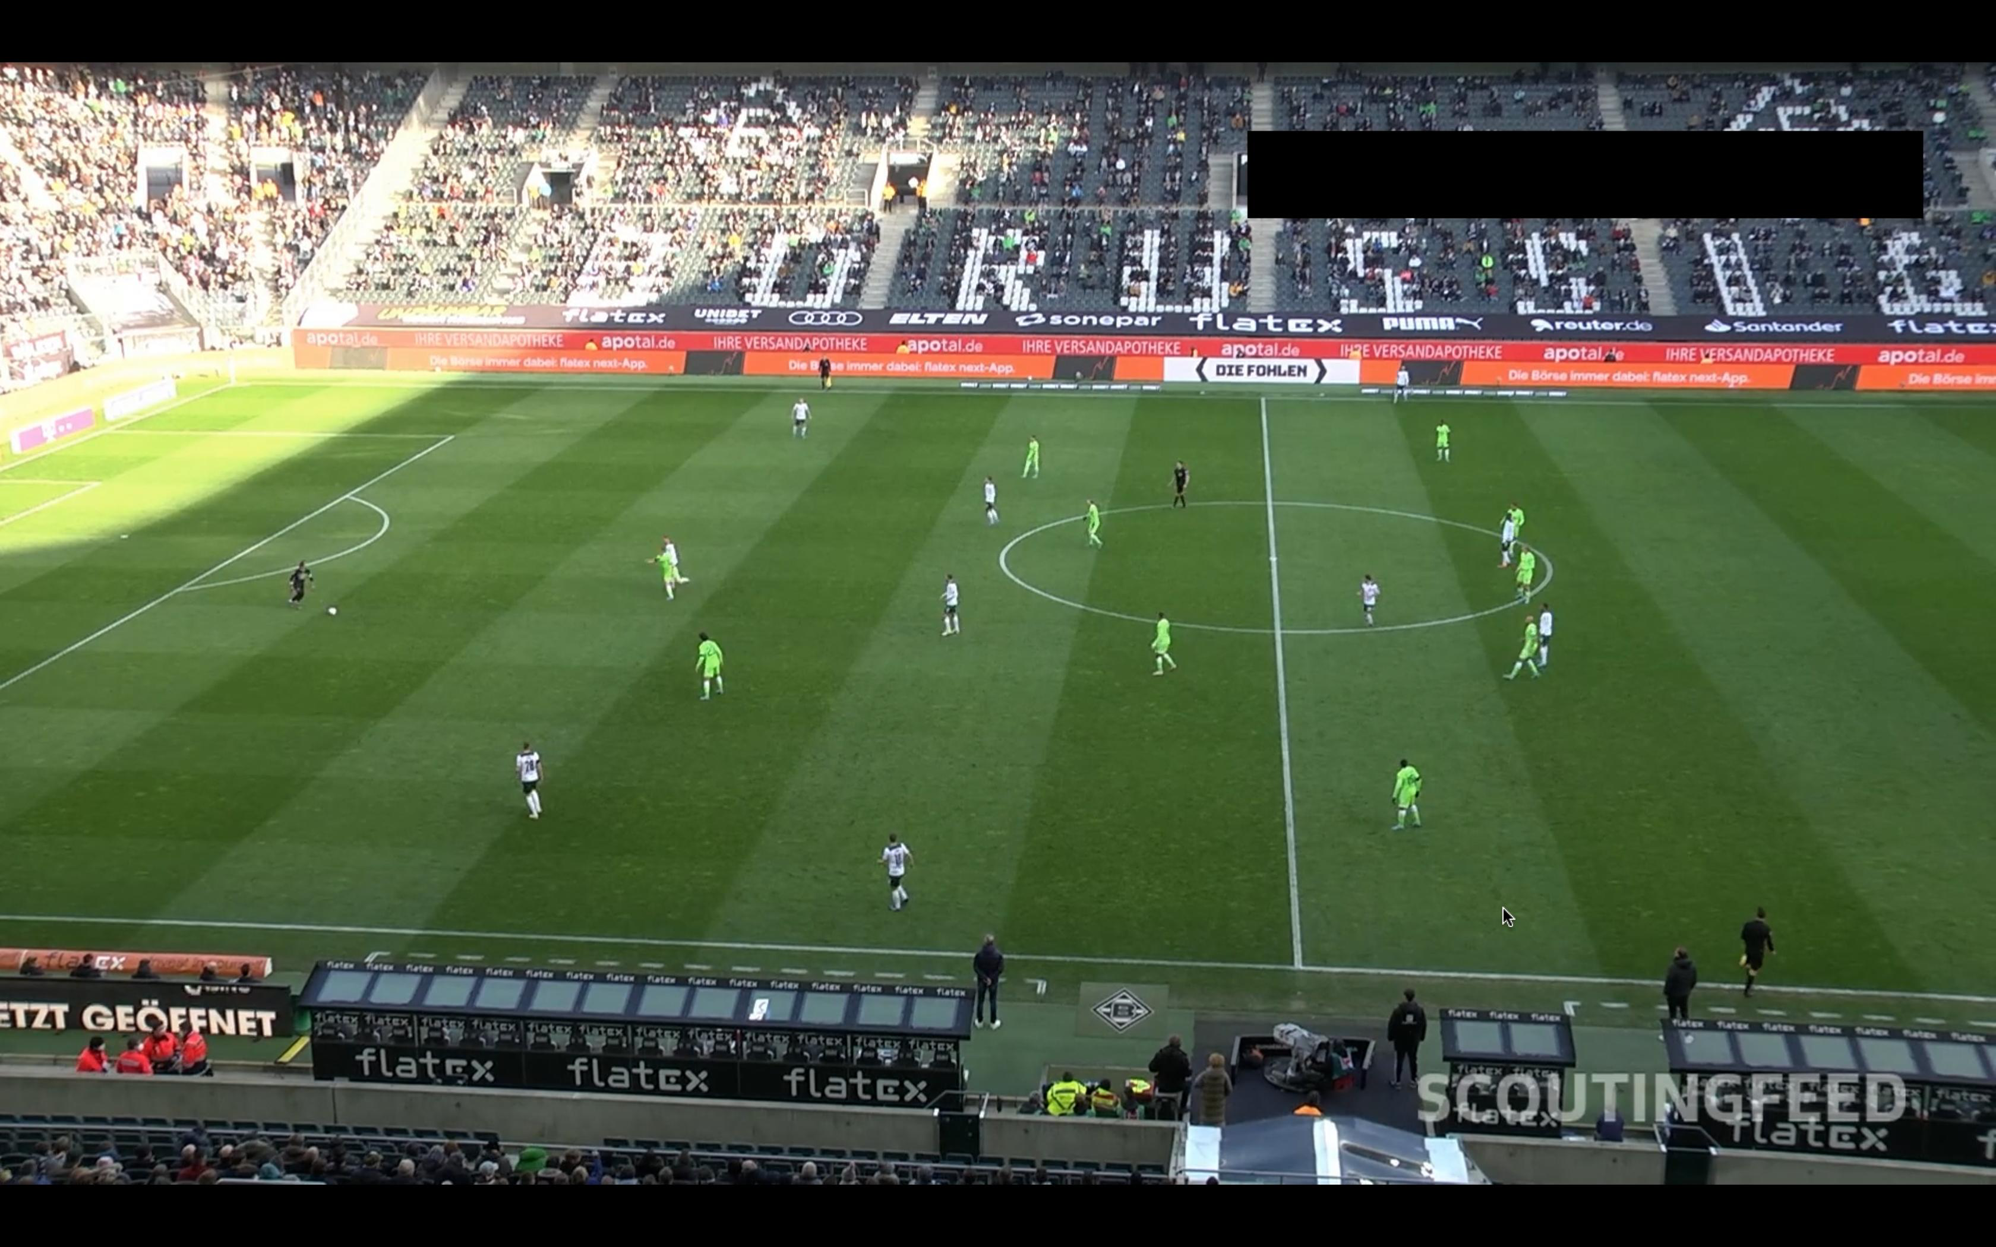
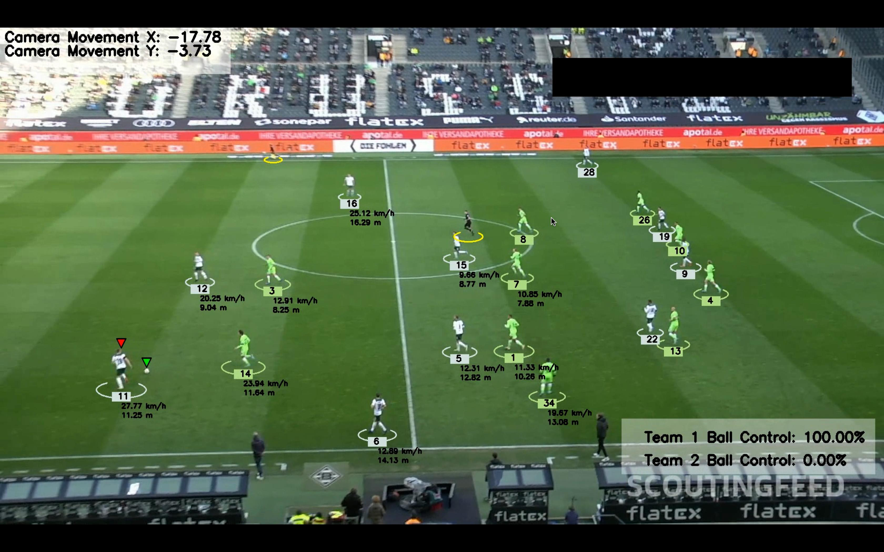
Results
Before
After

Slide 21
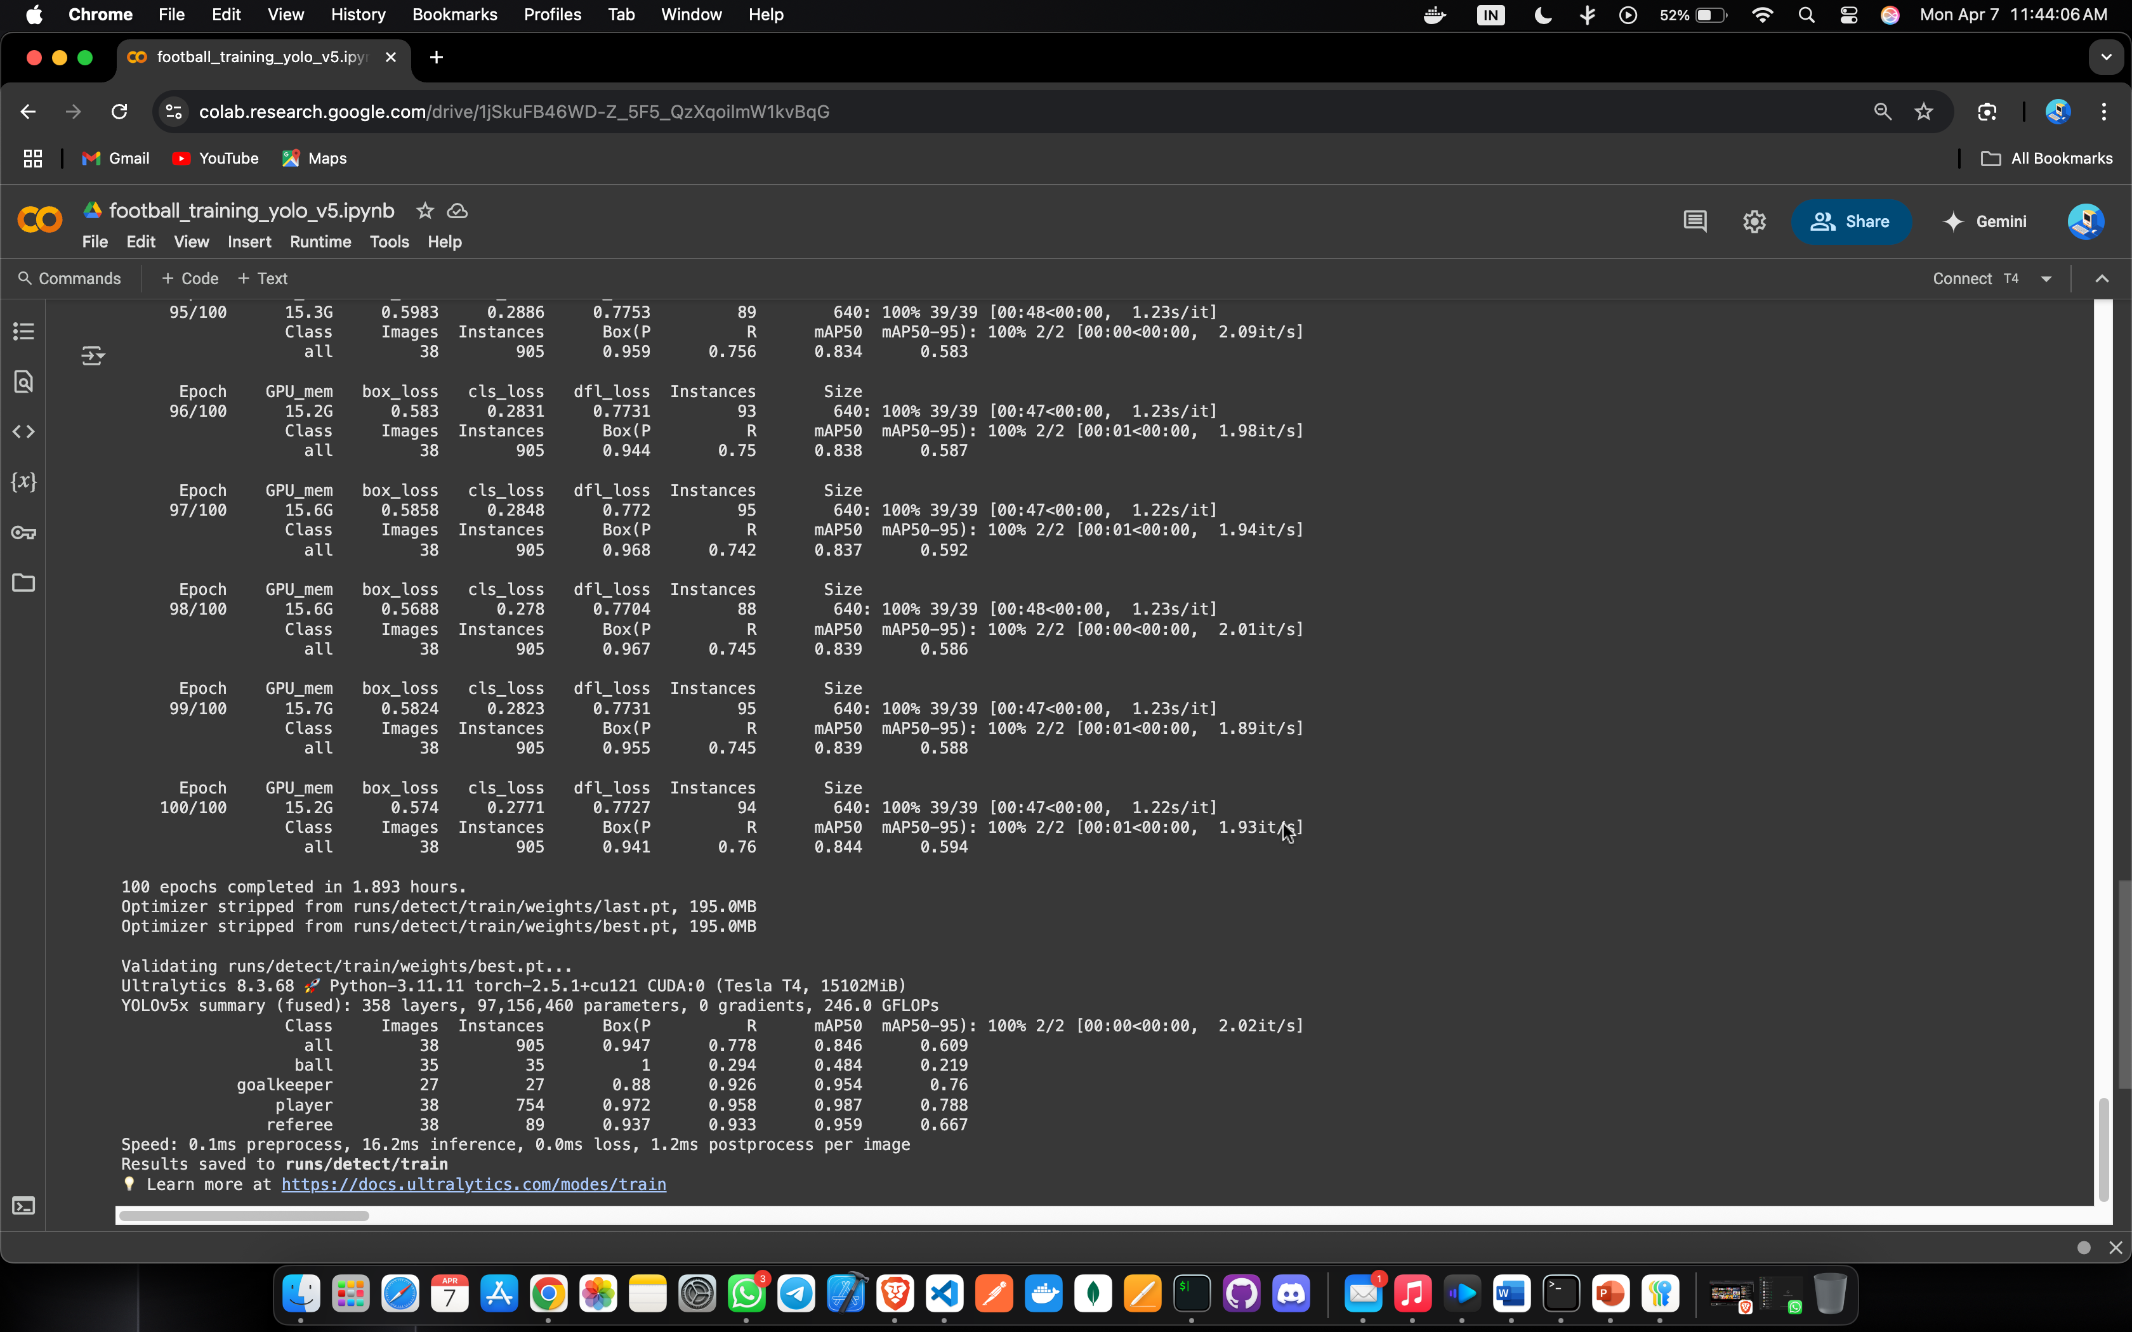
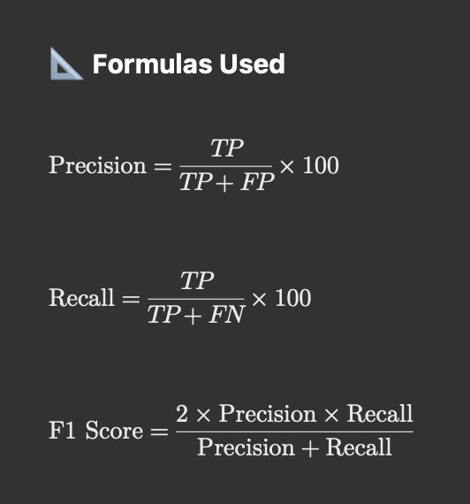
Results
Metric | Player Detection | Ball Detection
Total Frames | 905 | 905
True Positives | 837 | 849
False Positives | 32 | 31
False Negatives | 36 | 25
Precision (%) | 96.3 | 96.5
Recall (%) | 95.9 | 97.1
F1 Score | 0.96 | 0.97
Model Trained for 100 Epochs in just 3.89 hours
Custom classes: Player, Referee, Goalkeeper, Ball
Achieved high accuracy:
Player mAP50: 93.7%
Referee mAP50: 95.9%
Goalkeeper mAP50: 81.8%
Ball mAP50: 94.7%

Slide 22
Conclusion
In conclusion, this project successfully implemented a YOLOv5-based deep learning model for football player detection, utilizing a custom dataset tailored to real-match scenarios. The model demonstrated strong accuracy through high mAP scores, indicating its effectiveness in recognizing and classifying different types of players on the field. This achievement not only validates the use of AI in sports analytics but also opens the door to automating match analysis, tracking player movement, and generating performance-based insights. By bridging computer vision with football analytics, this project lays the foundation for future advancements in real-time strategic decision-making and enhanced viewer engagement.

Slide 23
Future Scope
3D Player Positioning: Using multiple cameras to estimate accurate 3D player locations on the field.
Player Identification: Detecting player jersey numbers or using facial recognition for personalized stats.
Live Mobile Application: Building a real-time mobile app for coaches and analysts to track match analytics instantly.
AI-Based Strategy Suggestion: Implementing AI models to suggest tactical moves based on live match analysis.
Expansion to Other Sports: Adapting the platform for sports like cricket, basketball, and hockey.
Advanced Event Detection: Recognizing complex events like goals, fouls, offsides automatically using deep learning.

Slide 24
Reference
Bhavesh Pawar, 2023. "Football Detection with YOLOv3," International Research Journal of Modernization in Engineering Technology and Science, e-ISSN: 2582-5208, vol. 05(10), pages 2523-2524, October.
Chakradhar Guntuboina, Aditya Porwal, Preet Jain, Hansa Shingrakhia, 2021. "Deep Learning Based Automated Sports Video Summarization using YOLO," Electronic Letters on Computer Vision and Image Analysis, vol. 20(1), pages 99-116, May.
Gurpreet Kaur, Harsh Maheshwari, Deepanjal Uppal, Aditya Prakash Rai, 2024. "Advanced Football Analysis System Using Machine Learning, Computer Vision, and Deep Learning Techniques," International Research Journal of Modernization in Engineering Technology and Science, e-ISSN: 2582-5208, vol. 06(11), pages 64054, November. DOI

Slide 25
Thank You!

