Slide 1
Let’s Git this Party Started
An introduction to Git and GitHub
@Kim_Moir

Slide 2
Tonight’s agenda
Introduction
A short history of open source version control systems
Why Git and GitHub
Hands on exercises: Using Git, GitHub
Git concepts
Notes:
-mention break half way through
-verify that everyone has wireless working
-give out GitHub stickers and collect names for door prize

Slide 3
Introduction
About you?
About me
Notes:
I’m honoured to be here tonight. This is my first time attending Girls Develop It Ottawa. How many of you are here for the first time?
Who has used version control systems before?
Who has used Git or GitHub before?
My name is Kim Moir and I’ve been involved in the open source Eclipse community for 10 years. I'll be starting a job as a release engineer at Mozilla in a few weeks. Anybody hear of Eclipse before? Eclipse is an open source community that produces software tools for developers. The Eclipse Foundation office is in Ottawa, on Centrepointe drive. 1000 committers, 70+ projects, millions of downloads. Release engineering “is concerned with the compilation, assembly, and delivery of source code into finished products or other software components.“ (Wikipedia definition). As a result, just like software developers we spend a lot of time interacting with the version control system. I have a business degree, not a computer science degree, so like many of you, I’ve learned a lot a long the way during my career. Outside of work, I’m a long distance runner.

Slide 4

What is open source
Notes:
-Code is developed in the open under an open source license that allows people to redistribute and modify the code
-Code can be inspected, downloaded and compiled by anyone
-Contributions are welcome from the community
-People can build upon this code and deliver commercial products that are based upon it

Slide 5




Open source communities
Notes:
Examples of open source communities
-develop Apache web server, Linux operating system, Eclipse IDE, Mozilla Firefox and so on
-Other examples Gentoo, Gnome, SPI etc
-Open source foundations provide governance models, intellectual property management, marketing, and infrastructure for these communities
-Git is also developed as a open source project for a version control system

Slide 6
What is version control
A system to manage changes to digital artifacts
Examples: code, documentation, the possibilities are endless
Notes:
It’s a system that that tracks and provides control over changes to source code, or other types of digital artifacts. Examples of source control you may have seen before. Wikipedia where you can look at the revision history of a document. Any other examples that people may have used?
Why do we need version control systems? We need to be able to track changes to our code. For instance, look back at the history and see what changes were made and who actually made them.. Be able to remove a change. And contribute changes of your own. For example, if the operating system on your laptop had a security bug that made it vulnerable, the software developers need to be able to go use the exact version of the code base that was used to build that version, and apply a patch to fix it. Version control systems let you do that. Without version control, there would be chaos.

Slide 7

Example: Book collaboration
Notes:
-People in many different timezones are collaborating on a book. They want to be able to make changes to their chapter without overwriting other author’s changes.
-Also, it would be interesting to see what changes were made and when in the document
-If there are changes that the editor doesn’t agree with, she can revert them back to the previous version
-The editor can also see if people are actually working on the book :-)

Slide 8

History of Version Control
Notes:
In the beginning, people didn’t have version control systems. They just passed files around via email. Very painful to merge changes.
Imagine if you were a student and working on a group paper. You all started with a one page summary of what you were going to do and then added the content to your liking. The same thing would apply to a group of developers working on a common code base.

Slide 9

CVS and SVN
Server
John
Paul
Susan
Kim
Remy
Notes:
In the 1990s, CVS was invented. It was basically a model that allowed developers to check out copy of a centralized repository make local changes, and release or merge these changes back into the central server. In the early 2000s, SVN was released and was supposed to overcome some of the problems with CVS.
Limitations of these centralized source control systems: hard to track changes, difficult to branch and merge, everything you do is public since the public server controls everything. Also, you have to deal with network latency when you contact the central server each time.

Slide 10

2005: Git
Notes:
Thus in 2005, Git was invented by Linus Torvalds who is famous for inventing something else. Any guesses? Linux. Linux is an open source operating system that’s very popular around the world. Most web sites run on the Linux operating system.
Why Git was developed
The Linux development team used to use a version control system called BitKeeper which they quite liked. However, the authors of BItKeeper withdrew their open source license and made it proprietary. Thus the Linux kernel team had to find a new version control system. And if you’ve spent your spare time writing an operating system, perhaps it’s not difficult to write a distributed version control system. When asked why he named it Git, he said
"I'm an egotistical bastard, and I name all my projects after myself. First Linux, now git."
http://en.wikipedia.org/wiki/Git_%28software%29
Git : English slang for a difficult or unpleasant person.

Slide 11
"I'm an egotistical bastard, and I name all my projects after myself. First Linux, now git."
--Linus Torvalds

Slide 12
Source Control
Centralized all use a central repository: CVS, Subversion, Perforce
Distributed (DCVS) allow you to reconcile your local repository with a centralized one: Git, Mercurial

Slide 13
Git Design Goals
Fast
Distributed
Each commit has a corresponding hash key
Everyone has a local copy of the history
Notes:
It’s quite popular with many open source projects such as Android, Apache, Linux, Eclipse and more. It’s also used within corporations.
Advantages and disadvantages of Git
-distributed, fast, everyone has a copy of the local repo and its history
-Since it contains all history, it’s easy to revert to a historical point in your source code
-many models for organization for the development team
Disadvantages
-have to clone the entire repo if you want to just check out one project
-learning curve

Slide 14
Development models
Lieutenant
Lieutenant
Canonical repo
Committers
Notes:
define committers
For example: Linux kernel
Very flexible

Slide 15
Another model
Canonical repo
Committers
Notes:
Eclipse SDK project uses canonical repo which committers push and pull from, not each other explicitly
As with any DCVS, an agreement is reached within the team on regarding how they would like to work

Slide 16
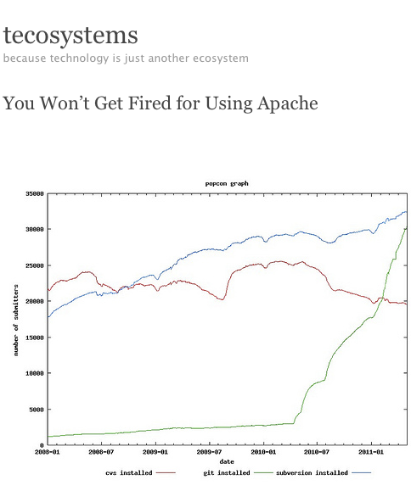
Git Usage
Notes:
Source Stephen O’Grady Redmonk
Git usage is rising rapidly so it’s a good skill to learn
At the Eclipse foundation, we have been using CVS for 10 years, and half the projects recently finished migrating to Git.

Slide 17
Installation steps
Install git
Setup ssh keys
Create github account and add ssh key
Setup your name and email in gitconfig
git config --list

Slide 18
Check your installation first
Is git installed? Yes, if this command runs
git
Is ssh installed and a key created? Yes, if this file exists
ls ~/.ssh/id_rsa.pub

Slide 19
Installing Git
Windows: http://help.github.com/win-set-up-git/
Linux: http://help.github.com/linux-set-up-git/
Mac: http://help.github.com/mac-set-up-git/
Notes:
1. Install git. (If you don’t already have it installed already)
2. Setup ssh keys (if you don’t already have one generated on your machine) and copy to GitHub
3. Setup name and email in git config
4. API token setup isn’t necessary for this tutorial, can be skipped if you want

Slide 20
Create a local repository
Change to your home directory
cd ~/
create a working directory
mkdir my_repo
cd my_repo
ls -la to look at the directory
git init
ls -la
Should see .git
To check the status of your repo
git status
Notes:
Key concepts in Git - cloning, branching, merging, committing, push to remote, pull, log, help, creating branches, switching branches
-explain local versus remote repos
-checksums are associated with every commit
-Git client and server on various operating systems
-look at git server config - git config --list
-git protocols:git, ssh, http
-concept of commit rights since you have permissions on the repo, you commit to it
-remote repos - you will have to have the correct permissions to push
-can only push via ssh

Slide 21
Git-ting help
man <command> (print the online manual)
program help (git help)
<program> help command (git help init)

Slide 22
Add files to your repo
Create a file
touch hello_world.txt
Check repo status
git status
Git only tracks files we tell it to
Add the file to the repo
git add hello_world.txt
git status
File should now be tracked

Slide 23
Changes and commits
Open hello_world.txt and add some more text
git status
Stage the change
git add hello_world.txt
Commit the change
git commit -m “added text”
Create another file
touch newfile.txt
Add all untracked files in the current directory
git add .
Commit the change
git commit -m “added newfile”
Notes:
Difference between staging and committing

Slide 24
Why do you need to add files?
Git tracks your changes, not your files
We are telling git to track the current state of the file when we add it
Staging is adding the file to the repository to be tracked
If you change a file, you also have to tell git to track the changed file

Slide 25
What have you done?
git log
git log | grep newfile
git log --pretty=oneline
gitk
Notes:
git log can be used to look at the history of the repo
git log --pretty=oneline shows the hash tags associated with commits to the repo with the most recent commit first
gitk - graphical view of the repo

Slide 26
Git archeology
add text to hello_world.txt
git add .
git commit -m “added text”
Find the commit hash
git log --pretty=oneline
checkout a previous commit
git checkout <hash>
cat hello_world.txt
To return to the current version
git checkout master
Notes:
By default, master is the current branch in a git repo
git log --pretty=oneline shows commit history with most recent commit first
You can have many branches in a repo, we’ll talk more about that later

Slide 27
Tags are better for Humans
The reality is that nobody types hashes to check out a commit
One approach is to use tags
Tags as a general practice are considered immutable
Tags are often used to record a moment in time for administrative purposes
Notes:
Tags are a snapshot of a repository at a point in time
For instance, at Eclipse, we tagged the repos with a timestamp that reflected the time the build started. So we could go back in time and see what went into each build.
Each tag tags the whole repo, not just a single file or directory

Slide 28
Tags
Tag your current repo as version_one
cat hello_world.txt
git tag version_one
checkout previous changeset
git checkout version_one^
cat hello_world.txt
tag the previous changeset as a RC
git tag rc
git checkout version_one
Use gitk and git tag to view tags
Notes:
To find your tag in a repo with a large number of tags
git tag -l | grep <yourtag>

Slide 29
Undoing Local changes
Return to master branch
git checkout master
If you haven’t committed
change hello_world.txt
git checkout hello_world.txt
Version of file is overwritten with the one from the repo

Slide 30
Undoing Commits (1)
If staged
change hello_world.txt
git add hello_world.txt
git reset HEAD hello_world.txt
This will unstage the change
git checkout hello_world.txt
roll back unstaged changes

Slide 31
Undoing Commits (2)
cat hello_world.txt
Find the commit hash
git log --pretty=oneline
git revert <hash>
cat hello_world.txt
Your change is reverted to the previous commit
Can revert your revert if you like :-)

Slide 32
git diff
git diff shows the difference between staged and unstaged changes
change hello_world.txt
git diff
git add .
git commit -m “update text”
git diff
git status

Slide 33

Notes:
What is a branch?
A branch in Git is a different version of the source code. It starts as the copy of an existing branch. The default branch is called master. For instance, you may want to try to implement a new feature that will radically change how your product works. So you may want to create a new branch so you can explore this work without disrupting the work of others. When you’re sure that this feature is working and won’t break the build, you can merge the changes from this branch into the main development stream. Another example: You need to fix a bug for a customer. So you can branch the code base from the release branch and implement that one fix for a new release. Ongoing work isn't touched.

Slide 34
Branching
Why branch?
  Branch to conduct some exploratory work without impacting the work that others are doing in the master branch
  Branch to backport changes to a old release

Slide 35
How to branch
Create a new branch called v2
git checkout -b v2
add a new file
touch v2.txt
change hello_world.txt
stage your changes
git add .
commit to the new branch
git commit -m “changes to v2 branch”
Notes:
Look at branches in gitk
yellow: tags
green: branches

Slide 36
Switching branches is easy breezy
List all branches
git branch -a
Branch with * is active
switch to master
git checkout master
ls to view files
switch to v2
git checkout v2
ls to view files
Notes:
Branching is Git is cheap
Can have local branches that the server doesn’t know about
When you branch in Git, the entire repo is branched
In CVS, you can branch just a single file or directory. Not in Git.

Slide 37
Commit to a branch
Switch to master
git checkout master
touch master.txt
git add .
git commit -m “added master.txt”
git checkout v2
Notes:
Must commit to the branch before switching to another branch or your changes will be lost

Slide 38

Notes:
Merging is the opposite of branching
While you’re working in your local branch on your awesome new feature, other people on your team will also be making changes.
You want to keep your local branch current so that you have all the changes that other team members are contributing

Slide 39
How to Merge
What branch are we in?
git status
If not v2,
git checkout v2
Merge changes from master into v2
git merge master

Slide 40
Merge conflicts
git checkout master
edit hello_world.txt
git commit -am “update text in master”
git checkout v2
edit hello_world.txt and add different text
git commit -am “hello_world.txt in v2”
merge from master to v2
git merge master
you will be notified of a conflict - update the file to fix it
git commit -am “hello_world.txt in v2”
git merge master
Notes:
The same file may be changed by two different people at the same time in their version of the local repository
Attempting to merge them may not work - you have a conflict
You need to modify the files before you move on

Slide 41
Git blame
Shows who last modified the file or made the last commit
git blame hello_world.txt

Slide 42
GitHub
GitHub is a commercial site that allows you to host Git repositories
Many open source projects host or mirror their repositories to GitHub
Allows you to showcase your code to potential employers
Possibly attract new contributors
Learn from others!
Notes:
-history of GitHub - open source and commercial aspects. GitHub was launched in 2008 and is a web based service for hosting git repositories. It’s a leader in social coding. Just like you can follow someone on Twitter, you can follow a developer on GitHub and see the work that they are doing. There is also issue tracking, so you can open bugs or feature requests against people’s code. You can also look a graphs and see how project’s develop and who is contributing to them. For example:
Who’s contributing
https://github.com/eclipse/orion.server/contributors
Impact graph for Eclipse Orion
https://github.com/eclipse/orion.client/graphs/impact
-mention that code there is open source, what does open source mean, what benefits does it offer
-very quick mention of open source business models, how this giving away software for money can make money
Why release your code as open source on GitHub?
-Shows a portfolio of your work for potential employers
-showcase your open source project to attempt to get new contributors providing fixes to your project.
-Open Source projects are often mirrored to GitHub even though the primary development may take place on another server. For instance, for legal reasons, all eclipse code is hosted on git.eclipse.org. However, these projects are mirrored to GitHub.
-Allows you to focus on writing code, not managing infrastructure, just like any hosting infrastructure
-many open source projects host mirror their projects to GitHub, give examples
-can mirror both personal and professional projects (although this may depend on your employer - legal issues)
There are other hosting services for git repositories. For instance, Atlassian provides BitBucket which has similar capabilities

Slide 43
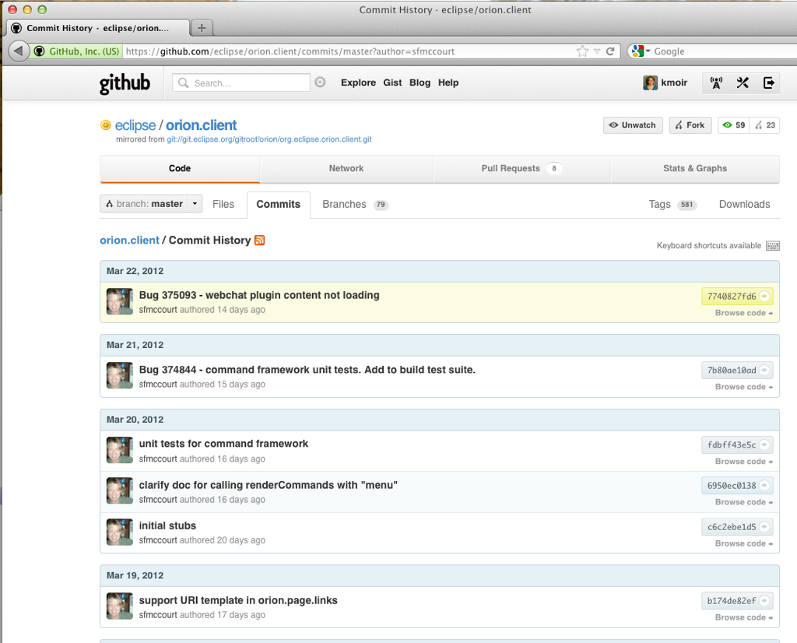
Notes:
-Software is social
-Look at graphs in GitHub to see commit activity and code submitted
For example, look at Susan McCourt, Orion committer
https://github.com/eclipse/orion.client/commits/master?author=sfmccourt
https://github.com/sfmccourt folllow
-Watch a project or follow a person, learn in the open
-Fork the code if desired

Slide 44

Notes:
Git clone
A git clone is a local copy of a remote repository. All history is copied locally. You can then modify the locally, and if you have permissions, push the changes up to a remote repository. If you don’t have rights, you can create a pull request to ask the repository owner to accept the changes on your behalf and add them to the repository.

Slide 45
Clone the course repository
Browse to this git tutorial
https://github.com/kmoir/Git-tutorial
find the clone url
cd /~
git clone git@github.com:kmoir/Git-tutorial.git
cd Git-tutorial
git status
ls

Slide 46
Remote Repos
View active remotes
git remote
Get latest version and merge updates from Remote
git pull <remote name> <local branch>
git pull origin master

Slide 47


Slide 48
How to play well with others
Commit local changes
git commit -am “my latest commit”
pull any changes from remote repo
git pull origin master
push local changes to the remote
git push origin master
Notes:
You must always integrate changes from the remote repository into your local copy before you can push up your changes

Slide 49
Beyond the command line
Many IDEs have Git integration
Example Eclipse + EGit
Allow you to work seamlessly with Git repos from within your IDE
Notes:
Confession: I don't use the command line when I use Git to interact with the code repositories I work with
Brief history of IDEs
IDEs are integrated development environments i.e. Eclipse, NetBeans, IntelliJ. Many open source and commercial IDEs are available.
Basically, they are desktop applications that providing tooling to you to make it easier to develop software i.e. automatic compilation, connecting to source code repositories, content assist, refactoring etc.

Slide 50
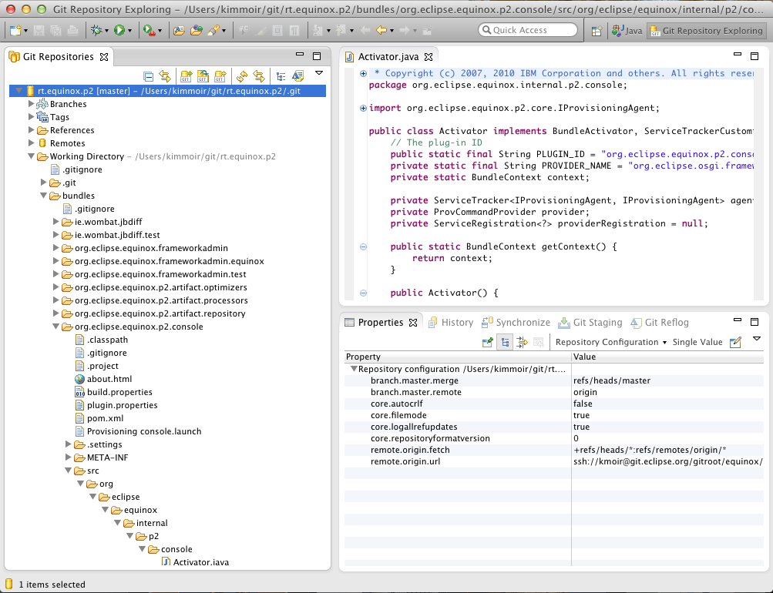
Notes:
-Clone repos, commit code, branch tag etc. all within your IDE

Slide 51
Eclipse Orion
demo connecting to GitHub via Orion
Request password here http://www.eclipse.org/orion
Login here http://orionhub.org
Clone the repo https://github.com/eclipse/orion.client.git
http://wiki.eclipse.org/Orion/Getting_Started_with_Orion
https://github.com/eclipse/orion.client.git

Slide 52
Photo Credits
Linus Torvalds Wikipedia http://en.wikipedia.org/wiki/File:Linus_Torvalds.jpeg
Git utilization graph http://redmonk.com/sogrady/2011/11/28/you-wont-get-fired-for-using-apache/
Mozilla pins http://www.flickr.com/photos/flod/2221300134/sizes/z/in/photostream/
Women with laptops at Pop Life http://www.flickr.com/photos/yourdon/5157431891/sizes/l/in/photostream/
Merge http://www.flickr.com/photos/lex/43631705/sizes/o/in/photostream/
Merging Ryan Gosling http://programmerryangosling.tumblr.com/post/16921926583
X wing clones http://www.flickr.com/photos/pmiaki/5520399713/
Branches http://www.flickr.com/photos/e_phots/3012896283/
Stormtroopers with Linux http://www.flickr.com/photos/kalexanderson/6261634332/in/photostream/

Slide 53
Legal
Copyright Kim Moir 2012. All rights reserved. This presentation and source code are available under the Creative Commons Att. Nc Cd 3.0 License
Eclipse and the Eclipse logo are trademarks of the Eclipse Foundation, Inc.
Apache and the Apache logo are trademarks of the Apache Software Foundation
Linux and the Linux foundation logo are trademarks of the Linux foundation
Mozilla, Firefox, Thunderbird and their associated logos are trademarks of the Mozilla foundation

Slide 54
References
Pro Git book http://progit.org/
The Git parable http://tom.preston-werner.com/2009/05/19/the-git-parable.html
Girls Develop IT NYC Version Control with Git https://github.com/GDIAdmin/Git-Introduction
Git Hub help http://help.github.com
The Designer’s Guide to Git or: How I Learned to Stop Worrying and Love the Repository http://www.sitepoint.com/the-designers-guide-to-git-or-how-i-learned-to-stop-worrying-and-love-the-repository/
Git: The Lean, Mean, Distributed Machine http://www.slideshare.net/err/git-machine
You won’t get fired for Using Apache http://redmonk.com/sogrady/2011/11/28/you-wont-get-fired-for-using-apache/
The Rise of Git http://www.infoworld.com/d/application-development/torvaldss-git-the-it-technology-software-version-control-1`67799
Lars Vogel’s Git tutorial http://www.vogella.de/articles/Git/article.html

