Slide 1
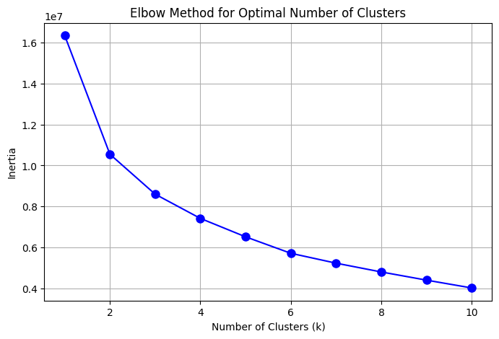
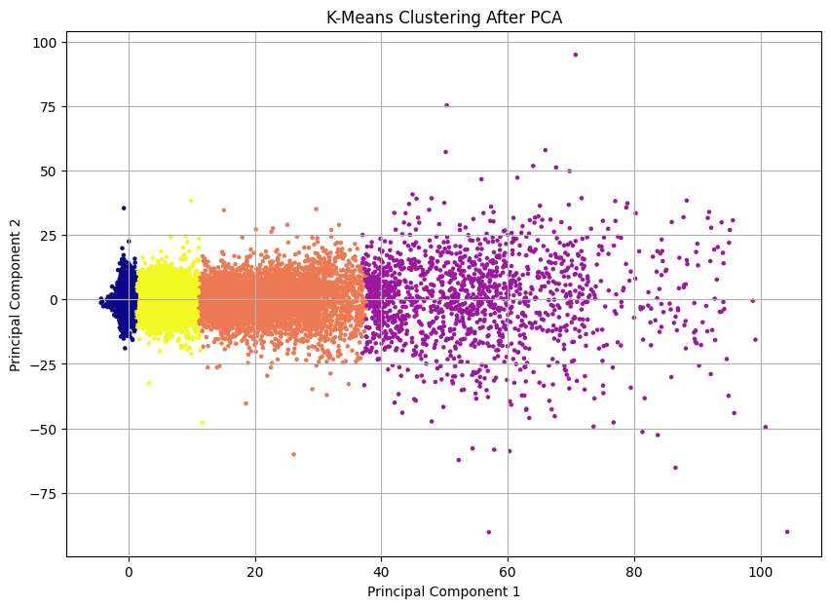
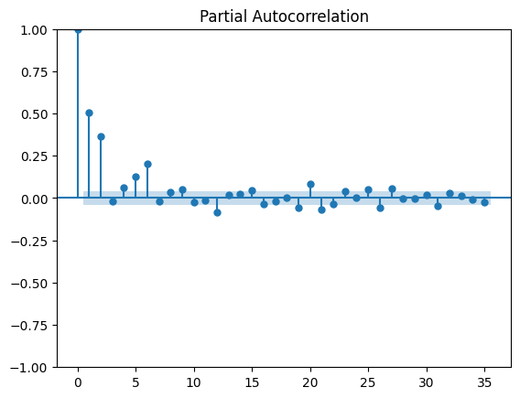
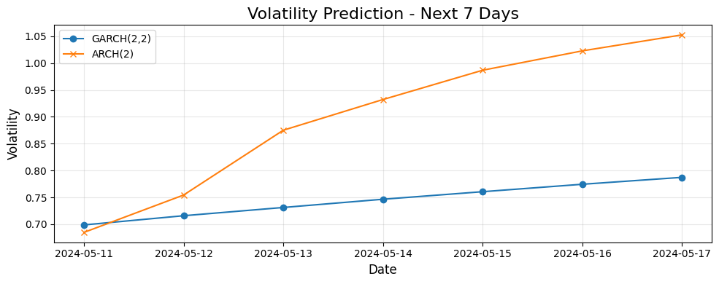
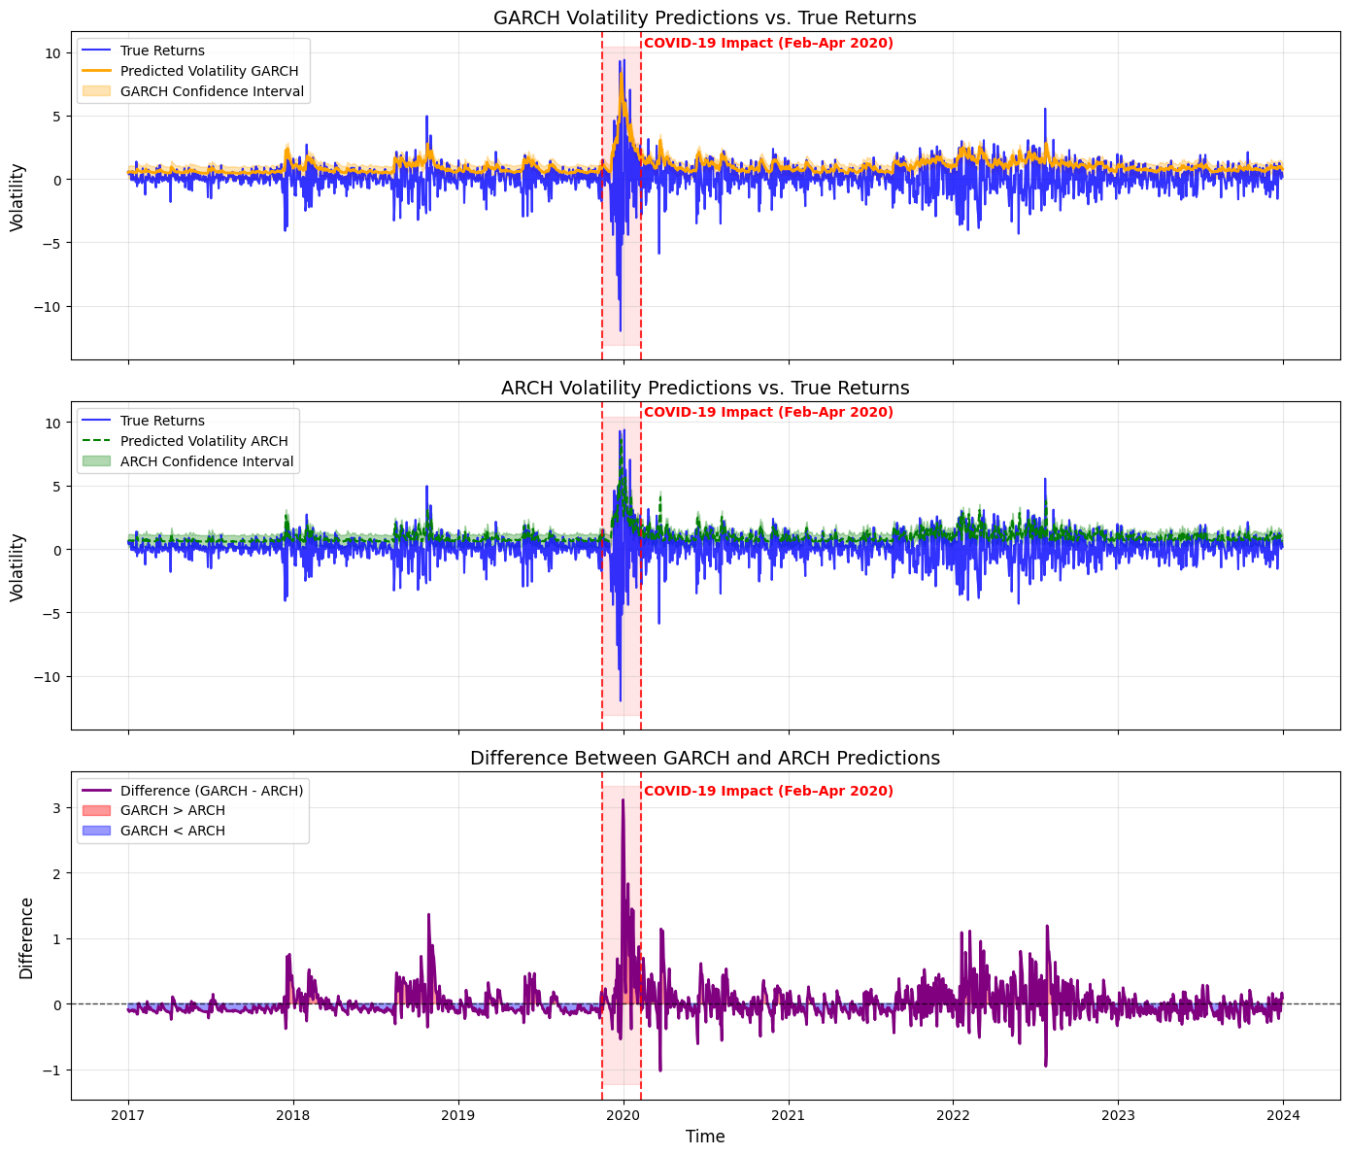
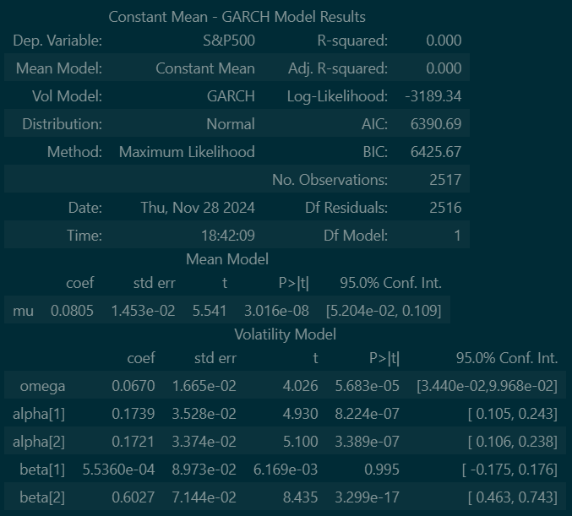
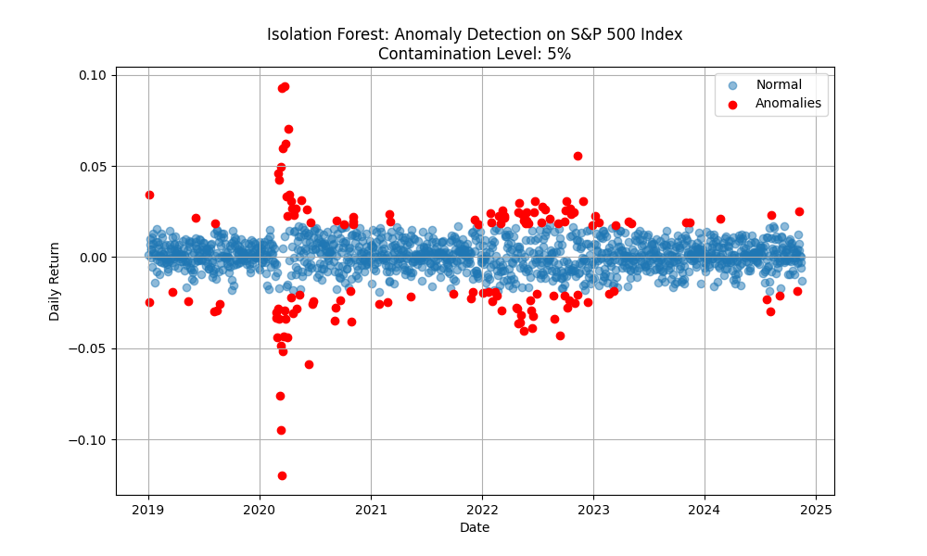
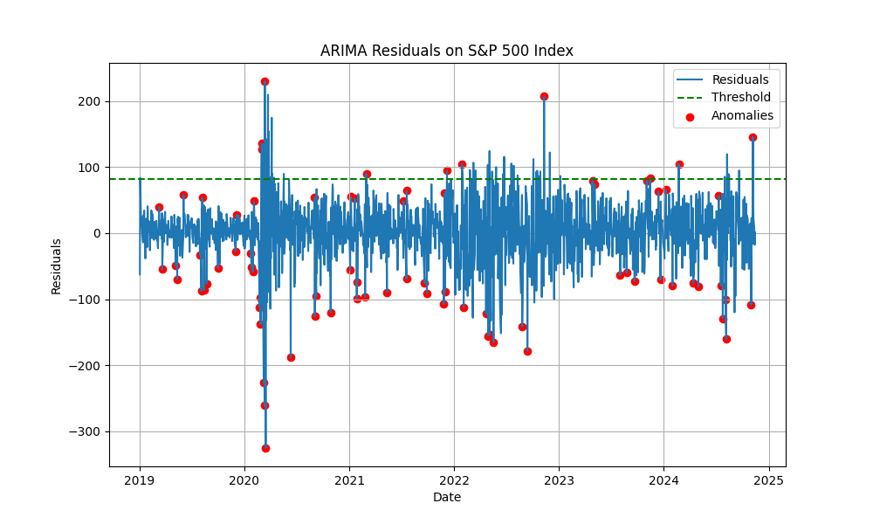
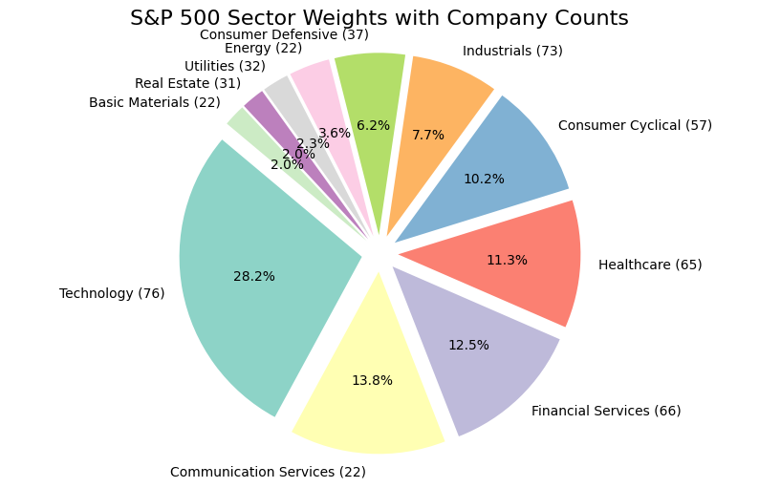
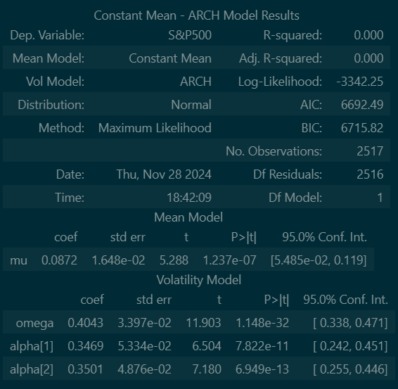
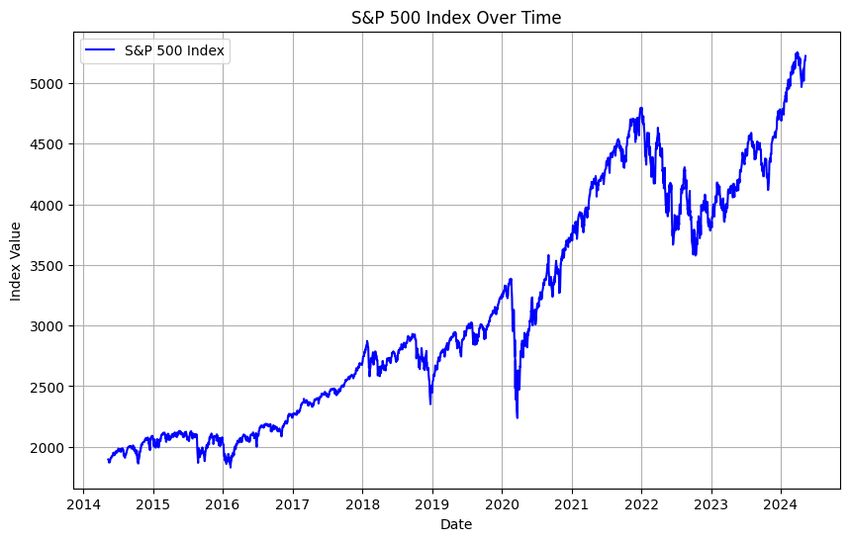
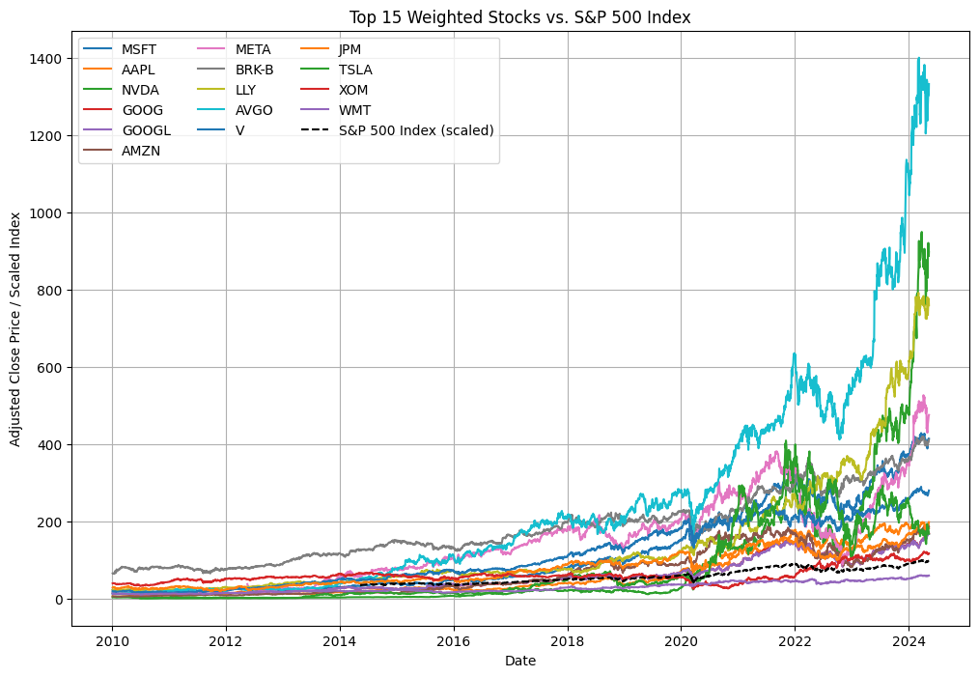
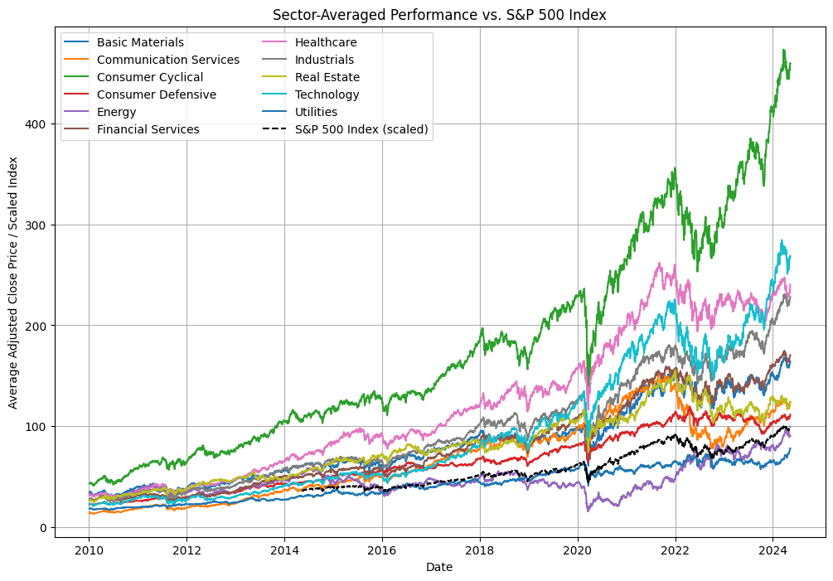
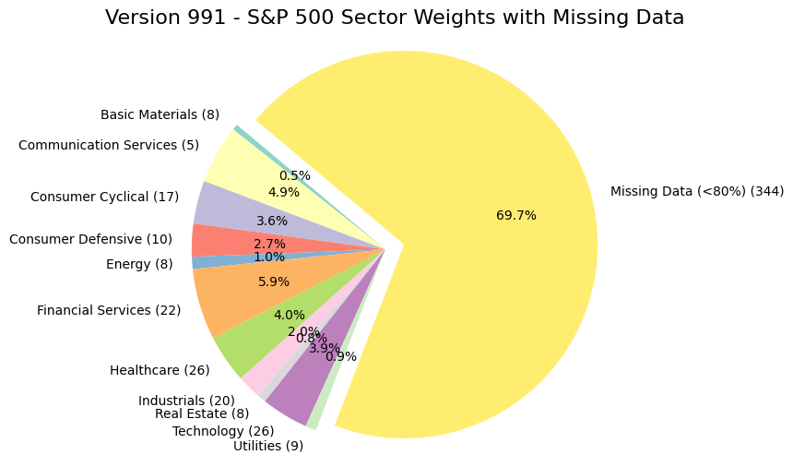
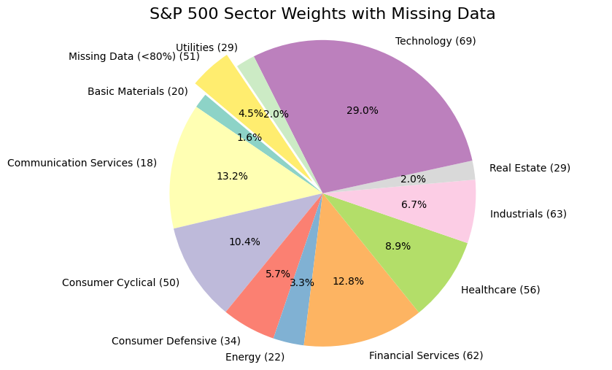
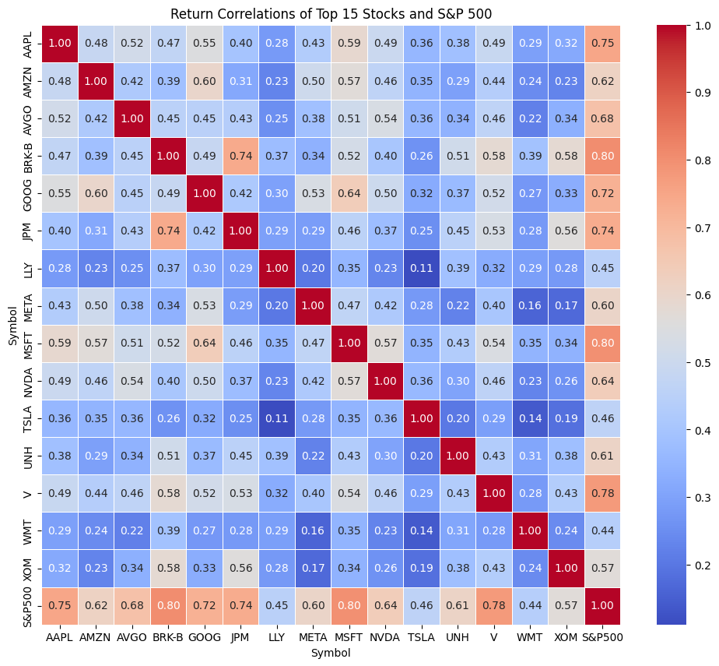
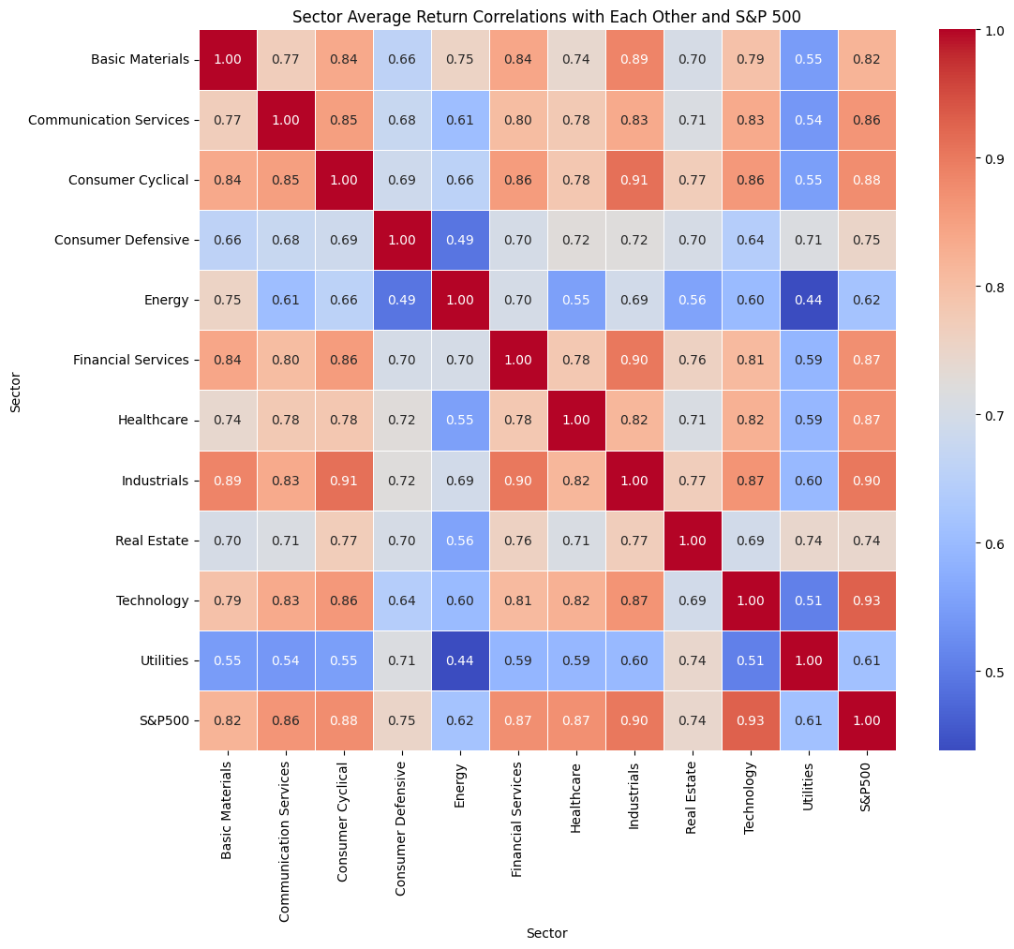
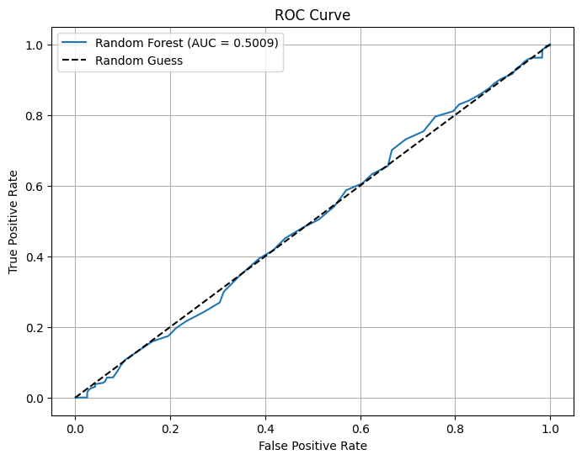
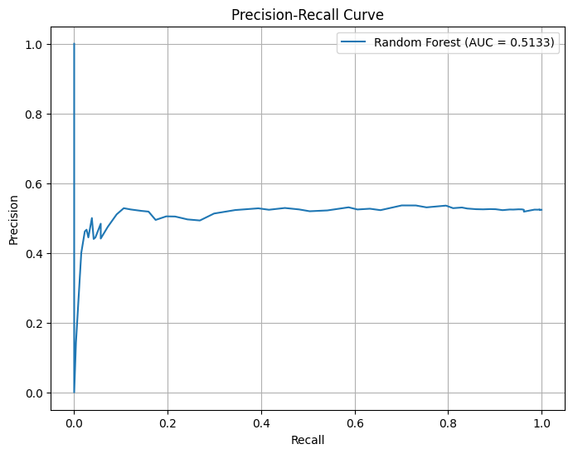
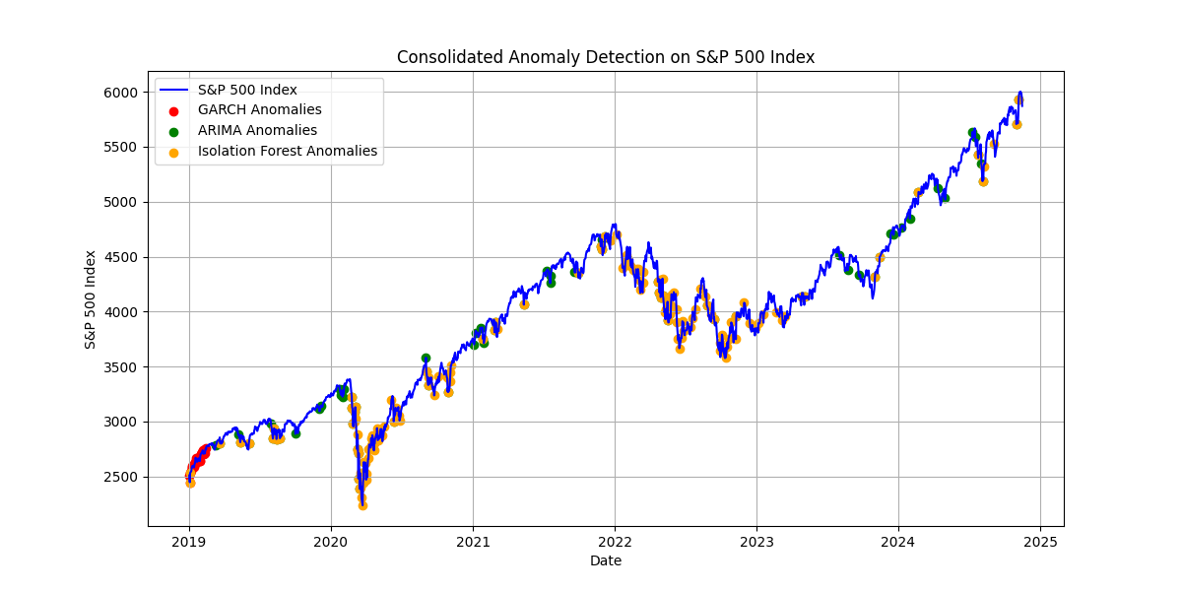
The XGBoost and SVM models were evaluated for predicting the daily movement of the S&P 500 index. XGBoost achieved a test set accuracy of 49.21% and an average cross-validation accuracy of 49.43%, with a balanced classification performance across classes. Class 1 (price increases) had a precision of 51% and recall of 56%, while class 0 (price decreases) had a precision of 46% and recall of 41%, resulting in a macro-average F1-score of 0.49. SVM outperformed XGBoost in accuracy, achieving 51.98% on the test set and 52.36% in cross-validation. However, SVM exhibited a strong bias toward predicting price increases, with a precision of 52% and recall of 95% for class 1, while severely underperforming for class 0, with a recall of only 4%. These results highlight that while SVM achieved higher accuracy, it struggles with class imbalance, and XGBoost provides more balanced predictions but lacks sufficient discriminative power, underscoring the need for improved features and class balancing techniques
S&P 500 Analysis
Clustering – Kmeans (4,42,10), PCA(2)
Forecasting – (G)ARCH (2,2) and (2,0)
Kyle Mollard
Introduction
The objective of this project is to provide data analysis in the S&P 500 Index using a combination of data mining algorithms and applied times series. The S&P 500 is one of the most widely monitored financial indices, and anomalies in its performance often coincide with major economic events. Detecting these anomalies and trends provides valuable insights into market risk, investor behavior, and economic conditions.
Davies-Bouldin Index: 0.969
Datasets, Preprocessing, and EDA
Outlier Detection - Isolation Forest and ARIMA
This section explores the datasets; finding their composition, weight, validity, and correlations. Version 960 of the dataset was chosen (2024-05-10).
Feature Selection - RFE, Lasso, and Mutual Information
The feature selection methods—RFE, Lasso, and Mutual Information—consistently identified Momentum as a key feature, with RFE and Lasso also selecting Volume and Return, while Mutual Information chose Volatility and 5Day_MA. All methods achieved similar accuracy (~53%) but heavily favored predicting price increases (class 1), with high recall (~95-98%) and poor performance on price decreases (class 0). These results highlight the need for better features, such as lagged values or external market data, and techniques to address class imbalance for improved performance.
Hyperparameter Tuning
XGBoost achieved a test accuracy of 49.21% and balanced performance across classes, with precision and recall of ~50% for both price increases and decreases. SVM performed better overall, with 51.98% accuracy, but was heavily biased toward predicting price increases, achieving 95% recall for increases and only 4% for decreases. Hyperparameter tuning further revealed that simpler configurations, such as SVM with a linear kernel and XGBoost with shallow trees and a low learning rate, perform best, yielding slightly improved cross-validation accuracies (53.99% for SVM and 53.65% for XGBoost). These results highlight the need for more informative features, addressing class imbalance, and incorporating external data to improve predictive power and model performance.
Classification
In this project, k-Nearest Neighbors (k-NN), Logistic Regression, and Random Forest were applied to predict the daily movement of the S&P 500 index based on features such as trading volume, daily returns, volatility, and momentum. While Logistic Regression achieved the highest accuracy (53.97%), it exhibited significant bias toward predicting price increases. Both k-NN and Random Forest showed balanced performance across classes but with accuracies close to random guessing. Feature engineering added technical indicators (e.g., moving averages and momentum), yet these features did not capture sufficient predictive power.
Conclusion and Future Investigations
This project highlighted the challenges of applying data mining algorithms to time series stock market data, which is heavily influenced by qualitative and external factors. Despite these difficulties, meaningful correlations were identified, particularly among stocks within the same sector and between the weighted components of the S&P 500 and its overall value. While the current models provided limited predictive power, further improvements could be achieved by integrating advanced forecasting tools like Prophet, exploring more robust feature engineering, and employing ensemble methods to capture non-linear patterns. These steps would enhance the ability to contextualize and predict stock market trends effectively.
References
Larxel (2024). “S&P 500 Stocks (updated daily).” Available. https://www.kaggle.com/datasets/andrewmvd/sp-500-stocks.
Ritvik Kharkar (2020). “ritivikmath”. Available. https://www.youtube.com/@ritvikmath.
[1] Charu C. Aggarwal, Data Mining: The Textbook, Springer, 2015. Available: https://www.springer.com/gp/book/9783319141411
[2] Jonathan D. Cryer and Kung-Sik Chan, Time Series Analysis: With Applications in R, 2nd ed., Springer, 2010. Available: https://www.springer.com/gp/book/9780387759586

