Slide 1
CEIS 200: Software Engineering I
Project Report Requirement Specifications
Professor Messaoud Laddada
Group One: Nathalie Davis, Kamil Moralewski, Phillip Tette

Slide 2
Project Level Summary Evaluations
Session One - Requirements
What would you do better or differently?
Restructure for optimal readability and flow
Add notes to track progress and working model for future developments
Thoroughly consider all use cases and additional design requirements to mitigate future redevelopments and better invest work efforts.
Full team involvement reviewing SRS to make sure everyone is on the same page to avoid all confusion and misapprehensions.
Provide customers the opportunity to share their thoughts on how the software feels and what they would like added or tweaked.
What was the quality of the tools and techniques?
Visio is an excellent tool that enabled us to create use case and UML class diagrams providing and easy to follow outline.
Are the requirements clear?
Our requirements are clear, and our use case diagram clearly shows the flow and purpose of our application.
What are the strengths and weaknesses?
Strengths
Comprehensive definitions listing
Clear work breakdown structure diagrams
Descriptive software resource section
Followed IEEE-830 format
Good communications plan
Weaknesses
Could optimize the use case diagrams with more information explaining in simpler form but greater detail, how users would interact with the application.
The logical order of classes needs to be reworked for flow purposes.
What are your recommendations or suggestions?
A fully fleshed out, but well written example of this process from start to finish as a reference point. Reasoning behind this statement is creating these deliverables from an extremely inexperienced standing makes it too easy to develop incorrect perceptions and assumptions or worse habits.
*It is worth nothing that this isn’t a cookie cutter process and may vary greatly from project to project.

Slide 3
Project Level Summary Evaluations
Session Two - Analysis and Design
What would you do better or differently?
Consistent communication to discuss and explain thoughts and ideas.
  Frequent quality checks i.e., validate and criticize each other's work.
Investigate product use thoroughly to enable effective planning processes.
  Play through the motions of every actor for the software (use cases).
Background checks to prevent inadvertent support to:
  Puppy mills
  Solicitation
Legal considerations, what licenses are we and the vendors who use our platform needing to prevent lawsuits and illegal activities.
Do they have a good understanding of key risks for their projects and how to mitigate risk (external and internal)?
Given the scope and potential scale of the project, there are many risks.
The key risks are:
Preventing puppy mills from operating on our platform (external)
Availability of animals (external)
Poor customer reception (internal/external)
*Each of these risks have the potential to cause irreparable long-term damage to the image and performance of the application.
What additional risks would you consider for the project?
Not researching competitors.
Attempting to merchandise too soon could backfire.
Gaining a deeper understanding for system designs and SRS.
Are we providing our own hardware or relying on PaaS to run our software, and what costs would this incur.
Unforeseen legal issues.

Slide 4
Project Level Summary Evaluations
Session Three - Testing
What would you do better or differently?
Research corresponding tools and libraries to conduct applicable tests covering full spectrum application functions. In reference to Django testing familiarize ourselves with the frameworks being used. Put our tests into classes as methods so that they work with unit test. Will be using a series of special assertion methods in the unittest.TestCase class instead of the built-in assert statements so that means we need to be familiar and better prepared when we reach this step.
Do you get a good understanding of their testing process or the thoroughness of their testing? Yes, or no, Explain either way.
Yes, specified test methods have been identified for all frameworks throughout our web application.
Is there traceability from requirements?
Yes, not only will all the testing being done be monetizable, but all automated testing will be automatically inputted into a systems folder within the database.
Do they have a test plan and test cases? If so, describe the quality. How do they apply to the three testing concepts of verify, validate, and explore?
There are several methods to be employed on the application. Targeting all testing components..
Exploratory testing: Checking the features and experiment using them. Form of manual testing, done without a plan, exploring application.
Complete set of manual tests: list of all the features within our application with the different types of input it can accept, and the expected results. (Cross checking all items on list after changes are made)
Automated testing: Execution of test plan Chronological through script. Verifying desired inputs and outputs.
Unit Tests: Write unit tests for all built-in functions.
Unittest: Utilize unittest test cases and the unittest test runner: The principles of unittest are easily portable to other frameworks for future flexibility.
Django: Test how web applications works on unittest to validate code you’re going to be using in a web application. The routes, views, and models require imports.
How would your new functional requirements for the project impact the testing process?
Sadly, all great things take time to build righting tests along with code will be very intensive and time consuming. The knowledge gap learning to write tests properly will be the biggest challenge. Along with methods and syntax.

Slide 5
Use Case Diagram

Slide 6
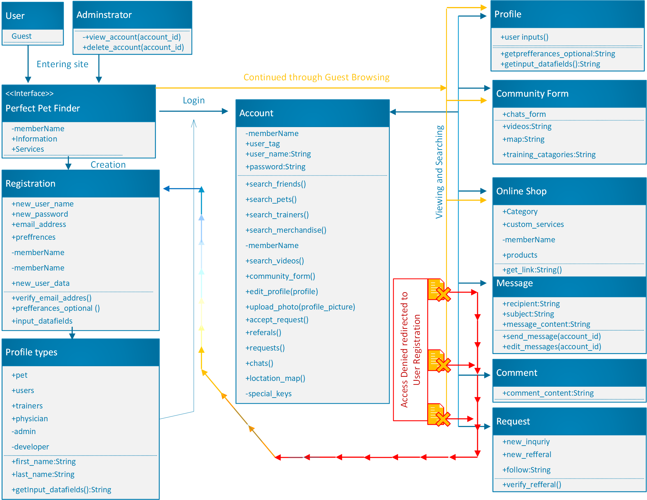
Class Diagram

Slide 7
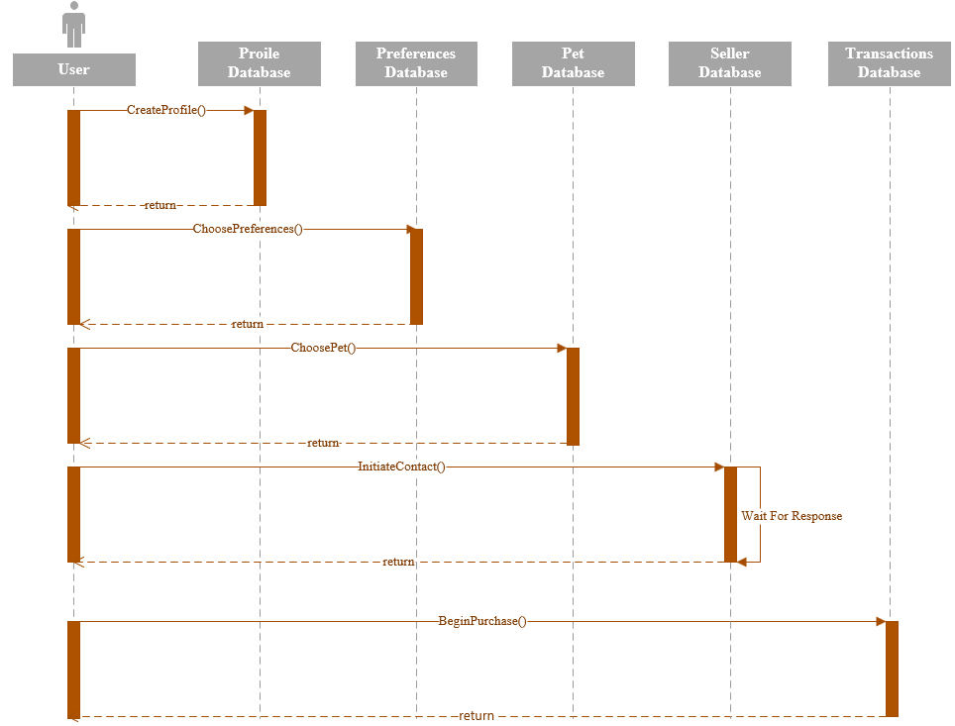
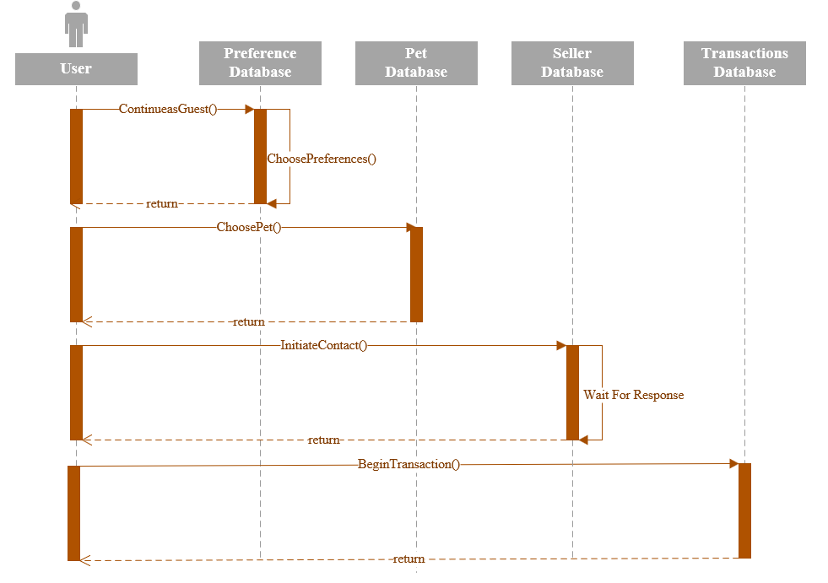
Sequence Diagrams
Registered User
Guest User

Slide 8
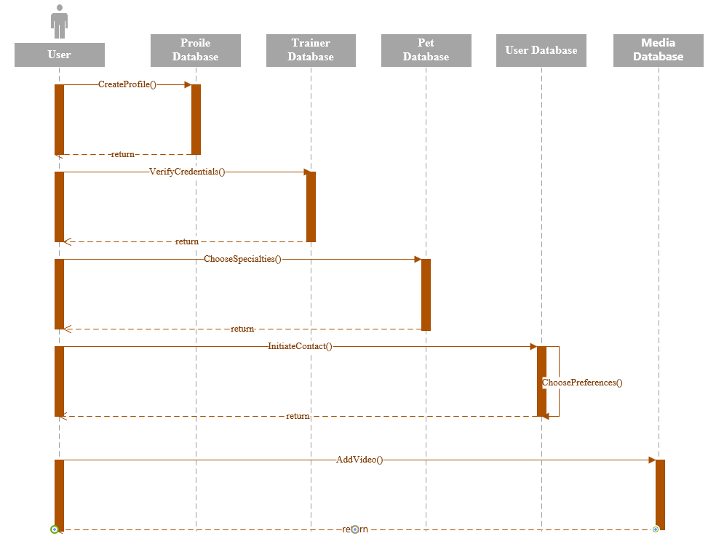
Sequence Diagram
Trainer

Slide 9
State Machine Diagram

Slide 10
Risk Analysis
The risk assessment matrix is designed to enable the user to objectively rate risks based on the severity and likelihood of varying events or circumstances. By providing the user with a visual reference as seen below, it is much easier to prioritize efforts of mitigation to the most appropriate and relevant risks.
Risk Probability/Severity RMMM
1. Inexperienced Engineering Team A/IV (RAC 3) Extensive research, teamwork
Risk Assessment Matrix |  | Probability (Likelihood)
 |  | A ⋜ 80% | B ⋜ 60% | C ⋜ 40% | D ⋜ 20%
Severity (Impact) | I | 1 | 1 | 2 | 3
 | II | 1 | 2 | 3 | 4
 | III | 2 | 3 | 4 | 5
 | IV | 3 | 4 | 5 | 5
Risk Assessment Codes (RAC)
1 = Critical 2 = Serious 3 = Moderate 4 = Minor 5 = Negligible

Slide 11
Test Plan Overview
Staff:
5 Test Users
5 Test Use Observers
Testing Coordinator
Approach
Design & UI Coding
Development
Quality control
User acceptance
Launch
Schedule
Test cases – 1 week
Review and Adjustment – 1 week
Second round of testing – 1 week
Final review – 1 week
Requirements:
Fill out pet preferences/questionnaires
Location-Based results
Verifying User Profile
Feedback loop

Slide 12
Test Plan Overview
Pass Criteria:
All test cases functional
All buttons and tabs lead to proper destinations
Spelling and punctuation
Follows dependencies
Stays under budget
Fail Criteria:
One test case fails
Buttons lead to incorrect locations
System crash
Hardware overload
Risks & Contingencies:
Inexperienced Engineering Team
Program/Code Quality
Inaccurate cost estimation
All tests must be logged and documented.
Set budget left and right lateral limits.

Slide 13
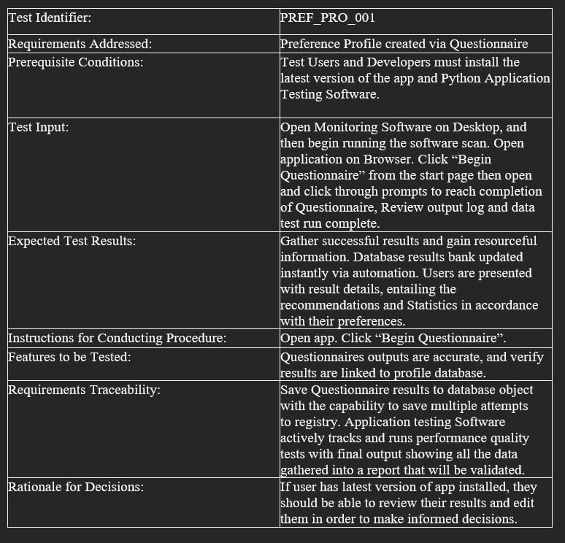
Test Case - Creating User Profile

Slide 14
Individual Evaluation - Phillip
Given my background in the information technology industry, much of what we discussed regarding the software engineering concepts and planning i.e., Scrum and Agile processes were familiar to me.
The scope and level of detail that I discovered throughout the weeks was however very interesting. I appreciate being humbled every now and again, and this project absolutely did that for me. As we began to dig deeper into the requirements, we continued to identify new requirements that should have been considered originally but we had not.
The experience obtained through this class will provide additional insight into project considerations in multiple ways. For example, when creating an application that provides transactions nationwide, what legal requirements exist? Without attempting to create a pseudo application, that thought would not have crossed my mind.

Slide 15
Individual Evaluation - Kamil
This class has opened my eyes into the actual work done by a software engineer. I see how the entire project is a team effort and requires everyone to do their part. Effective communication and proper documentation will avoid someone having guess what something is or means. It is important to follow all codes and regulations to avoid future legal troubles. All stakeholders’ ideas need to be heard and all concerns should be addressed during the planning phase. Setting specific constraints and dependencies will avoid common mistakes. Every team member needs to be ready to adapt to schedule changes and resource or hardware failures. Object-oriented analysis and design diagrams portray the functionality of the app by showing project flow in a flow diagram, all classes and dependencies on a class diagram, and specific use cases on use case diagrams. Collecting metrics can reveal early budget problems and bugs in code that can save time and money. Well-crafted test plans will test all the features and action responses to show the progress and the need for adjustments before final release.

Slide 16
Individual Evaluation - Nathalie
What I learned
What I learned during this Software Engineering course was homed in on the design and structure aspects of Software and application development. Without diving too deep into the subcategories within the Software process I’ll briefly summaries the outlined steps.
Cultivating a team: while I was very blessed with the team, I received in this class 😊.(I’ll miss you guys!). Team building is detrimental for successful builds. Making sure you have competent and capable individuals working alongside you to better you and provide constructive criticism is beneficial beyond measure. Knowing you can count on your teammates to do their part allows you to focus on your part and in turn will result in a great Project. Of course, a system of accountability will always be in place but working with people who are Emotionally astute and socially aware aids in the communication aspects of every step needed to reach the end goal.

Slide 17
References
Boehm, B. W. (1986). A Spiral Model of Software Development and Enhancement. ACM SIGSOFT Software Engineering Notes. doi: 10.1145/12944.12948
Chidamber, S. R., Kemerer, A. (1993). A Metrics Suite for Object Oriented Design. Cambridge, MA: MIT Sloan School of Management E53-315.
Machiavelli, N., Thompson, N.H. (2008). The Prince. New York, NY: Cosimo Classics.
Maxim, Bruce R., Pressman, Roger S. (2015). Software Engineering: A Practitioner's Approach (8th ed.). New York, NY: McGraw-Hill.
Object Management Group (OMG). (2017, December 5). Unified Modeling Language 2.5.1. Retrieved from https://www.omg.org/spec/UML/2.5.1/Links to an external site.

