Slide 1
Exploring Family Factors that Influence Childhood Health Conditions
Presented by Kyle Morehead and Maria Hudson

Slide 2
Inspiration
For years, epidemiologists and public health experts have studied trends in prevalence of many diseases.
In particular, asthma, ADD/ADHD, autism, and behavioral issues have been diagnosed more frequently.
Can looking at the family characteristics around these children help pinpoint causes or situations where intervention can help?

Slide 3
Data Source
The National Health Information Survey is conducted by the CDC each year since 1962
Households are sampled. With in each household, researchers sample one adult and one child. Household and family information are also collected.
Data are published in 6 separate datasets: Household, Family, Sample Child, Sample Adult, Person, and Injury.
Each file for each year has 15,000 – 45,000 records and up to 725 variables!
Different years had data in different format: CSV, fixed-width text file, zip files, and self-extracting zip files.
SAS, SPSS, and Stata programs to aid in reading data files are also published.

Slide 4
Obtaining Data
We downloaded data from the CDC page for the NHIS survey:
https://www.cdc.gov/nchs/nhis/data-questionnaires-documentation.htm
Initially we explored the 2017 data to determine if it would help us answer our research questions.
We determined that we would need the family, sample child, and sample adult file for each year.
Data from 2006 – 2017 were downloaded along with the SAS program to read them in.

Slide 5
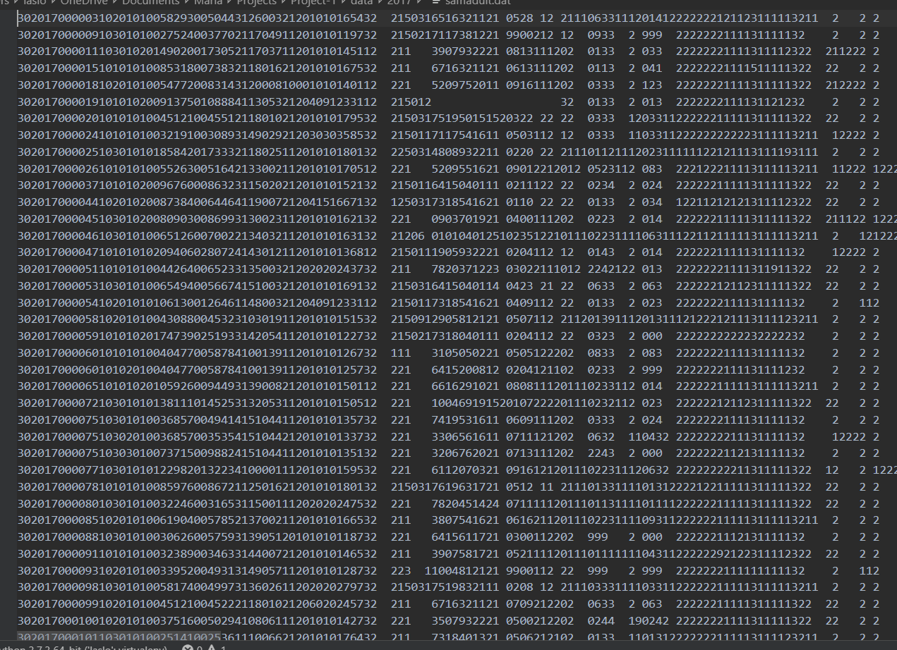
Reading Data into Pandas
Challenging!
Recent years released data as CSV but most years are only available in fixed-with text files.
Here’s what it looked like:

Slide 6
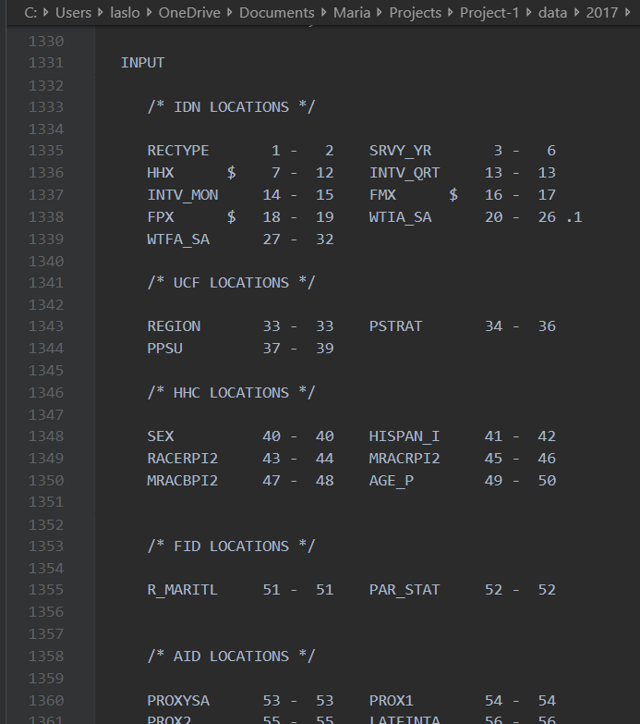
Reading Data into Pandas (Continued)
What we had: Ready-made programs for SAS, Stata, and SPSS but nothing for Python
What we did: Used Python to read the SAS program in as a text file
We located the input statement that told us where each variable started and ended on the flat file.
In case you’re wondering… this is what an input statement in SAS looks like:

Slide 7
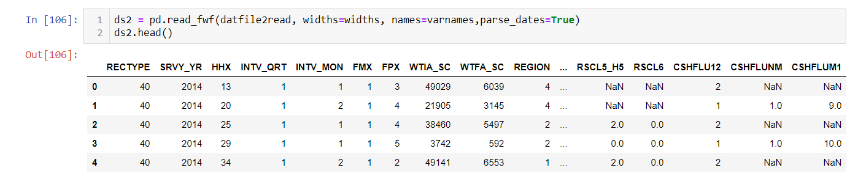
Reading Data into Pandas (Continued)
Fortunately, plain text is kind of easy to deal with and any program is just a plain text file.
We located the input statement that told us where each variable started and ended on the flat file.
We put that information into a list that we could feed into a pandas function.
So now, one line of code read in all that gobblygook!
Because we had the SAS program for each year, we could now read in any year we wanted to!

Slide 8
PHEW! Oh wait.. We’re not done…

Slide 9
Analyzing the Data– One step forward… two steps back
We found that not all years had the information we needed.
In particular, the food-security questions in recent surveys did not exist in earlier ones and we had to re-think that analysis.
There were several survey design changes over the years that made recent data different enough from the earlier years that we couldn’t trend backwards past 2006.
We had to reduce the scope of what we wanted to do initially.

Slide 10
Analyzing the Data– Getting there…
Instead of food-insecurity questions found on recent surveys, we used the ratio of family income to the poverty level to determine if a family lived in poverty.
If the sampled adult was a current smoker, we considered the house a smoking household.
If the sampled child had any of the conditions we were interested in, we considered the household to have that condition present.
LIMITATION– We are almost certainly undercounting both the smoking households and the households with each condition.
BONUS– If we find significant relationships, we can be very certain of that significance since the actual rates are likely higher.

Slide 11
Significance Testing
We used paired t-tests to determine if the difference in condition prevalence between smoking and non-smoking households was significant.
This assumes that smoking households are independent of non-smoking households.
We also tested the effects of poverty, which assumes that non-impoverished households are independent of impoverished households.
Later we broke up smoking/poverty into four categories to look for confounding effects.
We considered using Chi-Square, but that would have just told us there is a difference between any two of the 4 breakouts.
We tested smoking vs. non-smoking within impoverished households with a t-test. Then we tested smoking vs. non-smoking within non-impoverished households.

Slide 12
Results
As expected, the presence of a smoker in a household had significant impacts on the prevalence of asthma.
Slightly less expected, the presence of a smoker in a household also had significant impacts on the prevalence of ADD or ADHD as well as behavioral and emotional issues.
There did not appear to be any relationship between smoking in a household and autism prevalence.

Slide 13
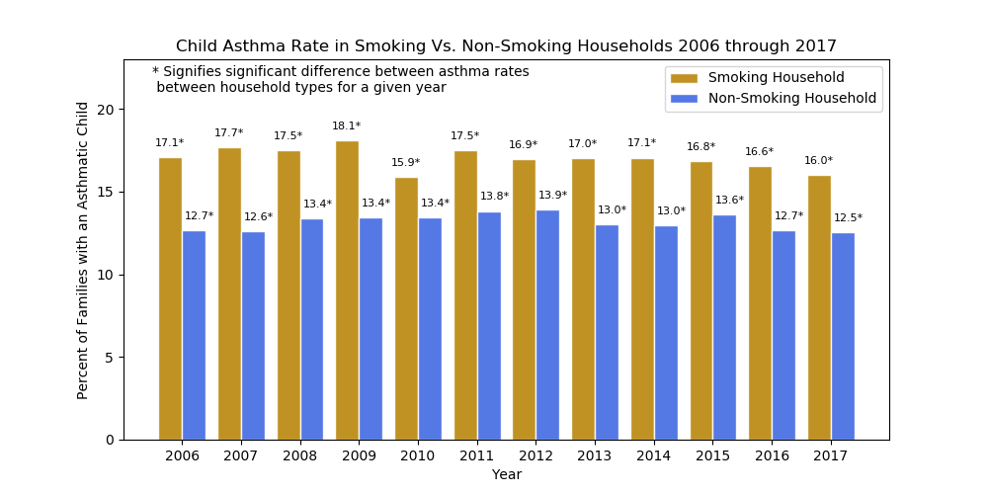

Slide 14
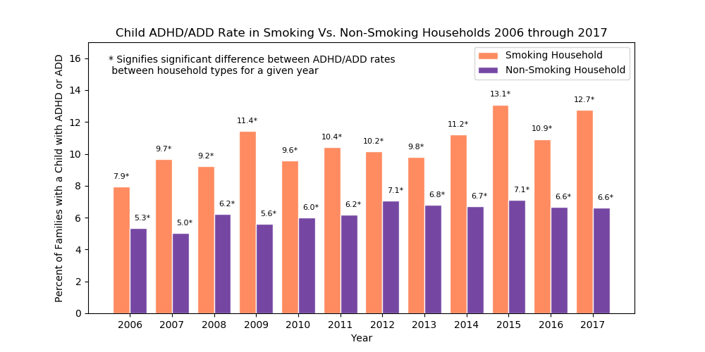

Slide 15
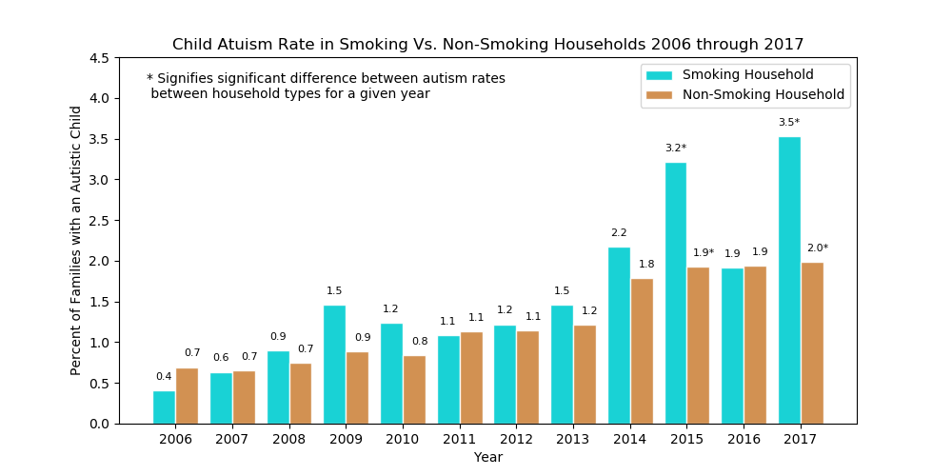

Slide 16
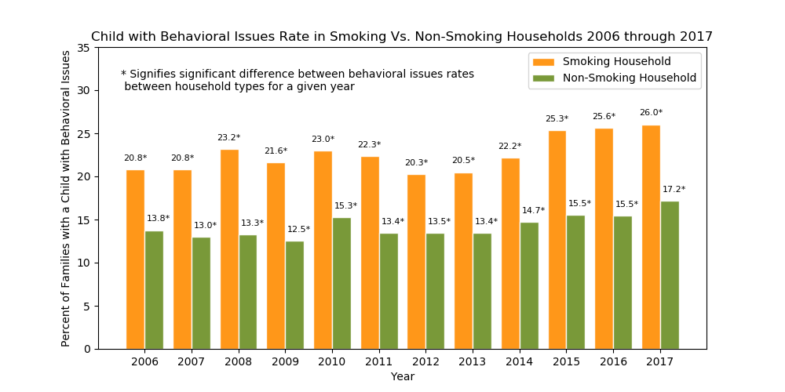

Slide 17
Results
We ran the same analyses by Poverty Status
If a household’s total income was the same or less than the poverty threshold in that geographic area, we considered the household to be impoverished.
The results were similar to smoking households.
The level of significance was not as high (i.e., p-values were lower but still significant)

Slide 18
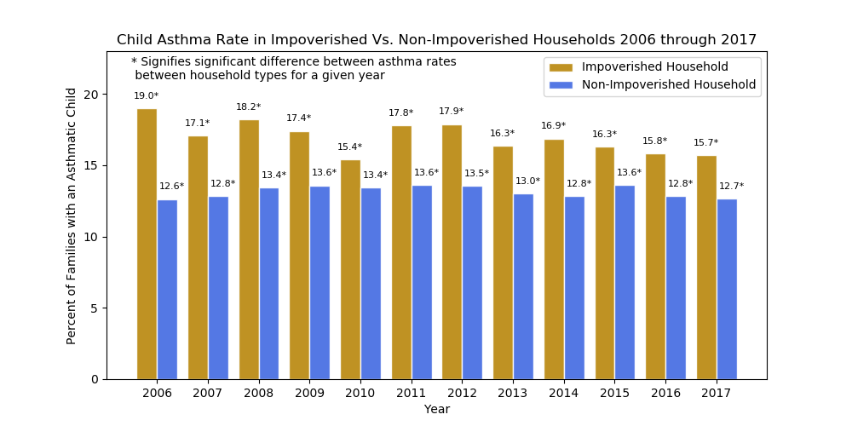

Slide 19
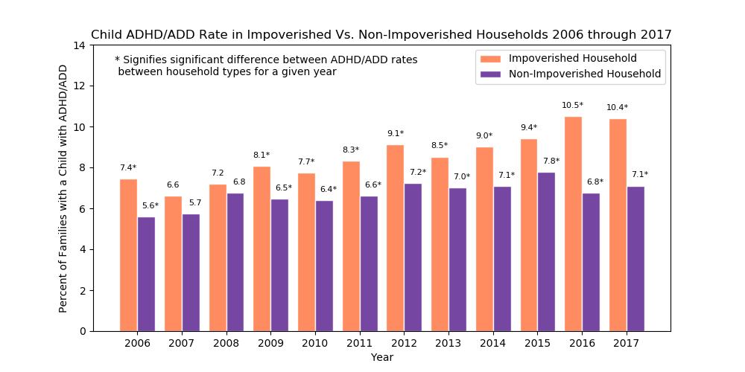

Slide 20
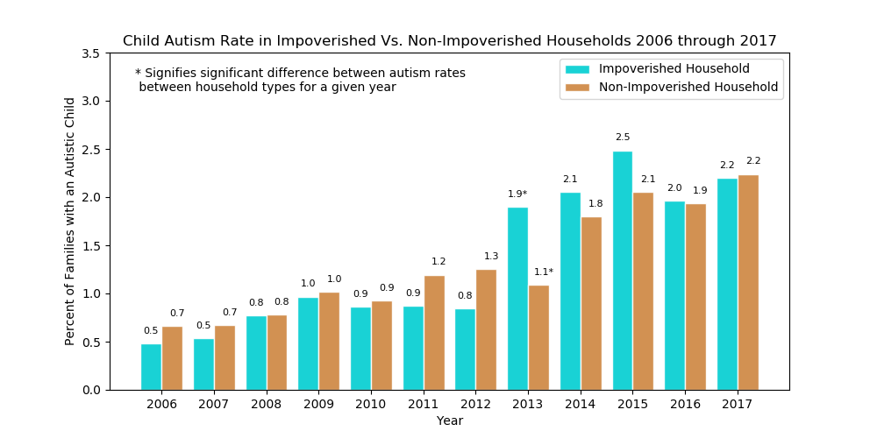

Slide 21
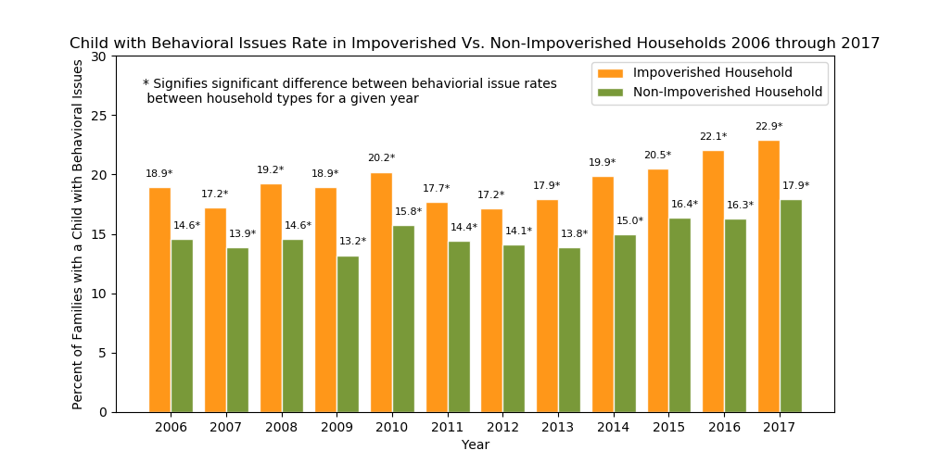

Slide 22
Do we have confounding effects?

Slide 23
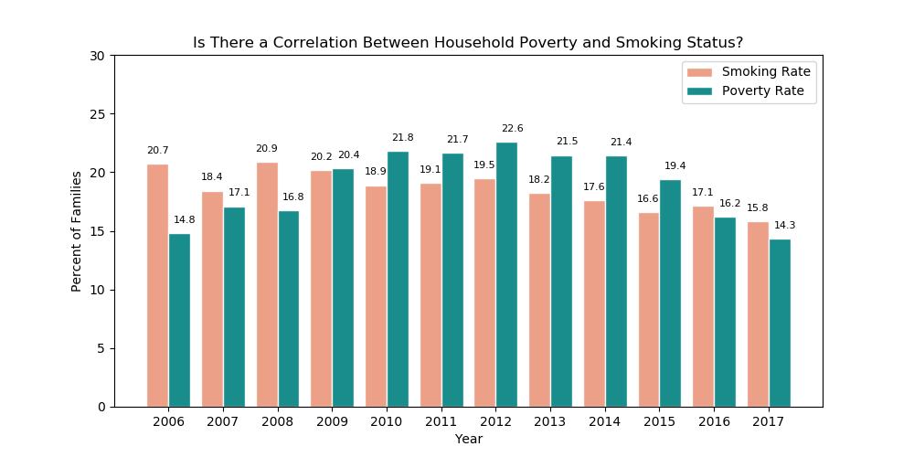

Slide 24
Short Version– Yes There is a Confounding Effect
A quick Google search confirms that public health officials have noted the correlation between smoking and poverty
So, does that invalidate our results?
To see if our results were still significant, we ran by breaking the data frame into four categories:
Smoking, Impoverished Households
Non-Smoking, Impoverished Households
Smoking, Non-Impoverished Households
Non-Smoking, Non-Impoverished Households

Slide 25
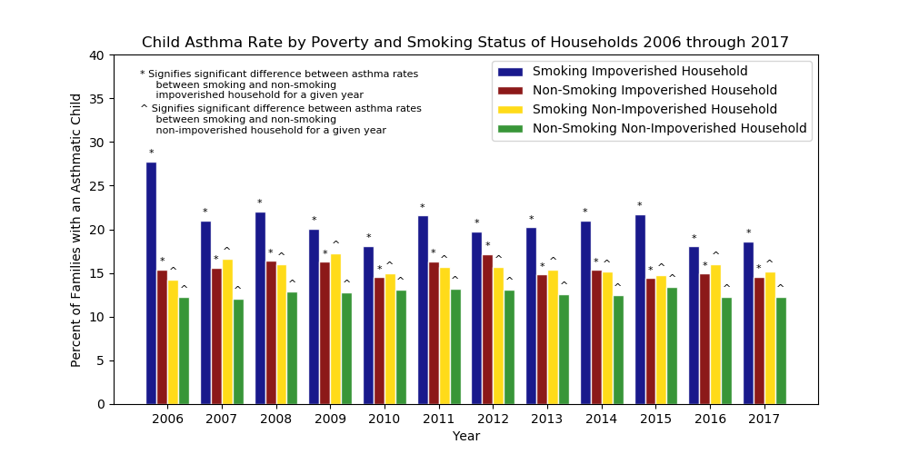

Slide 26
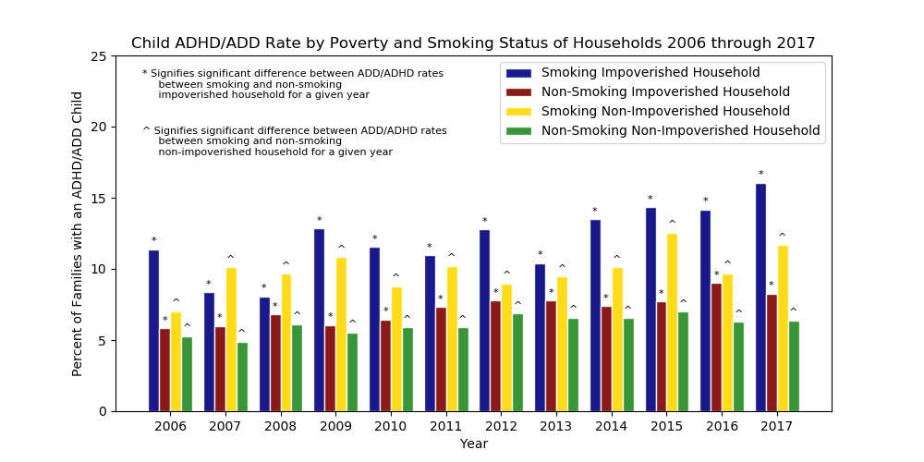

Slide 27
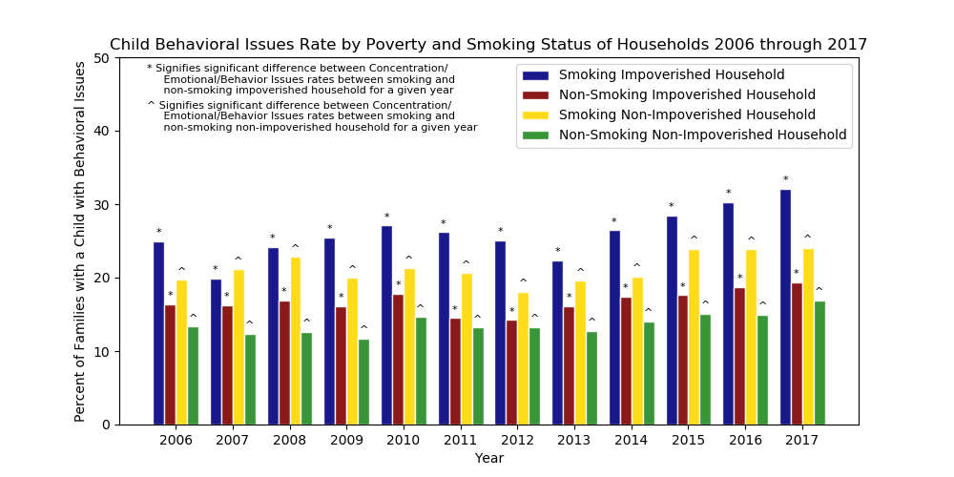

Slide 28
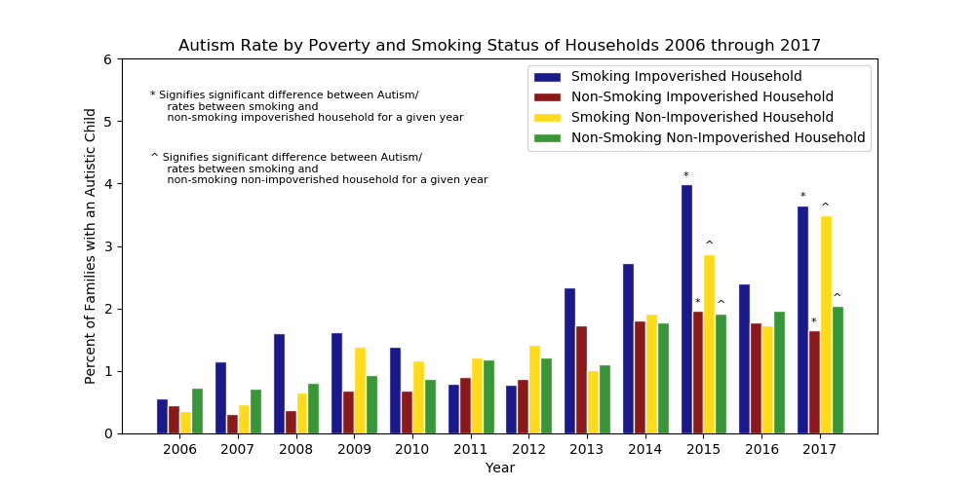

Slide 29
Limitations
Our methods will underestimate the prevalence of smoking and the prevalence of the childhood conditions studied.
We have no way to directly assess the child’s exposure to cigarette smoke. It is possible that an adult smoker will choose to smoke away from the child to minimize impact.

Slide 30
Conclusions
Both smoking status and poverty have significant impacts on the prevalence of asthma, ADD/ADHD, and concentration/emotional/behavioral issues of children living in the household.
Even when separating out poverty from smoking status, the effects are significant.
In fact, it appears that the effects of poverty and smoking are cumulative. Impoverished households generally had the highest prevalence of asthma, ADD/ADHD, and concentration/emotional/behavioral issues.

Slide 31
Conclusions
While smoking and/or poverty appear to have a significant relationship to autism prevalence in some years, most often there is not a significant relationship between these factors and autism.
Intervention strategies should prioritize households that see the largest impact– impoverished household with at least one adult smoker in the family.

Slide 32
Ideas Further Study
While the reasons for smoking’s impact on asthma are known, it is not as clear how smoking impacts a child’s concentration, attention, or behavioral health. Investigation into the causal factors could help design interventions to mitigate these impacts.
Do other childhood conditions see the same influence of family characteristics?
Autism did not appear to be influenced at all, confirming our understanding of this as a genetically-based condition.
We did not study other conditions such as sickle-cell anemia, diabetes, and other conditions that we assumed to be genetic.
Did we miss anything by leaving these out?
Does the amount of smoking or the level of poverty influence the rates of the conditions studied?

