Slide 1

Diverging Color Maps for Scientific Visualization
5th International Symposium on Visual Computing
December 2, 2009
Kenneth Moreland
Sandia National Laboratories
Sandia is a multiprogram laboratory operated by Sandia Corporation, a Lockheed Martin Company, for the United States Department of Energy’s National Nuclear Security Administration under contract DE-AC04-94AL85000.

Slide 2
Motivation
IEEE Computer Graphics & Applications, (27) 3
Borland and Taylor
Rainbow Color Map (Still) Considered Harmful
“The fact that [the rainbow color map] is selected as the default color map in many visualization toolkits encourages its popularity (both within the visualization community and to casual users)… Inspection or documentation indicated that ParaView, Matlab, VisAD, Ensight, Iris Explorer and AVS Express all use the rainbow color map by default.”
Notes:
So I’m eating my lunch reading the latest issue of CG&A…
We got called out. I decided to make a change.

Slide 3
Rainbow Color Map Problems
?
✓
Ware, Information Visualization: Perception for Design, 2004.
Notes:
There are numerous well studied problems with the rainbow color map. Let us review them before continuing.
First problem, ordering. There is no “natural” ordering of hues.
Ordering by wavelength (in the rainbow) has no perceptual meaning. Users may never have learned the order or even be aware that an order exists.
In experiment by Ware, participants given paint chips and asked to put in order.
For saturated hues, there was no consistency in ordering.
Some ordered by rainbow, but no more than other schemes. Some were ordered by brightness. Some ordered alphabetically. Some were random.
In contrast, grey shades were always ordered by brightness in either light to dark or dark to light.

Slide 4
Rainbow Color Map Problems
Sharp Changes: Introduce Mach band artifacts
Wide Bands: Hide details
Notes:
Second problem: Non-uniform perception.
Our vision sensitive to small wavelength changes around cyan and yellow/orange.
Hue wheel has abrupt changes at pure cyan and pure yellow.
Causes Mach bands to appear: an artificial line to appear at abrupt changes in color.
Mach bands can be helpful in detecting discontinuities or other sharp changes.
But introducing them arbitrarily is distracting and, worse, misleading.
At blue, green, and red, vision insensitive to changes.
Causes wide bands to form. Hides changes in those regions.
Incidentally, hiding happens at min, max, and median of range: often the most statistically interesting.

Slide 5
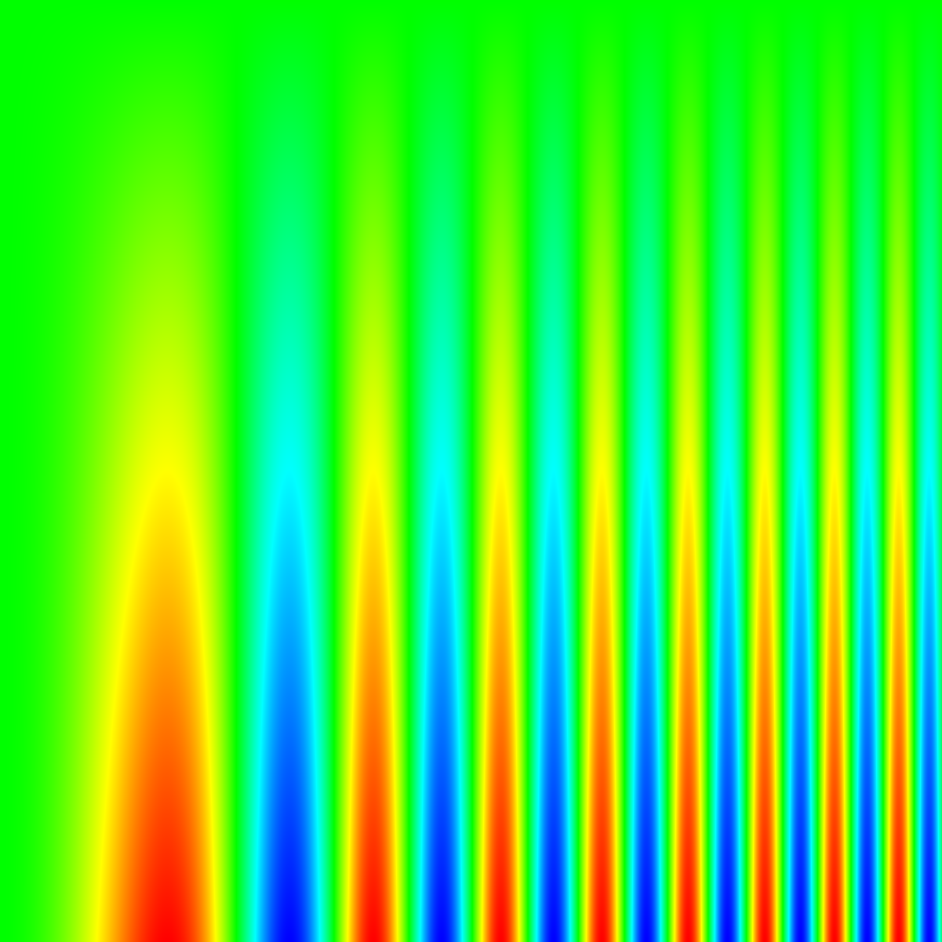
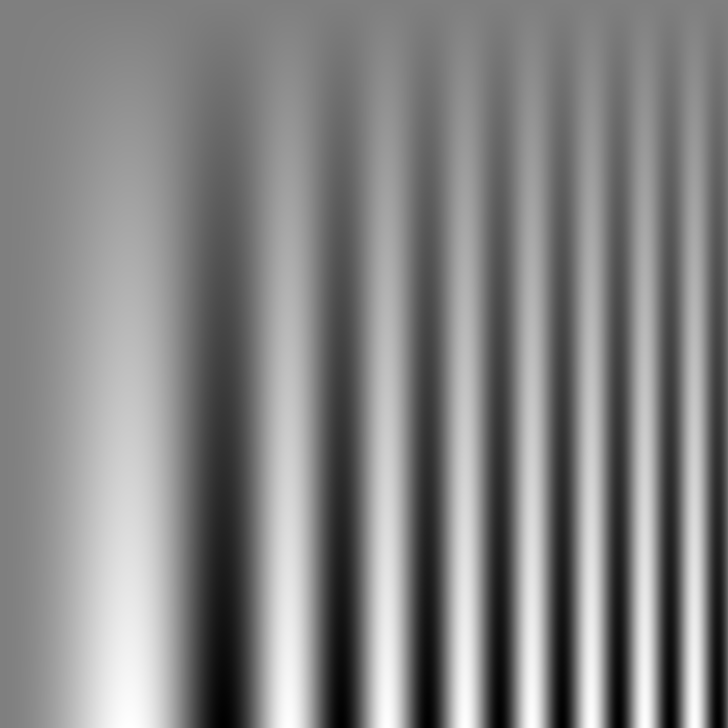
Rainbow Color Map Problems
Notes:
These problems are exemplified by mapping colors to this contrast sensitivity function.
On the horizontal is a sinusoid with increasing frequency to the right. On the vertical decreasing amplitude at the top.
At the top, our insensitivity to changes in green hide the sinusoid at the top, which is clearly visible in the grayscale map.
Those sharp changes in cyan and yellow add odd cone shapes to the image; the grayscale clearly shows that the transition is smooth.

Slide 6
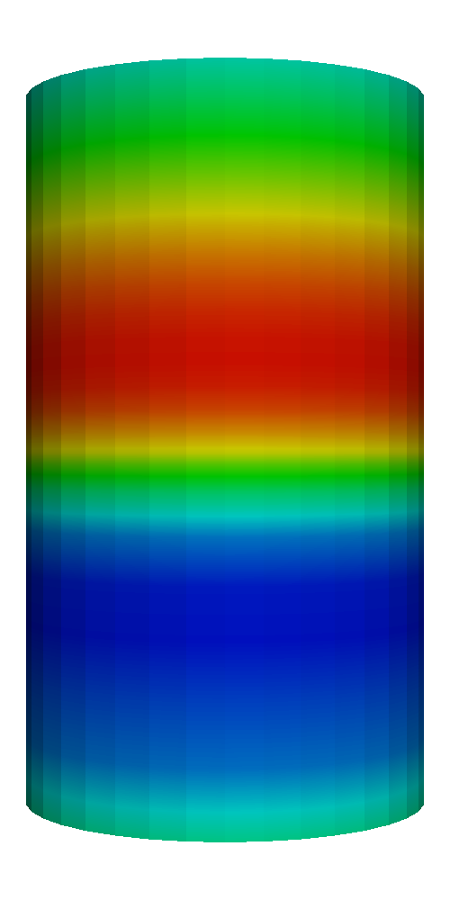
Rainbow Color Map Problems
Original
Deuteranope Vision
(Simulated by Vischeck)
Notes:
Third problem: Sensitive to color deficiencies.
Map relies on all channels of trichromatic vision. However, roughly 5% of the population has only dichromatic vision.
This portion of the population cannot resolve differences between significantly disparate portions of the rainbow spectrum (usually the greens and reds of the middle and high regions).

Slide 7
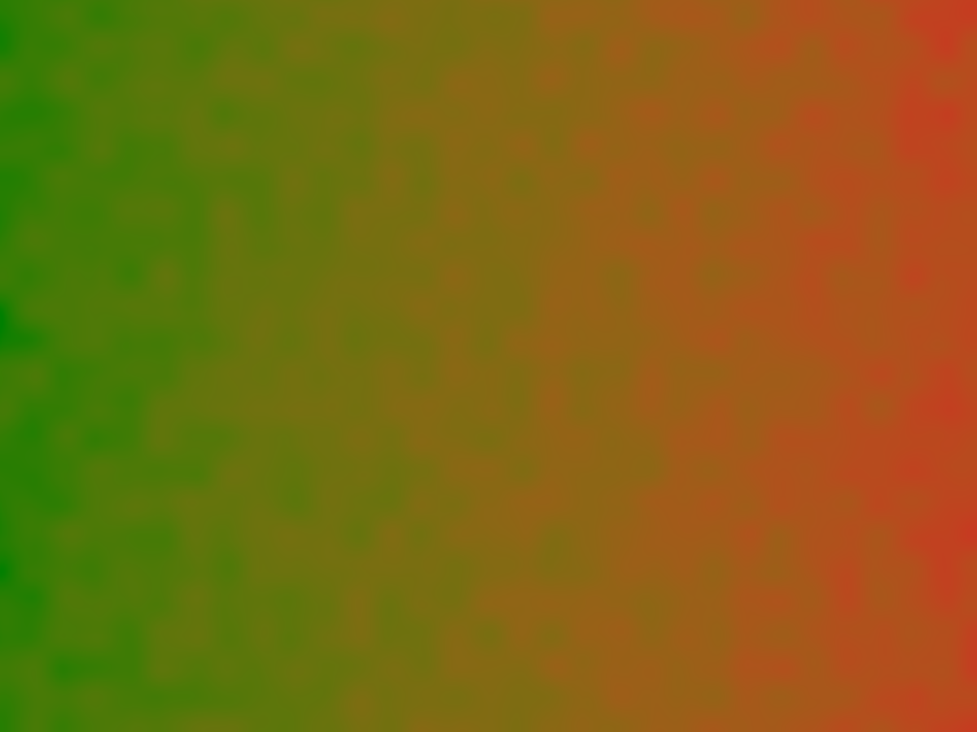
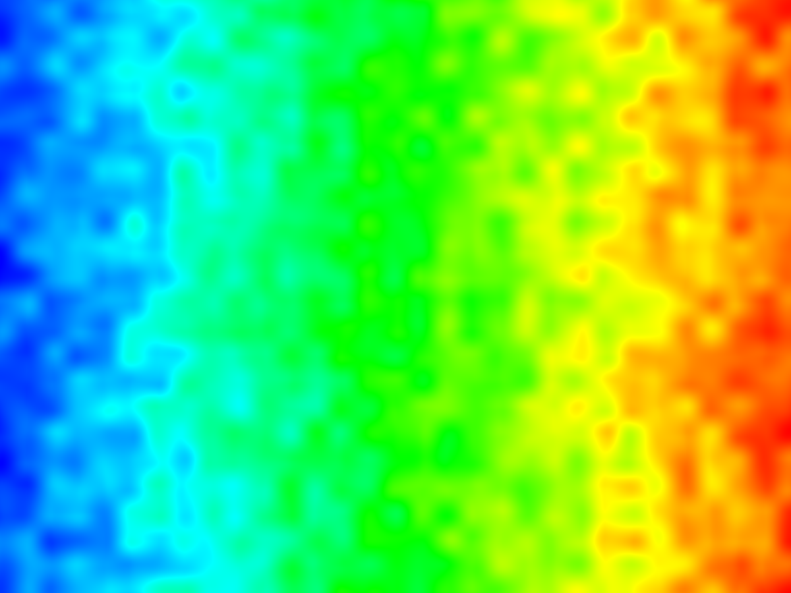
Rainbow Color Map Features
Notes:
One of the good things that rainbow maps do well (although unintentionally) is combine changing hue and luminance together.
Perceptual studies show that changing luminance and color shade together is more effective than either alone.
Get around trappings of either alone.
For example, consider a color map that does not change luminance (an isoluminant map).
High frequency (abrupt) changes do not show up clearly.
Hue changes do not produce Mach bands.

Slide 8
Rainbow Color Map Features
Notes:
On the other hand, luminance, although most effective for low contrast and high frequency signals, has problems with low frequency signals.
Brightness is measured against adjacent nearby values. Varying backgrounds can throw the perceived brightness off by as much as 20%.

Slide 9
Rainbow Color Map Features
Notes:
Hue perception is (mostly) non relative. The large hue swings of rainbow hide any problems with relative brightness.
In the bottom, there is no mistake that the bar is all green (middle value).
Side note: you can clearly see the large region where the bar melds into the foreground bar. Compare that to gray bar, which has a similar equal value in the middle, but the like part is so small that you are probably connecting that Mach band across it.

Slide 10
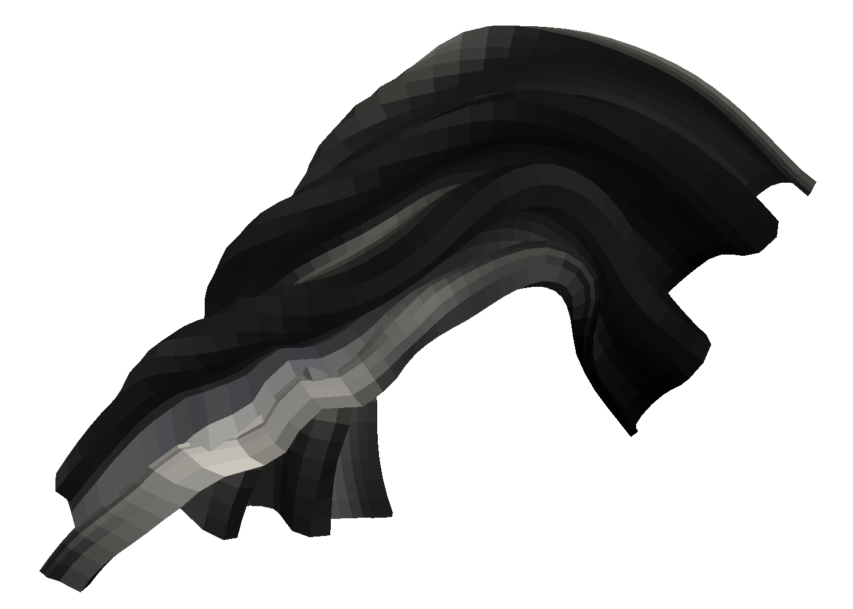
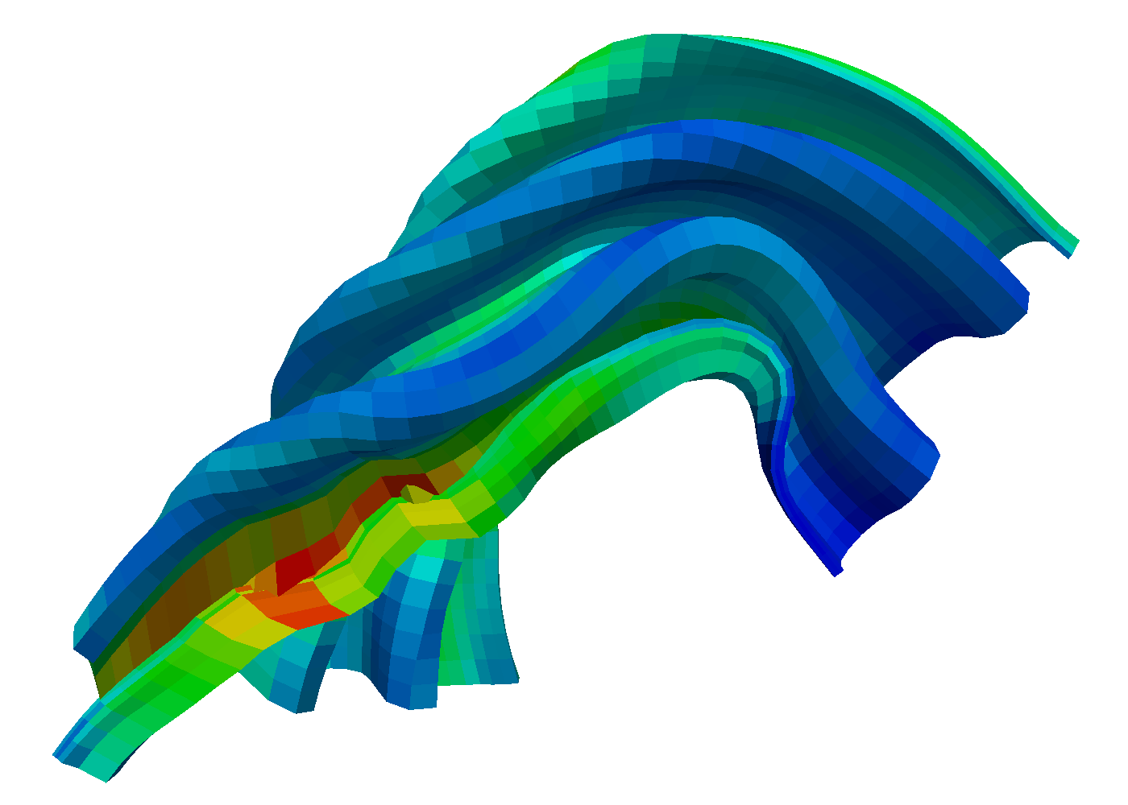
Rainbow Map Features
Notes:
Another vital feature of a color map for many scientific visualization applications is the ability to apply the map to a 3D surface.
The rainbow map performs admirably here.
Shading is the most important cue to 3D shape.
Too large of variance in color map luminance can interfere with shading.
Too dark colors can hide shading.

Slide 11
Rainbow Map Features (Anecdotal)
It looks good.
Notes:
When faced with the question why use the rainbow color map, to most common response I get (assuming it was a conscious decision) is that it creates an attractive picture.
I make no effort to quantify this. It is subjective anyway. (Some users find the saturated colors garish).
In our experience, users will not accept color maps that make images they fell are ugly or dull.
In the past our group experimented with trying to deliver isoluminant color maps. Aside from generally being a bad idea anyway, they just do not look very good.

Slide 12
Rainbow Map Features (Anecdotal)
Now I understand why I like the rainbow band to display temperatures. The rainbow band produces sharper variations even if the images are misleading :)
Notes:
Amalia Black, email correspondence, 10/12/2007.

Slide 13
Rainbow Map Features (Anecdotal)
Bottom 25%
Center 50%
Top 25%
Middle
Notes:
This is an interesting observation. The rainbow color map naturally breaks up the range of values into groups based on these bands that it inadvertently forms.
The rainbow colors naturally break up the range into quartiles that quickly identify the region of the range.

Slide 14
Guidelines for Color Maps
To show detail in a visualization, always have considerable luminance contrast between foreground and background information. Never make the difference only through chromatic variation.
Use only a few colors if they are distinct codes.
Black or white borders around colored symbols can help make them distinct by ensuring a luminance contrast break with surrounding colors.
Red, green, yellow, and blue are hard-wired into the brain as primaries. If it is necessary to remember a color coding, these colors are the first that should be considered.
When color-coding large areas, use muted colors, especially if colored symbols are to be superimposed.
Small color-coded objects should be given high-saturation colors.
When a perceptually meaningful ordering is needed, use a sequence that varies monotonically on at least one of the opponent color channels. Examples are red to green, yellow to blue, low saturation to high saturation, and dark to light. Variation on more than one channel is often better.
If it is important to show variations above and below zero, use a neutral value to represent zero and use increases in saturation toward opposite colors to show positive and negative values.
Color contrast can cause large errors in the representation of quantity. Contrast errors can be reduced with borders around selected areas, or by using muted, relatively uniform backgrounds.
For the reproduction of smooth color sequences, several million colors are needed under optimal viewing conditions. In this case, care must be taken to calibrate the monitor and take into account monitor gamma values.
When reproducing complex, continuously shaded images, it is critical to preserve the color relationships and to make sure that, under the particular lighting conditions, neutral values are perceived as neutral.
Beware of oversaturating colors, especially when a printed image is to be the end product.
Ware, Information Visualization: Perception for Design
Notes:
So, getting back to the original goal: getting rid of the rainbow color map.
I need a replacement.
Review the literature for better choices.
Ware provides these guidelines for choosing color maps.
As a vis expert, I should certainly be cognizant of these, but our end users are unlikely to know all or perhaps any of these.
I cannot rely on anyone, including myself, to always take all these guidelines into account.
What about just a color map?

Slide 15
Suggested Color Maps
From Ware [2004], Rheingans [1999], Brewer [2005], and Stone [2003]
Notes:
There are lots of color maps suggested in literature.
Have different design constraints and their own attractors/detractors
Which one to use? Depends on the situation.
Could provide an array of choices. Picking the right one requires careful analysis using the guidelines shown before.
At some point the application is going to use some initial color map.
Most users, including myself, will just accept this one most (if not all) the time.
We cannot expect it to always be perfect, but we should be able to engineer it to be good (almost) all the time.
THAT is what we are looking for.

Slide 16
Color Map Requirements
The map yields images that are aesthetically pleasing.
The map has a maximal perceptual resolution.
Interference with the shading of 3D surfaces is minimal.
The map is not sensitive to vision deficiencies.
The order of the colors should be intuitively the same for all people.
The perceptual interpolation matches the underlying scalars of the map.

