Slide 1

Diverging Color Maps for Scientific Visualization
5th International Symposium on Visual Computing
December 2, 2009
Kenneth Moreland
Sandia National Laboratories
Sandia is a multiprogram laboratory operated by Sandia Corporation, a Lockheed Martin Company, for the United States Department of Energy’s National Nuclear Security Administration under contract DE-AC04-94AL85000.

Slide 2
Motivation
Notes:
So I’m eating my lunch reading the latest issue of CG&A…

Slide 3
Rainbow Color Map Problems
?
✓
Ware, Information Visualization: Perception for Design, 2004.
Notes:
There are numerous well studied problems with the rainbow color map. Let us review them before continuing.
First problem, ordering. There is no “natural” ordering of hues.
Ordering by wavelength (in the rainbow) has no perceptual meaning. Users may never have learned the order or even be aware that an order exists.
In experiment by Ware, participants given paint chips and asked to put in order.
For saturated hues, there was no consistency in ordering.
Some ordered by rainbow, but no more than other schemes. Some were ordered by brightness. Some ordered alphabetically. Some were random.
In contrast, grey shades were always ordered by brightness in either light to dark or dark to light.

Slide 4
Rainbow Color Map Problems
Sharp Changes: Introduce Mach band artifacts
Wide Bands: Hide details
Notes:
Second problem: Non-uniform perception.
Our vision sensitive to small wavelength changes around cyan and yellow/orange.
Hue wheel has abrupt changes at pure cyan and pure yellow.
Causes Mach bands to appear: an artificial line to appear at abrupt changes in color.
Mach bands can be helpful in detecting discontinuities or other sharp changes.
But introducing them arbitrarily is distracting and, worse, misleading.
At blue, green, and red, vision insensitive to changes.
Causes wide bands to form. Hides changes in those regions.
Incidentally, hiding happens at min, max, and median of range: often the most statistically interesting.

Slide 5
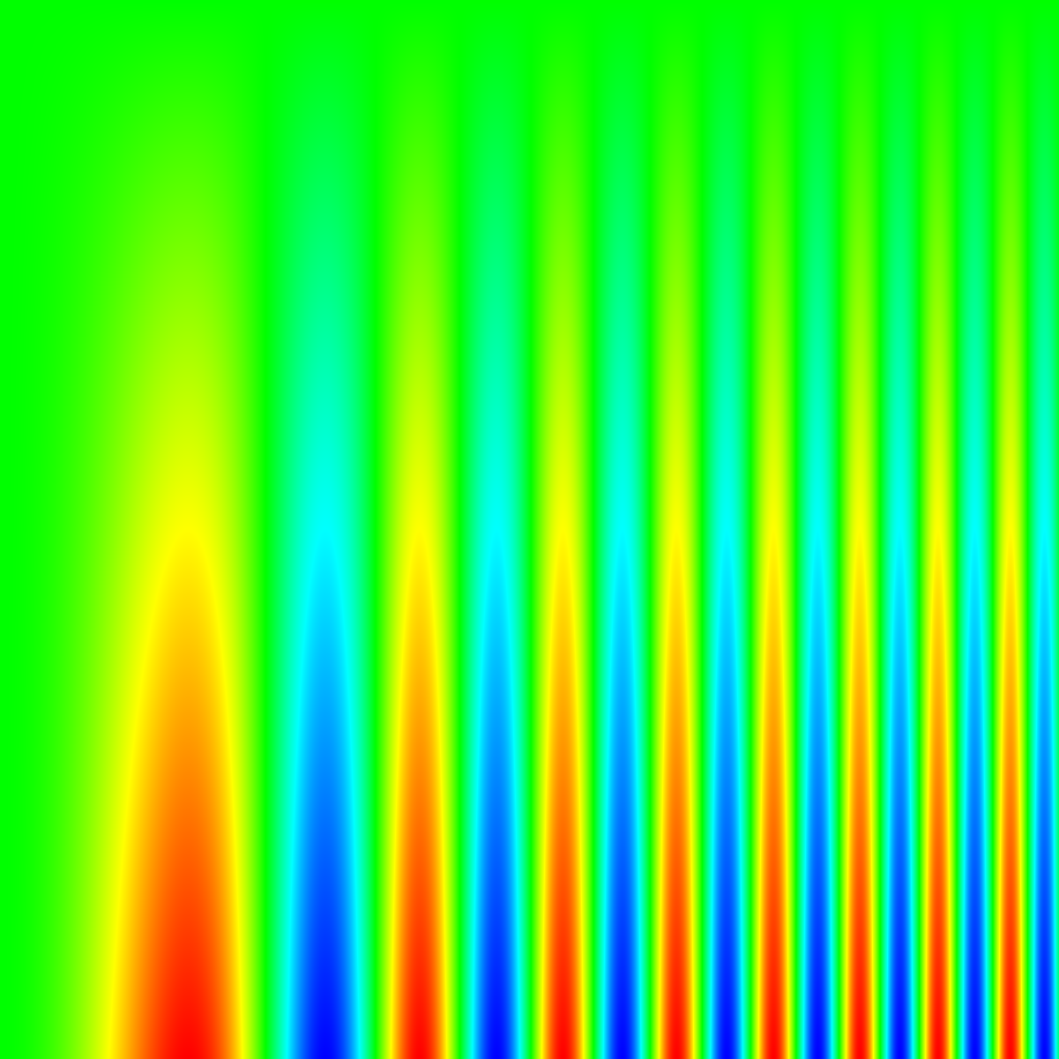

Rainbow Color Map Problems
Notes:
These problems are exemplified by mapping colors to this contrast sensitivity function.
On the horizontal is a sinusoid with increasing frequency to the right. On the vertical decreasing amplitude at the top.
At the top, our insensitivity to changes in green hide the sinusoid at the top, which is clearly visible in the grayscale map.
Those sharp changes in cyan and yellow add odd cone shapes to the image; the grayscale clearly shows that the transition is smooth.

Slide 6
Rainbow Color Map Problems
Notes:
Third problem: Sensitive to color deficiencies.
Map relies on all channels of trichromatic vision. However, roughly 5% of the population has only dichromatic vision.
This portion of the population cannot resolve differences between significantly disparate portions of the rainbow spectrum (usually the greens and reds of the middle and high regions).

Slide 7

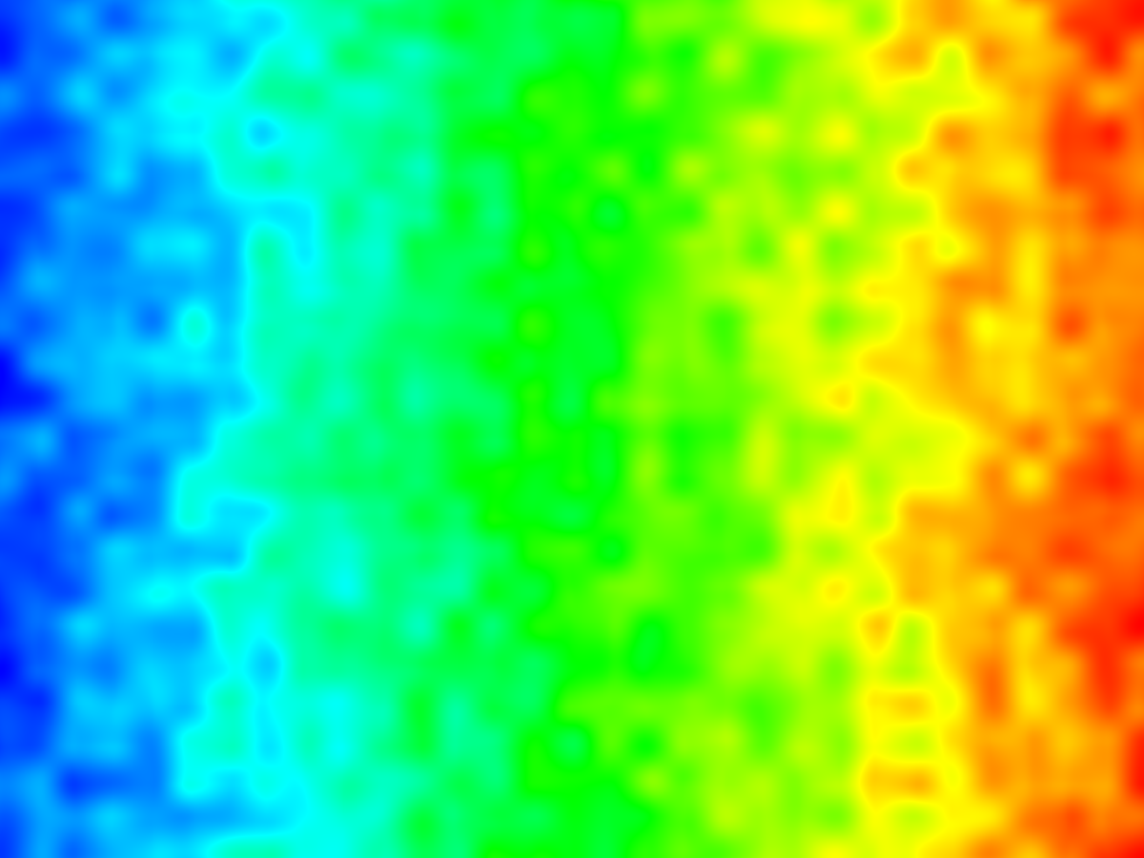
Rainbow Color Map Features
Notes:
One of the good things that rainbow maps do well (although unintentionally) is combine changing hue and luminance together.
Perceptual studies show that changing luminance and color shade together is more effective than either alone.
Get around trappings of either alone.
For example, consider a color map that does not change luminance (an isoluminant map).
High frequency (abrupt) changes do not show up clearly.
Hue changes do not produce Mach bands.

Slide 8
Rainbow Color Map Features
Notes:
On the other hand, luminance, although most effective for low contrast and high frequency signals, has problems with low frequency signals.
Brightness is measured against adjacent nearby values. Varying backgrounds can throw the perceived brightness off by as much as 20%.

Slide 9
Rainbow Color Map Features
Notes:
Hue perception is (mostly) non relative. The large hue swings of rainbow hide any problems with relative brightness.
In the bottom, there is no mistake that the bar is all green (middle value).
Side note: you can clearly see the large region where the bar melds into the foreground bar. Compare that to gray bar, which has a similar equal value in the middle, but the like part is so small that you are probably connecting that Mach band across it.

Slide 10
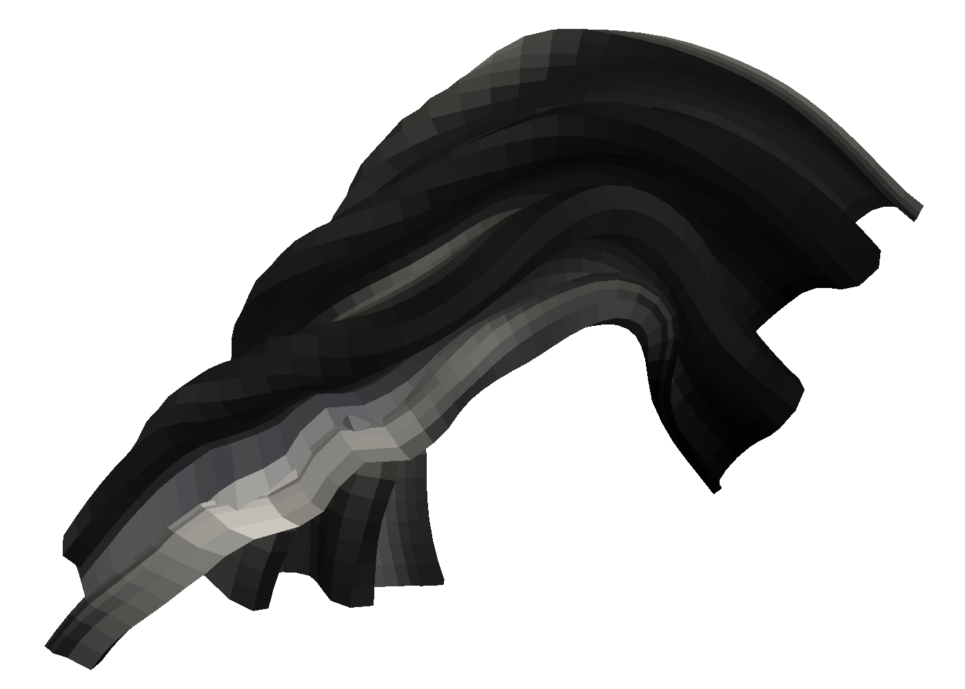
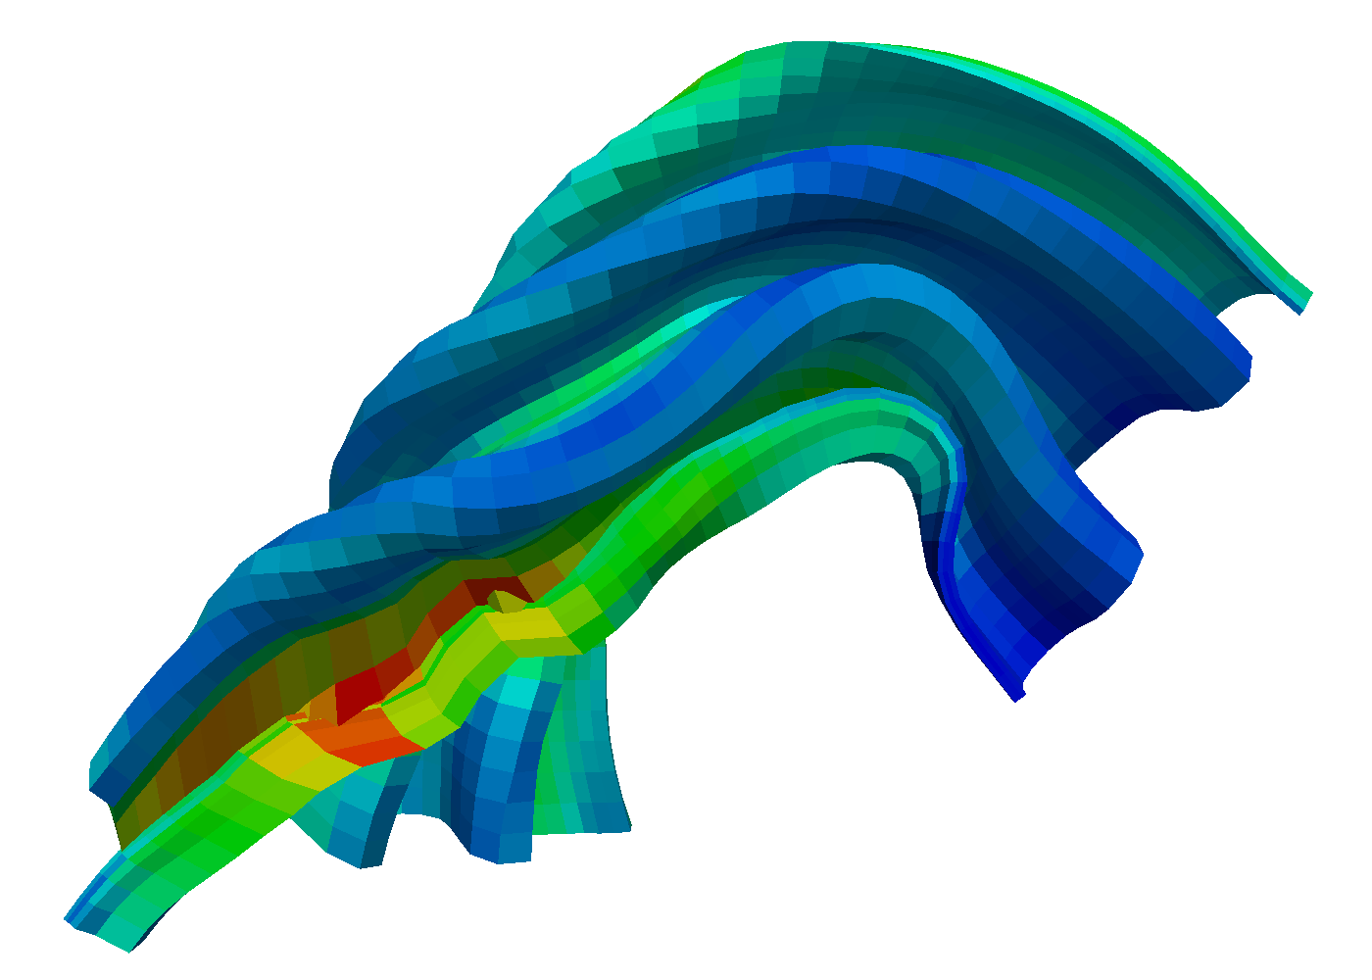
Rainbow Map Features
Notes:
Another vital feature of a color map for many scientific visualization applications is the ability to apply the map to a 3D surface.
The rainbow map performs admirably here.
Shading is the most important cue to 3D shape.
Too large of variance in color map luminance can interfere with shading.
Too dark colors can hide shading.

Slide 11
Rainbow Map Features (Anecdotal)
It looks good.
Notes:
When faced with the question why use the rainbow color map, to most common response I get (assuming it was a conscious decision) is that it creates an attractive picture.
I make no effort to quantify this. It is subjective anyway. (Some users find the saturated colors garish).
In our experience, users will not accept color maps that make images they fell are ugly or dull.
In the past our group experimented with trying to deliver isoluminant color maps. Aside from generally being a bad idea anyway, they just do not look very good.

Slide 12
Rainbow Map Features (Anecdotal)
Separation.

Slide 13
Rainbow Map Features (Anecdotal)
Bottom 25%
Center 50%
Top 25%
Middle
Notes:
This is an interesting observation. The rainbow color map naturally breaks up the range of values into groups based on these bands that it inadvertently forms.
The rainbow colors naturally break up the range into quartiles that quickly identify the region of the range.

Slide 14
Color Map Requirements
The map yields images that are aesthetically pleasing.
The map has a maximal perceptual resolution.
Interference with the shading of 3D surfaces is minimal.
The map is not sensitive to vision deficiencies.
The order of the colors should be intuitively the same for all people.
The perceptual interpolation matches the underlying scalars of the map.

