Slide 1
Eulerian-Based Method
Lagrangian-Based Method
0
6
12
18
24
0
6
12
18
24
F0
F6
F12
F18
F24
F0→6
F6→12
F12→18
F18→24
T=24
T=24
T=12
T=12
T=18
T=18
T=6
T=6

Slide 2
0
6
12
18
24
In situ phase
F0→6
F6→12
F12→18
F18→24
T=24
T=12
T=18
Post hoc phase
T=6

Slide 3
In Situ Phase
Post Hoc Phase
0
6
12
18
24
Input
F0→6
F6→12
F12→18
F18→24
T
T=24
T=12
Output
F0→6
F6→12
F12→18
F18→24
T=6
T=18

Slide 4
In Situ Phase
Post Hoc Phase
0
6
12
18
24
Input:
FM-1
FM-2
FM-3
FM-4
T
T=24
T=12
Output:
FM-1
FM-2
FM-3
FM-4
T=6
T=18

Slide 5
In Situ Phase
Post Hoc Phase
0
1
2
3
FM-1
FM-2
FM-3
T
T = 2
T = 0
FM-1
FM-2
FM-3
T = 1
T = 3

Slide 6
x
Interval 1
Interval 2
time

Slide 7
x
x₀(t₁)
x₃(t₁)
x₃(t₂)
x₀(t₀ )
p₀(t₂)
x₁(t₁)
x₄(t₂)
p₀(t₁)
x₁(t₀ )
p₀(t₁)
x₄(t₁)
p₀(t₀ )
x₂(t₁)
x₅(t₂)
x₂(t₀ )
x₅(t₁)
Interval 1
Interval 2
time
In situ extracted flow map particle trajectory
Post hoc reconstructed particle trajectory

Slide 8
x
Interval 1
Interval 2
time
In situ extracted flow map particle trajectory
Post hoc reconstructed particle trajectory

Slide 9
x
x₀(t₁)
x₃(t₁)
x₀(t₀)
x₁(t₁)
p(t₁)
x₁(t₀)
p(t₁)
x₄(t₁)
p(t₀)
x₂(t₁)
x₂(t₀)
x₅(t₁)
Interval 1
Interval 2
time
In situ extracted flow map particle trajectory
Post hoc reconstructed particle trajectory

Slide 10
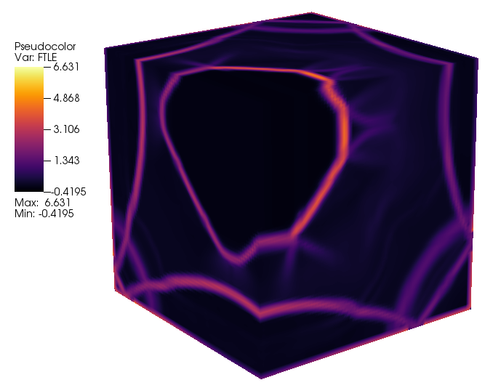


Slide 11
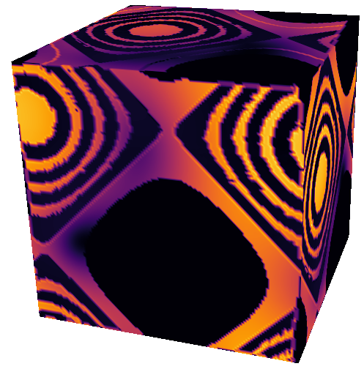
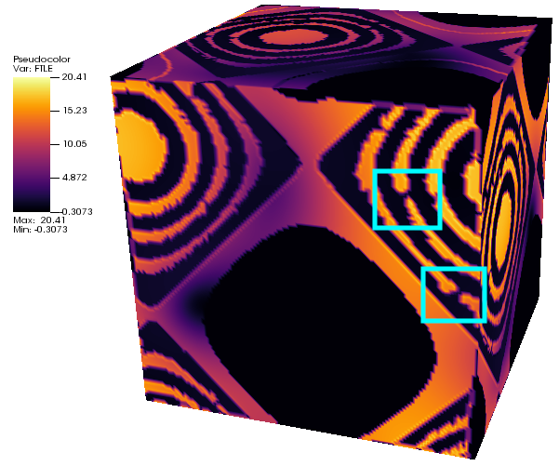

Slide 13
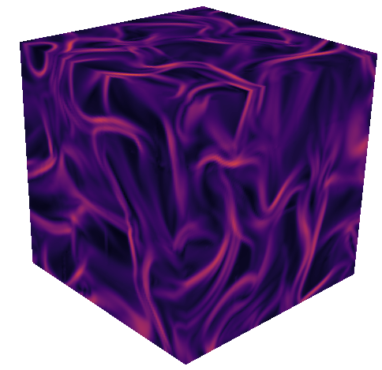
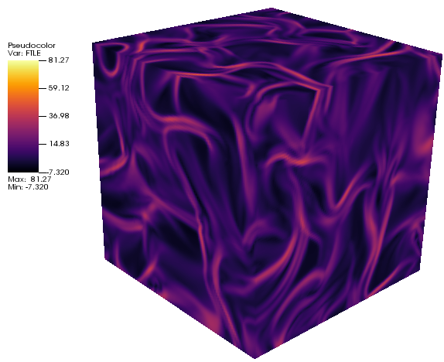

Slide 14
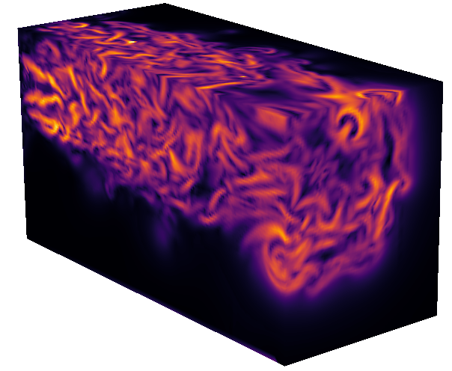
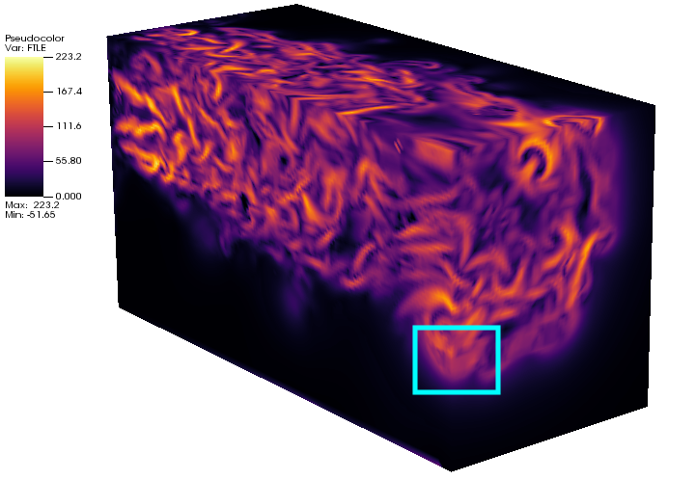

Slide 15
x
x
time
time
In situ phase
Post hoc phase

