Slide 1
Eulerian-Based Method
Lagrangian-Based Method
0
6
12
18
24
0
6
12
18
24
F0
F6
F12
F18
F24
F0→6
F6→12
F12→18
F18→24
T=24
T=24
T=12
T=12
T=18
T=18
T=6
T=6

Slide 2
0
6
12
18
24
In situ phase
F0→6
F6→12
F12→18
F18→24
T=24
T=12
T=18
Post hoc phase
T=6

Slide 3
In Situ Phase
Post Hoc Phase
0
6
12
18
24
Input
F0→6
F6→12
F12→18
F18→24
T
T=24
T=12
Output
Interval1
F6→12
F12→18
F18→24
T=6
T=18

Slide 4
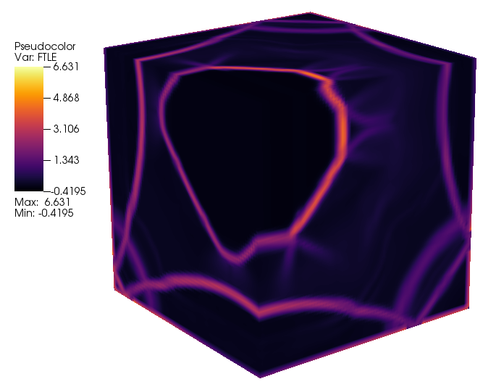


Slide 5
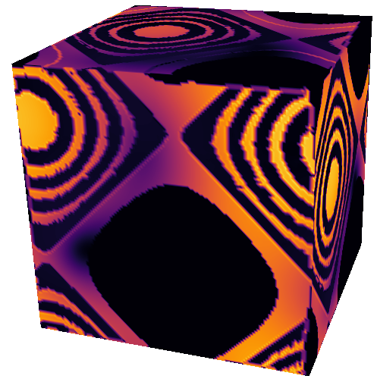
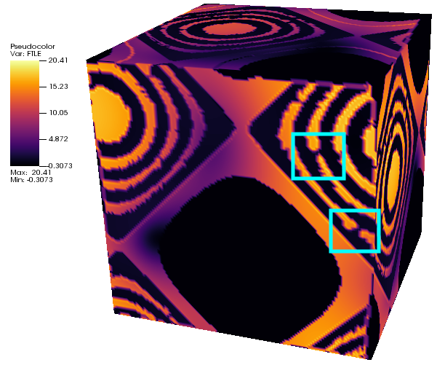

Slide 7
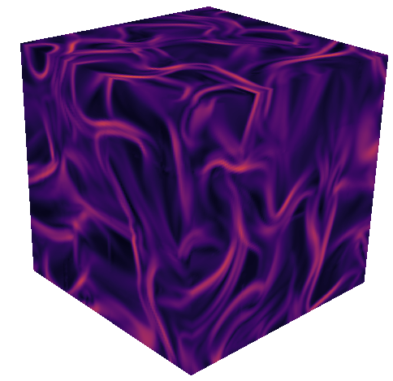
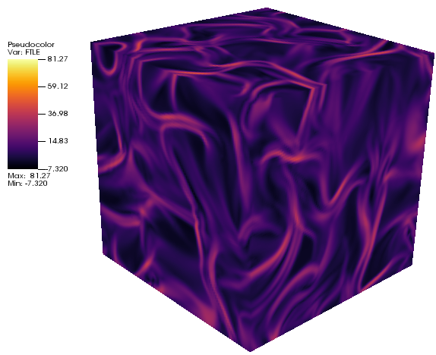

Slide 8
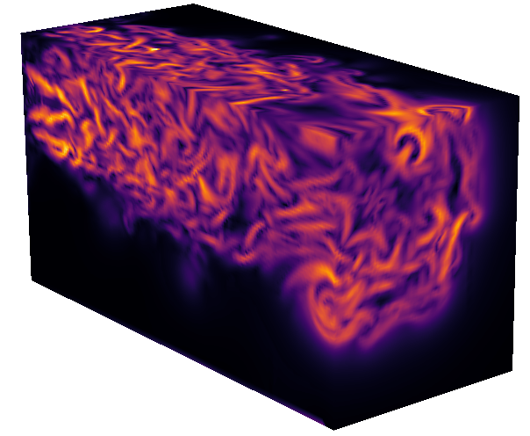
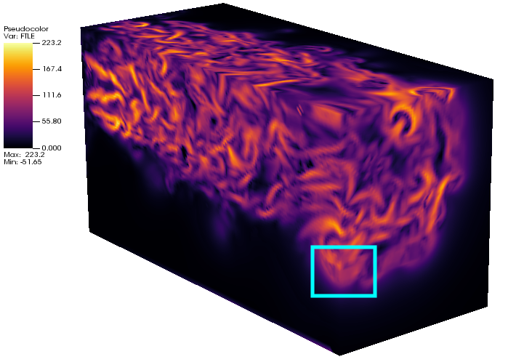

Slide 9
x
x
time
time
In situ phase
Post hoc phase

