Slide 1
Milestone 4547
Data Co-Processing for Extreme Scale Analysis
SAND# 2013-1427 P
Preliminary Executive Summary of Milestone Report
February 8, 2013
David Rogers, Ron Oldfield, Kenneth Moreland and Nathan Fabian
Sandia National Laboratories
Sandia National Laboratories is a multi-program laboratory operated by Sandia Corporation, a wholly owned subsidiary of Lockheed Martin company, for the U.S. Department of Energy’s National Nuclear Security Administration under contract DE-AC04-94AL85000.

Slide 2
Summary
Milestone 4745 “Data Co-Processing for Extreme Scale Analysis” was successfully completed on time, and demonstrated against the letter and spirit of stated Milestone.
The Milestone Team completed over 10 million node hours of Cielo tests on both in-situ and in-transit analysis capabilities on a problem provided by a Sandia analyst.
The results of these experiments have been detailed in a SAND report, which is published as an unclassified unlimited release document, available to the entire mod/sim community

Slide 3
The path to Exascale
Milestone 4745 is an important step in capability development, customer engagement, and scalability development on the path to exascale. It represents significant work on the development of both Catalyst, an open source in-situ analysis capability, and Nessie, an open source data services capability.
This Milestone is part of an integrated R&D roadmap aimed at characterizing, understanding, and promoting solutions for complex analysis problems on advanced architectures.
It is an important foundation step in developing cross-cutting capabilities.

Slide 4
Milestone 4745
SC calculations produce complex datasets that are increasingly difficult to explore and understand using traditional post-processing workflows. To advance understanding of underlying physics, uncertainties, and results of ASC codes, SNL must gather as much relevant data as possible from large simulations. This drives SNL to couple data analysis and visualization capability with a running simulation, so that high fidelity data can be extracted and written to disk. This Milestone evaluates two approaches for providing such a coupling:
In-situ processing provides ``tightly-coupled'' analysis capabilities through libraries linked directly with the simulation. SNL has collaborated on developing an in-situ capability designed for this purpose.
In-transit processing provides ``loosely-coupled'' analysis capabilities by performing the analysis on separate processing resources. SNL provides this capability through a ``data services'' capability designed for this purpose.
SNL will engineer, test and evaluate customer-driven operations on large-scale data created by a running simulation. The data operations will be performed by instrumented versions of both the in-situ and in-transit solutions, with the resulting performance data published and made available to the ASC community.
A program review will be conducted, and its results documented. A report will be submitted as a record of milestone completion.

Slide 5
Motivation
SC calculations produce complex datasets that are increasingly difficult to explore and understand using traditional post-processing workflows. To advance understanding of underlying physics, uncertainties, and results of ASC codes, SNL must gather as much relevant data as possible from large simulations. This drives SNL to couple data analysis and visualization capability with a running simulation, so that high fidelity data can be extracted and written to disk.
Note: ASC program will benefit from a detailed understanding of the relationship between analyst tasks, analysis operations, and disk I/O performance.

Slide 6
In-situ and In-transit workflows
In-situ processing provides ``tightly-coupled'' analysis capabilities through libraries linked directly with the simulation. SNL has collaborated on developing an in-situ capability designed for this purpose.
In-transit processing provides ``loosely-coupled'' analysis capabilities by performing the analysis on separate processing resources. SNL provides this capability through a ``data services'' capability designed for this purpose.
Diagram of in-situ workflow, accomplished in this Milestone through the use of Catalyst, an open source, VTK-based analysis library.
Diagram of in-transit workflow, in which the science code communicates with data services nodes to perform analysis operations. This is accomplished in this Milestone through the use of Nessie, an open source data services library.

Slide 7
Milestone 4745, completion criteria
SC calculations produce complex datasets that are increasingly difficult to explore and understand using traditional post-processing workflows. To advance understanding of underlying physics, uncertainties, and results of ASC codes, SNL must gather as much relevant data as possible from large simulations. This drives SNL to couple data analysis and visualization capability with a running simulation, so that high fidelity data can be extracted and written to disk. This Milestone evaluates two approaches for providing such a coupling:
In-situ processing provides ``tightly-coupled'' analysis capabilities through libraries linked directly with the simulation. SNL has collaborated on developing an in-situ capability designed for this purpose.
In-transit processing provides ``loosely-coupled'' analysis capabilities by performing the analysis on separate processing resources. SNL provides this capability through a ``data services'' capability designed for this purpose.
SNL will engineer, test and evaluate customer-driven operations on large-scale data created by a running simulation. The data operations will be performed by instrumented versions of both the in-situ and in-transit solutions, with the resulting performance data published and made available to the ASC community.
A program review will be conducted, and its results documented. A report will be submitted as a record of milestone completion.

Slide 8
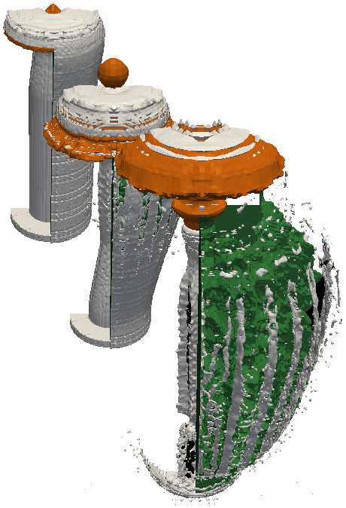
Experiment Driver
Milestone focused on “customer-driven operations on large-scale data created by a running simulation”
Customer driver use case: characterize fragments in an
explosion simulation, an analysis step critical for
understanding shock physics
Partner: Jason Wilke
Critical steps
Find fragments (multiple operations required)
Characterize fragments (mass, velocity, etc.)
Retain relevant data
Milestone experiments focused on identifying the fragments. This operation is a significantly complex part the analysis, so it serves as a useful way to characterize the operations in the driver use case.
Full range of data experiments run at 32k cores on Cielo. Partial experiments done at 64k cores on Cielo. This report presents results from the 32k runs.

Slide 9
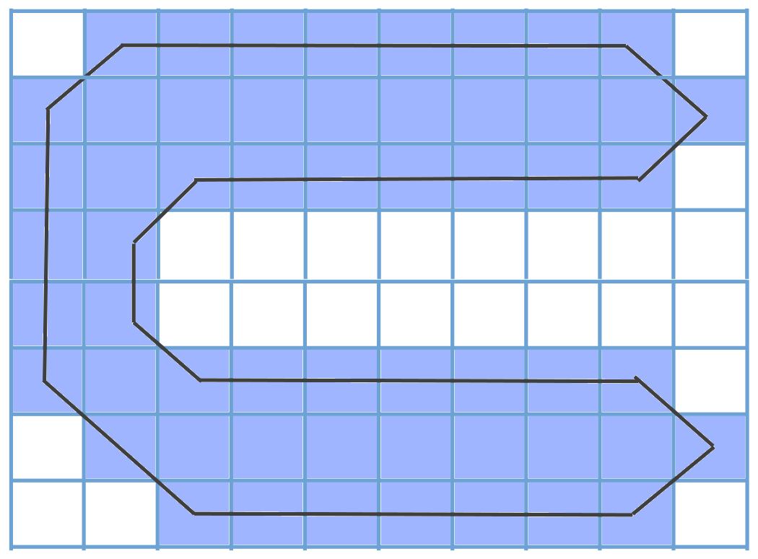
Fragment detection
Operations required for fragment detection (requires a watertight surface)
Find block neighbors
Fix AMR bondaries by inserting degenerate cells
Create surfaces
Find components across neighbors
Step 2
Step 3
Step 4

Slide 10
Implemented Workflows
In situ: A CTH job that directly runs in situ analysis
Baseline: Basic algorithm with somewhat redundant step of global communication to find AMR block neighbors
Refined: Improved algorithm that gets AMR block neighbors from CTH
In transit: CTH transfers data to separate server job
Extra nodes: CTH job size same as other runs, extra nodes are used to allocate the VDA service
Internal nodes: CTH job given less nodes that are assigned to VDA service so that together both jobs use the same nodes as other runs
Spyplot file: Write Spyplot files from CTH, then post process analysis by reading back in and batch processing in ParaView.

Slide 11
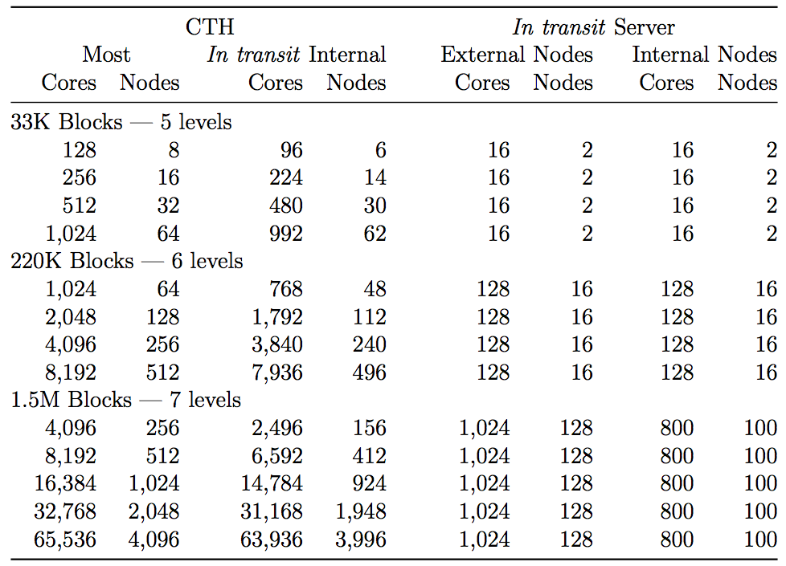
Experiment, cont’d
For each application, we ran strong scaling experiments for three different datasets.
Each data set comes from the same initial conditions but with a different maximum level of refinement
Measurements of different job sizes with different data set sizes provides a weak scaling overview.
Table shows the range of core sizes used for the various experiments. For every application we used the maximum 16 cores-per-node for the CTH client, since CTH is primarily bound b computation and scales very well.

Slide 12
In Transit Allocations
“Extra Nodes” allocated for VDA services
256 Nodes
16 Nodes
Simulation
Vis
“Internal Nodes” included in job allocation
256 Nodes
Simulation
Vis

Slide 13
Experiment Configurations
All experiments performed on Cielo supercomputer at LANL, jointly managed by Los Alamos National Laboratory and Sandia National Laboratories
8,944 node Cray XE6
Node: 2 AMD Opteron 6136 (Magny-Cours) 8-way processor chips
Total of 16 cores/node
2.4 GHz peak computation speed per core
Peak of 1.37 Petaflops
32 GB memory/core
Notes:
I was lazy and just took a screenshot from the paper rather than try to recreate the table.

Slide 14
Experiment, cont’d
All applications complete 500 cycles (i.e., timestep calculations) of the CTH code.
The first four applications execute an analysis operation once every 10 cycles
Spyplot file application outputs spyplot data at a fixed interval in simulated time, calculated so that the application executed the same number of analysis operations performed by the in-situ and in-transit applications
Total number of analysis operations is the same
Data captured was from instrumented code and HPCToolkit

Slide 15
Experiment, cont’d
For each application, we ran strong scaling experiments for three different datasets.
Each data set comes from the same initial conditions but with a different maximum level of refinement
Measurements of different job sizes with different data set sizes provides a weak scaling overview.
Table shows the range of core sizes used for the various experiments. For every application we used the maximum 16 cores-per-node for the CTH client, since CTH is primarily bound b computation and scales very well.

Slide 17
Results

Slide 18
Total Runtime for All Experiments
In situ baseline
In situ refined
Spyplot I/O (post-processing)
5 applications
3 datasets
Strong scaling for each dataset
Error bars show variance
In transit extra nodes
In transit internal nodes
Notes:
Experiments (recap)
5 applications: 2 in-situ, 2 in-transit, 1 traditional post-processing
3 datasets: 33k, 220k, 1.5m
Notes:
Total runtime
Strong scaling for each dataset
Error bars show variance across 5 or more runs

Slide 19
Pipeline Summary Timing (1.5m blocks)
Acceptable scaling performance, with the exception of the baseline algorithm.

Slide 20
Pipeline Summary Timing (1.5m blocks)
No significant improvement at 32K cores. Probably insufficient work for analysis (only 45 blocks per process).

Slide 21
Pipeline Summary Timing (1.5m blocks)
Writing files surprisingly fast. Although slower than most alternatives, still a viable option.

Slide 22
Pipeline Summary Timing (1.5m blocks)
“Sweet spot” at 8K cores: in transit with unrefined algorithm beats in situ with refined algorithm.

Slide 23
Timing Per Task
In situ baseline
In situ refined
Spyplot I/O (post-processing)
CTH scales well.
Spyplot I/O not bad
Baseline algorithm does not scale
In transit extra nodes
In transit internal nodes
Notes:
Notes:
- CTH computation scales really well (as expected)
- Baseline analysis algorithm scales poorly. Looks independent of number of cores.
- Refined algorithm has much lower analysis overhead, but initialization cost is problematic
- In-transit is compute bound at 4 & 8K, analysis bound (requires waits at 16 and 32K
- Not enough work for the compute nodes
- Analysis algorithm is not scalable

Slide 24
Timing Per Task
In situ baseline
In situ refined
Spyplot I/O (post-processing)
Refined analysis has much lower overhead, but initialization is problematic.
Refined algorithm requires additional data to be passed. Not done for in-transit experiments.
In transit extra nodes
In transit internal nodes

Slide 25
Timing Per Task
In situ baseline
In situ refined
Spyplot I/O (post-processing)
Service is a fixed size (800 nodes), the wait time should be independent of the number of cores on the client.
In transit extra nodes
In transit internal nodes

Slide 26
Timing Per Task
In situ baseline
In situ refined
Spyplot I/O (post-processing)
“sweet spot”, where compute and analysis are balanced (equal)
In transit extra nodes
In transit internal nodes
Notes:
Transition: Let’s have a closer look at the “Sweet Spot”

Slide 27
Time-Series Analysis (8k cores)
Although number of blocks changes very little, CTH runtime gets longer as simulation progresses.
Vis time is roughly constant.
In transit will “win” when xfer+wait is less than viz.
In transit can flatten the runtime as long as extra simulation time consumes only wait time.
In situ baseline
In situ refined
In transit extra nodes
In transit internal nodes
Notes:
Shows operation time over the course of a single execution.

Slide 28
Time-Series Analysis: Variance
CTH (mean+std)
CTH (overlayed)
Anomalies that cause large variance are clearly identified in overlay plot.
Not sure the true cause of the outliers.

Slide 29
Time-Series Analysis: Variance
In situ baseline
In situ refined
Refined algorithm has much less communication, resulting in less variance.
Scales are different in the two plots.

Slide 30
Time-Series Analysis: Variance
In-transit transfer times have noticeable variance.
Possibly caused by placement issues.
Scheduler does not optimize allocations for transfers between jobs.
In transit extra nodes transfer
In transit extra nodes wait
In transit internal nodes transfer
In transit internal nodes wait

Slide 31
Block Processing Rate (Viz)
In situ baseline
In situ refined
Refined algorithm is scalable, baseline algorithm is not. (Verifies previous work.)

Slide 32
In Transit Node Scaling
Wait for Server
Transfer Data
2 server cores: 64:1
10 cycles in 37 secs
Client idle waiting for servers (also affects xfers)
4 server cores: 32:1
10 cycles in 23 secs
8 server cores: 16:1
10 cycles in 19 secs
Less than 1% time waiting
Notes:
HPCToolkit traces of small dataset on muzia
128 cores for CTH
Testing core scaling using one server

Slide 33
In Transit Node Scaling
33k blocks
218k blocks
1.5m blocks
For small datasets, there is clear benefit to using 4 and 8 cores/node (agreement previous slide)
For 1.5m blocks datasets (at large scale), the opposite appears to be true.
Needs further study.

Slide 34
Memory Footprint (on code side)
All memory measurements. Holds relatively steady for all workflows

Slide 35
Memory Footprint (on code side)
Memory overhead generally falls between 25% and 50%

Slide 36
Memory Footprint (on code side)
In transit generally has less memory overhead, but requires extra nodes allocated

Slide 37
Conclusions

Slide 38
Conclusions
In transit can provide a performance improvement over in situ in some circumstances, but the window is narrower than we initially expected it would be.
In transit analysis has an added overhead above embedded in situ analysis involving transferring data between parallel jobs. Given an analysis with perfect linear scalability, we suspect in transit workflows will always have an added cost, and our results support this. With an analysis that does not scale perfectly, possibly due to communication overhead, it is theoretically possible for in transit to be faster by reducing the size of the analysis job. This is one of the motivations for choosing an analysis task that requires significant communication. In our results, we do find instances where in transit is faster, but by a smaller margin and for fewer configurations than we initially anticipated. So although in transit has several other positive features, we do not anticipate performance to be the main motivations for using it.

Slide 39
Conclusions
The efficiency of in transit relies on balancing the time spent in simulation and analysis.
The significant overhead cost, apart from data transfer, in the in transit workflow is the idle time spent in the simulation waiting for the visualization and data analysis service to become ready or the idle time spent in the visualization and data analysis service waiting for the simulation to send more data. This idle waiting time is minimized when the simulation and analysis spend the same amount of wall clock time between transfers. Although not demonstrated in this work, it is possible to “auto-balance” the work between simulation and analysis by, at every iteration of the simulation, transfer data to the analysis if and only if the analysis service is ready to accept more work. The disadvantage of such an approach is that the idle process time could be replaced with unnecessary extra analysis or less analysis than necessary. However, we suspect that controlling the amount of visualization and data analysis performed through job allocation sizes fits well with users’ rules of thumb about resource allocation.

Slide 40
Conclusions
Memory overhead will be an important trade-off space.
The baseline amount of memory added to the CTH job to perform in situ processing is roughly 100MB per core. Considering that our embedded in situ library is a fully featured visualization toolkit containing over 2 million lines of code and algorithms developed over almost 2 decades, this overhead is not unreasonable. Nevertheless, this footprint can be problematic for simulations already tight on memory. Because of this, efforts are already underway to improve our memory footprint by making finer modules and being more selective on the available algorithms. This, of course, requires a compromise between the size of the library and the algorithms that are dynamically available. We also note that our algorithm has the potential to generate sizable meshes of its own. Thus, it may be fruitful to pursue and support incremental algorithms where possible.

Slide 41
Conclusions
Initialization time matters
Our scaling efforts to date focus on the scalability of the algorithms invoked during the run of a simulation. The initialization cost, a one-time penalty, has yet to be seriously considered. However, based on our HPCToolkit measurements, initialization becomes a significant cost at high process counts.
Disk-based I/O is not dead . . . yet.
Our initial assumption was that it would not be feasible to output full results at a fine enough temporal resolution from CTH to disk storage to perform our high fidelity analysis. However, our control workflow shows that although the overall time to write data to disk and then read back again incurs a large cost, it is still realistic to do so. Thus, users may still choose to incur the extra overhead to use a traditional offline post-processing visualization and data analysis workflow.

Slide 42
Conclusions
Better job scheduling is important
One of the more complicated parts of running an in transit workflow is scheduling the simulation job and service job to run in tandem. Frankly, the capabilities of the scheduler are inadequate for our needs. We cannot start and stop jobs independently and make reconnections dynamically. Another experiment we would like to do but is challenging to schedule is to allow simulation and service to share nodes. Since each node has 16 cores, perhaps we could get better transfer performance by allocating one core per node for service and the rest for simulation. A similar scheduling scheme will be important to take advantage of burst buffers in future architectures.

Slide 43
Future Work
Algorithm comparison. Three similar algorithms with three different scaling bahaviors
Contour algorithm (perfectly scalable)
Refined water tight contours (reasonably scalable)
Baseline water tight contours (not scalable)
No-wait analysis (in-transit)
Perform analysis if and only if the service is ready
Investigate initialization cost of in-situ vis
Zero copy transfers (in-transit)
Additional apps at Cielo scale
Improved OS and runtime support
Scheduling, placement, node sharing, specialized runtimes, …

Slide 44
Summary
Milestone 4745 “Data Co-Processing for Extreme Scale Analysis” was successfully completed on time, and demonstrated against the letter and spirit of stated Milestone.
The Milestone Team completed over 9 million node hours of Cielo tests on both in-situ and in-transit analysis capabilities on a problem provided by a Sandia analyst.
The results of these experiments have been detailed in a SAND report, which is published as an unclassified unlimited release document, available to the entire mod/sim community

