Slide 1
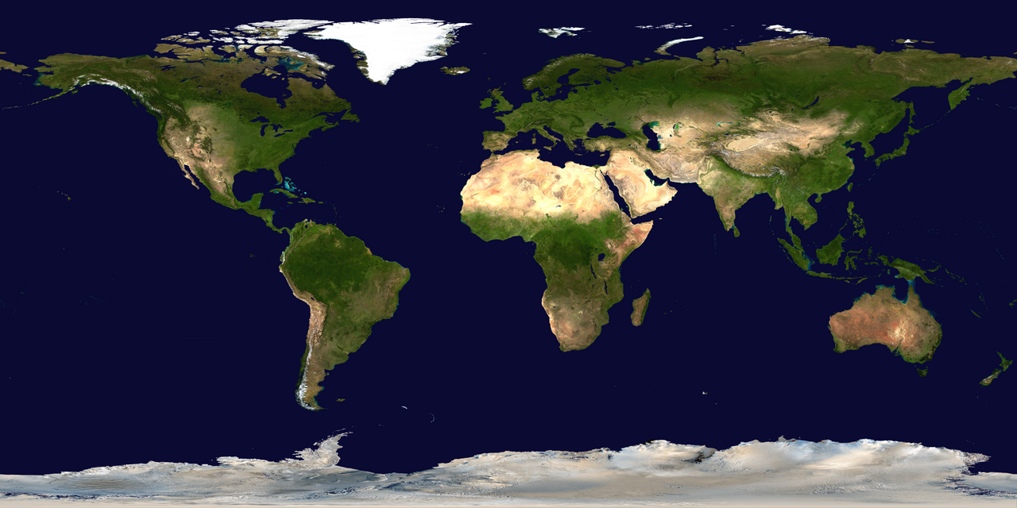
A
B
C
D
E
F
G
H
I
J
K
L
M
N
O
P
A
A
B
5
B
2
1
C
6
C
2
D
5
3
D
4
E
E
4
F
F
G
G
H
H
A
B
C
D
E
F
G
H
I
J
K
L
M
N
O
P

