Slide 1
Memory Management (Main Memory)
Notes:
Video Module 5-01

Slide 2

Overview
Objectives
Learn and understand the objectives Memory Management.
Learn and understand the design guiding principles to memory management.
Tell a story of an illusion.
Describe, discuss and evaluate contiguous memory placement strategies.
Learn and understand paging and segmentation.
Requirements
Understand Computer Organization principles (COMP 3350 or equivalent):
address bus, addressing space, memory..
Read Sections on Instructional Resources

Slide 3
Memory Management Objectives
Objectives
Offer what a user/programmer wants
a flat, fast, inexpensive, and infinite space starting at Address 0
Maximize the number of processes in the memory
Minimize the access time to memory
Read in Chapter on Main Memory
Introduction
Section Background

Slide 4
What Does a Programmer Want?
Convenience and simplicity:
The programmer wants to think of his program as a nice contiguous flat space”
starting at Address 0 (You do not want to think of a space starting at Address 547231. Do you?)
with an infinite size!
Some questions:
Should the programmer bother about where his/her program will be placed in memory?
Should the programmer know in advance where her/his program will run?
As part of memory management, the operating system will offer
an ILLUSION that the user is alone with as much memory as he wants.
This story is about how the operating system achieves this illusion with some hardware assistance (memory management unit, MMU)

Slide 5
The Illusion Starts with Two Spaces
Physical Space
0000000h (Low)
OS (with the help of the memory management unit MMU) manages a physical space
User (with CPU) see a logical space
0000000h
Logical Space
Logical
Address
Physical
Address
User
Program
FFFFFFFFh (High)
5

Slide 6
Logical and Physical addresses Relationships
How to translate a logical address into a physical address?
Who does the translation?
When should the translation (binding) be made?
We should look at the process lifetime!
Read in Chapter on Main Memory
Section Background
Notes:
Video Module 5-02

Slide 7
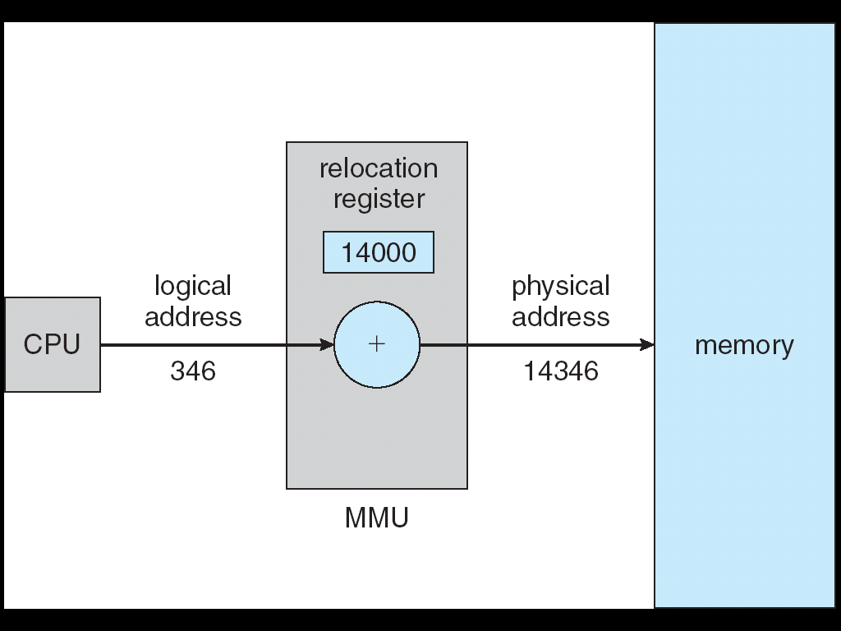
Example of Dynamic Translation Logical To Physical
////
Memory Management Unit
is a hardware device
7

Slide 8
Example of Dynamic Translation Logical To Physical
Memory Management Unit
is a hardware device
8

Slide 9
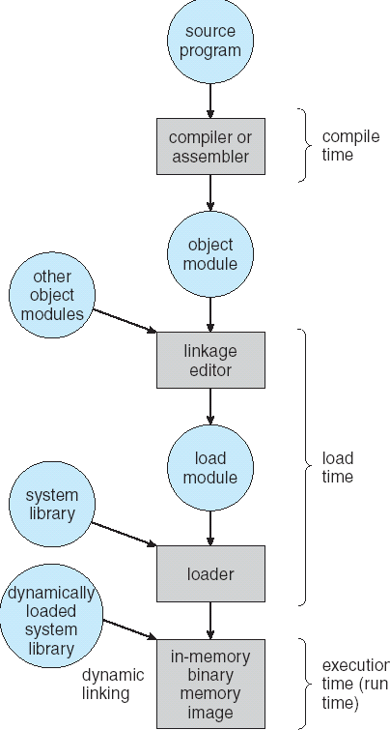
Lifetime of User Program
9

Slide 10
Lifetime of User Program
10

Slide 11
When to Bind Instructions and Data to Memory
When should the address binding occur?
Answer: Address binding of instructions and data to memory addresses can happen at three different stages
Compile time: If memory location known a priori, absolute code can be generated; must recompile code if starting location changes (Most constraining for OS)
Load time: Must generate relocatable code if memory location is not known at compile time
Execution time: Binding delayed until run time if the process can be moved during its execution from one memory segment to another. Need hardware support for address mapping/translations (Most Flexible for OS).

Slide 12
More About Logical vs. Physical Address Space
Logical (or virtual) address – generated by the CPU;
Physical address – address seen by the memory
Compile time: Logical and physical addresses are the same
Load-time: Logical and physical addresses are the same
Execution (running) time: address-binding schemes; logical (virtual) and physical addresses DIFFER

Slide 13
Contiguous Allocation
Where to place a process in the physical space?
How to insure a spot for a process in the physical space?
How does the OS keep track of the allocated space?
Contiguous Placement strategies:
First fit
Best-fit
Worst-fit
Read in Chapter on Main Memory
Introduction
Section Contiguous Memory Allocation
Notes:
Video Module 5-03

Slide 14
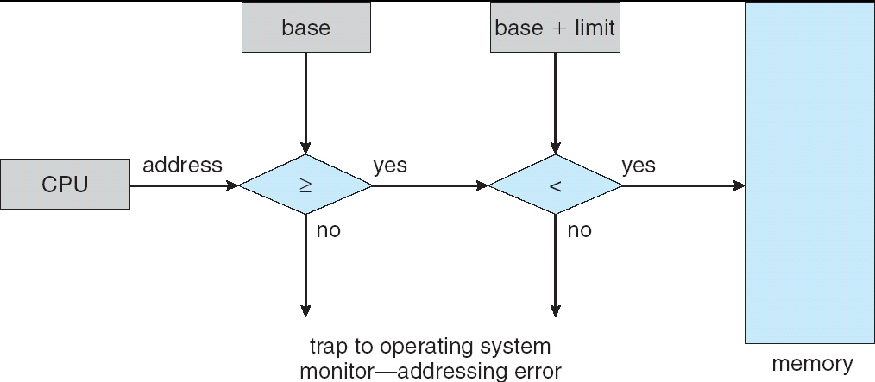
Contiguous Allocation
Main memory usually is divided into two partitions:
Resident operating system, usually held in low memory with interrupt vector
User processes then held in high memory
Relocation registers used to protect user processes from each other, and from changing operating-system code and data
Base register contains value of smallest physical address
Limit register contains range of logical addresses – each logical address must be less than the limit register
MMU maps logical address dynamically
OS
process 5
process 8
process 2

Slide 15
Contiguous Allocation (Cont.)
Multiple-partition allocation
Hole – block of available memory; holes of various size are scattered throughout memory
When a process arrives, it is allocated memory from a hole large enough to accommodate it
Operating system maintains information about: a) allocated partitions b) free partitions (hole)
P₈ leaves
P₉ arrives
P₁₀ arrives
P₉ leaves
OS
OS
OS
OS
OS
process 5
process 5
process 5
process 5
process 5
process 9
process 9
process 8
process 10
process 10
process 2
process 2
process 2
process 2
process 2

Slide 16
Contiguous Allocation (Cont.)
Multiple-partition allocation
Hole – block of available memory; holes of various size are scattered throughout memory
When a process arrives, it is allocated memory from a hole large enough to accommodate it
Operating system maintains information about: a) allocated partitions b) free partitions (hole)
OS
OS
OS
OS
OS
process 5
process 5
process 5
process 5
process 5
process 9
process 9
process 8
process 10
process 10
process 2
process 2
process 2
process 2
process 2

Slide 17
Dynamic Storage-Allocation Problem
How to satisfy a request of size n from a list of free holes
First-fit: Allocate the first hole that is big enough
Best-fit: Allocate the smallest hole that is big enough; must search entire list, unless ordered by size
Produces the smallest leftover hole
Worst-fit: Allocate the largest hole; must also search entire list
Produces the largest leftover hole
Question: how to judge a placement strategy?
Answer: fragmentation
First-fit and best-fit better than worst-fit in terms of speed and storage utilization

Slide 18
Evaluating Contiguous Placement Strategies
How to evaluate a placement strategy?
Answer: fragmentation of the memory!
There are two types of fragmentation:
External
Internal
How to reduce fragmentation (Internal and External)?
Read in Chapter on Main Memory
Sub Section Fragmentation
Notes:
Video Module 5-04

Slide 19
Fragmentation
External Fragmentation – total memory space exists to satisfy a request, but it is not contiguous
happens ALWAYS when using variable partitioning
Internal Fragmentation – allocated memory may be slightly larger than requested memory; this size difference is memory internal to a partition, but not being used
happens ALWAYS when using fixed partitioning (allocation is made in fixed sizes)
OS
process 5
process 11
process 10
process 2

Slide 20
What Memory Management Strategy to Choose?
What is more flexible? Variable partition or fixed partition?
Answer: It seems variable partition would be more flexible.
But, variable partition incurs external fragmentation.
How to reduce external fragmentation?
Answer: Reduce external fragmentation by compaction
Shuffle memory contents to place all free memory together in one large block
Compaction is possible only if relocation is dynamic, and is done at execution time
But, compaction is costly:
Computing how to shuffle around pieces, and
Transfer time to move data in memory
So, what to do?

Slide 21
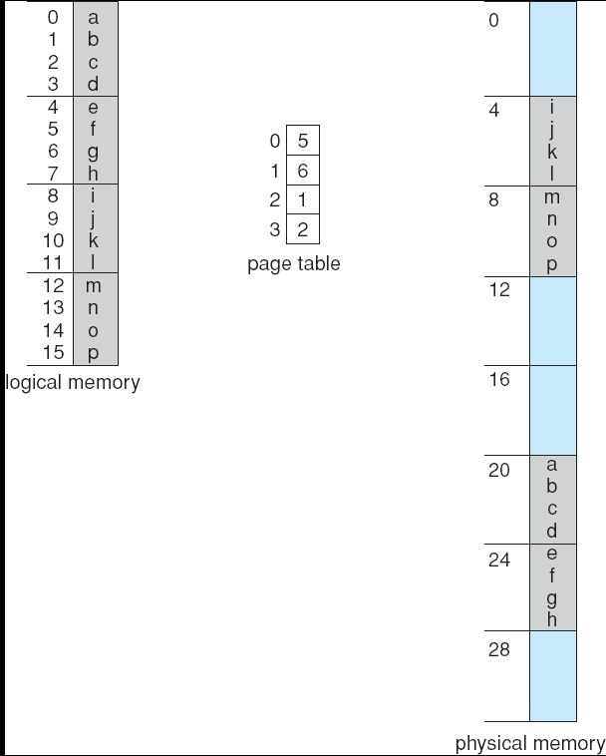
What To Do To Have Flexibility and Avoid Compaction?
Give up the requirement of contiguous placement! Meaning:
Cut the user program in “small” fixed size “pieces” and scatter them in the physical space

Slide 22
How To Keep Track of the Small “Pieces”?
Small pieces in the logical space are called PAGES. We number them.
Small pieces in the physical space are called FRAMES
Page Numbers
Frame Numbers
0
0
1
1
Pages
2
2
Frames
3
3
4
5
6
7

Slide 23
How To Keep Track of the Small “Pieces”?
Small pieces in the logical space are called PAGES. We number them.
Small pieces in the physical space are called FRAMES
Page Numbers
Frame Numbers
0
0
1
1
Pages
2
2
Frames
3
3
4
5
6
7

Slide 24
Paging
What is Paging?
How does it work?
Benefits and drawbacks (Overhead)
Read in Chapter on Main Memory
Section Paging
Notes:
Video Module 5-05

Slide 25
Paging
Logical address space of a process can be noncontiguous: it is divided in equal size pieces called pages (size is power of 2, between 512 bytes and 8,192 bytes).
The physical memory is divided into blocks of same size (as pages) called frames.
The process is allocated physical memory whenever there are enough available frames, even scattered.
Keep track of all free frames
To run a program of size n pages, need to find n free frames and load program
Set up a page table to translate (map) logical to physical addresses

Slide 26
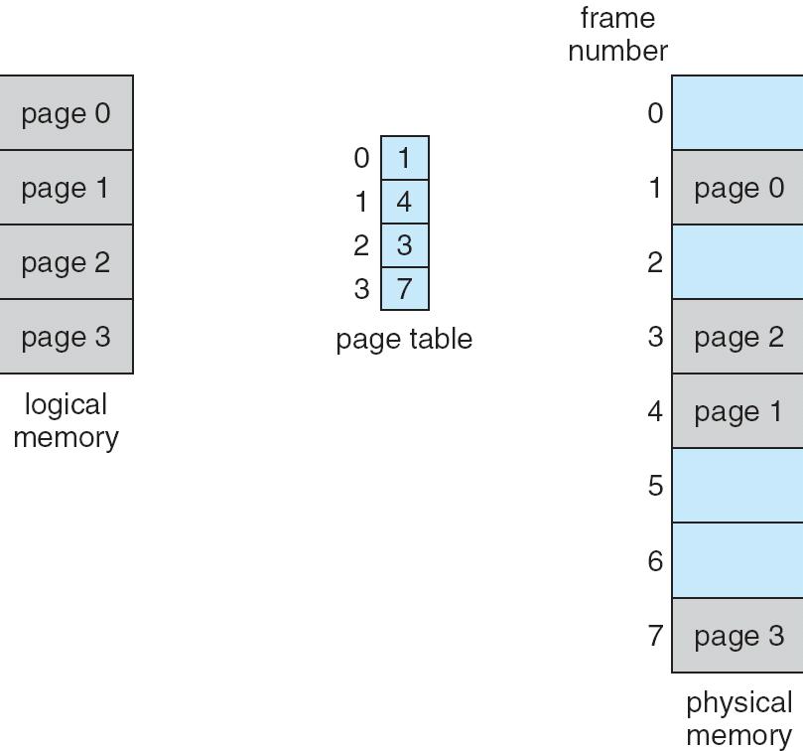
Example 2: Paging Model of Logical and Physical Memory
26

Slide 27
Address Translation Scheme: How to Translate?
Consider a CPU with an address bus of size is m bits
Page size = 2^{n}
Address of an item generated by CPU is divided into:
Page offset (d) – provides the offset (position) of the item inside the page. Offset = Logical Address % Page Size
Page number (p) – used as an index into a page table which contains the frame number. Page Number = Logical Address / Page Size
page number
page offset
Logical Address =
p
d
m - n
n
m bits

Slide 28
Address Translation Scheme: How to Translate?
Consider a CPU with an address bus of size is m bits
Page size = 2^{n}
Address generated by CPU is divided into:
Page offset (d) – provides the offset (position) of the item inside the page. Offset = Logical Address % Page Size
Page number (p) – used as an index into a page table which contains the frame number. Page Number = Logical Address / Page Size
page number
page offset
Logical Address =
p
d
m - n
n
m bits

Slide 29
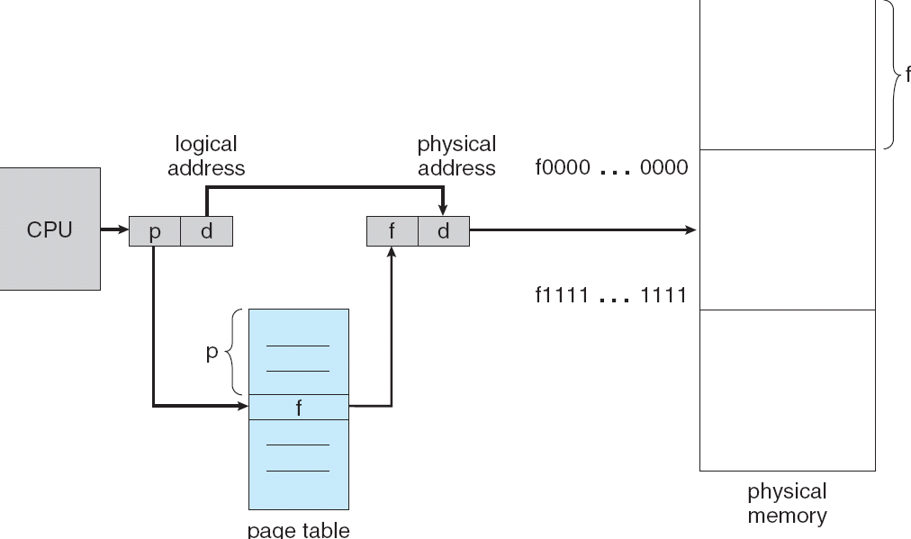
Paging Hardware
29

Slide 30
Paging Hardware
30

Slide 31
Implementation of Page Table
Page table is kept in main memory
Page-table base register (PTBR) points to the page table
Page-table length register (PRLR) indicates size of the page table
Notes:
Video Module 6-06

Slide 32
Benefits and Drawbacks of Paging
Benefits:
Flexibility to place processes: as long as there are enough frames, a process can be placed
External fragmentation is eliminated
Internal fragmentation limited to the last frame of a process (Size of a process is not always a multiple of pages)
Drawbacks
Each data/instruction accesses requires two memory accesses
Space overhead for the page table

Slide 33
Paging Address Translation Example
Consider a imaginary CPU with a small address bus (just to make the example simple)
CPU generates a logical/virtual address LA
Learn about how to translate LA into a physical address
Read in Chapter on Main Memory
in Section Paging
Sub Section Basic Method
Sub Section Protection
Notes:
Video Module 5-06

Slide 34
Example 1
Page Table
0
4
Consider a CPU with a 12 bit address bus and a 512-byte page size.
Consider this page table:
Example : CPU generates the logical address LA = 0xB62 (hexa)
In binary, 0xB62 = (1011 0110 0010)₂
Since the page size = 512 = 2⁹, then n=9 (See Slide 27) and
the offset is then made of the 9 least significant bits (highlighted in blue)
the page number is made of the remaining left most 3 bits (3 = 12-9)
LA = (1011 0110 0010)₂
The page number is (101)₂ = 5
The offset is (1 0110 0010)₂
The physical address will be built as follows: LA = 1011 0110 0010
1
9
2
2
3
4
4
7
5
3
6
0
7
4
Replace with Table[5]
Copy Offset
Physical Address = PA =
011
1 0110 0010

Slide 35
Example 1I
Page Table
0
4
Consider a CPU with a 12 bit address bus and a 512-byte page size.
Consider this page table:
Example : CPU generates the logical address LA = 0x529 (hexa)
In binary, LA = 0x529 = (0101 0010 1001)₂
Since the page size = 512 = 2⁹, then n=9 (See Slide 27) and
the offset is made of the 9 least significant bits (highlighted in blue)
the page number is made of the remaining left most 3 bits (3 = 12-9)
LA = (0101 0010 1001)₂
The page number is (010)₂ = 2
The offset is (1 0010 1001)₂
The physical address will be built as follows: LA = 0101 0010 1001
1
9
2
0
3
4
4
7
5
3
6
2
7
4
Replace with Table[2]
Copy Offset
Physical Address = PA =
000
1 0010 1001

Slide 36
Valid/Invalid Entry
How do we know that the frame number in an entry points to a page INDEED in the memory ?
Answer: use an extra bit to indicate if the page is indeed in the physical memory. This bit is called the validity bit.
Validity bit: it is a bit attached to each entry in the page table:
“valid” indicates that the associated page is in the process’ physical address space, and is thus a legal (valid) page
“invalid” indicates that the page is not in the process’ physical address space.

Slide 37
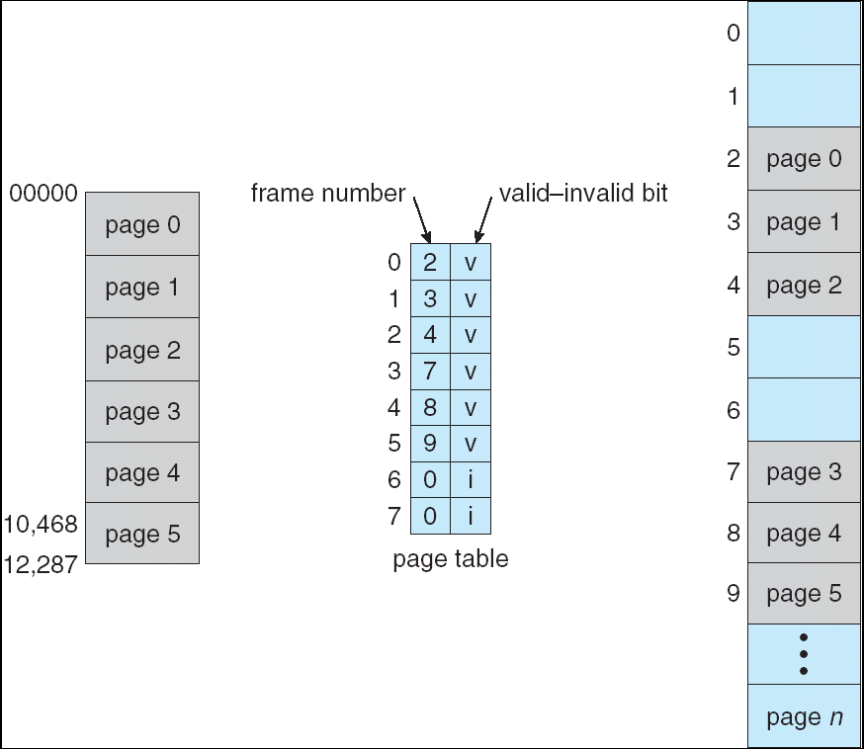
Valid (v) or Invalid (i) Bit In A Page Table
37

Slide 38
Paging Time Overhead
In this scheme every data/instruction access requires two memory accesses:
one for the page table and
one for the data/instruction.
The two memory access problem can be solved by the use of a special fast-lookup hardware cache called translation look-aside buffers (TLBs). Fundamentally, it is a fast cache.
Notes:
Video Module 6-06

Slide 39
Improving Access Time for Paging
How are the TLBs used?
Read in Chapter on Main Memory
in Section Paging
Sub Section Hardware Support
Notes:
Video Module 5-07

Slide 40
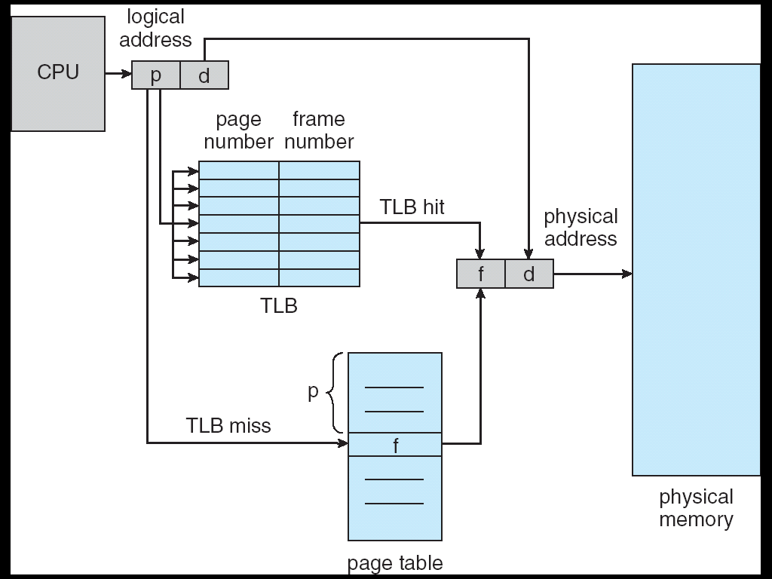
Paging Hardware With TLB
40

Slide 41
Paging Hardware With TLB
Does the TLB improve the access time?
41

Slide 42
Effective (Average) Access Time
Assume we are looking for an item: data or instruction
TLB Lookup (for the page number entry)= ε time unit
Assume memory access time is 1 unit time
A hit occurs when the page number entry is found in the TLB
Hit ratio = α = Number of hits/Number of accesses to the TLB
If the page number entry is found in the TLB (hit):
access time = time to access the TLB + time to access the item = ε +1
If the page number entry is NOT found in the TLB (miss):
access time = time to access the TLB
+ time to access the page table in main memory
+ time to access the item in memory = ε + 1 + 1 = 2 + ε
Effective (Average) Access Time (EAT)
EAT = (1 + ε) α + (2 + ε)(1 – α)
= 2 + ε – α
42

Slide 43
Page Table Overhead
Paging has two overheads:
Access time: each data or instruction access requires two memory accesses
Space overhead:
each process requires its own page table
each page table can be very large
How to alleviate these two overhead?
time (already seen): use of TLBs
space: consider inverted page table (see next slide)

Slide 44
Improving Space Overhead for Paging
Considerable space overhead
One page table per process
Each page table can be very large.
How to minimize this space overhead?
Answer: use an inverted page table
Read in Chapter on Main Memory
in Section Paging
Sub Section Inverted Page Tables
Notes:
Video Module 5-08

Slide 45
Inverted Page Table
Inverted because the table is indexed with the frame #: One entry for each real frame of memory
One single inverted page table is required for ALL processes.
Entry contains page number stored in that real memory location, with information about the process that owns that page
Decreases memory needed to store each page table, but increases time needed to search the table when a page reference occurs
Use hash table to limit the search to one — or at most a few — page-table entries

Slide 46
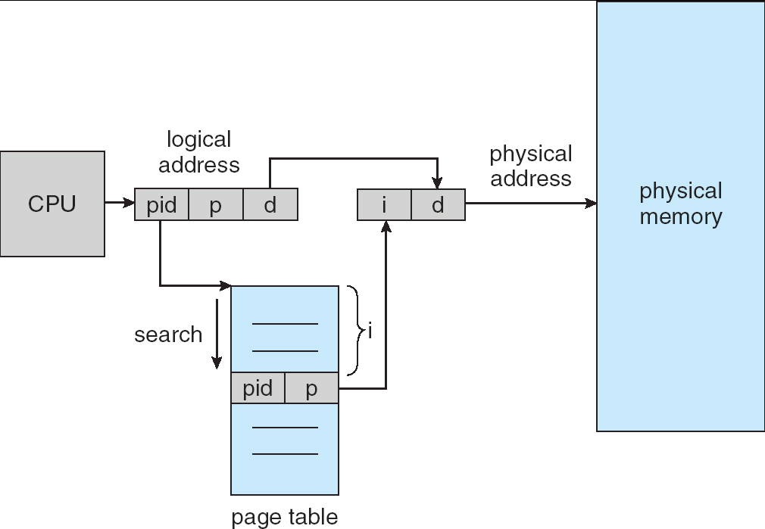
Inverted Page Table Architecture
46

Slide 47
Segmentation
What is Segmentation?
How does it work?
Read in Chapter on Main Memory
Section Segmentation
Notes:
Video Module 5-09

Slide 48
Segmentation
Memory-management scheme that supports user view of memory
A program is a collection of segments. A segment is a logical unit such as:
main program,
procedure,
function,
method,
object,
local variables, global variables,
common block,
stack,
symbol table, arrays

Slide 49
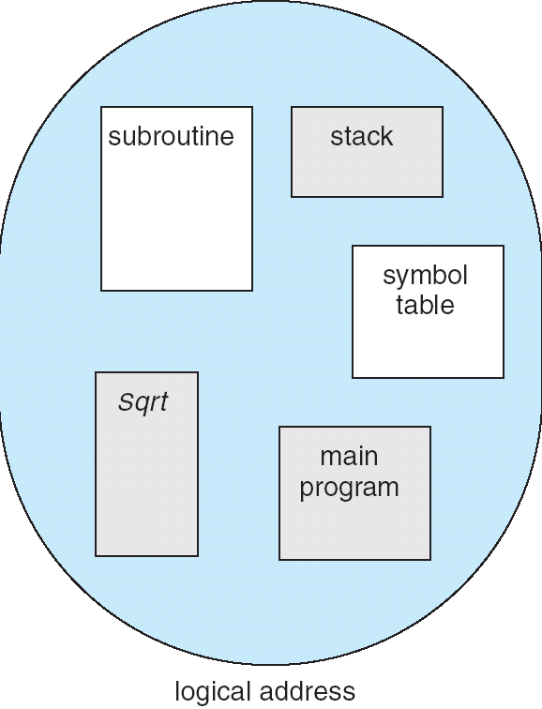
User’s View of a Program
49

Slide 50
Logical View of Segmentation
1
1
4
2
3
2
4
3
user space
physical memory space
50

Slide 51
Wrap Up
Learn and understand the objectives Memory Management.
Learn and understand the design guiding principles to memory management.
Tell a story of an illusion.
Describe, discuss and evaluate contiguous memory placement strategies.
Learn and understand paging and segmentation.
Read Section 7.8: Summary
Notes:
Video Module 6-10

Slide 52
OS
OS
process 5
F
C
process 5
E
process 10
D
B
process 10
process 2
C
B
process 11
process 11
process 2
A
A

