Slide 1
Generation of Satellite and Model Sea Surface Temperature Images
Katie Morrice
Research Programming
12/16/15

Slide 2
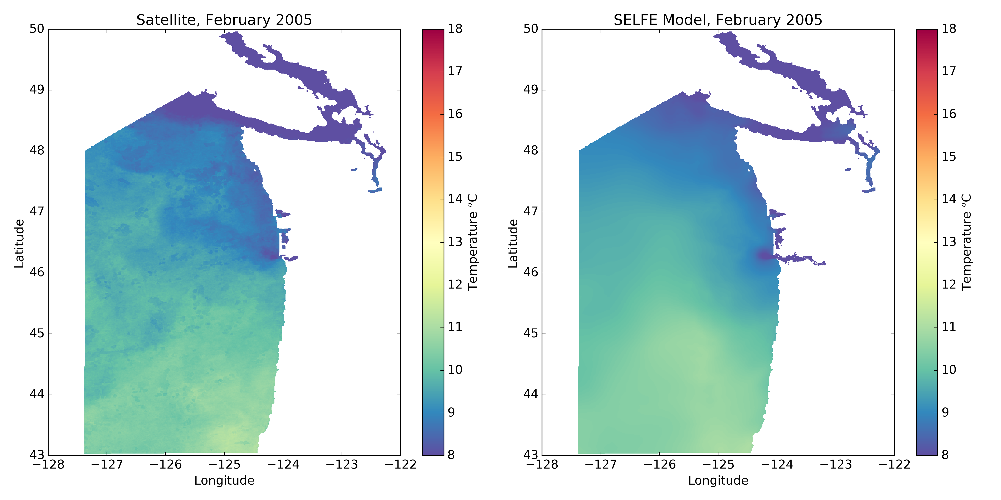
Satellite + Reference Model Simulation (run16), February

Slide 3
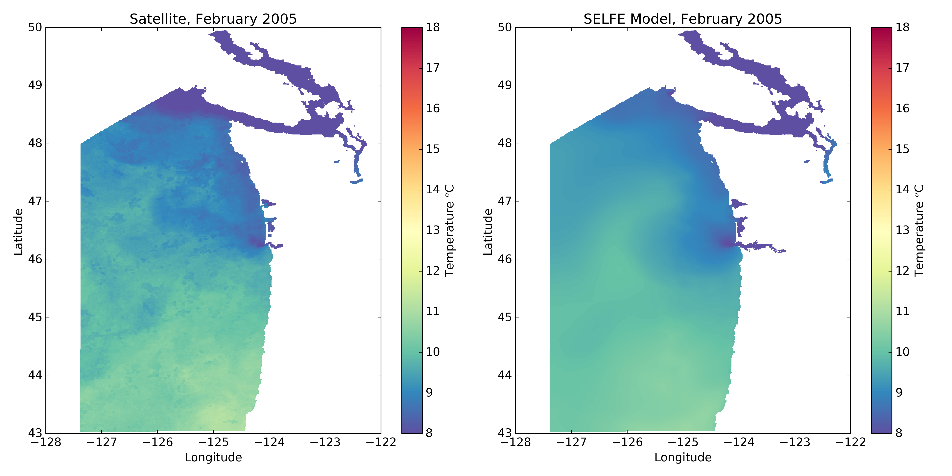
Satellite + Modified Model Simulation (run19), February

Slide 4
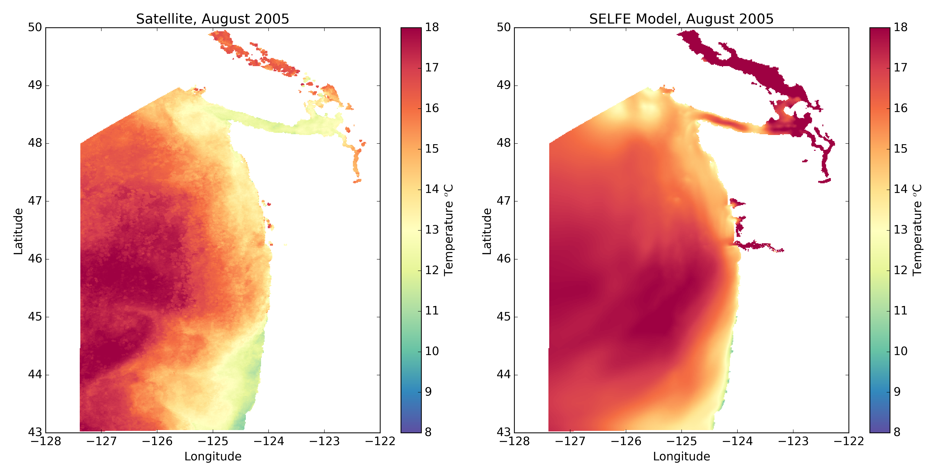
Satellite + Reference Model Simulation (run16), August

Slide 5
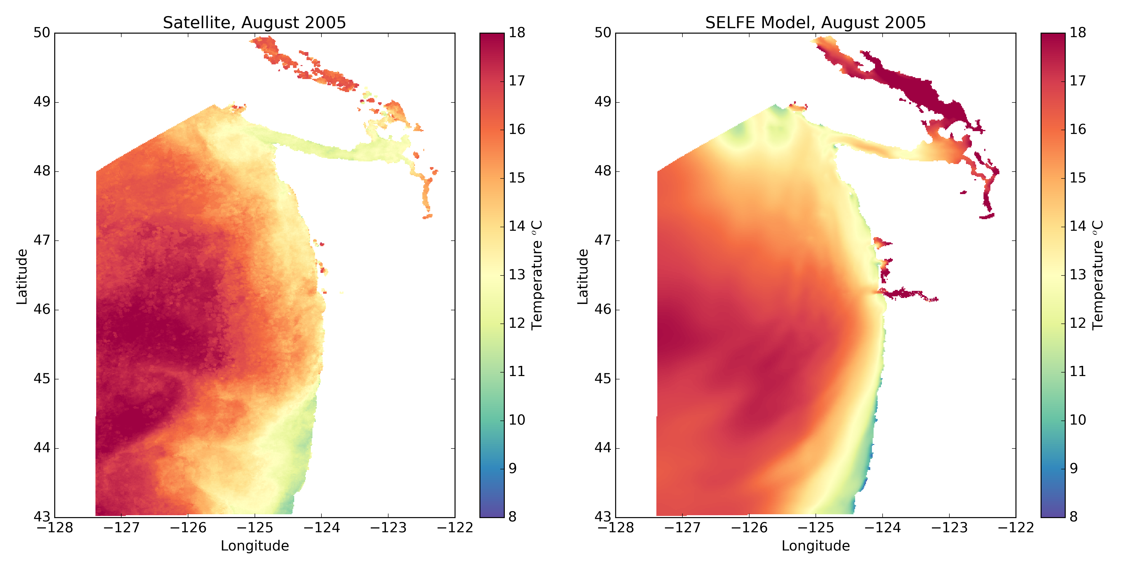
Satellite + Modified Model Simulation (run19), August

Slide 6
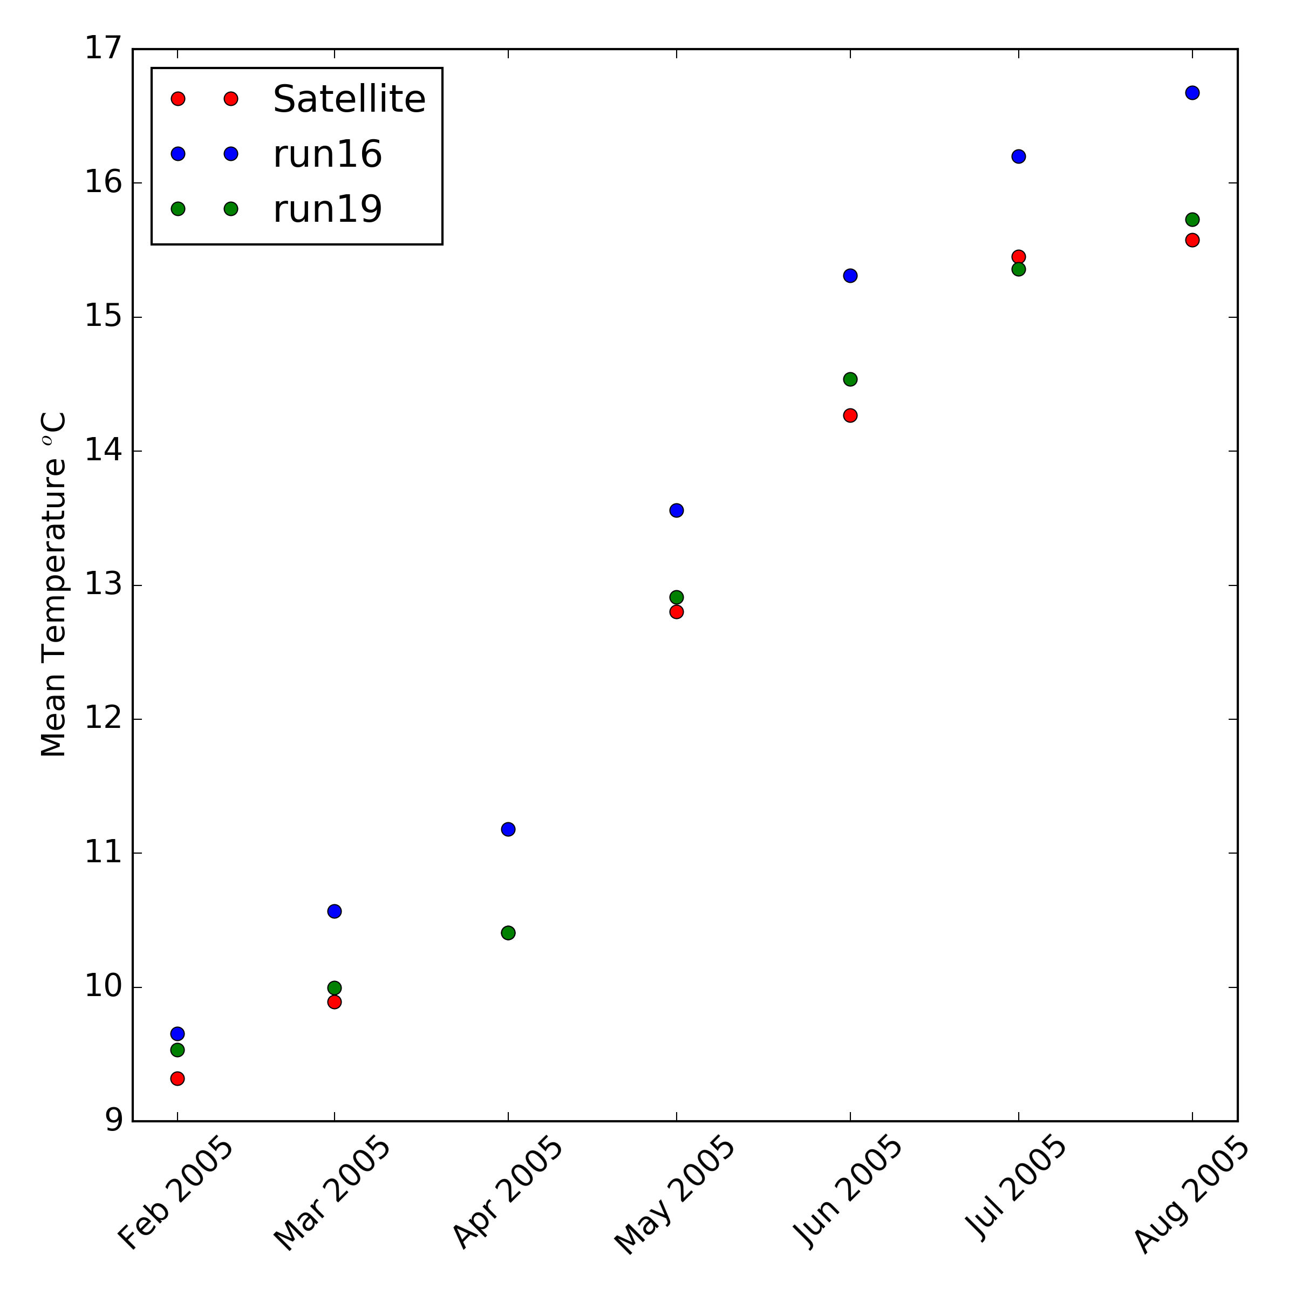
Monthly mean temperatures from satellite observations and model simulations.

Slide 7
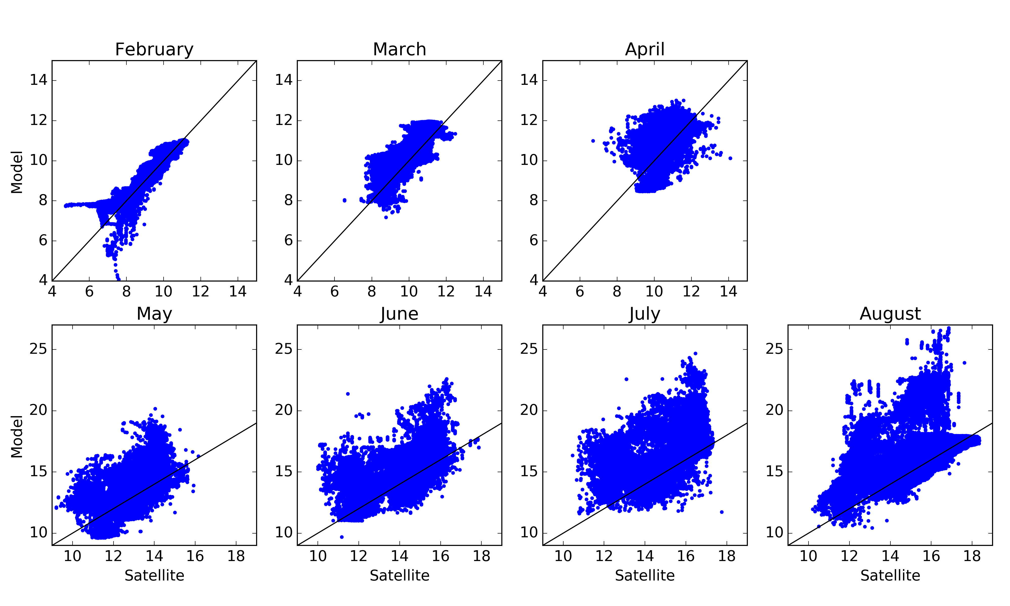
Satellite vs. Model Temperatures (reference, run16)

Slide 8
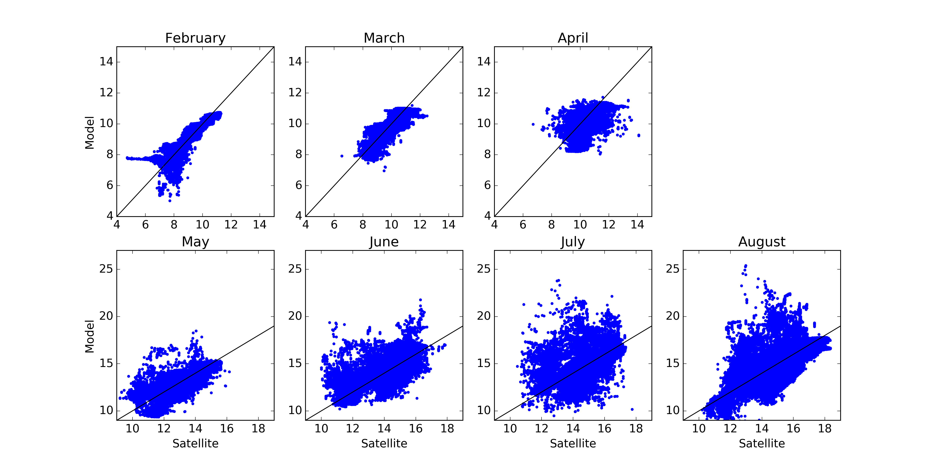
Satellite vs. Model Temperatures (modified, run19)

